Slide 2
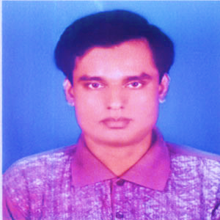
Presented by
Uttam Chandra Samadder
Head Teacher
Kachipara government primary school
Bauphal,Patuakhali.

Slide 3
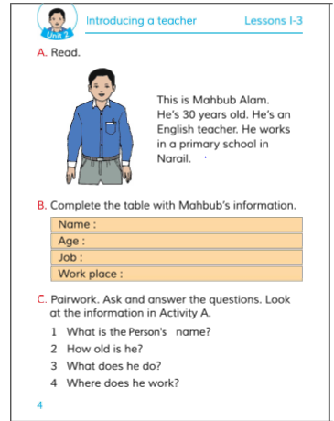
Subject-English
Class-Three
Lesson-1-3 Unit-2
Introducing a
Teacher.

Slide 4
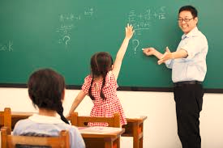
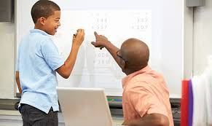
Look at the pictures

Slide 5
Our todays lesson
Introducing a teacher

Slide 6
Learning outcomes
At the end of the lesson…
SS will be able to…………
1.Read and say the topics.
2.Compleate the table with information.
3.Ask and answer w/h questions.

Slide 7
Say after me
This is Mahabub Alam

Slide 8
This is Uttam Samadder.

Slide 9
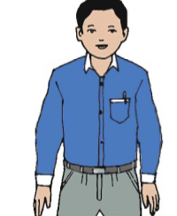
He’s 30 years old.
He’s 45 years old.

Slide 10
He is an English teacher.
He is an English teacher.

Slide 11
He works in a primary school in Narail.
He works in a primary school in Patuakhali.

Slide 12
Pair work
Read the topics in pair.

Slide 13
Complete the table with Mahabub’s information.
Name:
Age:
Job:
Work Place:
Pair
Work

Slide 14
Playing a missing word game.

Slide 15
Ask and answer the question
Pair/Single work.
1.What is the person’s name?
2.How old i8s he?
3.What does he do?
4.Where does he work?

