Slide 1

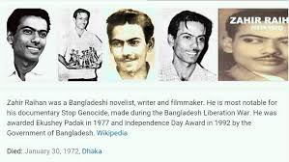
Welcome to all.

Slide 2
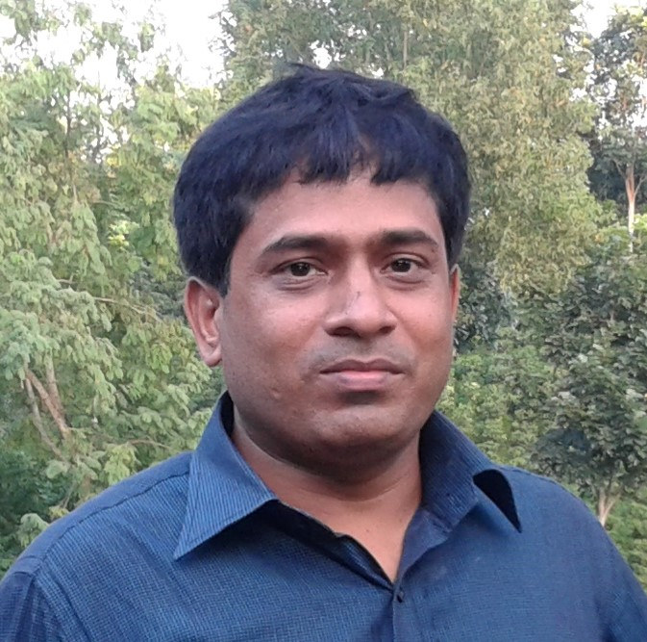
Conducted by
S. M. Monirul Islam
Assistant teacher in English
Govt. Model Secondary School,
Khulna Sadar, Khulna-9100,
Phone – 01711-397 309
E-mail: monirmodel@gmail.com
Subject : English 1st Paper
Class – IX-X,
Saturday, August 10, 2019
8:21:14 PM

Slide 3
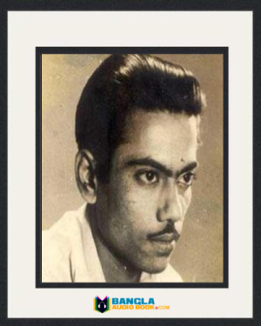
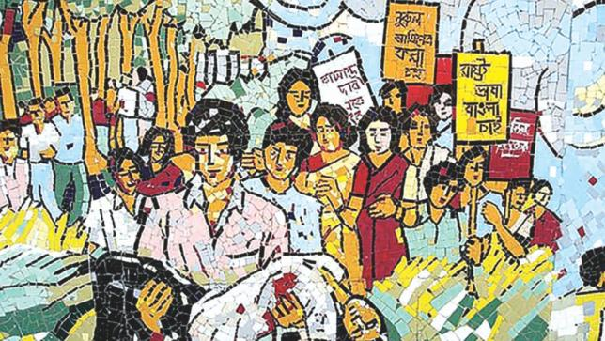
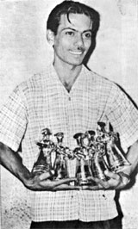
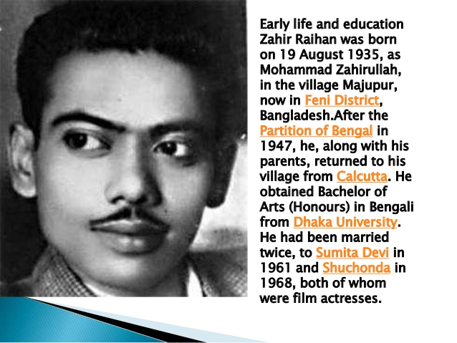
A: Look at the picture. He is a great son of our country.
Who is he? What do you know about him?

Slide 4
See the video to get more information.
Please click here to go to the link to enjoy the video.

Slide 5
Our lesson -
They Had Dreams 2
Unit : 10
[Dreams]
Lesson : 4

Slide 6
Learning outcomes
After the students have studied the lesson, they will be able to --- ---
listen for specific information.
participate in conversations and discussions.
understand and narrate problems.
take and give interviews.

Slide 7
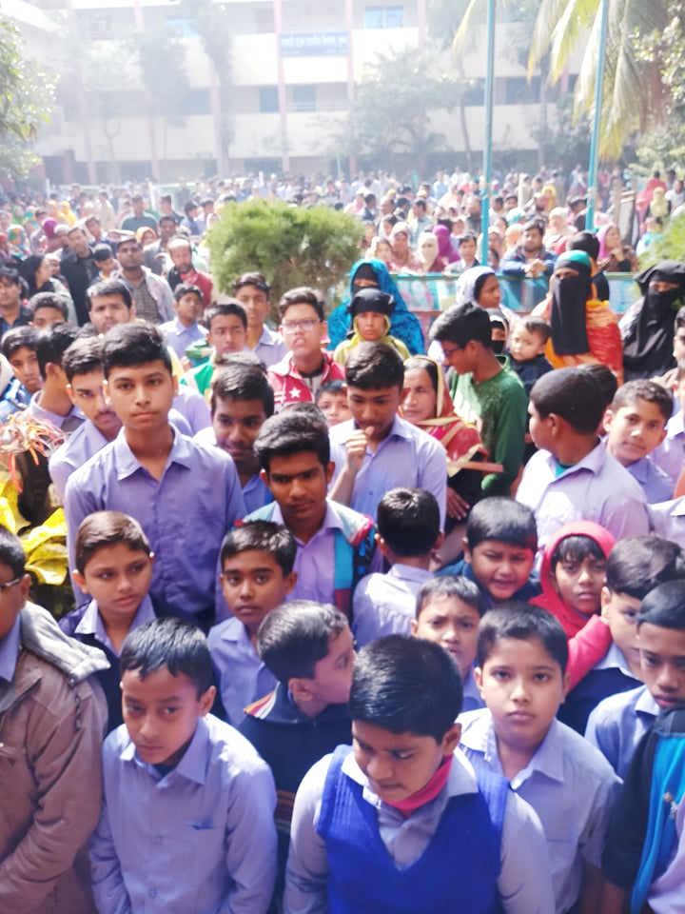
Vocabulary
Procession (N)
Meaning:
A line of people or vehicles that move along slowly, especially as a part of a ceremony
Syn.= menifestation

Slide 8

Capture (V)
Meaning:
To catch someone as a prisoner
Syn.= captivate, imprison, seize;
Ant. = liberate, free, release,

Slide 9
Protest (N)
Vocabulary
Meaning:
Showing diagement with something
Syn.= remonstration; Ant. = support

Slide 10
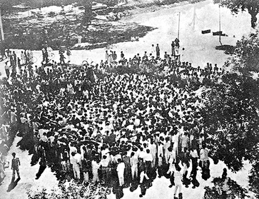
Collaborator (N)
Vocabulary
Meaning:
A person who helps the enemy in a war
Syn.= ally, partner

Slide 11
C: Use appropriate information from the text to complete the grid.
Zahir Raihan
participated in | famous as | Best documentary | movie based on language movement | Missing since | his dream
Language movement 1951,
Historic Amntale Meeting 1952,
Mass movement 1969,
Liberation War 1971,
Stop Genocide
30 December, 1971
To see the emergence of a free independent Bangladesh
A film maker
Jibon Theke Neya
TEXT

Slide 12
Zahir Raihan was one of the most talented film makers in Bangladesh. He was born on 19 August 1935 in the village Majupur, in Feni district. He was an active worker of the Language Movement. He was one of the ten students to go out in a procession on 21 February 1952 despite a ban on such activities. As a result, he and many others were arrested and taken to prison. Zahir was also present at the historical meeting of Amtala on February 21, 1952. He also took part in the mass movement in 1969. In 1971, he joined the Liberation War.
All through his life, Zahir dreamt for a democratic society, a society that will ensure freedom of speech and will. He had many dreams about our film industry too. He made a legendary film Jibon Theke Neya based on the Language Movement of 1952. It was a revolt against the then autocratic government. The family presented in that film was a miniature East Pakistan ruled by an autocrat who had to go to the prison for her conspiracy. During the liberation war this film was shown outside Bangladesh. Critics like Satyajit Ray, Mrinal Sen, and Ritwik Ghatak appreciated this film. Zahir gave all his money to the Freedom Fighters’ trust that he got from his film shows. Besides, his great documentary on Pakistani atrocities, Stop Genocide, helped create world sentiment in favour of our liberation war.
On 30 December 1971, someone informed Zahir about an address somewhere at Mirpur, where he might find his brother, the famous writer Shahidullah Kaiser. Shahidulla was captured and killed by the Pakistani army and the local collaborators during the last days of the war. Accordingly Zahir left home to get his brother back and he never returned.
Zahir’s dream was fulfilled. He could see the inception of a free independent Bangladesh though he did not get back his brother. And it’s a pity that this dreamer was missing at such a time when his dream came true.
BACK

Slide 13
Zahir Raihan was one of the most talented film makers in Bangladesh. He was born on 19 August 1935 in the village Majupur, in Feni district. He was an active worker of the Language Movement. He was one of the ten students to go out in a procession on 21 February 1952 despite a ban on such activities. As a result, he and many others were arrested and taken to prison. Zahir was also present at the historical meeting of Amtala on February 21, 1952. He also took part in the mass movement in 1969. In 1971, he joined the Liberation War.
All through his life, Zahir dreamt for a democratic society, a society that will ensure freedom of speech and will. He had many dreams about our film industry too. He made a legendary film Jibon Theke Neya based on the Language Movement of 1952. It was a revolt against the then autocratic government. The family presented in that film was a miniature East Pakistan ruled by an autocrat who had to go to the prison for her conspiracy. During the liberation war this film was shown outside Bangladesh. Critics like Satyajit Ray, Mrinal Sen, and Ritwik Ghatak appreciated this film. Zahir gave all his money to the Freedom Fighters’ trust that he got from his film shows. Besides, his great documentary on Pakistani atrocities, Stop Genocide, helped create world sentiment in favour of our liberation war.
On 30 December 1971, someone informed Zahir about an address somewhere at Mirpur, where he might find his brother, the famous writer Shahidullah Kaiser. Shahidulla was captured and killed by the Pakistani army and the local collaborators during the last days of the war. Accordingly Zahir left home to get his brother back and he never returned.
Zahir’s dream was fulfilled. He could see the inception of a free independent Bangladesh though he did not get back his brother. And it’s a pity that this dreamer was missing at such a time when his dream came true.
BACK

Slide 14

D: Read the following sentences and complete them.
a film maker
1. Zahir Raihan is famous as --- --- --- --- --- --- .
2. Zahir was imprisoned because ---
--- --- --- --- --- .
3. He participated in --- --- --- --- --- --- --- --- and --- --- --- --- .
4. Jibon Theke Neya symbolizes --- --- --- --- ---
--- --- .
5. He donated --- --- --- --- --- --- --- --- --- --- --- --- .
6. He worked to organize --- --- --- --- --- by his great documentary Stop Genocide.
7 His disappearance is a great --- --- --- .
he participated in the procession of language movement.
historic Amtala meeting
mass movement
the protest against the autocratic government.
money to the freedom fighter’s trust.
world support
pity.
TEXT

Slide 15
E: Work in pairs. Discuss
1. Why is Zahir Raihan considered a freedom fighter though he was a film maker?
2. How does the title of the lesson fit to the story of Zahir Raihan?

Slide 16
HOME WORK
Work in groups. Meet a freedom fighter in your locality. Interview him/her. Then write a paragraph on him/her.

Slide 17


