Slide 1

Welcome Everybody

Slide 2
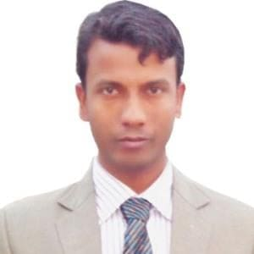

Introducation
Teacher
Lesson
Md. Kakan Khan
Assistant Teacher
119No South Dighaldhi Govt. Primary School
Matlob South, Chandpur.
Mobile-01853428325
E-mail: md.kakankhan@yahoo.com
Subject: English
Class: Five
Lesson Index:The hare & the tortoise
Lesson Part: A ( One day-the race began.)
Time: 35 Minutes
Date: 21-08-2019
মোঃআব্দুর রহিম, প্রধান শিক্ষক,মধুপুর সপ্রাবি,বাহুবল,হবিগঞ্জ।

Slide 3

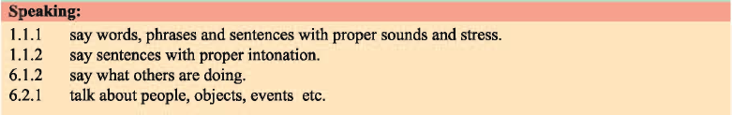
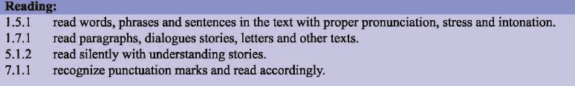
Learning Outcomes: Students will be able to

Slide 4
Lessonable Environment Creating
Dear Student,
Let’s go to see the hare and the tortoise video song.
https://www.youtube.com/watch?v=1H9EPBLESco

Slide 5

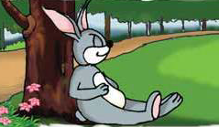
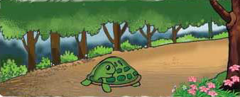
Dear Students,
We shall talk about……….
Lesson Headlines
&
Before discouses
What do you know about fastest animal?
What do you know about slowest animal?
AND
The hare
The tortoise

Slide 6
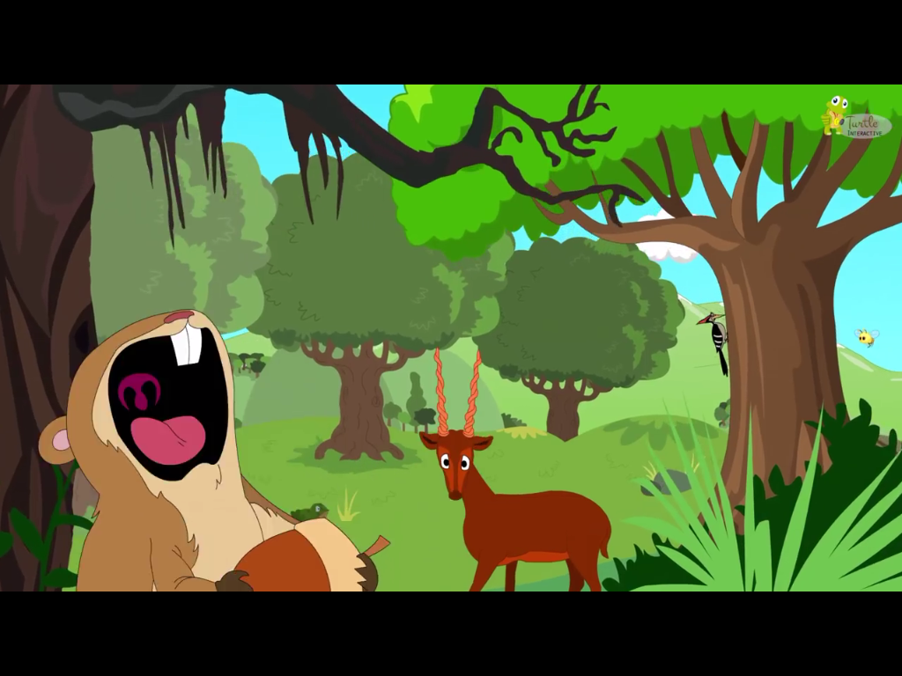
Today’s our lesson part is (One day The hare……………..the reace began.)
Maybe you can see forest and animals.

Slide 7
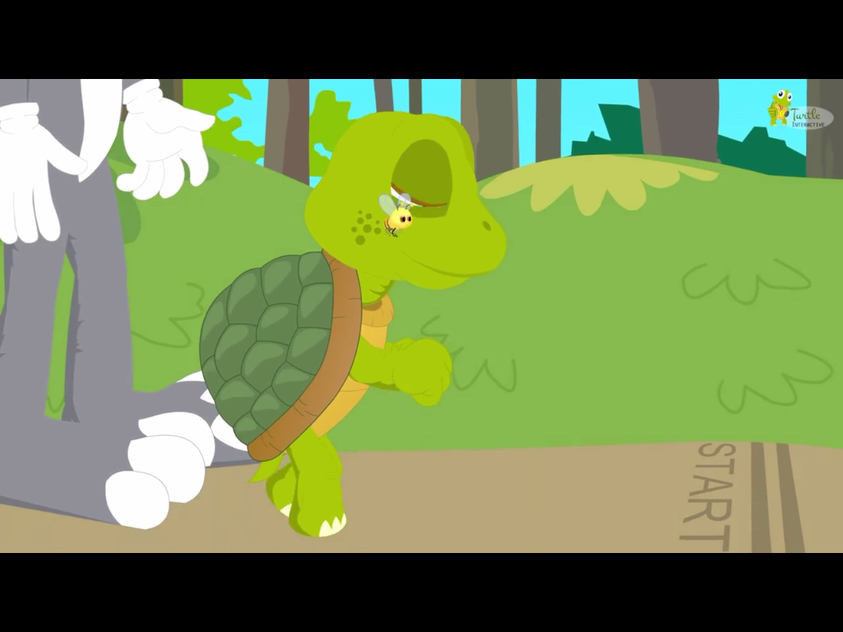
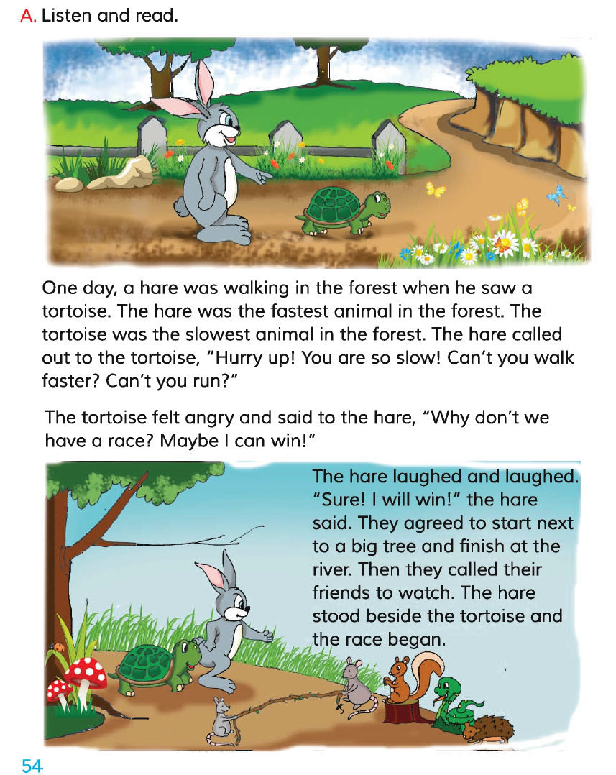
They have race began.

Slide 8
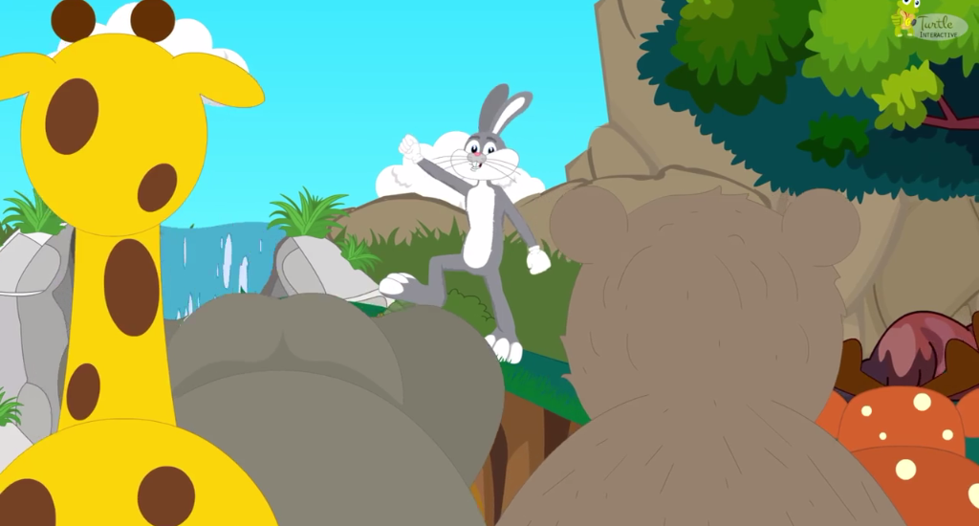
They were watching hare and tortoise race.

Slide 9
Dear Students,Everybody open your text book page number 54 and listen attentively.
Teacher’s two time read laoudly with meaning.
One day , a hare was walking in the forest when he saw a tortoise. The hare was the fastest animal in the forest. The tortoise was the slowest animal in the forest. The hare called out to the tortoise. “Hurry up! You are so slow! Can’t you walk faster? Can’t you run?”
The tortoise felt angry and said to the hare. “Why don’t we have a race? Maybe I can win!”
The hare laughed and laughed. “ Sure! I will win!” the hare said. They agreed to start next to big tree and finish at the river. Then they called their friends to watch. The hare stood beside the tortoise and the race began.
Then every student acordingly reading two lines.

Slide 10
Let’s go introduce to new words ,know meaning and making sentence.
Fast
দ্রুত গতি
The hare is fast run.
Slow
ধীর গতি
The tortoise is slow run.
Angry
রাগান্বিত
The tortoise angry to hare.
win
জয়লাভ করা
The tortoise win the race
Race
দৌড় প্রতিযোগীতা
The race win the tortoise
মোঃআব্দুর রহিম, প্রধান শিক্ষক,মধুপুর সপ্রাবি,বাহুবল,হবিগঞ্জ।

Slide 11
Now , All student read in text book with loudness . When any problem face solution help by teacher. Teacher whole class objervaton round by round attentively.

Slide 12
Group work
Group-2
Write meaning and sentence by “watch”
Group-3
Write meaning and sentence by “agree”
Group-1
Write meaning and sentence by “next”

Slide 13
Fills in the blanks with the correct word from the box.
Fastest,the tortoise, watch,beside,angry,the hare
The tortoise
a. ....................the slowest animal.
b. The hare is the............. Animal.
c. ………...Saw a tortoise.
d. The tortoise felt ……
e. The hare stood ……… the tortoise.
f. They called their friends to ……….
fastest
The hare
angry
beside
watch
Note: Teacher remain this is Small group work.

Slide 14
Evaluation
Who is the fastest animal?
Ans: The fastest animal is the hare.
Where was walking the hare?
Ans: The hare was waking in the forest.
who was angry to the hare?
Ans: The tortoise was angry to the hare.

Slide 15
Home work
Write to the “true” and “false”
The tortoise was happy to the hare.
The hare was slowest animal.
They were agreed to race.
The tortoise won the race.
They called Tigers to watch race.
The hare stood fornt the tortoise.

Slide 16

Goodbye Goodby
By
The Song sing everybody

