Slide 1
Welcome
CLASS-XI

Slide 2
GRAMMAR LESSON
Conducted by MD.ABDUR ROUF
BA(Hons) MA in English
Lecturer in English
Khalna Islamia Fazil(Degree) Madrasah, Patnitala,Naogaon.

Slide 3
Direct and Indirect Speech or Narration
Contents
* Introduction
*Direct speech
*Indirect speech(Reported Speech)
*Difference between the two
*Change to indirect speech
*Back shift of tenses
*Change in adverbs/expressions of time
*No back shift
*conclusion

Slide 4


Time: on Saturday evening
I ‘m Jessica from Spain. I hate studying Grammar. I’m sure I make a lot of mistakes when I speak. But I don’t care. I’m happy people understand me mostly.
Jessica
Aslam

Slide 5
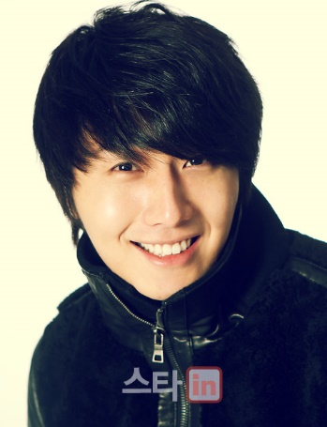
Time: on Sunday morning
The girl (She) said (that) she was Jessica from Spain. She hated studying Grammar. She was sure she made a lot of mistakes when she spoke. But she did not care. She was happy people understood her mostly.
Aslam
Karim

Slide 6
Why grammatical changes between direct and
indirect speech?
Words that are spoken or thought in one place by one person may be reported in another place at a different time, and perhaps by another person. Because of this, there are often grammatical differences between direct and indirect speech.

Slide 7
Direct and Indirect speech
When we report people’s words, thoughts, beliefs etc. we can give the exact words (more or less) that were said, or that we imagine were thought. This kind of structure is called ‘direct speech’.
We can also make somebody’s words or thoughts part of our own sentence, using conjunctions (e.g. that) and changing pronouns, tenses and other words where necessary. This kind of structure is called ‘indirect speech’ or ‘reported speech’.

Slide 8
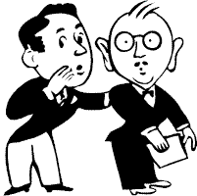


Direct speech
(Quoted Speech)
The speaker
The narrator
The listener
Tom said
“I am very busy now.”
“I am very busy now.”
David tells Harry
at a different time
David
Harry
Tom

Slide 9

Direct speech
Let’s work out the rules!
Structure of sentence
Clause 1
Clause 2
“I am very busy now,” said Tom.
actual words of
the speaker with
no change/ reported clause
Narrative part/
Reporting clause
Use of quotation marks
Outside the quotation marks

Slide 10
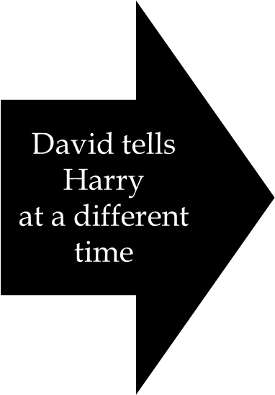

What is indirect speech?
(Reported speech)
The Speaker
The reporter
The listener
“I am very busy now.”
Tom said he was very busy then.

Slide 11

Rules of indirect speech
(reported speech)
Tom said, ‘I am very busy now’. (direct)
Tom said he was very busy then. (indirect)
Change in the exact words of the speaker
No use of speech marks
The pronoun ‘I’ is changed to ‘he’.
The verb ‘am’ is changed to ‘was’.
The adverb ‘now’ is changed to ‘then’.
You can add an optional conjunction ‘that’ in place of comma.
e.g. Tom said that he was very busy then.

Slide 12
Remember
that can usually be omitted after reporting verb say and tell +object. But it should be kept after other verbs: complain, explain, object, point out, protest etc.-Thomson & Martinet

Slide 13



Indirect Speech change of pronouns
It’s logical to change the pronouns:
(think yourself as reporters)
Ahmad said, “I like to fly kites”.
Ahmad said ____ liked to fly kites.
‘’I have bought balloons for my sister’’ Harry said.
Harry said _______ had bought balloons
for ______ sister.
Emma said to her mother, ‘’I was feeding my
kitten.’’
Emma told ______ mother _______ had been
feeding __________ kitten.
he
he
his
her
she
her

Slide 14
Indirect Speech change of pronouns
I he/ she
we they
mine his/ hers/ours
me him/her
ours theirs
us them
myself/ourselves himself/herself/ themselves

Slide 15
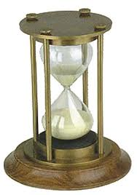
Indirect Speech
Tense change
When you report the speaker’s words, at a different time & place
move back in TIME.
Present and Future into past
Past into past perfect
Back shift

Slide 16
Back shift of Tenses
Direct speech
Indirect speech
She said, "It's cold.”
Present Simple
She said, "I'm teaching English online."
Present Continuous
She said, “I have been browsing the web since 1999.”
present perfect continuous
She said it was cold.
Past Simple
She said she was teaching English online.
Past Continuous
She said she had been browsing the web since 1999.
Past perfect continuous

Slide 17
Back Shift of Tenses
Direct speech
Indirect speech
She said, “I have browsed
the web’’.
Present Perfect
She said, "I taught online yesterday.”
Simple Past
She said, "I was teaching earlier."
Past Continuous
She said she had browsed the web.
Past Perfect
She said she taught/had taught online the day before.
Past Perfect
She said she had been teaching earlier.
Past Perfect Continuous

Slide 18
Back shift(modal auxiliaries)
Direct speech
Indirect speech
She said, "I'll teach English online tomorrow.”
She said, “I can teach English online.”
She said, "I must have a computer to teach English online.”
She said, “I may be late”
She said she would teach English online tomorrow.
She said she could teach English online.
She said she had to/must have a computer to teach English online.
She said she might be late.

Slide 19
Modal Auxiliaries
Direct speech
Indirect speech
may
can
will/shall(future)
must
should
could
might
ought to
would
used to
might
could
would
must/ Had to
Should
could
might
ought to
would
used to
no back
shift

Slide 20
Expressions of time
Direct speech
Indirect speech
today
yesterday
tomorrow
next week/year etc.
last week
now
last night
these
this(time expression)
this(adj.)
that day
the day before/previous day
the next day/the following day
the following week/year etc.
previous week
then
the night before
those
that
the

Slide 21


Indirect Speech
Remember!
No back shift
If you are reporting a fact:
“All that glitter is not gold”, said grandma.(direct speech)
Grandma said all that glitter is not gold. (indirect speech)
When you report a permanent situation:
Copernicus concluded, “Earth revolves round the sun”. (direct speech)
Copernicus concluded earth revolves round the sun. (indirect speech)
Contd.

Slide 22


Indirect Speech
no backshift is possible.
Remember!
If direct speech is in the
PAST PERFECT
“I had already told him the news,” Tom told me.(direct)
Tom told me he had already told him the news. (indirect)
PAST PERFECT CONTINUOUS
Ali said, “I had been browsing the internet for ages.” (direct)
Ali said he had been browsing the internet for ages.
(indirect)
Past forms of modal auxiliaries e.g.
could, would, should etc.

Slide 23
Indirect Speech
(Review)
Change in speaker’s words
Removal of commas
Change of pronouns (First and second person pronouns shift to third person)
Back shifting of tense ( a step back into PAST)
Change of adverbs of time/ time expressions ( cont.)

Slide 24
Indirect speech
Review
Tense of the verb is not back shifted when you
report a fact or a permanent situation
actual words are in past perfect/ past perfect continuous
past forms of modal verbs
Reporting words that have just been spoken with reference to present time and the reporting verb is
say/ says or tell/tells

Slide 25



Indirect speech
Learning check
Emma said to her mother, “I have wrapped the gift”.
Emma told her mother _________________ the gift.
Father said, “If I can, I’ll pick you up at school today.”
Father said that if ________ ,_____________________
up at school ________
“The sun rises in the east” ,the teacher told the
children.
The teacher told the children the sun _______ in
the east. ( cont.)
she had wrapped
he could
he would pick me/us
that day.
rises

Slide 26

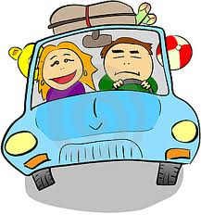
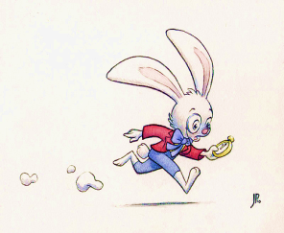
Indirect speech
Learning check
The gardener said to me, “I had been trimming
the hedge for two hours.”
The gardener told me _____________________the
hedge for two hours.
“We must go early tomorrow”, said my father.
My father said __________________ go early ____________
The teacher is saying, “ you are late in the class”.
The teacher is saying ________________ late in the class.
he had been trimming
they must go/ had to
the next day.
you/ they/ we are

Slide 27
Usage
Direct speech is found in conversations in books, in plays, and in quotations.
Indirect speech is normally used when conversation is reported verbally, though direct speech is sometimes employed here to give a more dramatic effect.

Slide 28
Thank

