Slide 1

Welcome Here

Slide 2
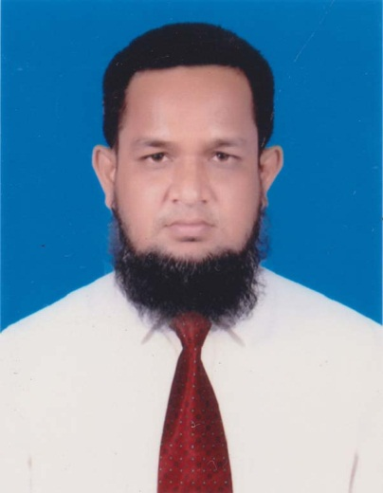
Introduction : Teacher
MD.ABDUR ROUF
Lecturer in English
B.A (Hons) M.A in English
Khalna Islamia Fazil(DEGREE) Madrasha
Patnitala,Naogaon.
Mob : 01767650169

Slide 3
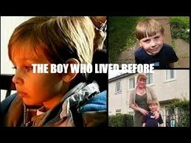
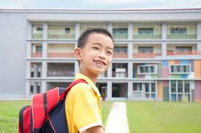

Look at the pictures :

Slide 4
Watch the table and try to guess :
Name | Present | Past | Future
Indefinite | Verb (Present Form) | Verb ( Past Form) | Verb (Future Form)
Continuous | To Be + Verb+ing | To Be + Verb+ing | Will/Shall+ To Be + Verb+ing
Perfect | To Have +Verb (P.P) | To Have +Verb (P.P) | Will/Shall+ To Have +Verb (P.P)
Perfect Continuous | To Have +Been+Verb+ing | To Have +Been+Verb+ing | Will/Shall+ To Have +Been+Verb+ing

Slide 5
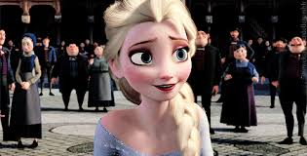

Introduction : Topic
Verb – Tense ( Part- I )
Created For Class : VI - XII
Estimated Time : 45 Minutes
Date : 25/08/2019

Slide 6
Outcomes of the lesson :
After reading the lesson, you will learn….
the classification of the tense.
the structures of various tenses.
to identify the tenses in sentence.
to make sentences according to tense.

Slide 7
lesson :- a.Kinds of tense
Present
Past
Tense
Future

Slide 8
Verb-Tense in Total :
Present
Indefinite
Continuous
Past
Perfect
Future
Perfect Continuous

Slide 9
A. Group Work :
Group-A
Write down the names of Indefinite Tenses .
Group-B
Write down the names of Continuous Tenses .
Group-C
Write down the names of Perfect Tenses .
Group-D
Write down the names of Perfect Continuous Tenses .

Slide 10
Lesson-B-I : Structures :
Indefinite Tenses :
Name : | Structure & Examples : | Explanation :
Present : | Sub + M.Verb ( Present Form ) + Extension = He plays cricket in the field. | Present Form Verb +s/es or Verb (Base)
Past : | Sub + M.Verb ( Past Form ) + Extension = He played cricket in the field. | Past Form Verb +d/ed
Future : | Sub + Shall/will + M.Verb ( Base Form ) + Extension = He will play cricket in the field. | Base Form Bare Infinitive Verb

Slide 11

Present Indefinite Tense :
Name : | Structure & Examples : | Explanation :
Positive : | Sub + M.Verb ( Present Form ) + Extension = He plays cricket in the field. | Present Form Verb +s/es or Verb (Base)
Negative : | Sub +do not/does not+ M.Verb ( Base Form ) + Extension = He does not play cricket in the field. | Main Verb (Base Form)
Interrogative : | Do/Does +Sub + M.Verb ( Base Form ) + Extension ? = Does he play cricket in the field ? | Main Verb (Base Form )

Slide 12
Past Indefinite Tense :
Name : | Structure & Examples : | Explanation :
Positive : | Sub + M.Verb ( Past Form ) + Extension = He played cricket in the field. | Main Verb (Past Form ) Verb +d/ed
Negative : | Sub +did not+ M.Verb ( Base Form ) + Extension = He did not play cricket in the field. | Main Verb (Base Form)
Interrogative : | Did +Sub + M.Verb ( Base Form ) + Extension ? = Did he play cricket in the field ? | Main Verb (Base Form )

Slide 13
Future Indefinite Tense :
Name : | Structure & Examples : | Explanation :
Positive : | Sub + shall/will+ M.Verb ( Base Form ) + Extension = He will play cricket in the field. | Main Verb (Base Form )
Negative : | Sub +shall not /will not + M.Verb ( Base Form ) + Extension = He will not play cricket in the field. | Main Verb (Base Form)
Interrogative : | Will / Shall +Sub + M.Verb ( Base Form ) + Extension ? = Will he play cricket in the field ? | Main Verb (Base Form )

Slide 14

Make some sentences : Indefinite :
He (go) – to the school.
Present : He goes to the school .
Past : He went to the school .
Future :He will go to the school .

Slide 15
Lesson- B-II : Structure
Continuous Tenses :
Name : | Structure & Examples : | Explanation :
Present : | Sub + am/is/are+M.Verb +ing + Extension = He is playing cricket in the field. | To Be Verb (Present Form) Am/is/are
Past : | Sub +was/were+ M.Verb +ing + Extension = He was playing cricket in the field. | To Be verb (Past Form) Was/were
Future : | Sub + Shall/will + be+ M.Verb +ing + Extension = He will be playing cricket in the field. | To Be Verb (future Form) Shall be/will be

Slide 16
Lesson- B-II : Structure
Present Continuous Tenses:
Name : | Structure & Examples : | Explanation
Positive : | Sub + am/is/are+M.Verb +ing + Extension = He is playing cricket in the field. | To Be Verb Am/is/are
Negative : | Sub +is/am/are+not + M.Verb +ing + Extension = He is not playing cricket in the field. | To Be verb Is not/am not/are not
Interrogative | Am/Is/Are+Sub+ M.Verb +ing + Extension? = Is he playing cricket in the field? | To Be Verb Am/Is/Are

Slide 17
Lesson- B-II : Structure
Past Continuous Tenses:
Name : | Structure & Examples : | Explanation
Positive : | Sub + was/were+M.Verb +ing + Extension = He was playing cricket in the field. | To Be Verb Was/were
Negative : | Sub +was/were +not + M.Verb +ing + Extension = He was not playing cricket in the field. | To Be verb Was not/were not
Interrogative | Was/Were+Sub+ M.Verb +ing + Extension? = Was he playing cricket in the field? | To Be Verb Was/were

Slide 18
Lesson- B-II : Structure
Future Continuous Tenses:
Name : | Structure & Examples : | Explanation
Positive : | Sub + will/shall+be +M.Verb +ing + Extension = He will be playing cricket in the field. | To Be Verb Will/shall +be
Negative : | Sub +will/shall+not+be + M.Verb +ing + Extension = He will be not playing cricket in the field. | To Be verb Will not be/shall be not
Interrogative | Will/Shall+Sub+ be + M.Verb +ing + Extension? = Will he be playing cricket in the field? | To Be Verb Will/Shall

Slide 19
Make sentence as directed :
I
My parents (live) – in a small village in Rajshahi. (Past Continuous)
My parents were living in a small village in Rajshahi .
II
She ( cook ) – a good dish for us now. ( Present Continuous )
She is cooking a good dish for us now.
III
Hasan (wait ) – for me in the station tomorrow. ( Future Continuous)
Hasan will be waiting for me in the station tomorrow.

Slide 20
Lesson- B-III: Structure
Perfect Tenses :
Name : | Structure & Examples : | Explanation :
Present : | Sub +have/has+ M.Verb ( P.P) + Extension = He has played cricket in the field. | To Have Verb (Present Form) Has/have
Past : | Sub +had+ M.Verb ( P.P) + Extension = He had played cricket in the field. | To Have Verb (Past Form) Had
Future : | Sub + Shall/will +have+ M.Verb ( P.P ) + Extension = He will have played cricket in the field. | To Have Verb (Future Form) Will have/shall have

Slide 21
Lesson- B-III: Structure
Present Perfect Tense:
Name : | Structure & Examples : | Explanation :
Positive : | Sub +have/has+ M.Verb ( P.P) + Extension = He has played cricket in the field. | To Have Verb (Positive Form) Has/have
Negative : | Sub +has/have+not+ M.Verb ( P.P) + Extension = He has not played cricket in the field. | To Have Verb (Negative Form) Have not/have not
Interrogative : | Has/Have+Sub+ M.Verb ( P.P ) + Extension? = Has he played cricket in the field? | To Have Verb Have/Has …?

Slide 22
Lesson- B-III: Structure
Past Perfect Tense:
Name : | Structure & Examples : | Explanation :
Positive : | Sub +had+ M.Verb ( P.P) + Extension = He had played cricket in the field. | To Have Verb (Positive Form) had
Negative : | Sub +had+not+ M.Verb ( P.P) + Extension = He had not played cricket in the field. | To Have Verb (Negative Form) Had not
Interrogative : | Had+Sub+ M.Verb ( P.P ) + Extension? = Had he played cricket in the field? | To Have Verb Had….…?

Slide 23
Lesson- B-III: Structure
Future Perfect Tense:
Name : | Structure & Examples : | Explanation :
Positive : | Sub +will/shall+have + M.Verb ( P.P) + Extension = He will have played cricket in the field. | To Have Verb (Positive Form) Will have /shall have
Negative : | Sub +will/shall+not+have + M.Verb ( P.P) + Extension = He will not have played cricket in the field. | To Have Verb (Negative Form) Will not have /shall not have
Interrogative : | Will/Shall+Sub+have+ M.Verb ( P.P ) + Extension? = Will he have played cricket in the field? | To Have Verb Shall/Will+-+have…?

Slide 24
Make sentence as directed :
I
My parents (leave) – the small village in Rajshahi. (Past Perfect)
My parents had left the small village in Rajshahi .
II
She ( cook ) – a good dish for us today. ( Present Perfect )
She has cooked a good dish for us today.
III
Hasan (find) – me in the station tomorrow. ( Future Perfect )
Hasan will have found me in the station tomorrow.

Slide 25
B. Pair Work :
Kamal (write) – a story .
Make some sentences in the box as directed :
Tense | Indefinite | Continuous | Perfect
Present | Kamal writes a story . | Kamal is writing a story. | Kamal has written a story.
Past | Kamal wrote a story. | Kamal was writing a story | Kamal had written a story.
Future | Kamal will write a story | Kamal wiil be writing a story | Kamal will have written a story.

Slide 26
Lesson- B-IV: Structure
Perfect Continuous Tenses :
Name : | Structure & Examples : | Explanation :
Present | Sub +has/have+been+ M.Verb +ing + Extension = He has been playing cricket since noon. | Present Form Has been /have been
Past : | Sub +had been+ M.Verb +ing + Extension = He had been playing cricket since noon. | Past Form Had been
Future : | Sub + Shall/will + have been+ M.Verb +ing + Extension = He will have been playing cricket since noon | Future Form Will/shall +have been

Slide 27
Lesson- B-IV: Structure
Perfect Continuous Tenses :
Name : | Structure & Examples : | Explanation :
Present | Sub +has/have+been+ M.Verb +ing + Extension = He has been playing cricket since noon. | Present Form Has been /have been
Past : | Sub +had been+ M.Verb +ing + Extension = He had been playing cricket since noon. | Past Form Had been
Future : | Sub + Shall/will + have been+ M.Verb +ing + Extension = He will have been playing cricket since noon | Future Form Will/shall +have been

Slide 28
Lesson- B-IV: Structure
Present Perfect Continuous :
Name : | Structure & Examples : | Explanation :
Positive | Sub +has/have+been+ M.Verb +ing + Extension = He has been playing cricket since morning. | Auxiliary Verb Has been /have been
Negative | Sub +has/have+not+been+ M.Verb +ing + Extension = He has not been playing cricket since morning. | Auxiliary Verb Has not been/have not been
Interrog: | Have/Has+sub+ been+ M.Verb +ing + Extension ? = Has he been playing cricket since morning? | Auxiliary Verb Has/Have+--+been …..?

Slide 29
Lesson- B-IV: Structure
Past Perfect Continuous :
Name : | Structure & Examples : | Explanation :
Positive | Sub +had+been+ M.Verb +ing + Extension = He had been playing cricket since morning. | Auxiliary Verb Had been
Negative | Sub +had+not+been+ M.Verb +ing + Extension = He had not been playing cricket since morning. | Auxiliary Verb Had not been
Interrog: | Had +sub+ been+ M.Verb +ing + Extension ? = Had he been playing cricket since morning? | Auxiliary Verb Had+--+been …..?

Slide 30
Lesson- B-IV: Structure
Future Perfect Continuous :
Name : | Structure & Examples : | Explanation :
Positive | Sub +will/shall+have been+ M.Verb +ing + Extension = He will have been playing cricket since morning. | Auxiliary Verb Will have been/shall have been
Negative | Sub +will/shall +not+have been+ M.Verb +ing + Extension = He will not have been playing cricket since morning. | Auxiliary Verb Will not have been/shall not have been
Interrog: | Will/Shall+sub+ have been+ M.Verb +ing + Extension ? = Will he have been playing cricket since morning? | Auxiliary Verb Will/Shall+--+have been …..?

Slide 31
Tell the name of the tense in sentences
1
The boy will have been waiting in the station for two hours.
Future Perfect Continuous Tense
2
You have been running in the field for two hours.
Present Perfect Continuous Tense
3
The students had been writing an essay yesterday for two hours.
Past Perfect Continuous Tense

Slide 32

C. Evaluation :
Write down the answers of the following question ?
How many tenses are there in the verb of English Grammar?
Write down the names of the present tense .
Write down the three structures of perfect tense.

Slide 33

Home Work
Make sentences by all the structures:
She (buy) – a new dress in the market.
I (watch) – television at home .

Slide 34
Thank You

Slide 35

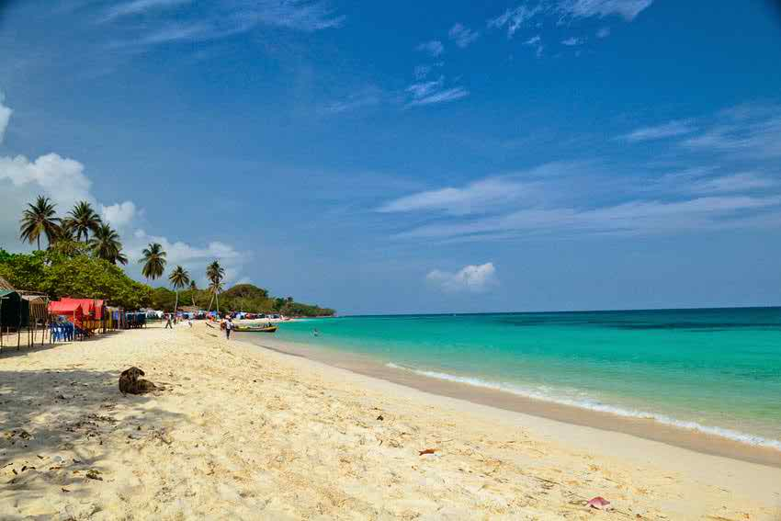
English:–Verb-Tense ||Class-VI-XI||Part-I
Composed By:
Mr. P.K. Chakrabarty
B.A.(Hons) M.A in English
Contact Information :
E-mail : tarunkcb001@gmail.com
Mob: 01986519507

