Slide 1
KHILBARIRTEK ISLAMIA HIGH SCHOOL, DHAKA
POWER POINT PRESENTATION
BY
MD. MONZURUL HOQUE
SENIOR ENG.TEACHER

Slide 2
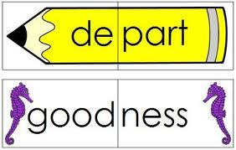
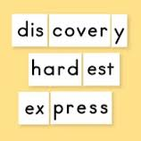
Please look ;

Slide 3
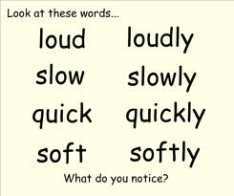

Slide 4
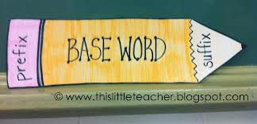

Slide 5
SUFFIXES
ation ,ance, ion, cy, ce (for abstract noun),
en (for verb) ,
er (for noun),
full , ic , cal, ive, less ( for adjective)
hood ( for noun),
ly (for adverb)

Slide 6
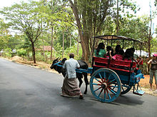
SUFFIXES
word + SUFFIXES = new word
ly (for adverb)
ment , ness (for abstract noun),
ship , sion, ance (for abstract noun)
tive (for adjective),
eer,ee,dom, age, th ,ance (for abstract noun)
ess, ress, ist, ism, mist, let, (for abstract noun)
al, ity, ty, ence, logy, (for abstract noun)
able, ant, ish (for adj)
Fy(verb)

Slide 7
Definition of Suffix
1. n. A letter, letters, syllable, or syllables added or appended to the end of a word or a root to modify the meaning; a postfix.
2. v. t. To add or annex to the end, as a letter or syllable to a word; to append.
Definition of Suffix
1. Noun. One or more letters or sounds added at the end of a word to modify the word's meaning, such as ''able'', which changes ''sing'' into ''singable'', for example. ¹
2. Verb. (transitive) to append (something) to the end of something else ¹
¹ Source: wiktionary.com
Definition of Suffix
1. to add as a suffix (a form affixed to the end of a root word) [v -ED, -ING, -ES]

Slide 8
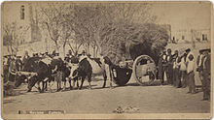
PREFIXES
PREFIXES + word = new word
anti, en, ir, il, in,
im, dis, de,
un, non, mis , mal,
less, ab, a, semi ,sub,
auto, pre, to, co, re

Slide 9
Definition of Prefix
1. n. A letter, letters, syllable, or syllables added or appended to the beginning of a word or a root to modify the meaning; a postfix.
2. v. t. To add or annex to the beginning , as a letter or syllable to a word; to append.
Definition of Prefix
1. Noun. One or more letters or sounds added at the beginning of a word to modify the word's meaning, such as ''able'', which changes ''sing'' into ''singable'', for example. ¹
2. Verb. (transitive) to append (something) to the of so beginning mething else ¹
¹ Source: wiktionary.com
Definition of Prefix
1. to add as a suffix (a form affixed to the end of a root word) [v -E

Slide 10
Home work
1.Use suffix/prefix or both with the italic words in the text to make clear meaning of the passage.
a. A post man is the most (a) eager waited person . He renders valuable service to us. He performs his duties (b) regular and © sincere. He is so (d) care that he does not deliver letter without the legal (e) own of the thing to be delivered. If he fails to discharge his duties (f) proper ,it may cause ( g) reparable loss to the person concerned. But he is not given proper(h) treat.
b. (a) Honest is the best of all virtues. An honest man is always (b) truth. He is never © harm to anybody. No body is(d) satisfied with him. On the other hand everybody (e) likes a (f) honest man (g) respectful even after his death. Without honesty peace and happiness is (h) possible.

Slide 11
(a) Honest is the best of all virtues. An honest man is always (b) truth. He is never © harm to anybody. No body is(d) satisfied with him. On the other hand everybody (e) likes a (f) honest man (g) respectful even after his death. Without honesty peace and happiness is (h) possible.

Slide 12
Language game
Make as many words as you can:
complete, balanced, commit, illustrate, prohibit, legal, study, perform, active, activate,
write, wise, nature , govern, organise,loud, friend, guilt, free,depend.

Slide 13
Thank you all,
BY
MD.MONZURUL HOQUE MASTER OF EDUCATION, SENIOR ENGLISH TEACHER
KHILBARIRTEK ISLAMIA HIGH SCHOOL, GULSHAN , DHAKA.
TRAINED IN ENGLISH LANGUAGE TEACHING & CLT.
monzurul74@yahoo.com,
Cell : 01712 693 113

