Slide 1
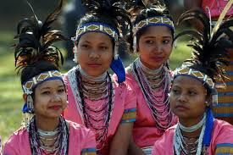
Welcome

Slide 2
Introduction
Teachers Info
Abul kucher
Assistant Teacher, ICT
Bishowanathpur Salameia
Hossaina Dhakil Madrasha
Class Info
Class : Eight
Subject: English 1st Paper
Lesson: ?
Time: 50 minutes

Slide 3
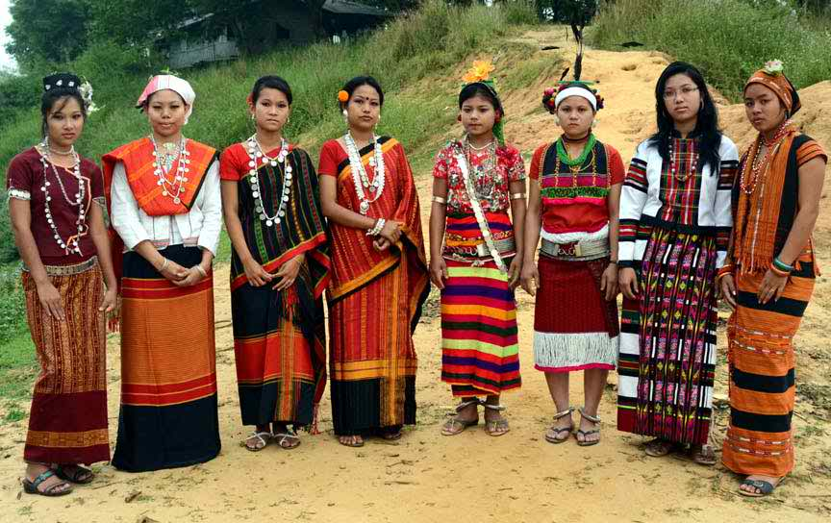
What can you see in these picture?

Slide 4
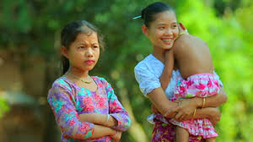
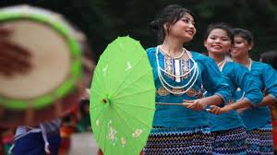
Who are they?

Slide 5
Our Ethnic Friend

Slide 6
After this lessons students will be able to…
Identify their living districts,
explain about their foods,
write about the ethnic people.

Slide 7
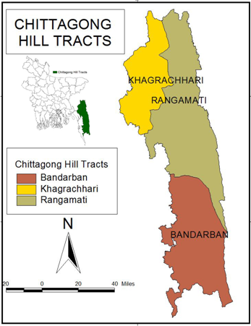
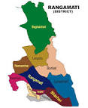
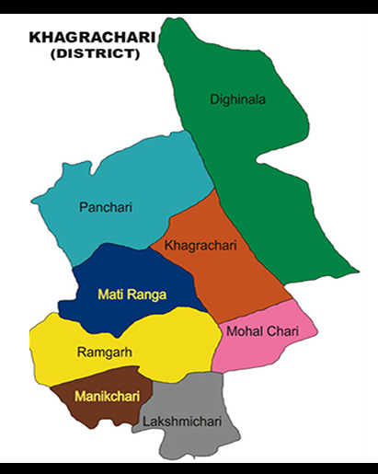
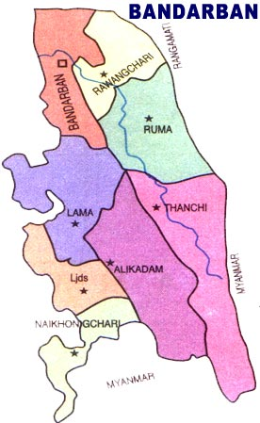
Living place

Slide 8
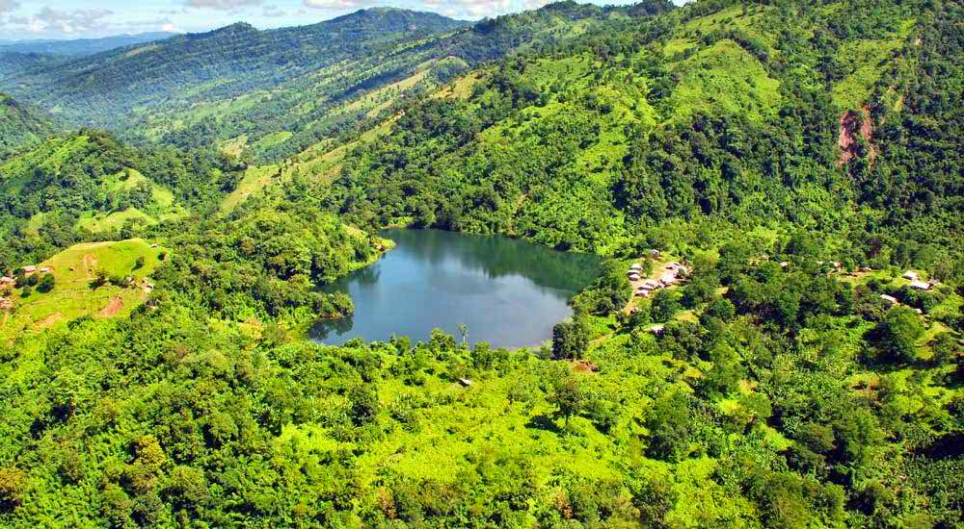
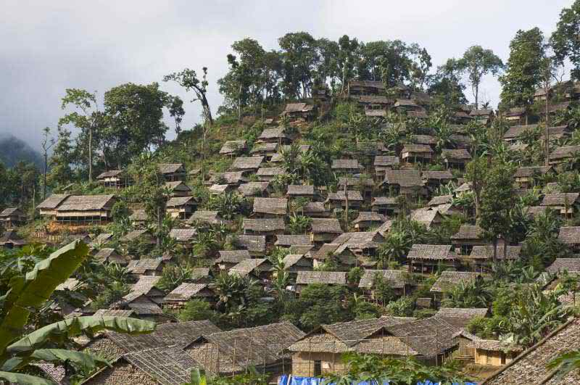
Forest area
Hills and rural area

Slide 9
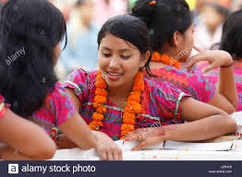
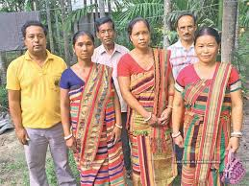
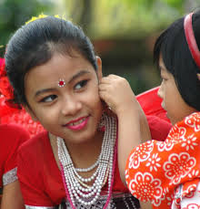
Marma
(Chittagong)
Chakma
(Chittagong)
Tripura
(Sylhet)

Slide 10
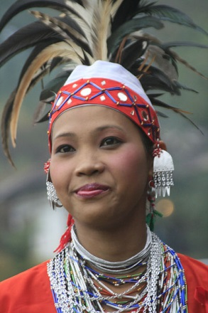
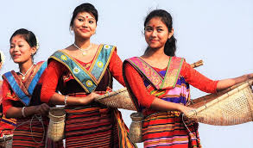
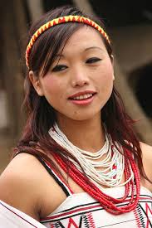
Garo
(Mymenshing)
Hajang
(Mymenshing)
Santal
(Rajshahi)
Khasia
(Sylhet)

Slide 11
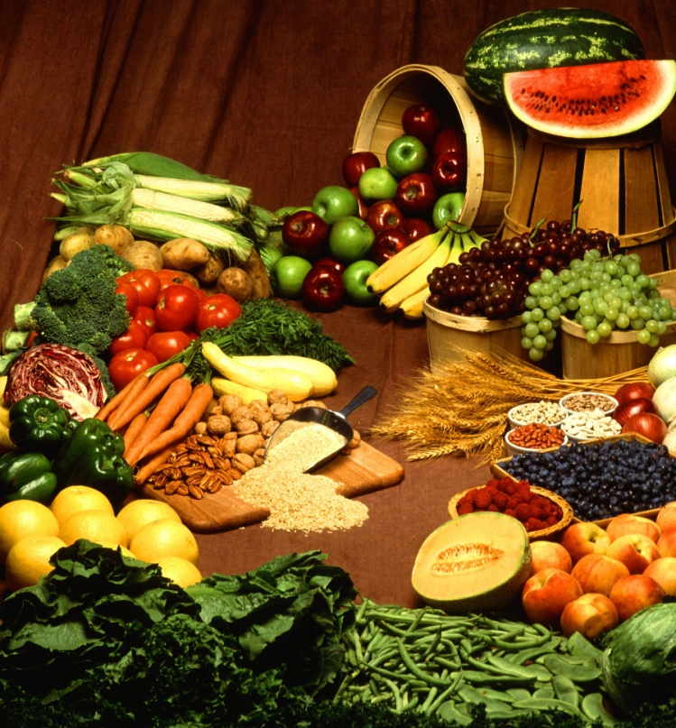
Look at these pictures below
Vegetables
Fishes

Slide 12
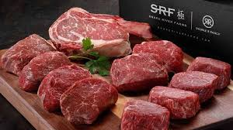
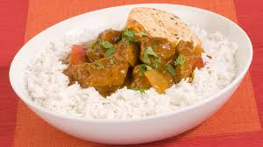
Meat
Rice and Curry

Slide 13
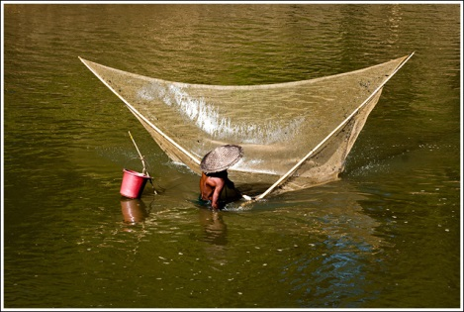
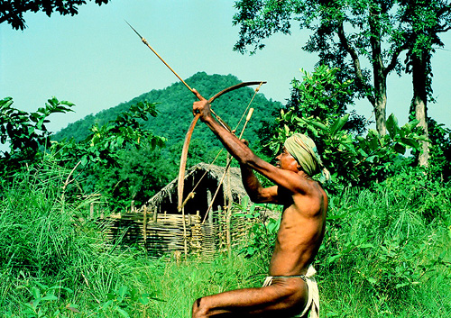
Fishing and hunting

Slide 14
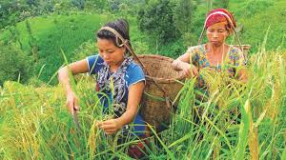
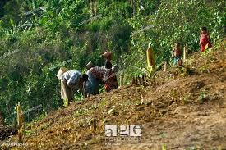
Jhum cultivation and sow seed

Slide 15
GROUP WORK
Explain about the Ethnic people’s food habits.

Slide 16
Homework
Write a short paragraph on Ethnic people.

Slide 17
Thank You

