Slide 1
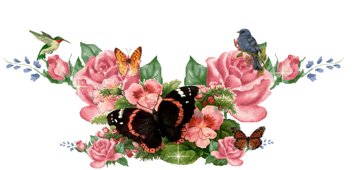


Slide 2
INTRODUCTION
Md. Shamsuddoha
Asst.Teacher (English)
Gangore High School
Niamatpur, Naogaon.
shamshzoha@gmail.com
Sub: English
Class: Eight
Unite: One
Time: 50 minutes
Date: 16/02/2019

Slide 3
Let’s watch the video clips
Do you understand what type of song is this?
Folk song

Slide 4
So, todays lesson is about……..
Our Folk Songs

Slide 5
Learning outcomes
By the end of the lesson the learners will be able to…
Read and understand the text
Tell the meaning of the new words
Write the name of musical instruments
Write a paragraph on Folk song

Slide 6
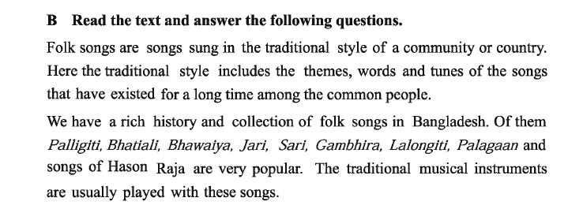
Dear students, open page at 2, section B of your text book. Now read
the text silently and try to find out the new words.

Slide 7
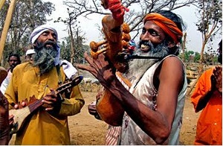
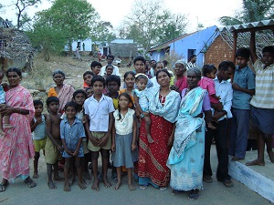
Individual Work
04
Min
Key words
relating to the traditional art or culture
Folk
Rahim likes to sing folk songs.
the people living in one particular area
Community
We live in a global community.

Slide 8
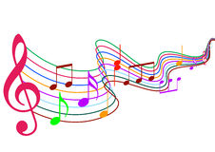
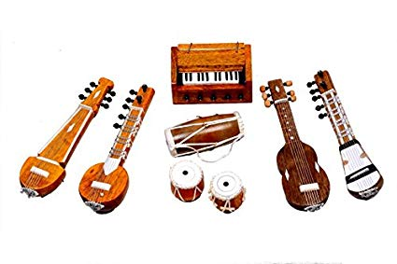
Music related
Musical
Runa comes from a musical family.
An object that is played to produce
Musical sounds
Instrument
My favorite music instrument is
the flute.

Slide 9
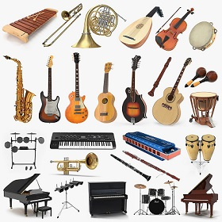
There are different types of musical instruments are played with our folk
songs. These instruments, usually homemade, that are played by folk musicians.

Slide 10
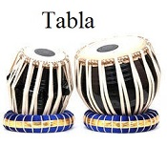
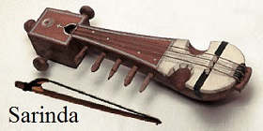
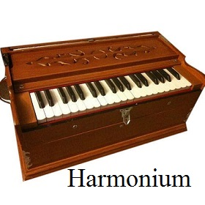
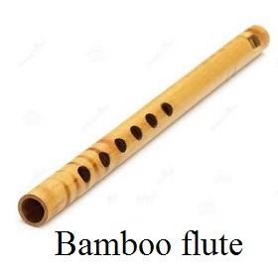
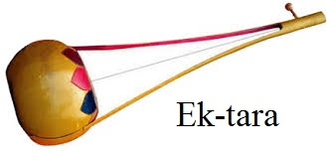
Let’s see some musical instruments

Slide 11
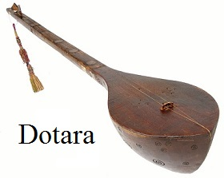
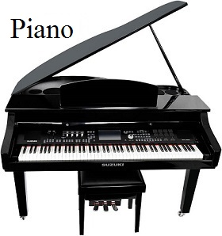
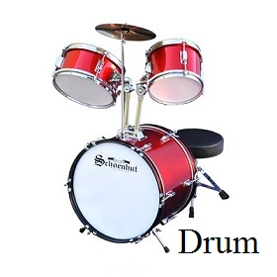
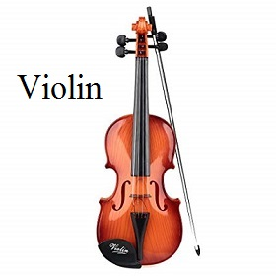
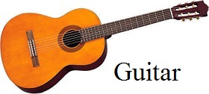
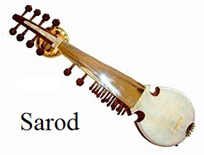

Slide 12

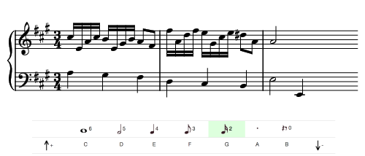
Pair Work
06
Min
Write the name of musical instruments are played with folk songs
in our country?

Slide 13
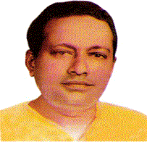
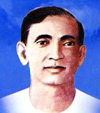
Folk songs and singer
Abdul Alim (27 July 1931 – 5 September 1974) was
the greatest Palligiti singer of Bangladeshi
Palligiti
Abbas Uddin Ahmed (27 October 1901 – 30 December 1959) was a Bengali folk song composer and singer. He was known for Bhawaiya folk song which is a style commonly found in Rangpur.
Bhawaiya

Slide 14
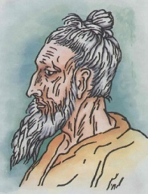
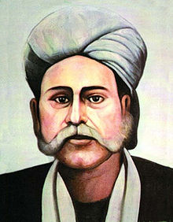
Lalon Shah (1774-1890) was a prominent Bengali
philosopher, Baul saint, songwriter, social reformer, composer and singer of Baul songs.
Lalongiti
Hason Raja (21 December 1854-6 December 1922) was a Bengali mystic poet and songwriter from
Sylhet. His unique style of music made him one of the most prominent figures in Bengali culture.
Hason Raja

Slide 15
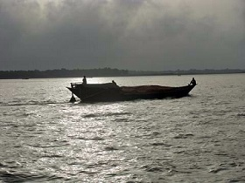
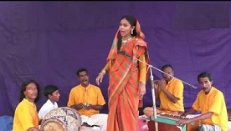
Bhatiali or bhatiyali is a form of folk music in both Bangladesh and West Bengal. Bhatiali is a river song mostly sung by boatmen while going down streams of the river.
Bhatiali
Jari gaan is a kind of sad song. Its origin is the
tragic events of Medina and Karbala and the
death of Hazrat Imam Hassan and Hussain.
Jari gaan

Slide 16
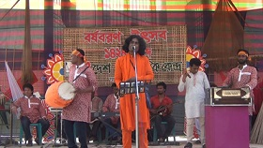
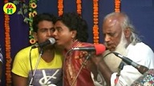
Sari gaan or Sari songs are usually sung before
or after the boat races, a popular amusement in
East Bengal during the monsoon months.
Sari gaan
Pala gaan is also a kind of traditional Bengali folk song. It is an essential component of all the major rural festivals during the dry seasons. Pala gaan is performed by a group of performers.
Pala gaan

Slide 17
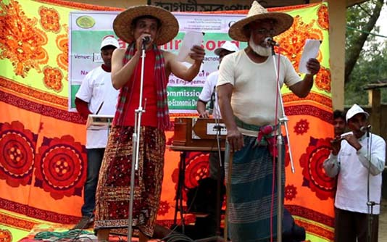
Gambhira
Gambhira is a type of folk song popular in the northwestern region of
Bangladesh. Chapai Nawabganj district is the main centre of Gambhira
performances in Bangladesh. The tradition is also popular in the nearby
districts of Rajshahi and Naogaon.

Slide 18

10
Min
Group Work
Discuss in groups and write a paragraph on “Folk song of Bangladesh.”

Slide 19
Evaluation
Give short answer to the following questions.
What is folk song?
Who is Lalon Shah?
Who usually likes folk songs?

Slide 20

Do you want more or less programmes on folk songs on our TV
channels? Describe why?

Slide 21

