Slide 1
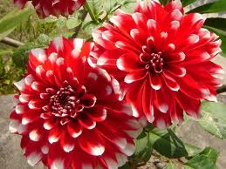
Welcome

Slide 2
Teacher`s Introduction:
MD. SHAMSUDDAWHA
Assistant Teacher (English)
Gangore High School
Niamatpur, Naogaon
Mobile no. 01717-516353
E-mail: shamsd22@yahoo.com

Slide 3
Lesson Introduction:
Subject: English 1st Paper
Class: Nine
Unit: 3
Lesson: Six
Time: 50 min.

Slide 4
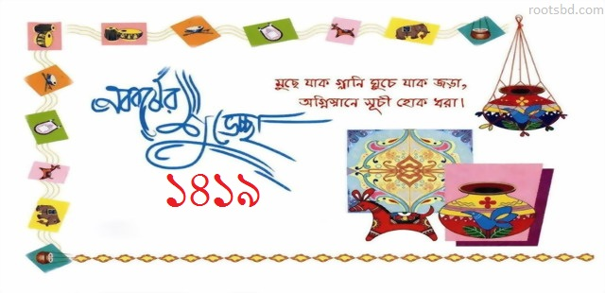
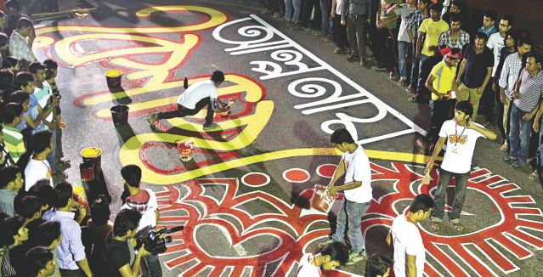
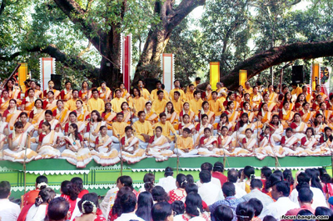

Slide 5
What do you see in the pictures?

Slide 6
So, todays lesson is……
Pohela Boishakh

Slide 7
Learning outcome:
At the end of the lesson the students able to----
1. They can give the definition of pohela boishakh
2. The students able to tell when does it hold.
3. The student able to learn unknown words and it`s
meaning.

Slide 8

Time: 05 minute
Individual Work:
a. What’ the picture about ?
b. What are they doing ?

Slide 9
Individual questions solutions
a. The picture about Pahela boishakh.
b. They are celebrating pohela boishakh.

Slide 10
TEACHER`S READING:
Pahela Boishakh is the first day of Bangla new year. The day is a public holiday. Every year the day is celebrated traditionally. People wake up early in the morning ,have a bath and wear their traditional cloth. Women wear white saris with red borders and adom themselves with colourful churis and flowers, while men dress themselves with pajama and punjabis.

Slide 11
STUDENTS READING:
Pahela Boishakh is the first day of Bangla new year. The day is a public holiday. Every year the day is celebrated traditionally. People wake up early in the morning ,have a bath and wear their traditional cloth. Women wear white saris with red borders and adorn themselves with colourful churis and flowers, while men dress themselves with pajama and punjabis.

Slide 12
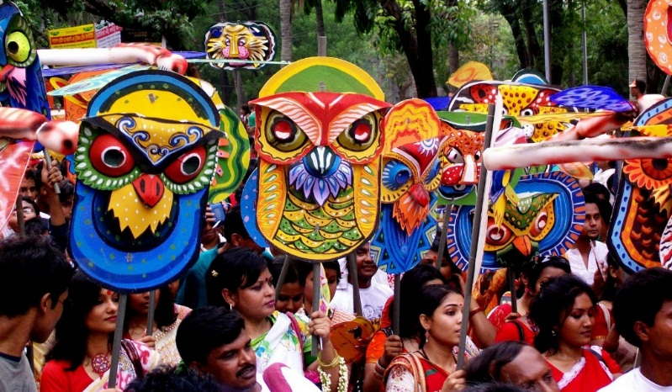
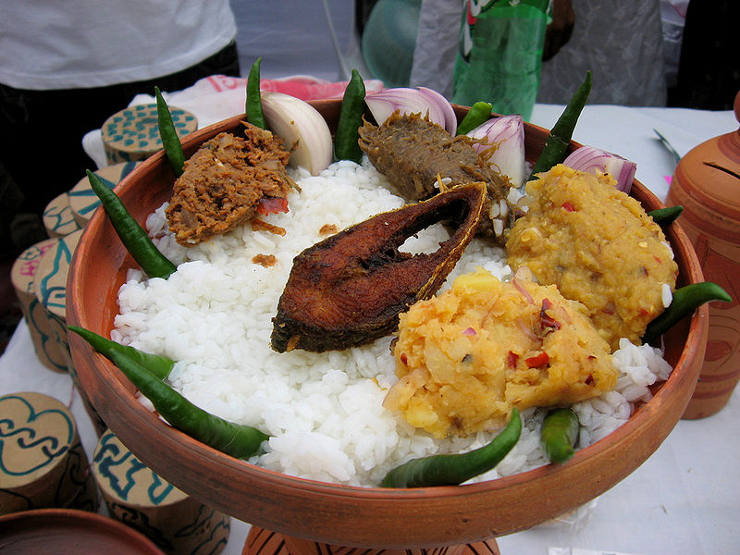

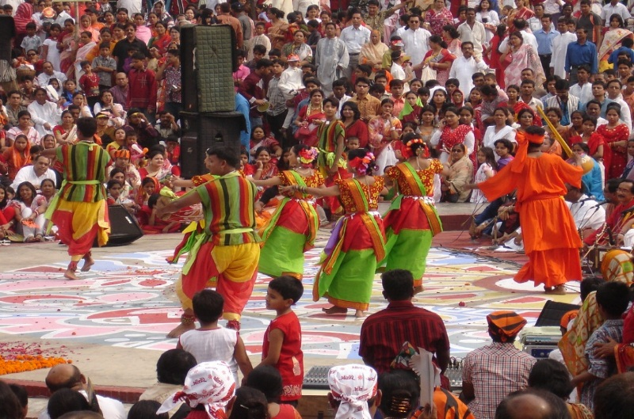
Procession
শোভাযাত্রা
Culture
সংস্কৃতি
Festive
উৎসবের আমেজ

Slide 13
Pair work :
Time: 05 minute
Make sentences with the following words:
Procession , Culture, Festive.

Slide 14
Pair work Solutions:
a. We made a procession last year.
b. Pohela boishakh is our traditional culture.
c. In the pohela boishakh, all the people of
Bangladesh is in a festive mood.

Slide 15
Group work
Time: 08 minute
Read the following sentences and say if the statements are true or false. If false give the correct information;
We celebrate pohela boishakh in the English new year.
b. The first programe of the day hold at Ramna batamul.
c. The day is only observed in Dhaka city.

Slide 16
Group work Solutions
False . Correct Answer: We celebrate pohela boishakh in the English new year.
b. True.
c. The day is observed all over the country.

Slide 17
Evaluation
1. We celebrate pohela boishakh on
(a) 1st May (b) 1st April (c) 1st boishakh (d) 10th boishakh
2. The biggest carnival of the country organized by the Fine Arts
student of university of-
(a) Dhaka (b) Rajshahi (c) Khulna (d) Jagannath
3. The artists sing traditional-
(a) English song (b) Bengali folk song (c) Arabic song
(d) Hindi song

Slide 18
Home work
Write a paragraph on about your religious festival in your own words that you celebrated last year.

Slide 19
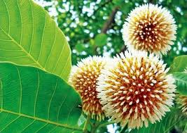
Thank You

