Slide 1


Slide 2


INTRODUCTION
Md. Shamsuddoha
Asst.Teacher (English)
Gangore High School
Niamatpur, Naogaon.
shamshzoha@gmail.com
Sub: English 2nd Paper
Topic: Writing Test
Class: IX – X
Time: 50 minutes
Date: 26/02/2019

Slide 3
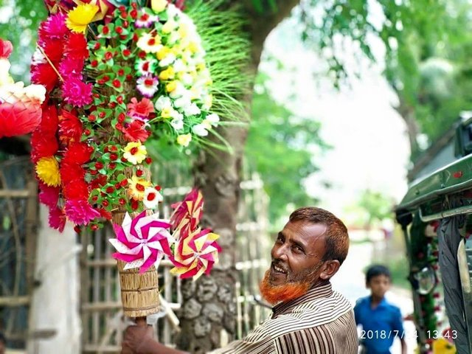
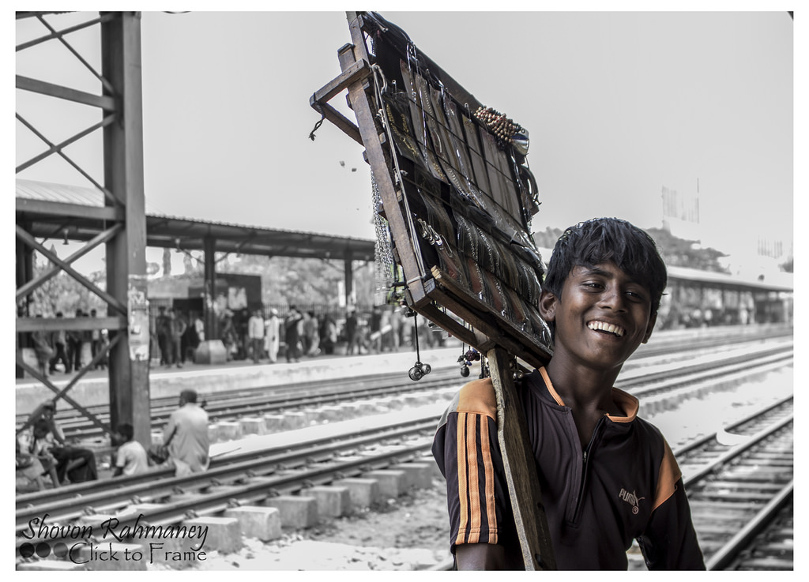
Look at the pictures.
Can you guess about the pictures?

Slide 4
Today’s topic is………………………
A Street Hawker

Slide 5
LEARNING OUTCOMES
By the end of the lesson the learners will be able to…
identify a street hawker.
tell the life of a street hawker.
write a paragraph on a street hawker.

Slide 6
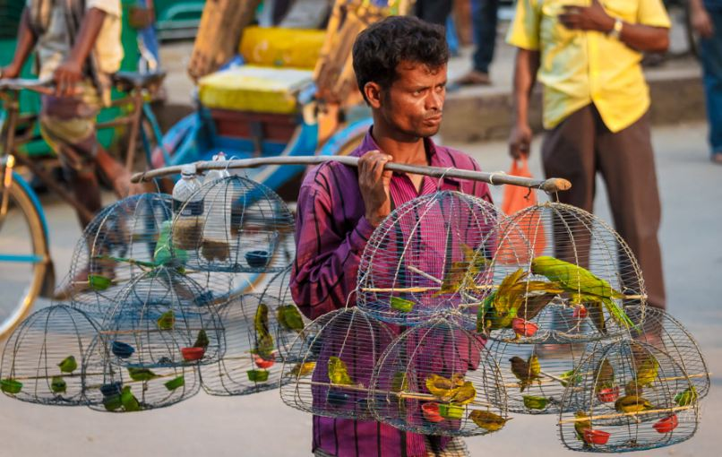
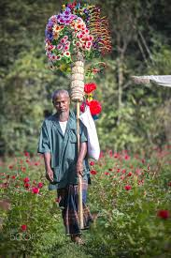
A person who sells various things moving from
street to street is called a street hawker. A street
hawker is a familiar figure in towns.

Slide 7
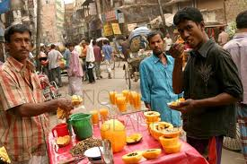
INDIVIDUAL WORK
5 min
Who is a street hawker?

Slide 8
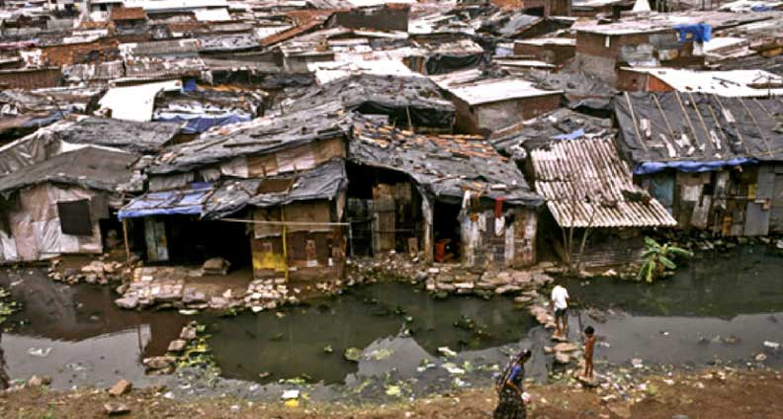
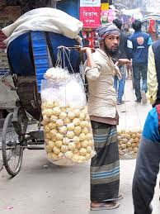
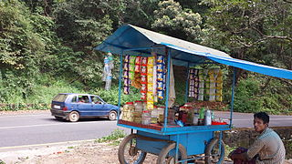
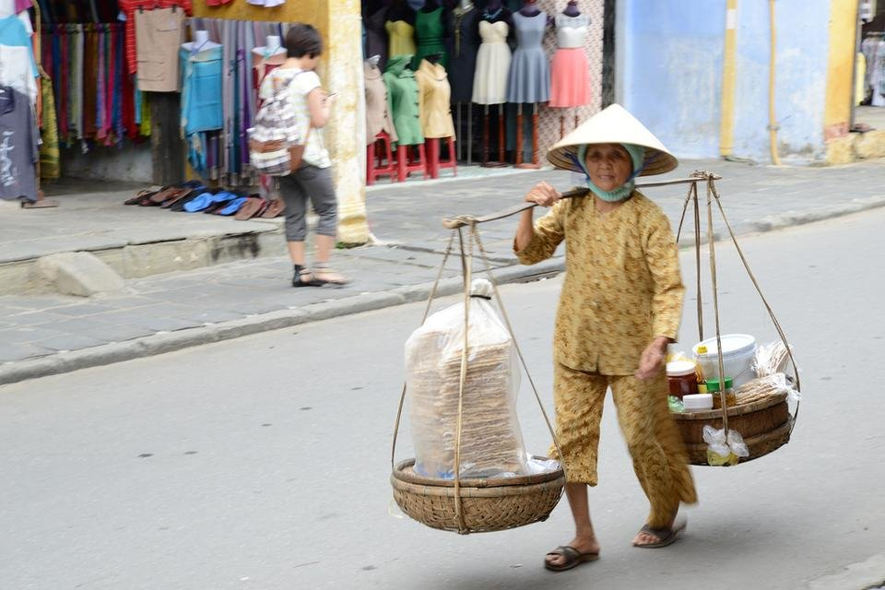
He usually lives in a hut or in a slum. He is the vendor
of a variety of things. He carries his things sometimes
on the head, sometimes in his hands and at some
other times in a small hand-cart.

Slide 9
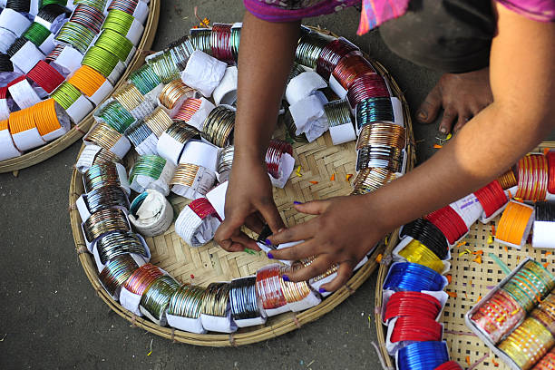
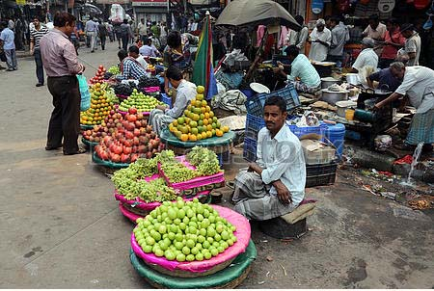
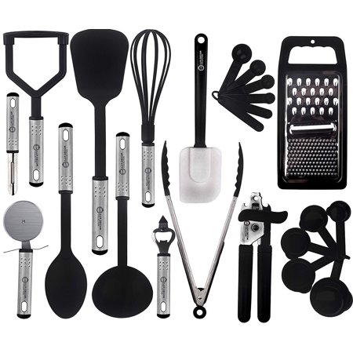
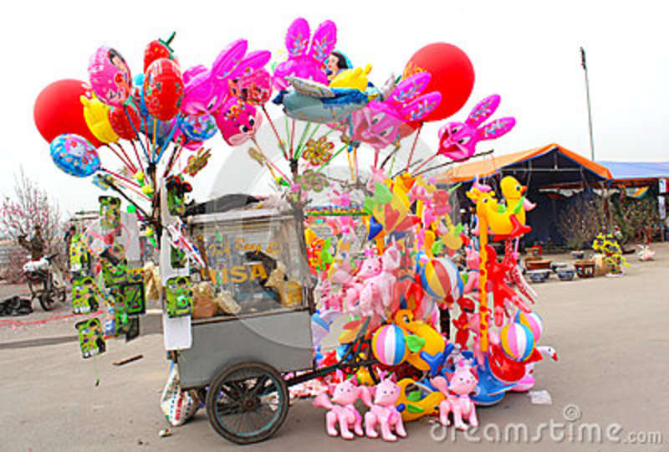
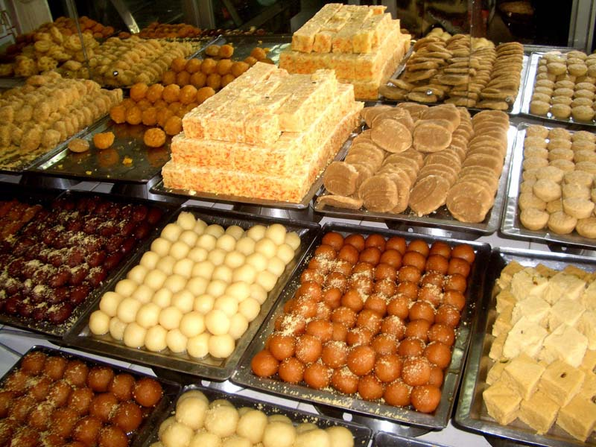
Bangles
Fruits
Utensils
Toys
Sweets
Flowers
He sells toys, bangles, ribbons, clothings, sweets, fruits, utensils, newspapers, fancy goods and things of domestic use by bringing them up to people's doors.

Slide 10
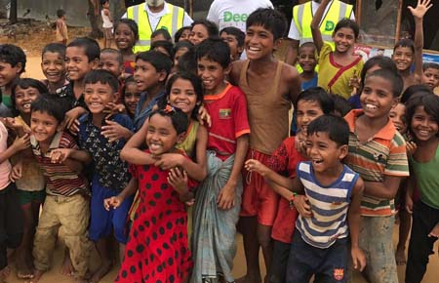
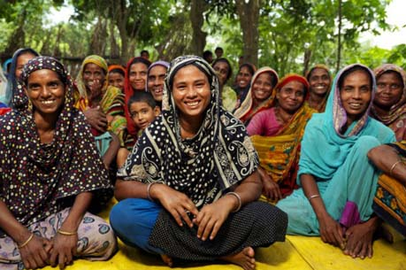
Children
Women
He is a clever fellow who knows how to run his business. He chooses things for children that will attract children and for women that will attract women.

Slide 11
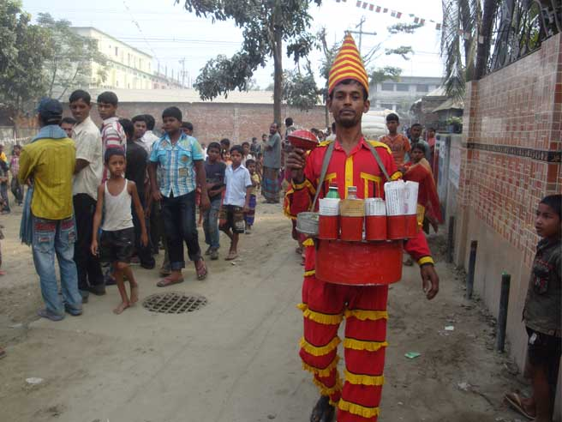
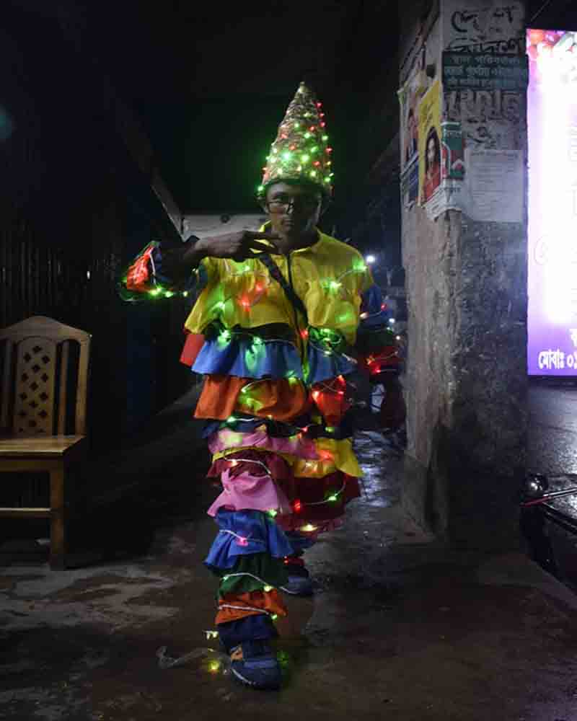
Peculiar dress
Sometimes he wears peculiar dress of different colors which is attracting.

Slide 12
PAIR WORK
8 min
Why does a street hawker wear a peculiar dress?
Who are the target of a street hawker?

Slide 13
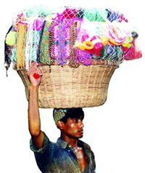
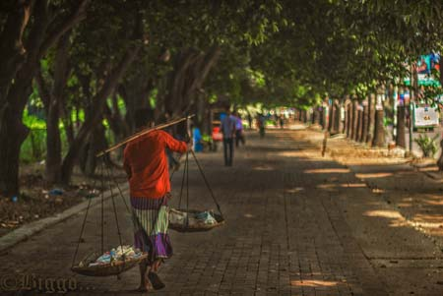
Hard labour
A street hawker's life is not easy and comfortable. He earns his livelihood by the sweat of hard labour.

Slide 14
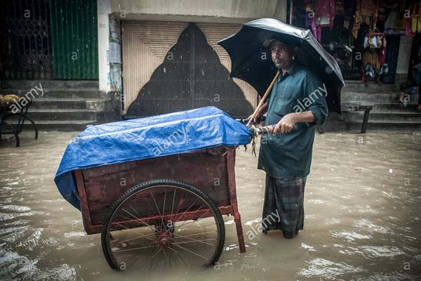
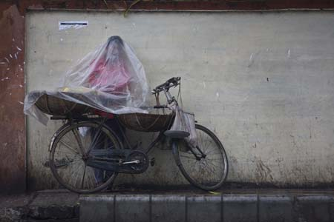
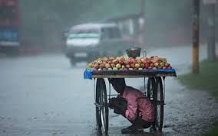
A rainy day
A street hawker faces great problem to sell his goods
during a rainy day. He also leads a miserable life with his family.

Slide 15
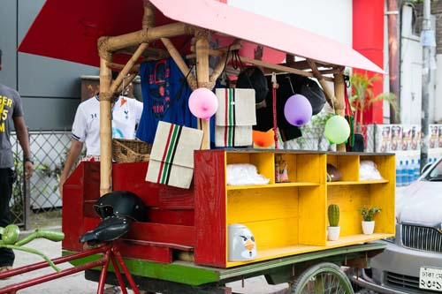
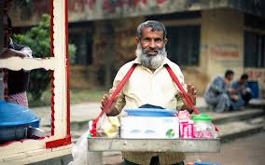
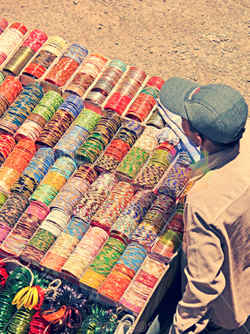
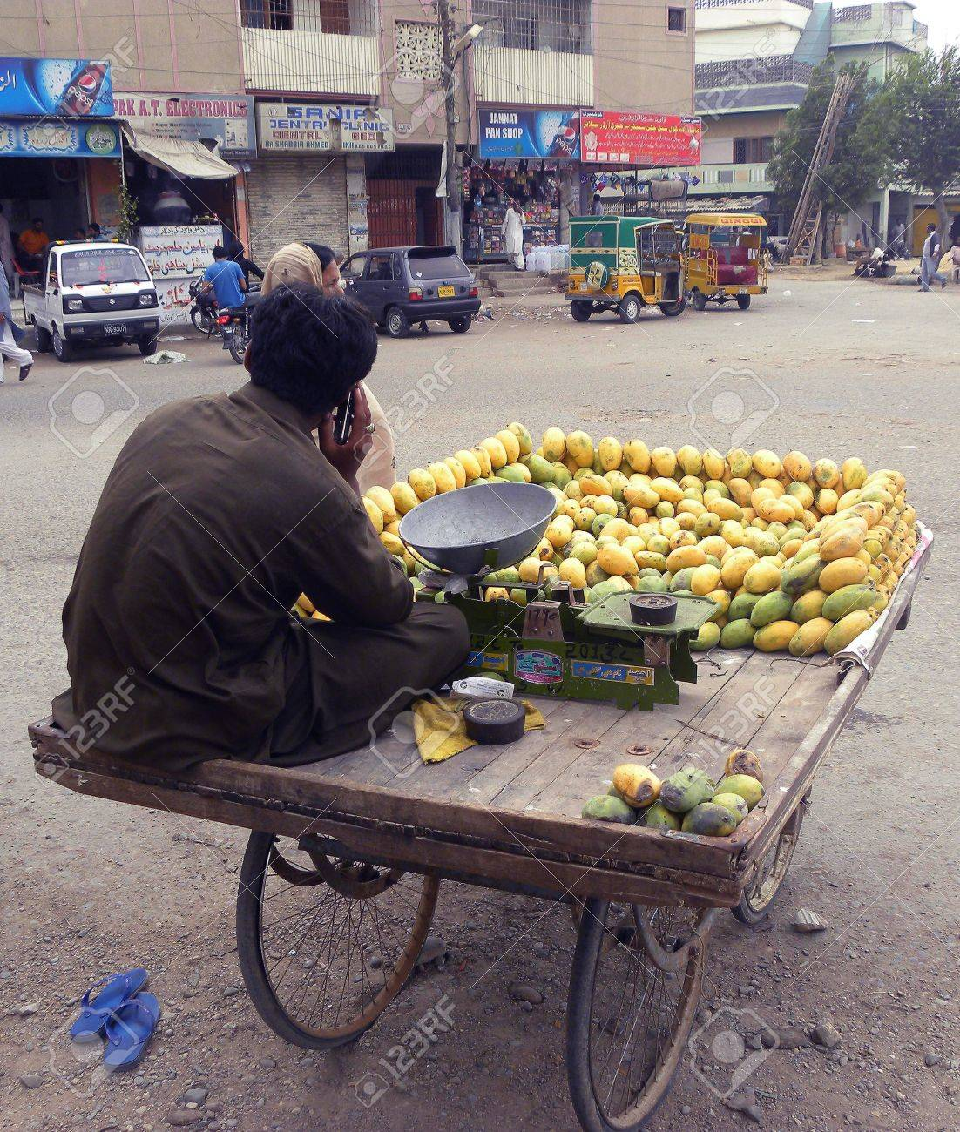
GROUP WORK
10 min
Write six sentences about a street hawker whom you have seen.

Slide 16
EVALUATION
Short question
Who is a street hawker?
Where does he live?
How does he lead his life?
What does he wear?

Slide 17

Write a paragraph about “A Street Hawker.”

Slide 18


