Slide 1


Slide 2
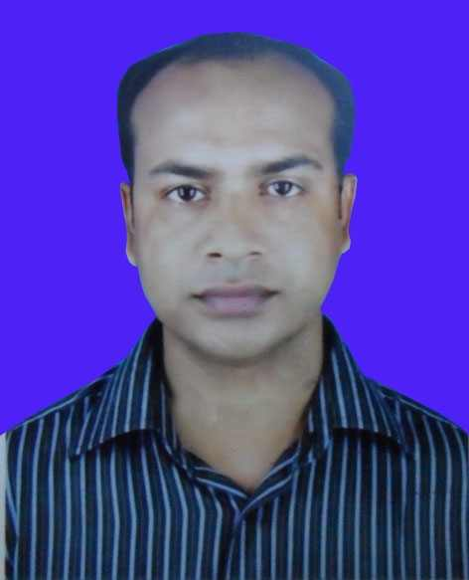
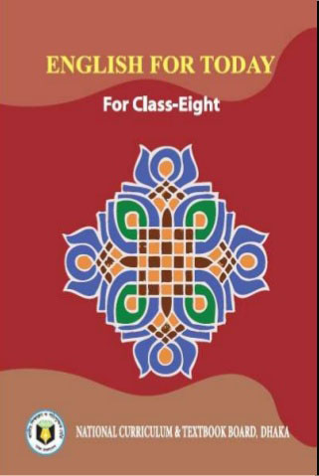
INTRODUCTION
Md. Shamsuddoha
Asst.Teacher (English)
Gangore High School
Niamatpur, Naogaon.
shamshzoha@gmail.com
Sub: English
Class: Eight
Time: 50 minutes
Date: 16/02/2019

Slide 3
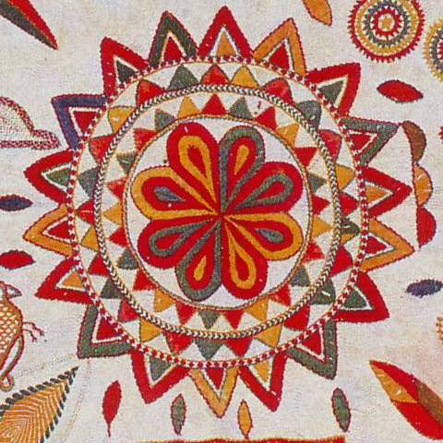
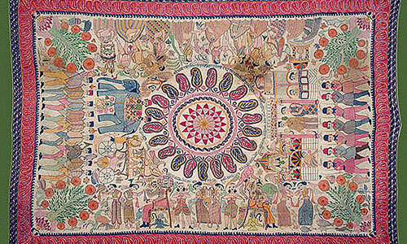
What do you see in the picture?
Can you guess what is it called?

Slide 4
So, today’s lesson is about………………………
NAKSHI KANTHA

Slide 5
LEARNING OUTCOMES
By the end of the lesson the learners will be able to…
tell about Nakshi Kantha
understand the new words
fill in the blanks
write a short paragraph

Slide 6
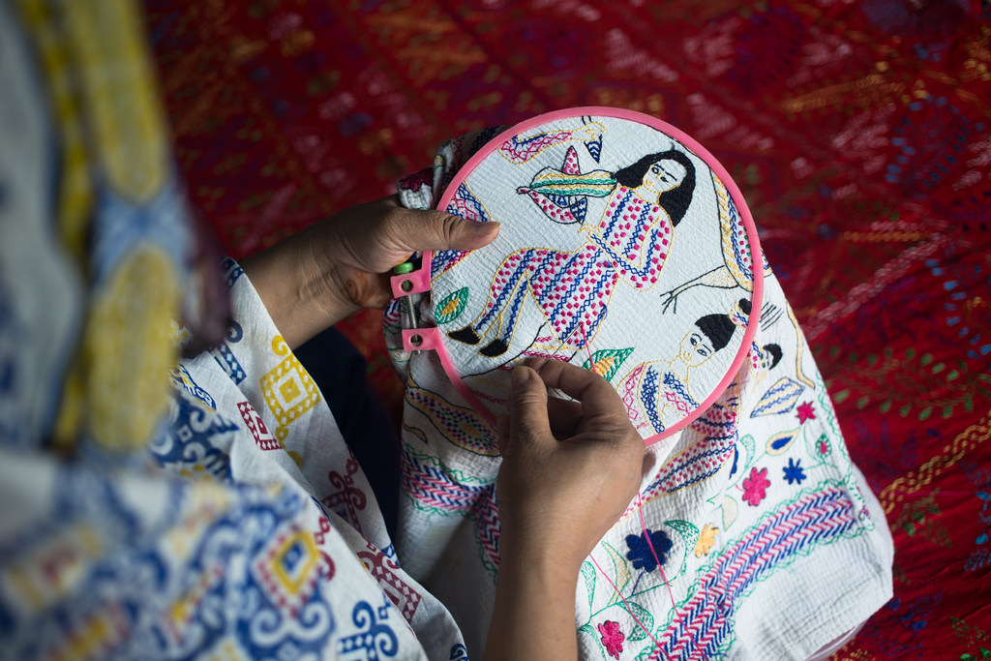
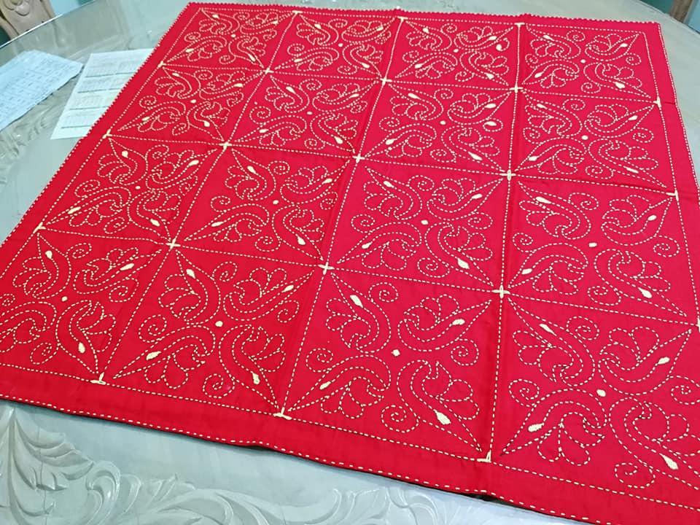
Nakshi kantha is a kind of embroidered quilt.
Nakshi means artistic pattern which was taken
from the Bengali word ‘naksha’.

Slide 7
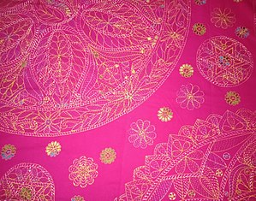
5 min
INDIVIDUAL WORK
1. What is Nakshi Kantha?
2. What does it mean by Nakshi?

Slide 8
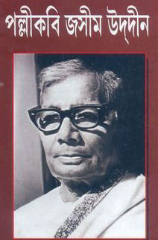
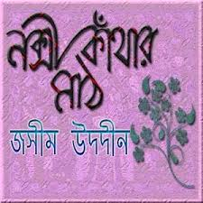
The name Nakshi kantha became famous after the poet Jasimuddin’s poem “Nakshi kanthar Math” was published in 1929. Traditional Kanthas are made for family use. Old or new cloth and thread are used to make this quilt. Mymensingh, Jamalpur, Rajshahi, Faridpuir Bogra and Jessore are most famous for this craft. Now it is produced commercially. We find them in many expensive handicraft shops in cities. The quilts are now in great demand.

Slide 9
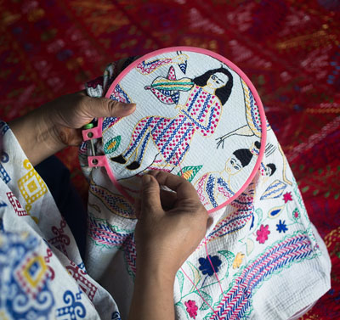
VOCABULARY
nakshi
artistic pattern
artistic
having or revealing natural creative skill

Slide 10
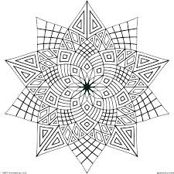
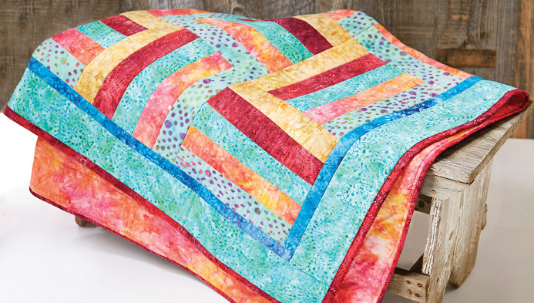
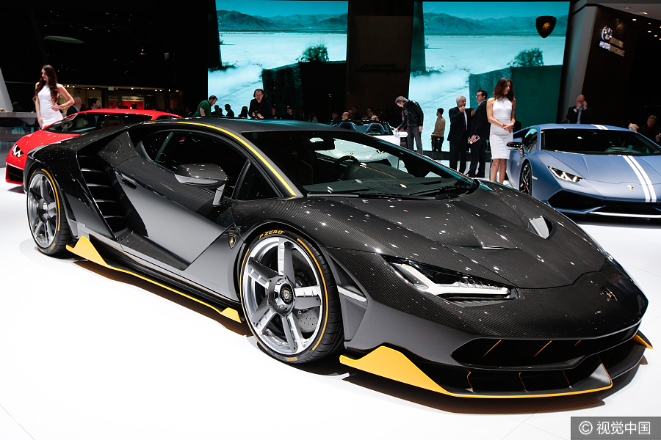
pattern
a decorative design
quilt
a thick cover for a bed, made from pieces
of fabric that are stitched together
expensive
costing a lot of money

Slide 11
8 min
PAIR WORK
Complete the sentences with clues from the box given below.
Bengali | patterns | embroidery | years | fashion
art | West | designs | quilt | naksha
Naksha means artistic ………………..
The name was taken from a …………..… word ……………..
The art has been practised in ……… Bengal for ……..
Nakshi kanthas are now sold in …………. Shops.
Nakshi kanthas are in great demand because of their colourful
…………… and …………
6. Nakshi kanthas are a kind of ………
patterns
Bengali
naksha
West
years
fashion
embroidery
designs
quilt

Slide 12
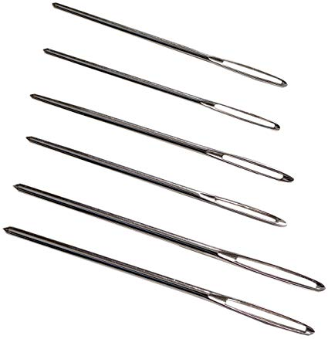
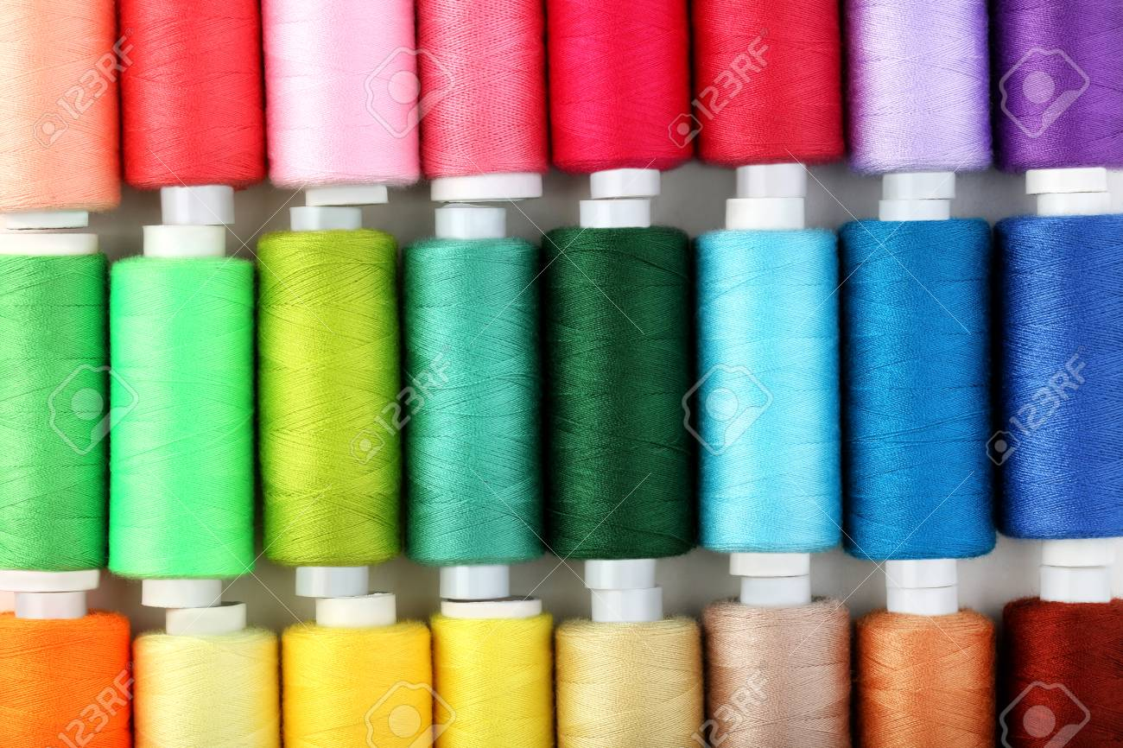
If you want to make a kantha, you need…….
needle
thread

Slide 13

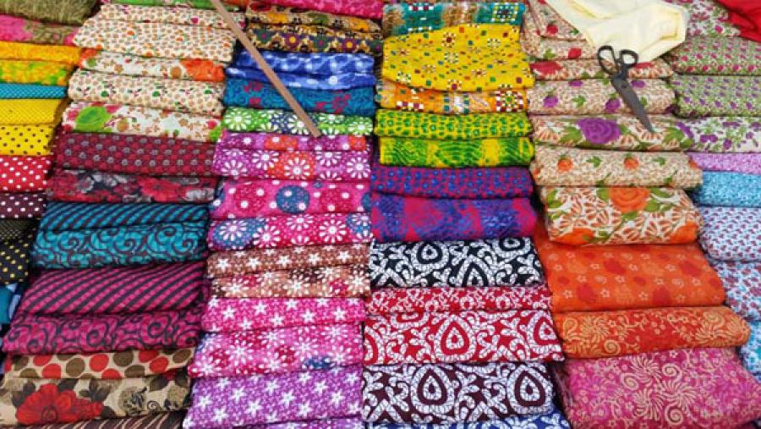
Old clothes
New clothes

Slide 14
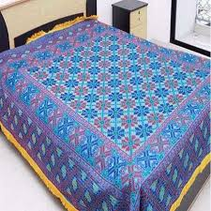
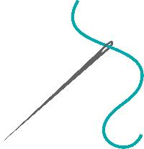
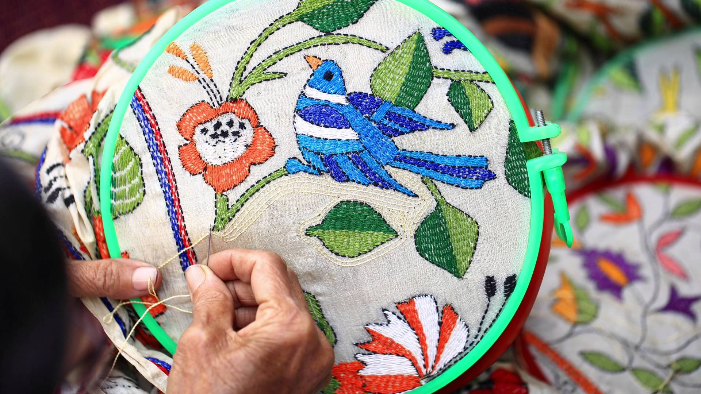
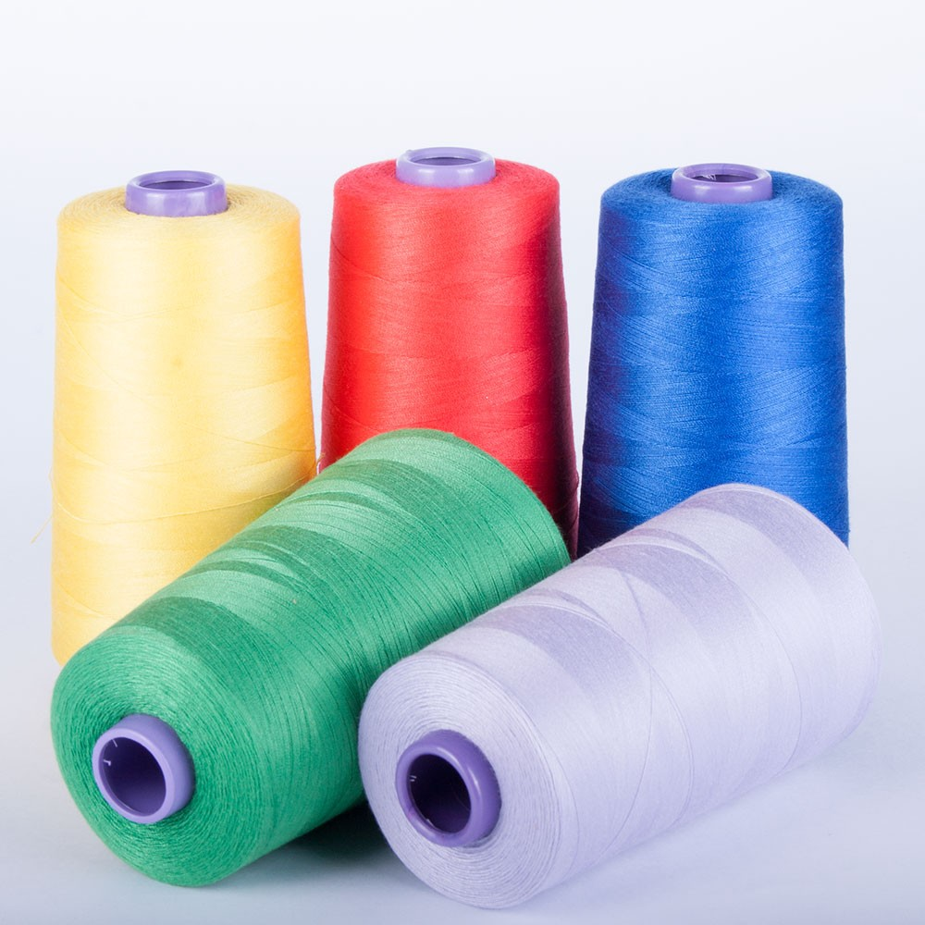
10 min
GROUP WORK
Write a short paragraph describing how to make a Nakshi kantha.

Slide 15

Fill in the blanks with appropriate word.
“Nakshi Kanthar Math” was published in _________.
Old or _____ cloth and thread are used to make the quilt.
______ has been practiced in West Bengal also.
We find nakshi kantha in many expensive handicraft shops in ____.

Slide 16

Why do you like a nakshi kantha? Describe it with your own words.

Slide 17



