Slide 1

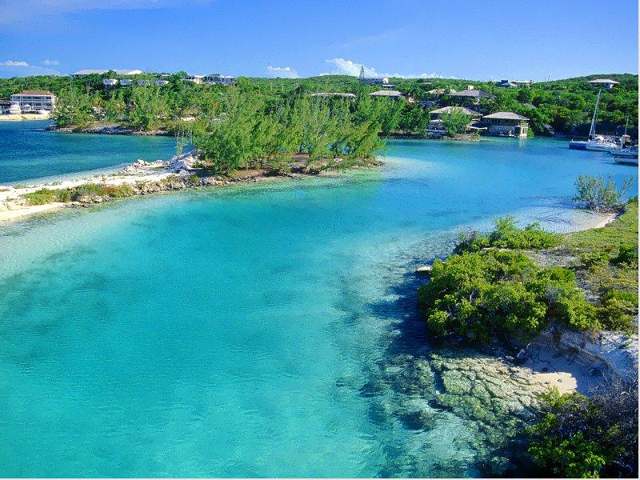
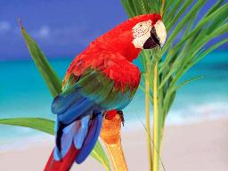
Welcome to This Session

Slide 2
Introduction
Md. Shamsuddoha
Assistant teacher (English)
Gangore High School
Niamatpur,Naogaon
Email: shamshzoha@gmail.com
Mobil: 01717-516353
Class: Eight
Subject: English 1st Paper
Unit: Six
Duration: 50 Min.
Date: 03/03/2016

Slide 3
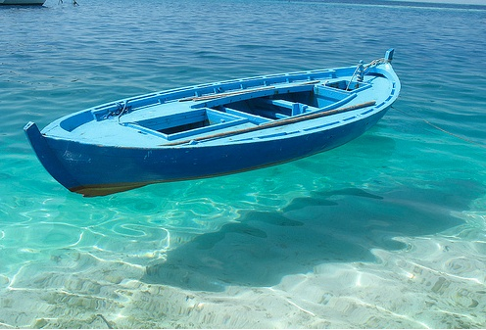

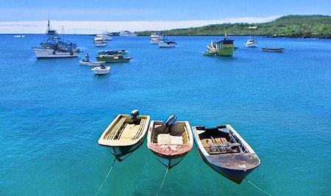
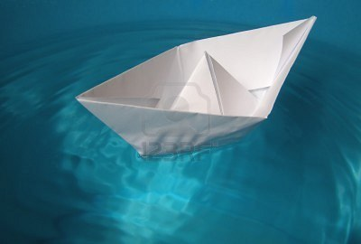
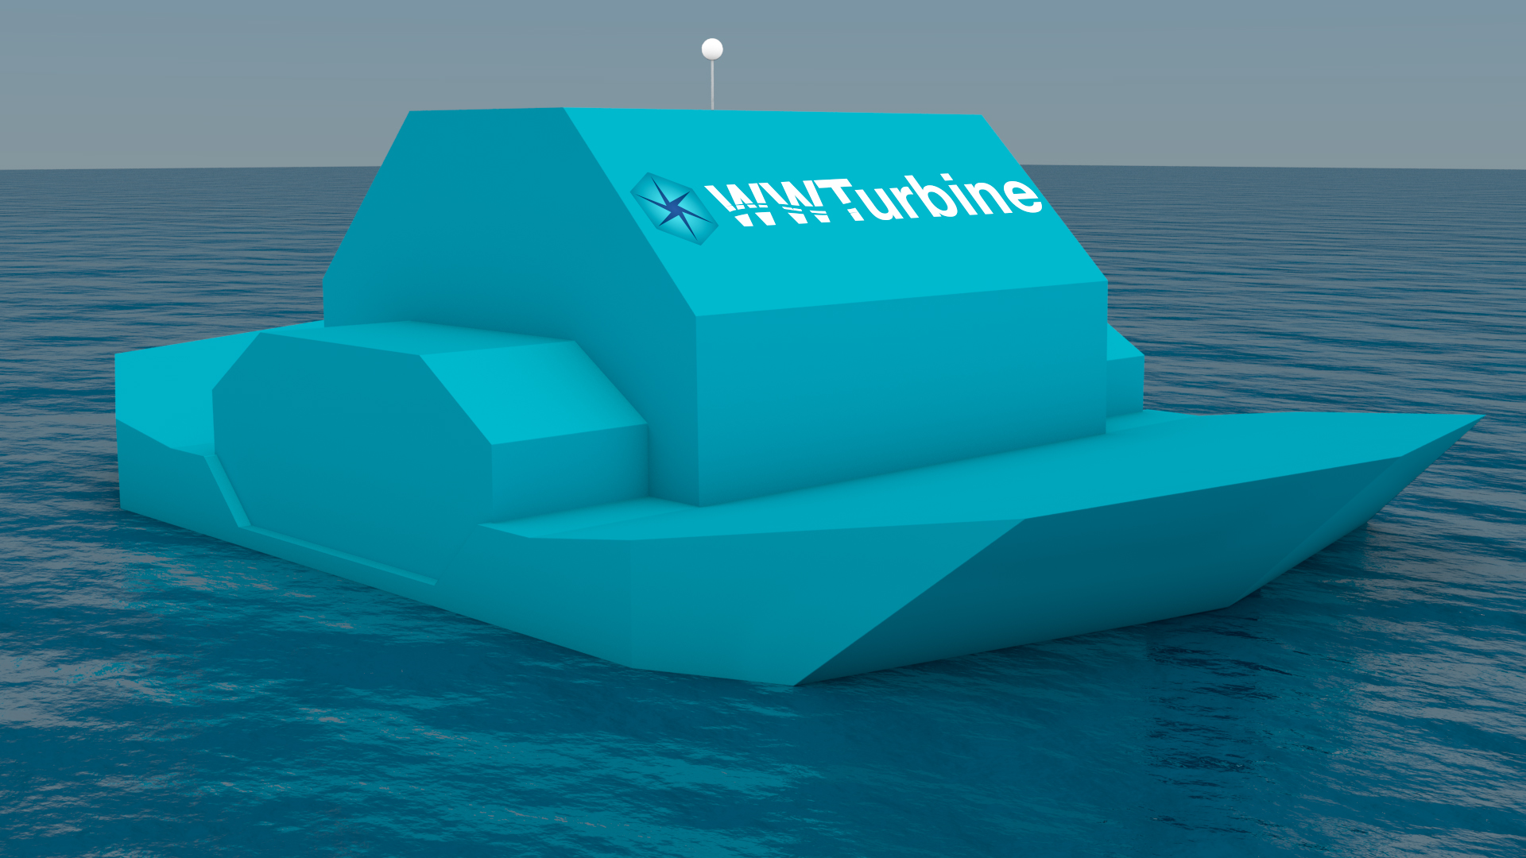
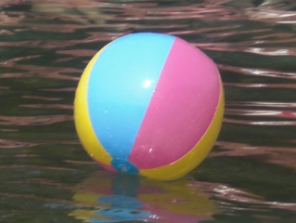
Can you guess about these images?
These objects are floating on the water.

Slide 4
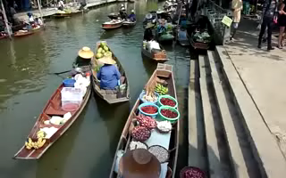
Watch the video

Slide 5
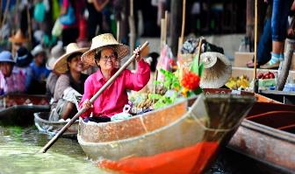
So, Todays Lesson is …………
The Tha Kha Floating Market

Slide 6
Learning Outcomes:
By the end of this lesson the learners-
Will be able to talk about the picture
Understand the vocabulary
Ask and answer the question
Write a short paragraph

Slide 7
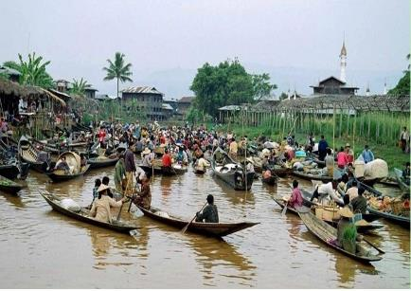
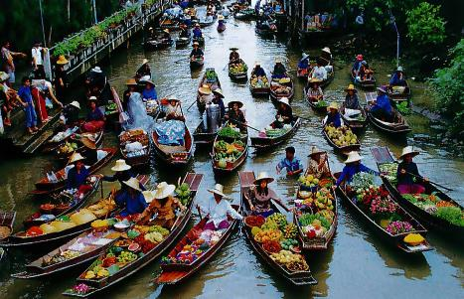
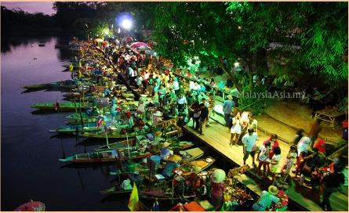
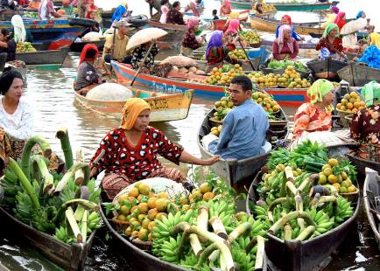
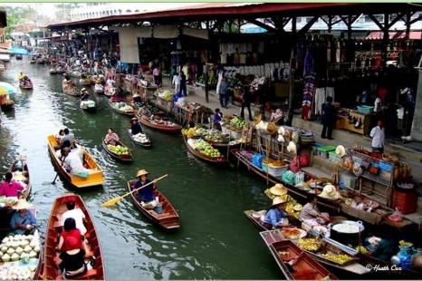
Tha Kha Floating Market

Slide 8
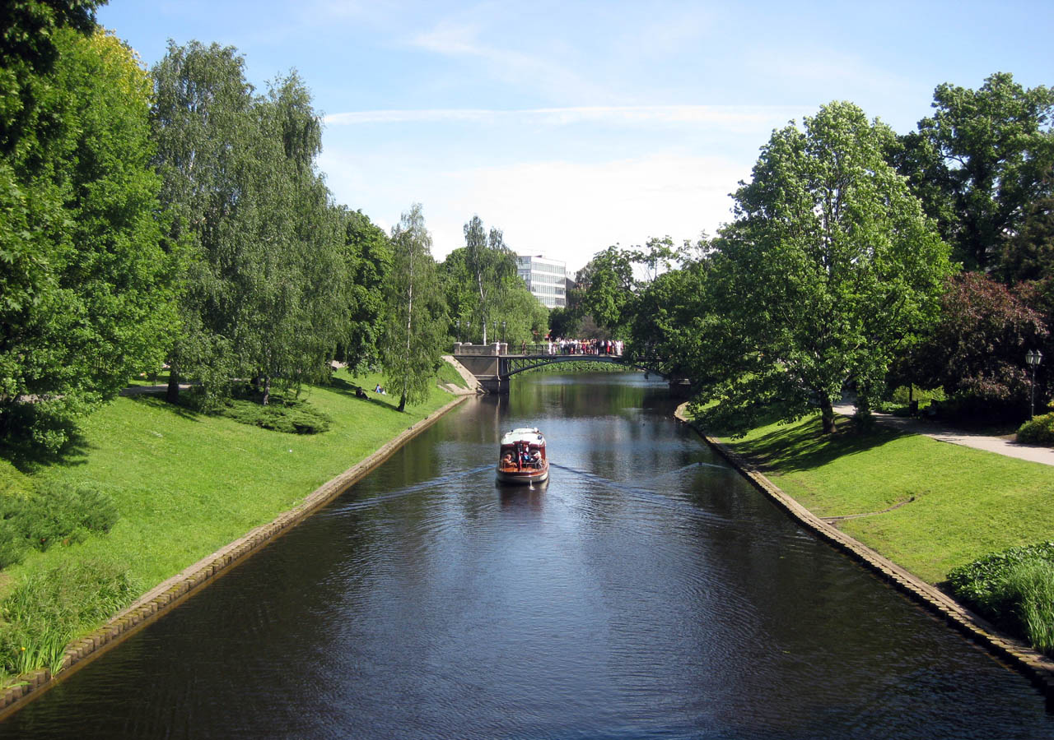

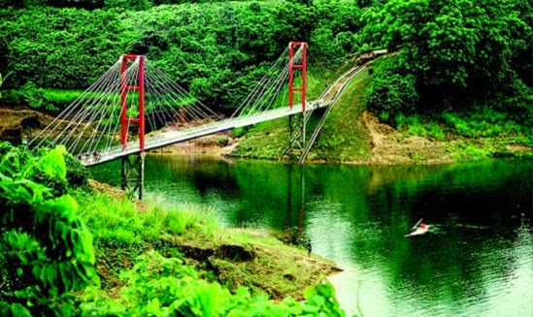

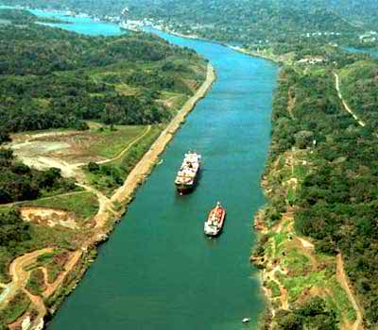
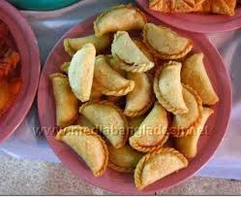
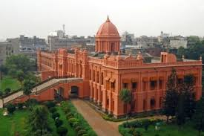
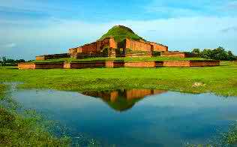

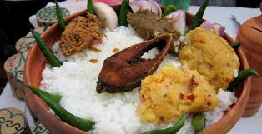

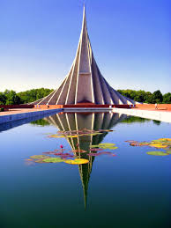
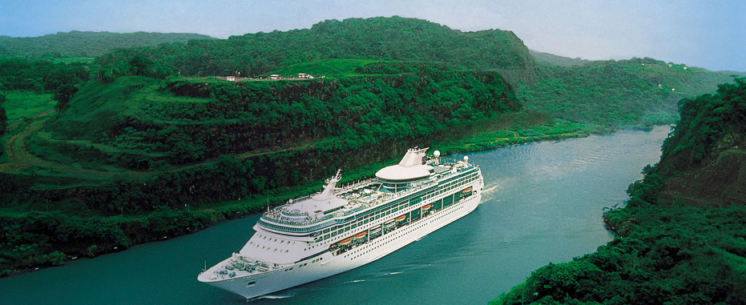

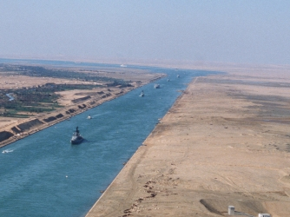
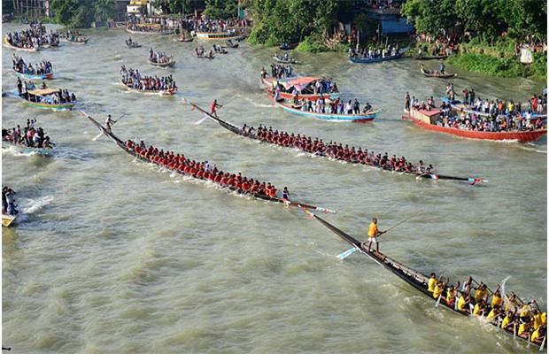
Individual Work: 03 min.
Travel
Traditional
Canal
Chit-chat
Visit
Channel
Conventional
Gossip
Vocabulary

Slide 9
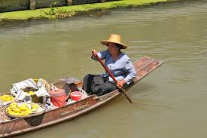
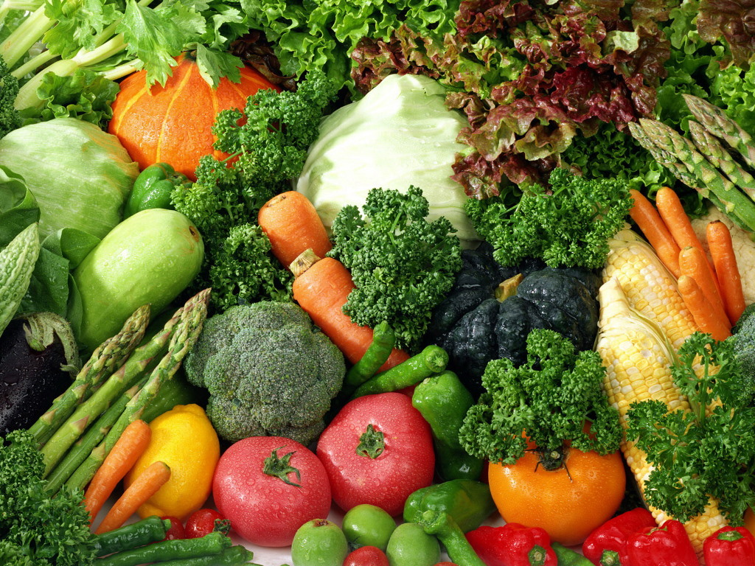
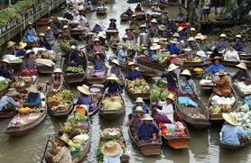

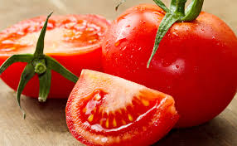

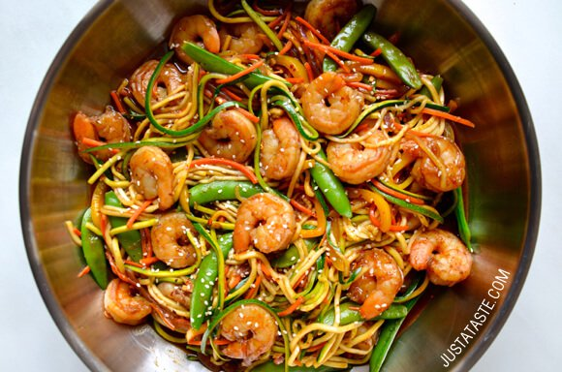
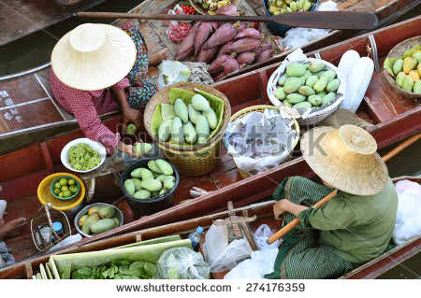
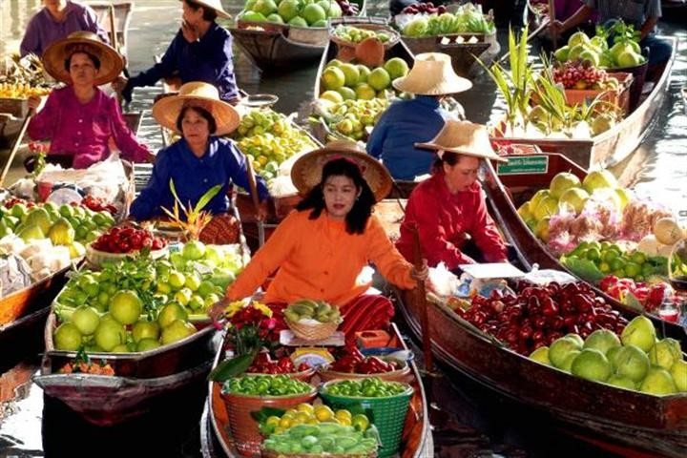
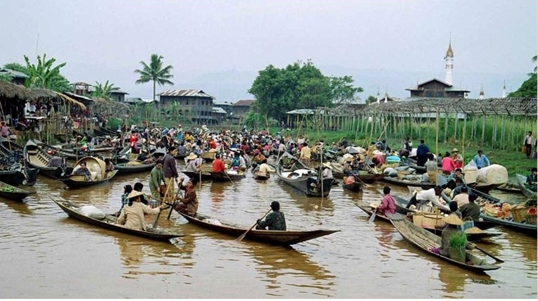
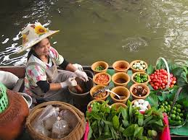
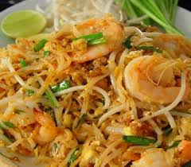
Zara and Mita ate a kind of traditional noodles with shrimp, tomato, vegetables, which is called ‘Pad Thai.’
The sellers are mainly elderly Thai women. Their small boats are laden with vegetables, flowers, foods, sweets etc.
The Tha Kha Floating market sits early in the morning and it is over before noon.

Slide 10

Pair Work: 6 min.
When does the Tha Kha Market sit?
Who are the sellers & what things are they sell?
What kind of food is ‘Pad Thai’?

Slide 11

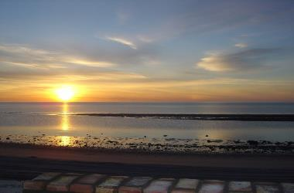
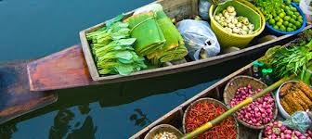
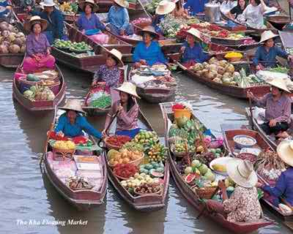
Watch the images
Early morning
Market sits

Slide 12
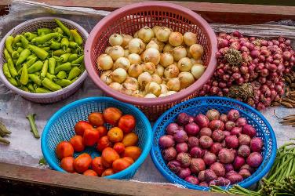


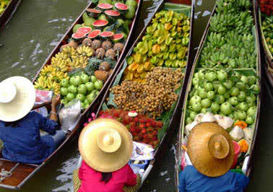
Boats laden with goods

Slide 13
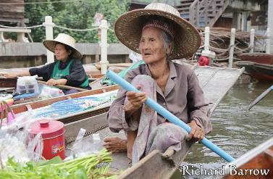
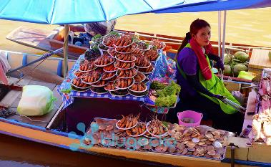
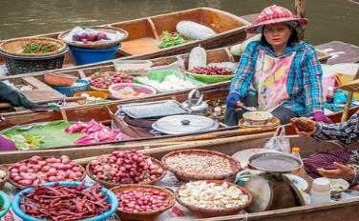
Sellers are mainly elderly women

Slide 14
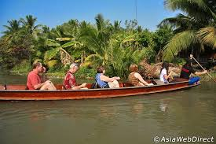
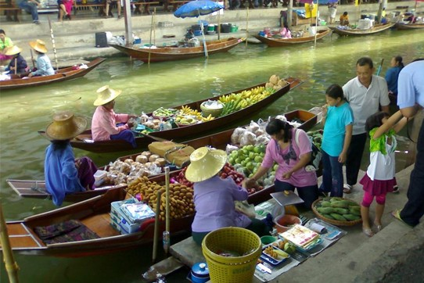
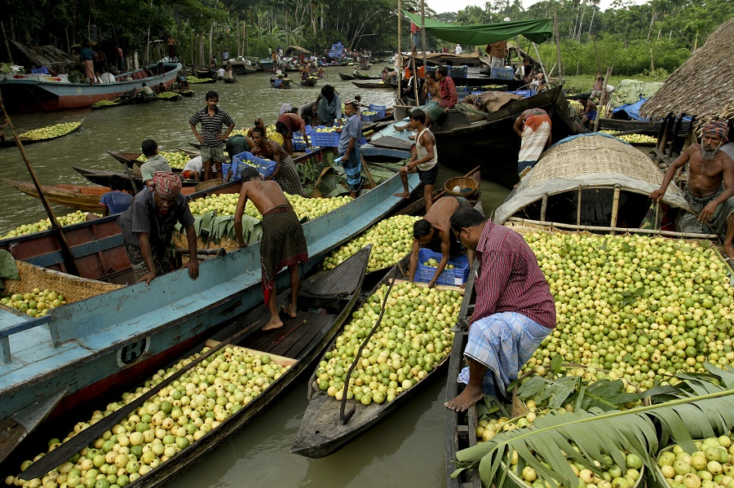
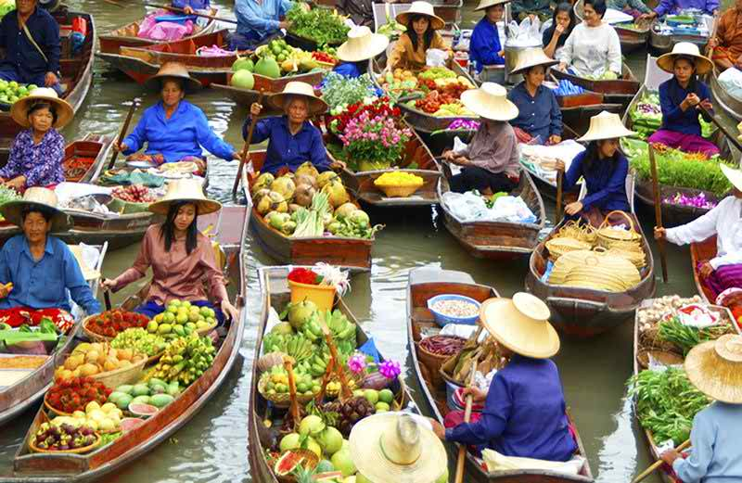
Buyers are buying goods

Slide 15

Group Work: 10min.
Now write a short paragraph on “The Tha Kha Floating Market.”

Slide 16
Evaluation: 04min.
What is meaning of the word ‘laden’?
(a) loaded (b) lay (c) loaner (d) liquid
Who are the sellers of The Tha Kha Floating Market?
(a) young ladies (b) young boys (c) aged women (d) aged men
‘Pad Thai’ is a kind of _______________.
(a) soup (b) juice (c) noodles (d) cold drinks
Tha Kha Floating Market is situated in _________________.
(a) England (b) Indonesia (c) Malaysia (d) Thailand

Slide 17

Write a composition on about “A Village Market”
in your own words.

Slide 18


