Slide 2
Introduction
Md. Oshakur Rahman
Assistant Teacher
Matihara B L High School,
Nawabgonj Dinajpur.
Mob: 01729-103040
Email: ashikbiram@gmail.com
Lesson Description
Subject: English 2nd Paper
Class: vi
Unit: One
Lesson: 01

Slide 3
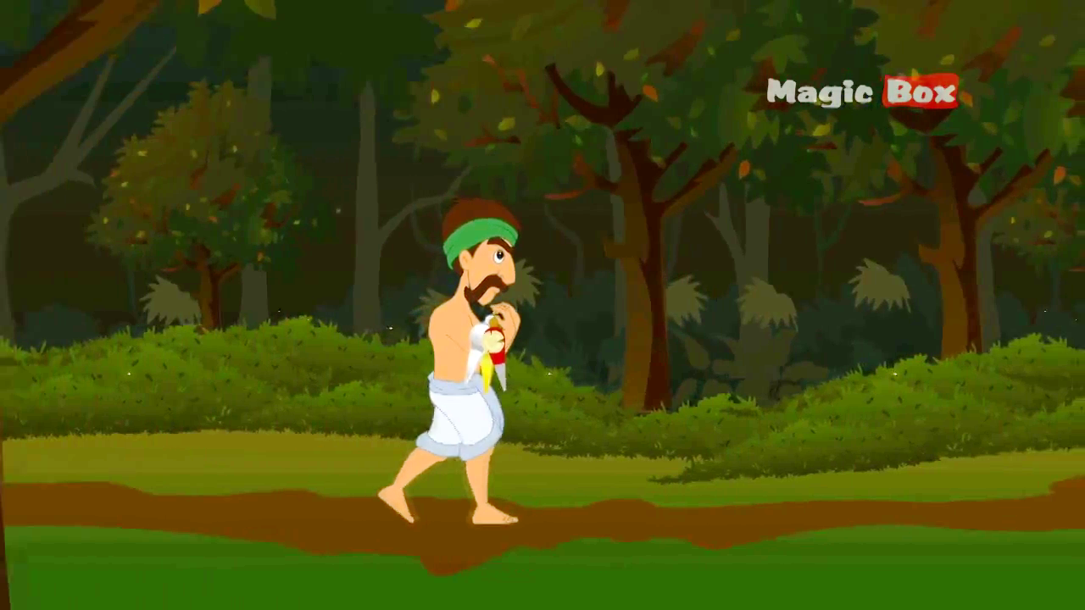
Do you know anything about this picture?

Slide 4
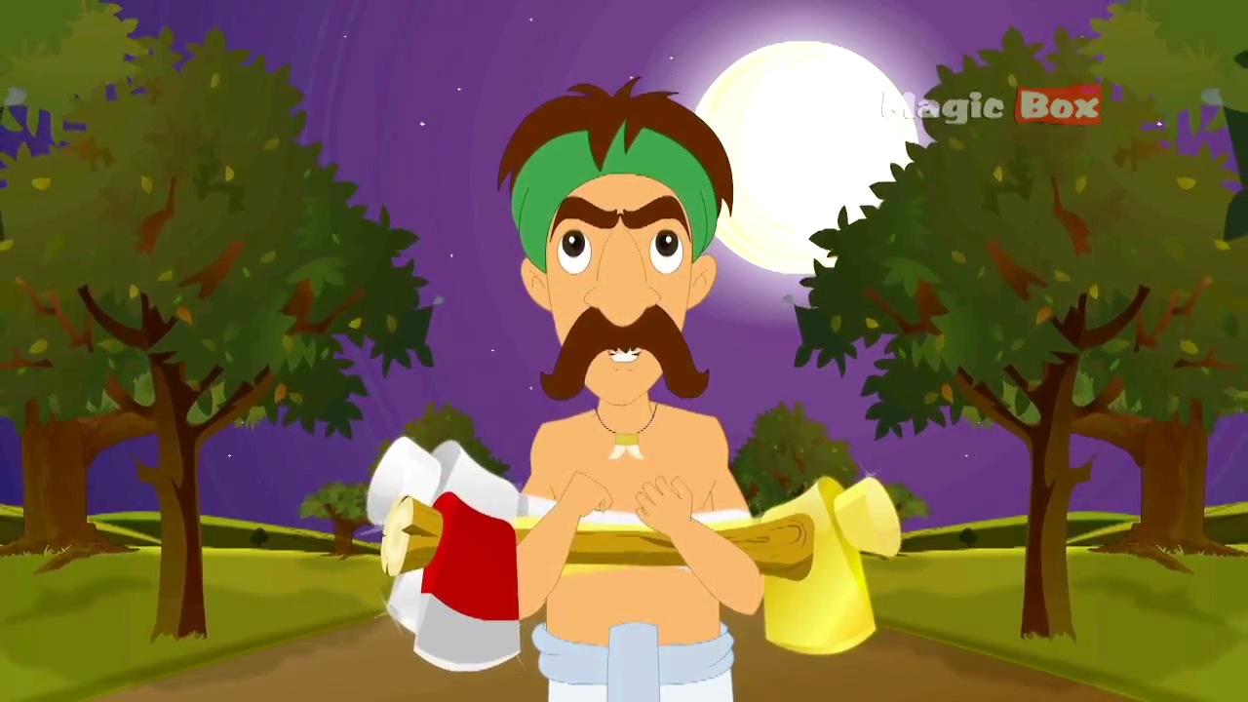
The wood cutter was awarded with all the three axes for his honesty.

Slide 5
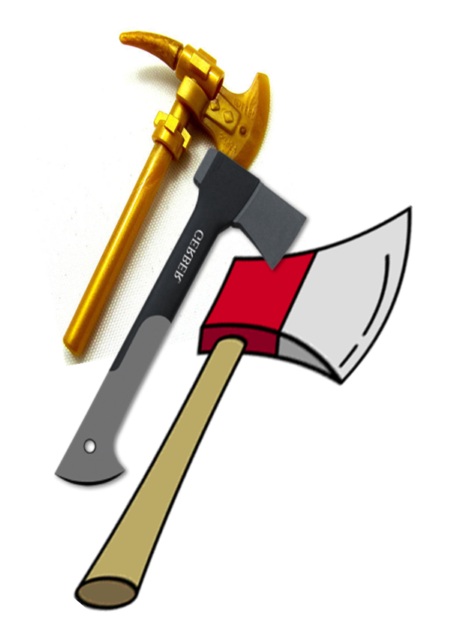
Follow
Axes
A material used for cutting.
A visible name of an object.

Slide 6
Follow
Honesty
Unseen
Name of a quality.
Invisible name
of a quality.

Slide 7
Can you guess what are we going to discuss today?

Slide 9
Learning outcomes
After we have studied this lesson, we will be able to ----
explain noun and its classifications
define the definition of nouns
identify nouns

Slide 10
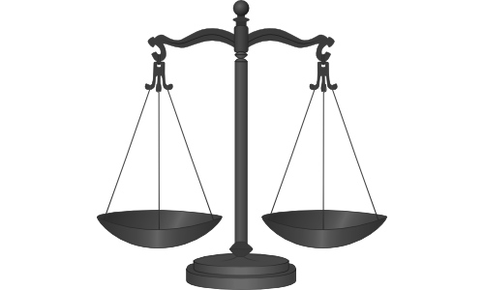
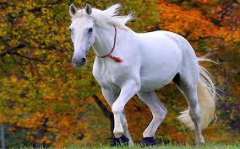
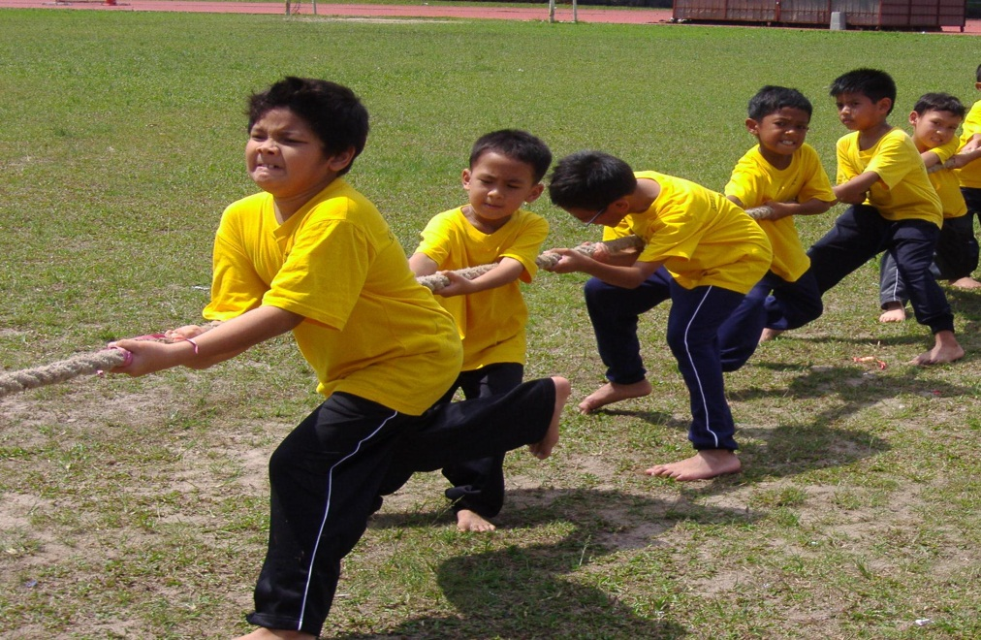
What kind of words have you observed?
Naming words
Honesty
Horse,
A noun is the name of anything.
Gold
Determination

Slide 11
Nouns are mainly classified into two kinds
Concrete Noun
দেখা যায়,ধরা যায়, ছোঁয়া যায় এমন সব নাম
Abstract Noun
গুণবাচক নাম যা দেখা যায় না, ধরা যায় না, ছোঁয়া যায় না

Slide 12
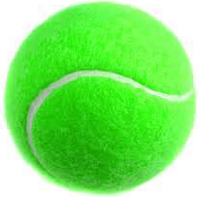
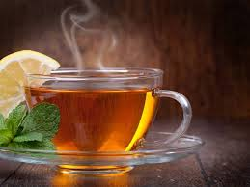
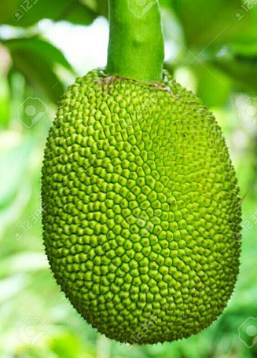
Make sentences with the pictures.
The ball looks green.
Tea refreshes our mind.
We like jackfruit very much.
Ball, tea and jackfruit are concrete noun.

Slide 13
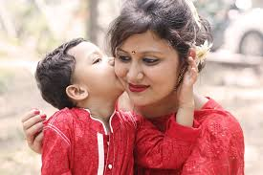
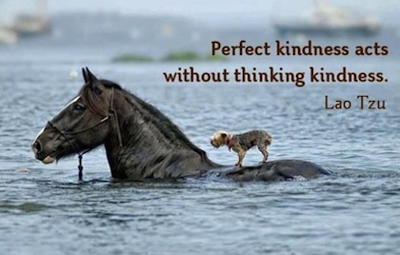
Explain the picture.
An abstract noun is a type of noun that has no physical existence.

Slide 14
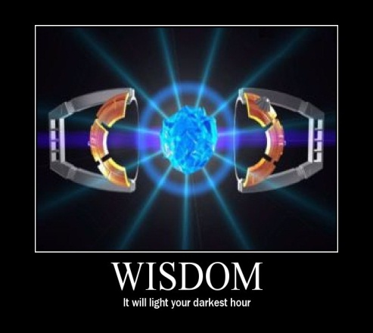
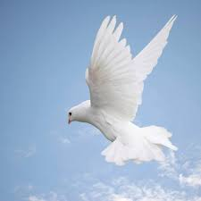
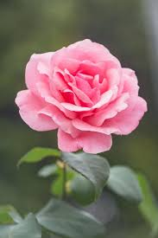
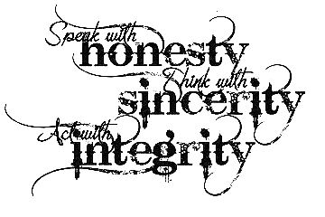
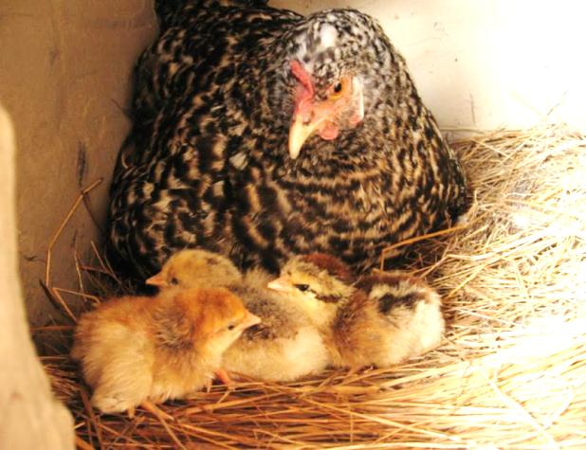
Identify concrete & abstract noun below.
Concrete
Abstract
Abstract
Concrete
Concrete
Abstract
Concrete
Abstract

Slide 15
Generally Abstract Nouns are formed with some suffixes like--------
ness
tion
hood
ship
kindness
preparation
boyhood
scholarship
ment
ce
th
ty
excitement
importance
depth
ability
and so on.

Slide 16
Pair Work
Identify the concrete and abstract nouns of the bold Italic words from the passage below.
Mother is the most blessing of Allah. Her love is divine. The kindness of mother is incomparable. She always takes care of her children. She provides her child with good foods, beautiful dresses. If her child falls in any danger, she stays in anxiety. A mother does her best for the betterment of her children. She always gives inspiration to her children to succeed in life. So we should take care of her cordially.

Slide 17
Evaluation
Answer the following questions.
What is concrete noun?
What is the main characteristic of concrete noun?
What do you mean by abstract?
How is abstract noun normally formed?
How can you recognize abstract noun?

Slide 18
Write down at least five examples / names of concrete and abstract nouns from your surrounding environment.

