Slide 1
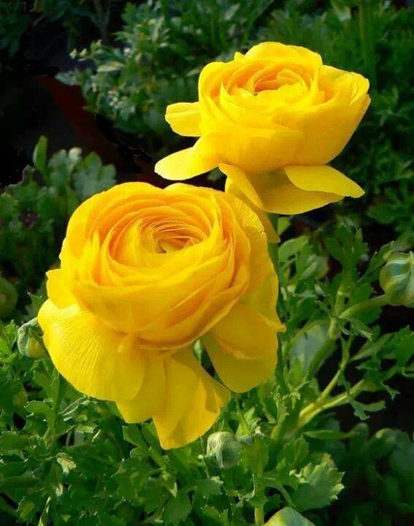
Welcome my English class

Slide 2
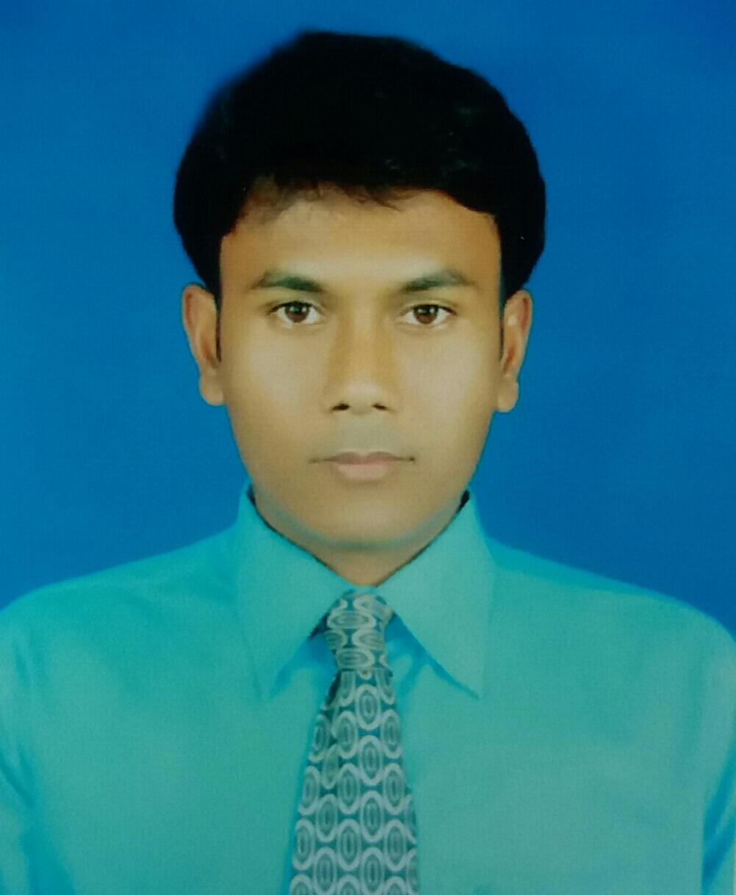
Narayan Biswas
Ass Teacher Ict
Faltita ssk Secondary School Fakirhat,Bagerhat.
Class:Ten
Sub:Eng-1st paper
Unit:one
Lesson:Two.

Slide 3
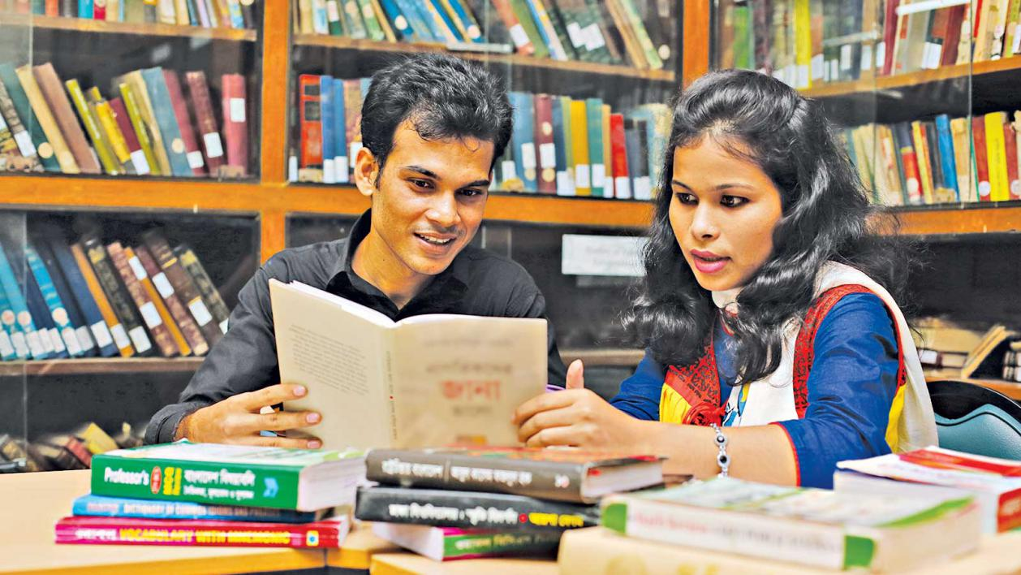
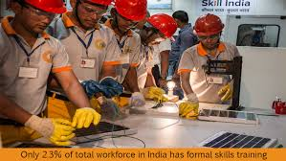
Look at the picture
knowledge
skill
Can you guess what may be our todays topic?

Slide 4
Knowledge, skill and attitudes

Slide 5
Learning outcomes
After completing the lesson,we will be able to------
read and understand texts through silent reading.
ask and questions.
some vocabulary .
fill in the gap.

Slide 6
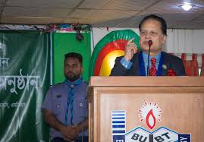
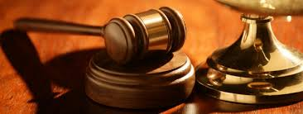
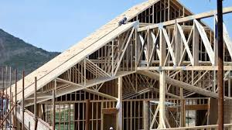
Executive
High official
Regarding justice
Legislative
Frame work
Structurees

Slide 7
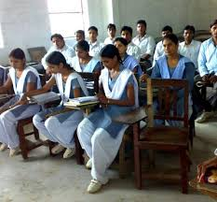
Silent Reading “Section-B”

Slide 8
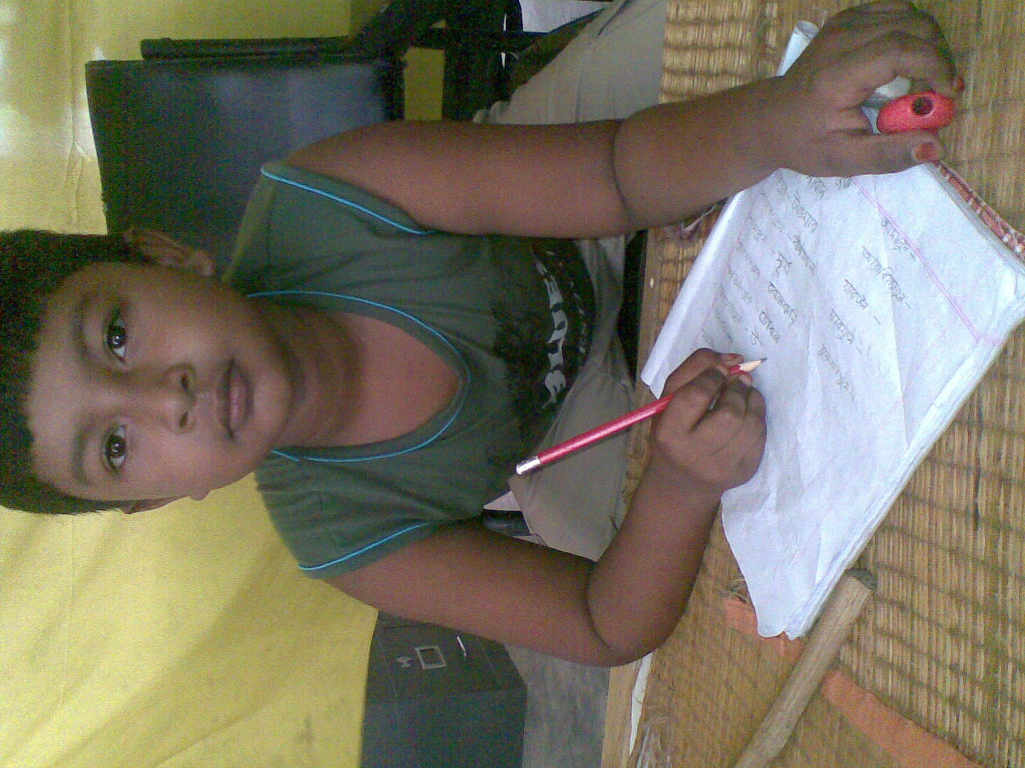
Today’s society is knowledge-based. Without having knowledge of modern sciences,technologies including ICT and other necessary subjects.

Slide 9
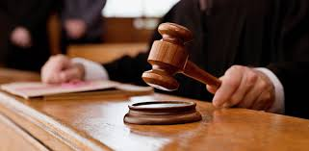
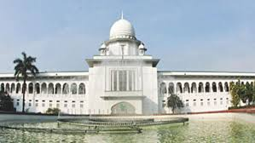
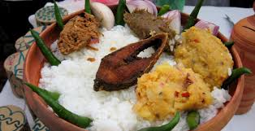
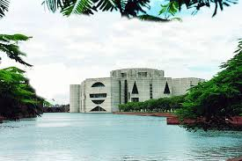
As a good citizen should have knowledge about are-----
Our state,its executive ,legislative power and judicial system.
Our government , its structure , function,history,culture and tradition etc.

Slide 10
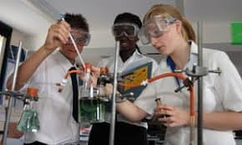
Second,you need skill to do things
Knowledge is not enough.You must be able to apply your knowledge to do things practically.

Slide 11
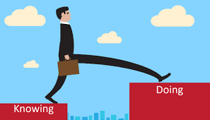
Finally, knowing and doing things.
Show your attitudes towards others, it will show how you think and feel about a person or thing.

Slide 12
Possible changes are----
You will develop the skill of speaking freely in English with your classmates and teacher.
Your shyness will gradually disappear.
You will learn to behave in a democratic way.

Slide 13
INDIVIDUAL WORK
1. What do you have to do to be a good citizen?
2. Why do you need skill?
3. What should you have knowledge about in class room?
4. What should a good citizen have?
5. Who is the right person to monitor and help you to do the group work?

Slide 14
Ans
We have to prepare ourselves to do good deeds in society to be a good citizen.
We need skill to apply our knowledge in practical situations.
We should have knowledge about group work in the classroom.
A good citizen should have a vast knowledge about his country,its constitutaion,people,history,culture and traditions.
Teacher is the right person to monitor and help me to do the group work.

Slide 15
Group Work
Read the following text and fill in each gap with a suitable word.
You need skills to do(a)------.(b)------ is not enough. You must be able to apply your knowledge to do things(c)------.Finally knowing and (d)-------things will bring about a change in your behavior towards(e)--------.
Ans: a) things; b) knowledge; c) practically; d) doing; e)other.

Slide 16
EVALUATION
1.To be a good citizen,we need---
i) Behavioural change; ii) skill; iii) knowledge; iv) all of them.
2.Knowing and doing things will bring about a change in your----towards other.
i) belief ii) sincerity; iii) behavior; iv) face
3.To be a good citizen you have to prepare yourself to do good work in---.
i) society ; ii) family; iii) madrasah; iv) relatives
4.There will be----change in your conduct through regular group work.
i) largely; ii) widely; iii) seriously; iv) noticeably.

Slide 17
Home Work

Slide 18
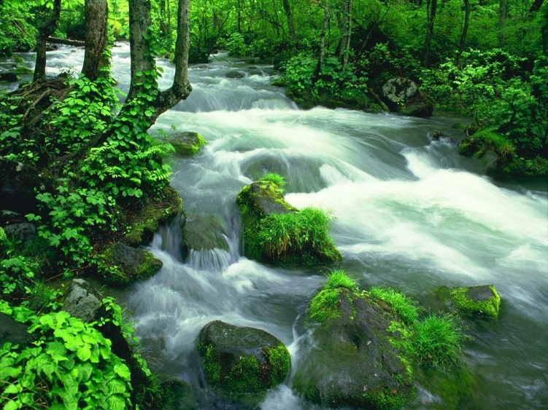
Bye Bye

