Slide 1
Welcome to my dear students.

Slide 2
IDENTITY
Md. Saidul Hoque
Assistant Teacher
Enayetpur Rahamotia Alim Madrash
Senbag, Noakhali.
Contact-0187229545
Email-saidul305844@gmail.com
English for Today
Dakhil: class seven
Unite: 4
Lesson: 6
Time: 45 minute
Date:11-12-2019.

Slide 3
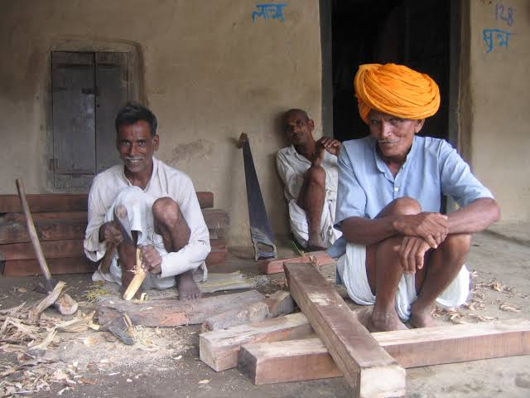
3.What does is say the those who build houses?
1.What do you thing about the picture?
Look at the picture?
2.What do they do?
They are name is Homemaker.

Slide 4
So dear, Todays lesson is-
The homemaker (1).

Slide 5
Learning Outcomes
After completing this lesson, Students will be able to--
1. A Family can tell what kind of work they need to do.
2. Describe the concept of outside work and home work. and
3. Tell you what a family does.

Slide 6
Word meaning and sentence making
Word | Image | Meaning
Community of people
Village
Sentence: A village is community of people no town.

Slide 7
word | Image | Meaning
Illiterate
Uneducated
Sentence: Someone who has not learned to read or write.

Slide 8
Word | Image | Meaning
Study
Read/learn
Sentence: Going to classes etc in order to learn about a subject.

Slide 9
Word | Image | Meaning
Repair
Renovate
Sentence: To fix something that is not working properly.

Slide 10
word | Image | Meaning
Another
Other
Sentence: The second of two thing or people.

Slide 11
Word | Image | Meaning
portion
some
Sentence: an amount something.

Slide 12
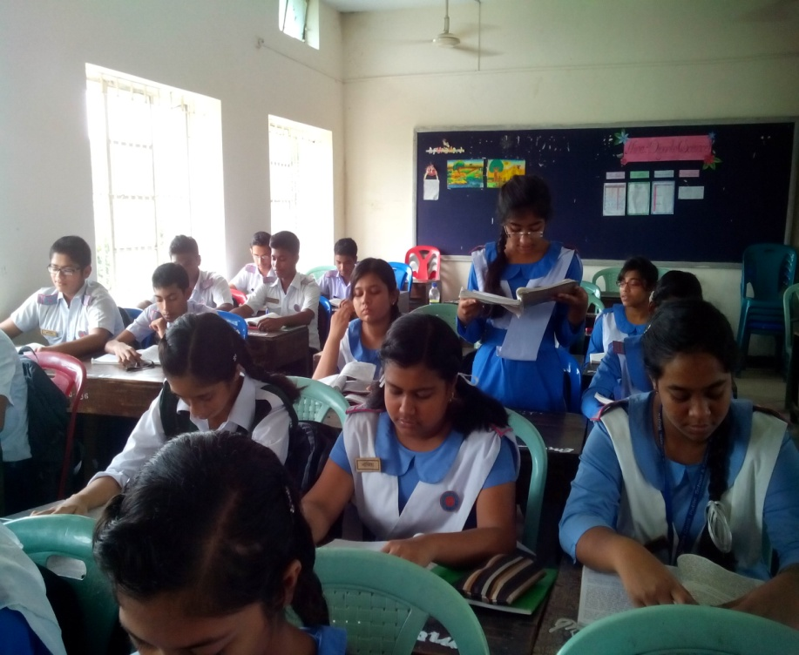
Loud/silent
Reading

Slide 13
Match the phrases/words with their meanings.
Live from hand to mouth | All the letters in a language
Rain or shine | A person who does not know how to read and write.
Alphabet | Spend all the money you earn on basic needs eg, foods and cloth-you cannot save any money.
Illiterate | In good or bed weather.
Phrases/words
Meanings

Slide 14
Fast discuss in groups and then write an answer to this question:
What do you think is the reason why Hafiza and Mitu do not go to madrasah?

Slide 15
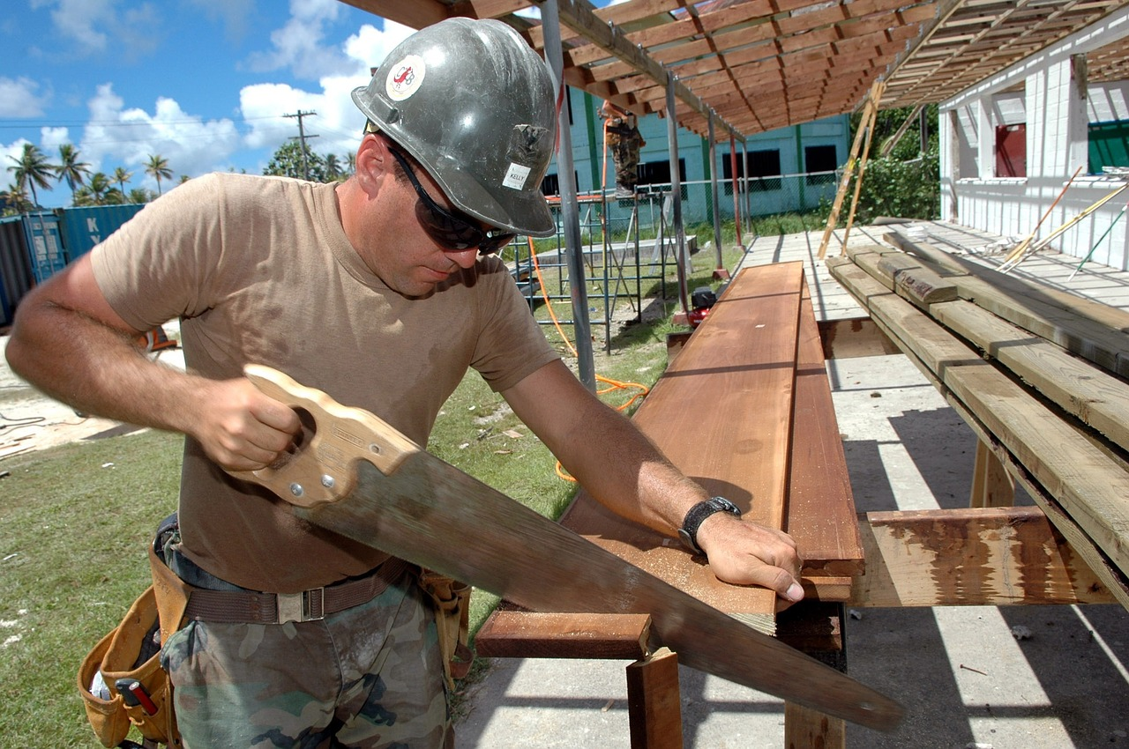
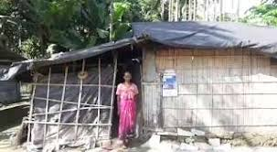
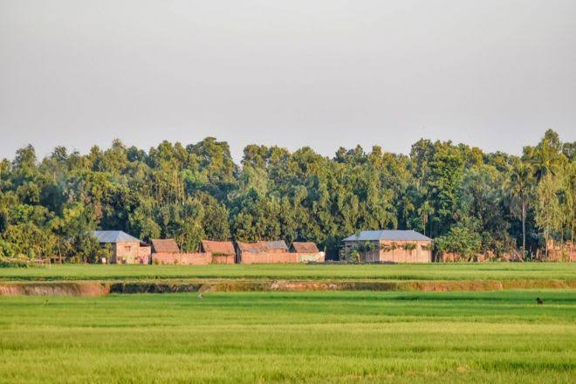
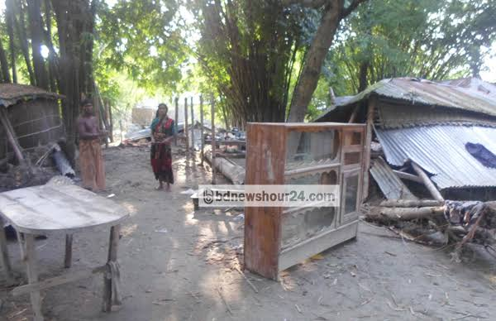
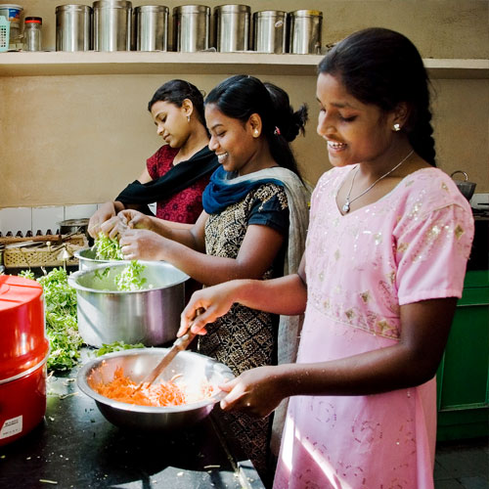
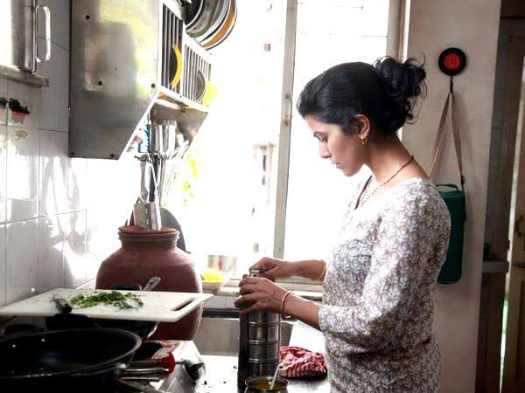
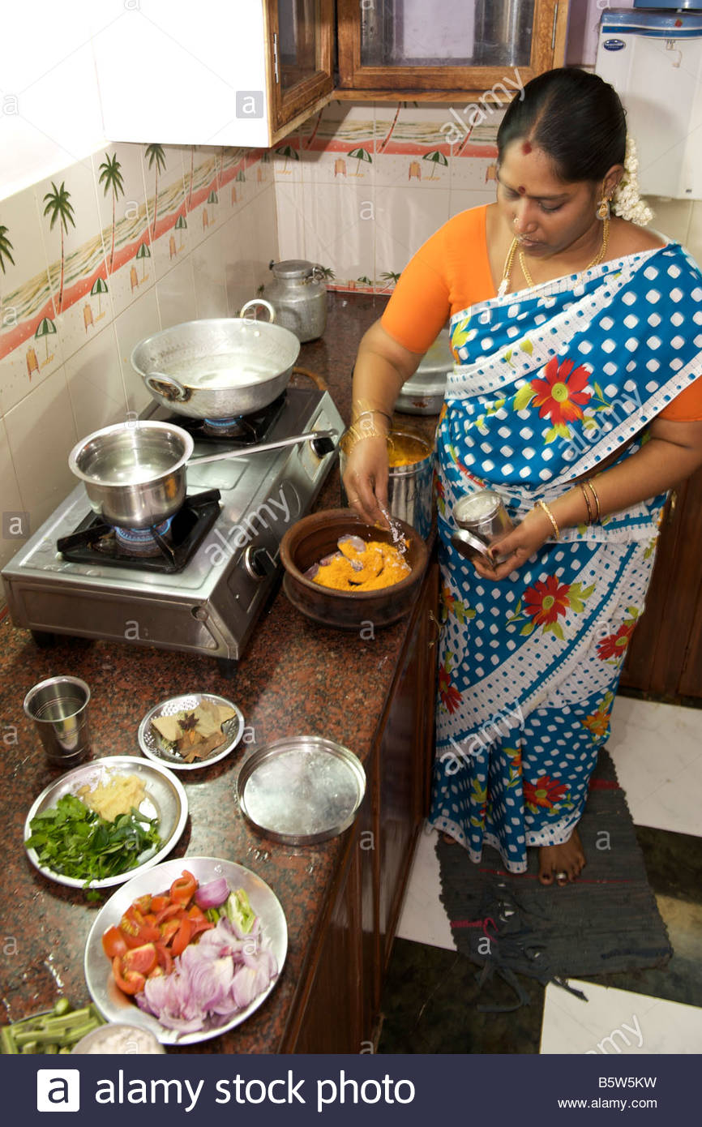
Evaluation
Look at theses picture and answer the following question---
Where do you think the family lives?
Here is what the girls are doing in the kitchen?
What is doing the woodworker?

Slide 16
House work
Write Substance of read in the text.

Slide 17
Thanks all are students
See you again

