Slide 1
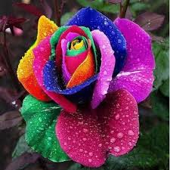
Welcome my dear student

Slide 2
MD. MASUD RANA
ASISSTANT TEACHER
BROMMAPUR GOVT. PRIMARY SCHOOL
HARIPUR , THAKURGAON
Sub: English
Class: Two
Lesson : Numbers (1,2,3,4)
Parts of the lesson: Activity-C
(Page No-4)

Slide 3
Let sing a song……….
Good morning,
good morning

Slide 4
Pevious lesson justify

Slide 5
Our today’s lesson is too–
Numbers-1,2,3,4
Activity-C

Slide 6
At the end of the lesson students will be able to know-------
Speaking: 1.1.1 repeat after the teacher simple words and phrases with proper
sounds and stress.
Reading: 2.1.1 recognize and read cardinal numbers up to 30.
Writing: 2.1.1 write cardinal numbers up to 30 in figures.

Slide 7
What is this?
What are these?
1
How many marble is there?
2
How many flowers are there?
3
How many cups are there?
4
How many kites are there?

Slide 8
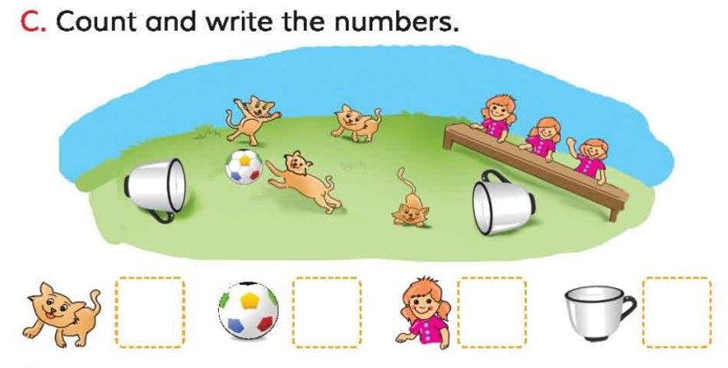
Open your English book at page-4 and see the Activity- C
What do you see in the picture?
4
1
3
2
How many cats are there?
How many cups are there?
How many dolls are there?
How many balls is there?

Slide 9
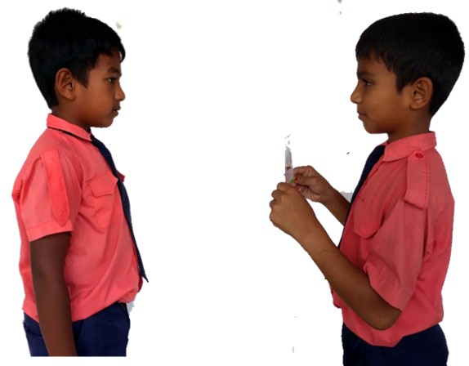
Pair work
How many ----------?
One more.

Slide 10
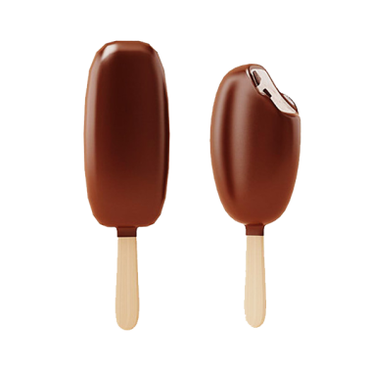
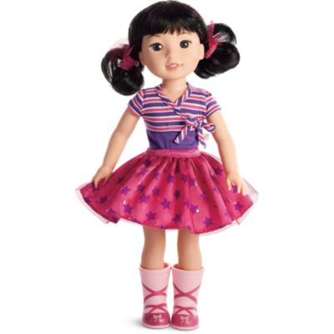
Group work
Count and write the numbers in figures and in words.
1- one
2- two
---------- girl
--------- ice-creams
--------------bats
------------ flowers
4- four
3- three
Let’s see the right answers.

Slide 11
Read and say.
three
one
four
two
four
two
three
one
three
one
four
two
four
two
three
one
Identifying weak students and taking to cure.

Slide 12
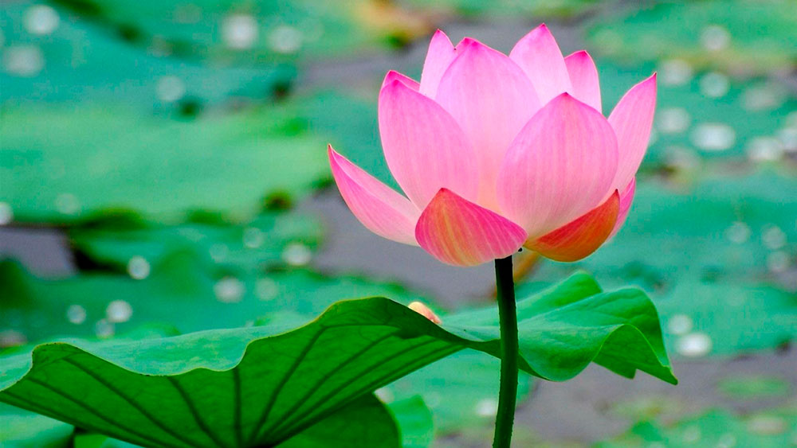
Find out the letters that are made by the word-------.
h
o
d
a
u
x
f
k
n
r
Find out the right word--------.
for
fore
four
force

Slide 13
Say the missing letter.
fou-
-our
f-ur
fo-r
ফোর
চার

Slide 14
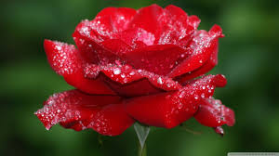
Thankyou

