Slide 2
Welcome to My Class

Slide 3
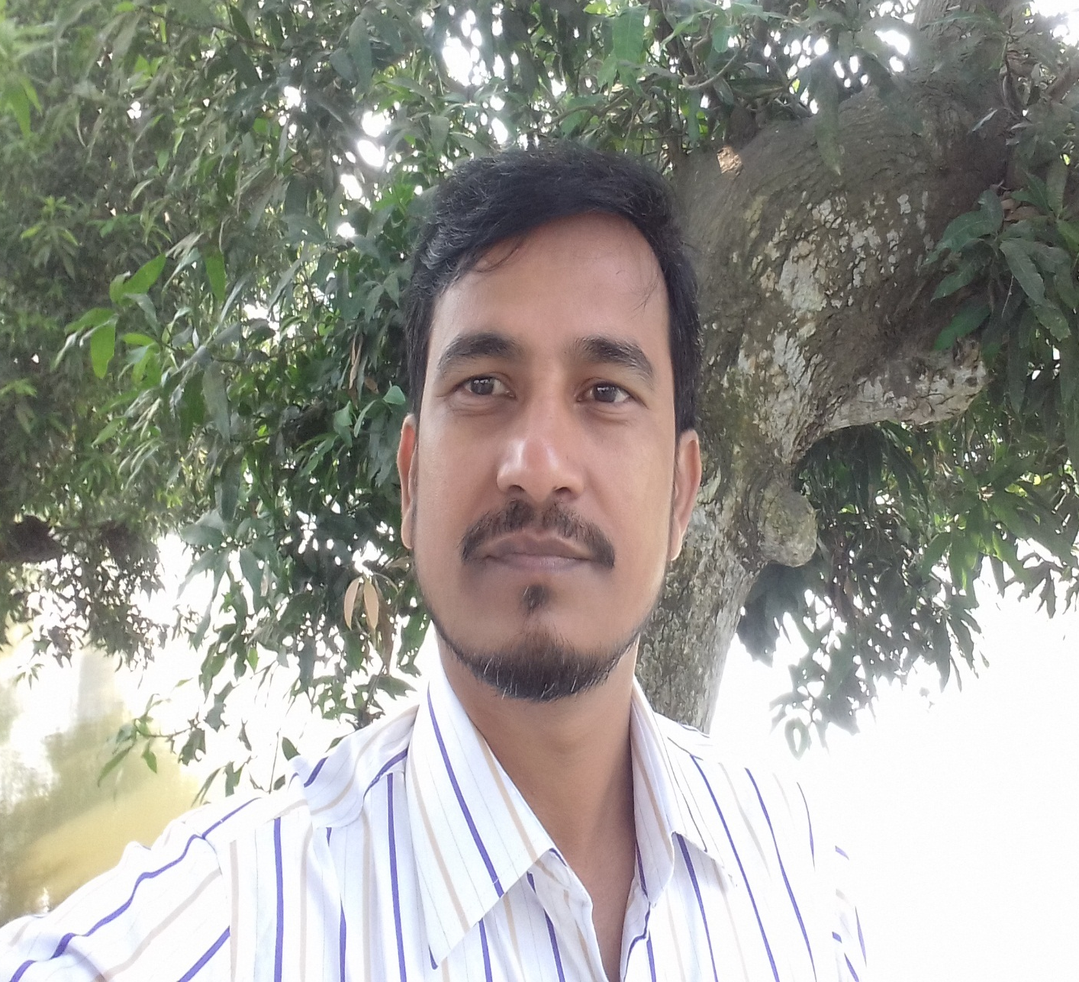
Let me introduce myself
Abdul Latif
Lecturer in English
Alauddin Siddique College
Kalihati, Tangail

Slide 4
Look at the following sentences
1. The crow tried to drink water from the jar.
2. Deforestation means cutting down trees indiscriminately.
3. It is important for us to lead a healthy life.
4. He went to market in the morning.
5. A tiger killed by the hunter was left in the jungle.

Slide 5
Declaration of the Lesson
Uses of Post-modifiers

Slide 6
Learning Outcome
After finishing the lesson the students will be able to use different types of post-modifiers in the sentences

Slide 7
Present participle and Present participle phrase as post -modifier
1. The flowers having petals look beautiful.
2. The birds flying in the sky look very attractive.
3. the latrines standing on ponds and rivers cause water pollution.
4. The man waiting at the door is a beggar.

Slide 8
Past Participle and Past Participle Phrase as Post -modifier
1. I saw a man injured by an accident.
2. The bridge destroyed by floods has been rebuilt.
3. He has got the money sent by his father.
4. The build constructed fifty years ago collapsed yesterday

Slide 9
Infinitive and Infinitive Phrase as Post-modifier
1. They left for town to earn money.
2. The old man was the last man to leave the village.
3. He was eager to hear the news
4. The boys went out to play football.

Slide 10
Appositive as Post-modifier
1. Abdul Kader, the principal, presided over the meeting.
2. Shakespeare, a great dramatist, was born in England.
Adverb as Post-modifier
1. Drug addiction has grasped the young generation seriously.
2. The tortoise walked slowly.

Slide 11
Nominal Clause as Post-modifier.
1. Our hope that he would come back soon proved false.
2. The idea that he was dishonest was wrong.
Prepositional Phrase as Post-modifier
1. He goes to college in the morning
2. The sun rises in the East.

Slide 12
Evaluation
to attend, cutting, the king, in the evening, made in Japan
1. The cunning fox invited all the foxes -------(use infinitive)to a meeting.
2. We must stop ------ (use present participle) down trees.
3. One day Robert Bruce,-----,(use appositive) was lying in a cave.
4. They went there----------- ( use prepositional phrase).
5. Hand watches -------- (use past participle phrase) are very popular.

Slide 13
Home Work
Practice the Uses of Post modifiers at Home

Slide 14
Thank You All
No More Now

