Slide 1
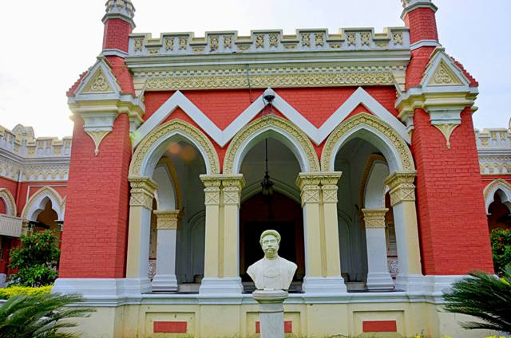
WELCOME TO MY DEAR STUDENT

Slide 2
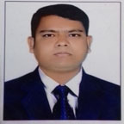
Introduction
MD. SHARIF HOSSEN
Asst. Teacher in English
Bataichhari High School
Barura, Cumilla
Class-VI
English 1st Paper

Slide 3
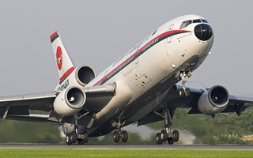
Let`s enjoy a video clip
Click here

Slide 4
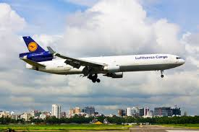
Sir, I mean varieties classes men are the passengers of this Biman. Such as Govt. officers, business man, students, Patients, tourists and our wage earners.
Can you imagine who are the passenger of this Biman?

Slide 5
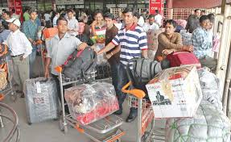
LESSON DECLARATION
OUR WAGE EARNERS

Slide 6
Learning outcomes
After completing the lesson students will be able to -
read and understand texts
infer meaning from context
ask and answer questions
Participate in short dialogues and conversations on familiar topics

Slide 7
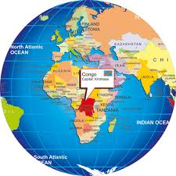
Our wage earners work in many countries in the world they are mainly United Arab Emirates (UAE), Oman, Qatar, Bahrain, Kuwait, Iran, Iraq Jordan, Syria, Egypt, Libya, Malaysia United Sates of America (USA), Canada, Australia, Singapore, New Zealand, United Kingdom and many other European countries.

Slide 8
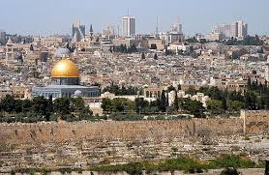
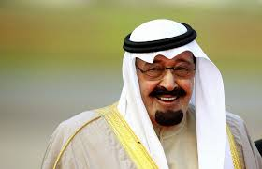
Saudi Arab - UAE

Slide 9
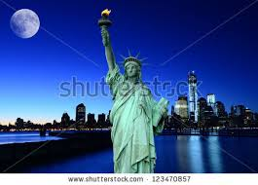
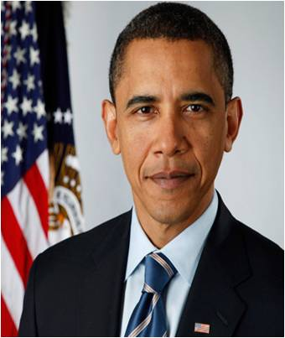
America - USA

Slide 10
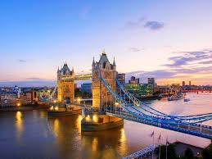
England - UK

Slide 11
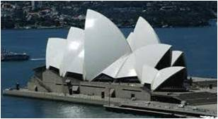
Australia

Slide 12
Kuwait

Slide 13
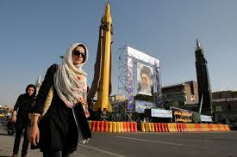
Iran

Slide 14
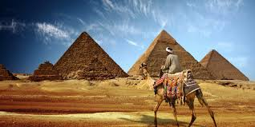
Egypt

Slide 15
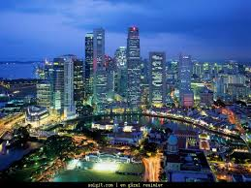
Singapore

Slide 16
Model reading
Dear students, listen the text attentively then go to Section B1 and complete column B of the following table with the information from the text .

Slide 17
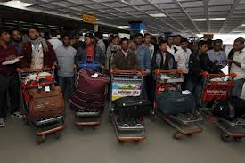
Wage earner
Key word
They are wage earners coming form abroad.
Meaning
(Click here)
Who earn money.

Slide 18
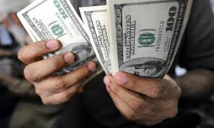
Remittance
Key word
Our wage earners send remittance to their family that increase our economical condition.
Meaning
(Click here)
allowance

Slide 19
Immigration
Key word
They are migrated to the USA, the UAE and other countries .
Meaning
(Click here)
Migration (go to another country).

Slide 20
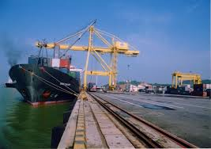
Export
Key word
Bangladesh has started export rice to Srilanka.
Meaning
(Click here)
Send to other countries

Slide 21
Silent reading.
Go to the text, Section ‘B’ . Work in pairs,. Ask and answer the following question first. Then read the text to match your answers.
# Do you know how many Bangladeshis work abroad ?
# Do you know what countries they work in ?
# Can you guess how hard they work ?

Slide 22
Pair Works
Make five meaningful sentences from the table.
A large number of | Is created | abroad only in May.
Nearly 73 thousands jobseekers | Wage earners abroad was | abroad for job
Remittance from Bangladesh | Skilled | In Malaysia too.
In May 2012 a large number of | Bangladeshi | US D 11.76 billion in May 2012.
The scope of manpower | Went | professionals also migrate to the USA.

Slide 23
HOME WORK
Make a dialogue between you and your partner about the importance of professionals skills for our wage earners.

Slide 24
THE END

