Slide 1
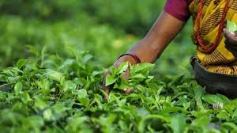
WELCOME

Slide 2
TEACHER’S IDENTITY
NAME: SHAMSUDDIN.
SENIOR TEACHER.
Mob.01767264934
VEDURIA SERAJIA FAZIL MADRASAH.
LALMOHAN,BHOLA.

Slide 3
OUR TODAY’s LESSON
A PARARGRAPH ON
PRICE HIKE’

Slide 4
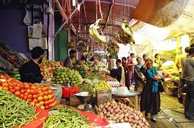
What is price hike?
Price hike means a sudden increase in the cost of dailiy commodities.It is one of the main problems in the third world countries.The people of Bangladesh often face this problem.

Slide 5
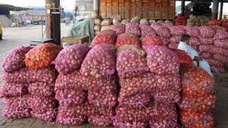
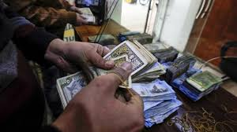
The causes of price hike
There are many reasons for price hike.Firstly,insufficient production is resposible for price hike.Secondly,It is caused by some dishonest businessmen.They stock commodities and create scarcity . They create artificial crisis and sell them at high price.Price hike is also caused by devaluation of money.

Slide 6
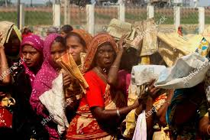
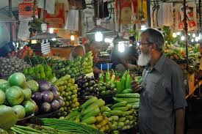
The impact of price hike
The impact of price hike is very dreadful .It is a serious problem for the middle and low class people.The day labourers can not lead their lives properly.Even the service holders have to suffer a lot.It affect the consumers.On the other hand ,those dishonest businessmen become rich overnight.

Slide 7
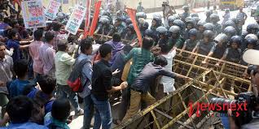
The way to get rid of it.
Now the problem is out of control.The situation can not go on.The government should take effective step to control price hike .The authorities can form monitoring cells.The law enforcing agencies should work more effectively. The dishonest businessmen should be given punishment .Besides all of us should work hard to become self sufficient of food.Patrotitic feeling should be awakened among us.Thus price hike can be controlled.

Slide 8
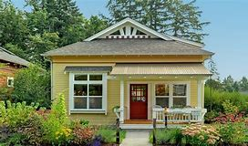
HOMEWORK
Write a paragraph on-----------
Price hike.

