Slide 1
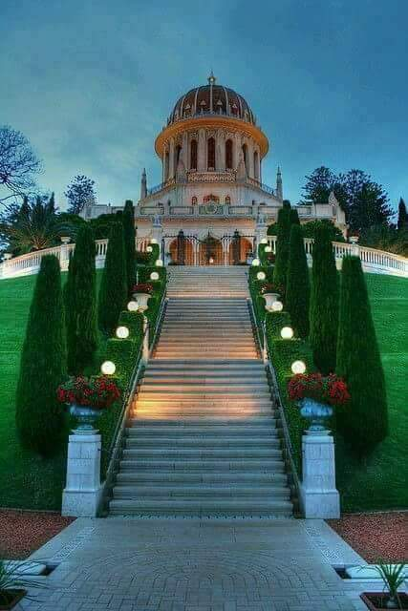
WELCOME TO ENGLISH CLASS

Slide 2

INTRODUCTION
MD. ANISUL HAQUE
ASSISTANT TEACHER (ENGLISH)
JAFARGONJ SCHOOL & COLLEGE
UTTAM (HAZIRHAT)
MAHANAGAR, RANGPUR.
anis127299@gmail.com
Class-7
Unite- 01
Lesson -5 : At the bookshop

Slide 3
Learning Outcomes
After completing the lesson students will be able to-
1.
Ask and answer questions with a book seller using proper stress, intonation and pronunciation.
2.
Follow verbal English, understand and follow sequences.
3.
Ask & answer questions.

Slide 4
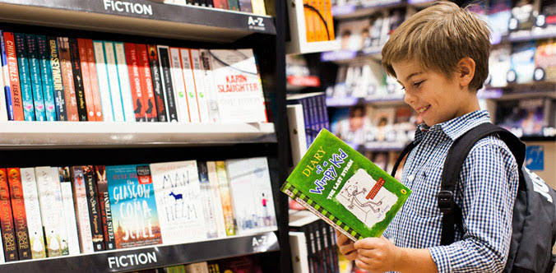
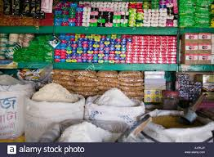
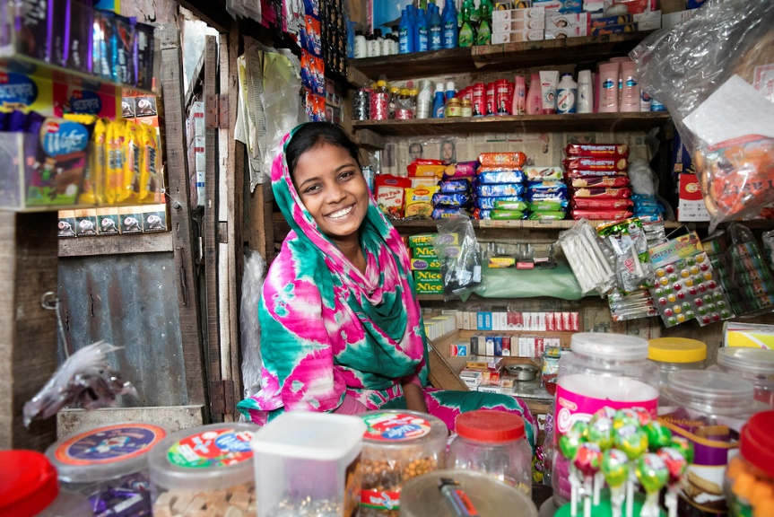
Look at the pictures and answer the following questions:
What are they?
Bookshop
Departmental store
Grocery shop

Slide 5

Todays Lesson is – “At the Bookshop”

Slide 6
Look at the pictures and answer the following questions:
What are they?
Bookshop
Departmental store
Grocery shop

Slide 7
Look at the picture and answer these questions.
1 What is it?
2 Where can you find it?
3 Is there a bookshop near your house or school or in your upazila / town? Tell
about it.
4 Can you guess what the people in the picture are talking about?

Slide 8

Listen to the CD and answer the following questions.
1 What do you mean by ‘in stock’ and ‘out of stock’?
2 Who are talking in this conversation?
3 Where is the conversation taking place?
4 How many books does the student want?
5 What books does he want to buy?
6 How much do the books cost?

Slide 9
Work in pairs. One of you is a customer and the other is a shop assistant.
Make a dialogue saying the following sentences in the right order. Then write the dialogue in your notebook and act it out.
• Thanks
• Hello. Can I help you?
• Yes. An eraser too.
• Fifteen taka, please.
• Here you are.
• Sure. anything else?
• Here is the money.
• How much?
• Can I have a pencil?

Slide 10
WRITE A PARAGRAPH ON “SCHOOLLIBRARY”
HOME WORK
THAKS ALL
SEE AGAIN.

