Slide 1
WELCOME

Slide 2
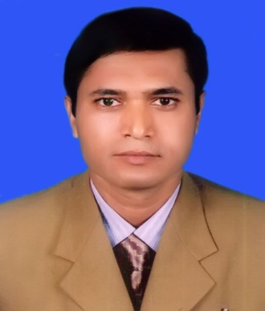
Identity
MD. MONSUR AHMED (M.A- B.Ed) ASSISTANT TEACHER (ICT) CHANDPUR NURIA HIGH SCHOOL PURAN BAZAR, CHANDPUR. MOB: 01673341343 E-mail: monsuratc@gmail.com
English For Today
Class : Six.

Slide 3
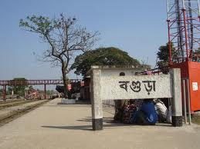
Today`s topic
Lesson- 3
At a Railway Station

Slide 4
Learning outcomes
After completing the lesson students will be able to…
➢Learn Vocabulary
read and understand texts
Talk about people, places and familiar objects in short and simple sentences
Write paragraph, letter, compositions.

Slide 5
Let`s enjoy a video.
A railway station
Notes:
showing the video teacher can try to elicit the answer then he will give feedback.

Slide 6
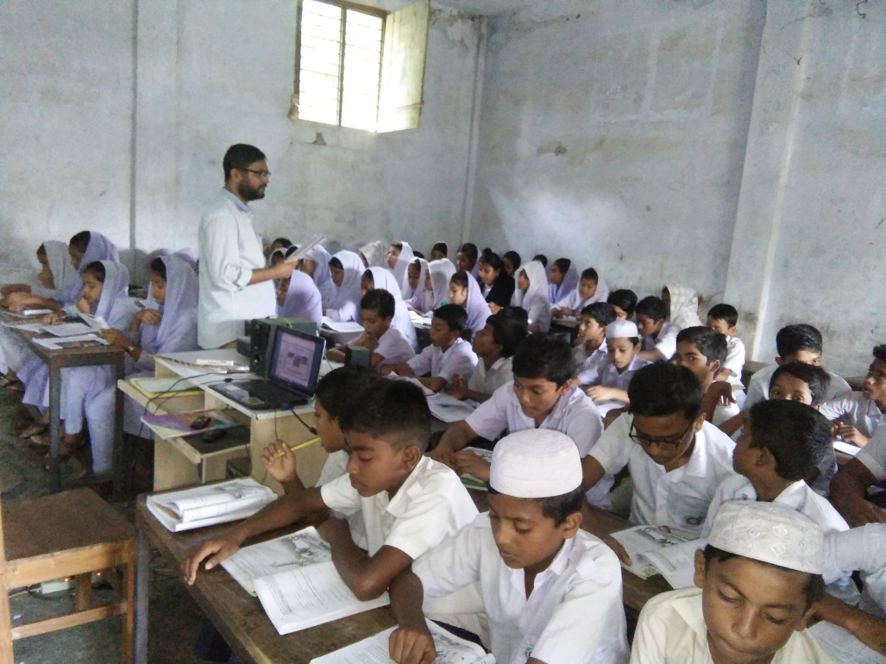
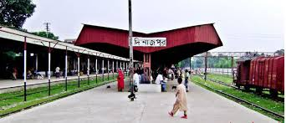
Listen the text attentively then talk with your partner about what the speaker saw and did at the railway station. Use your own words.
Notes:
Teacher will read the text.

Slide 7
WORDS MEANING
See off
I came to see him off.
Good Bye / Bid farewell

Slide 8
Queue
They are standing in the queue for vote.
Line

Slide 9
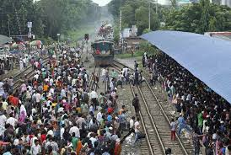
Crowded
There are very crowded in the station.
Density of people.

Slide 10
Couple
An old couple is waiting for train.
Pair

Slide 11
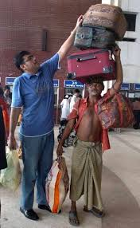
Luggage
A man is carrying his luggage.
baggage

Slide 12
Similar and opposite words.
Main Word | Similar Word | Opposite Word
See off | Goodbye | Receive
Long | Far | Short
Quiet | Silent | Busy
Heavy | Weight | Light
Pick up | Take off | Drop
Young | Youth | Old
Now go to the section - A2 and match the words.

Slide 13
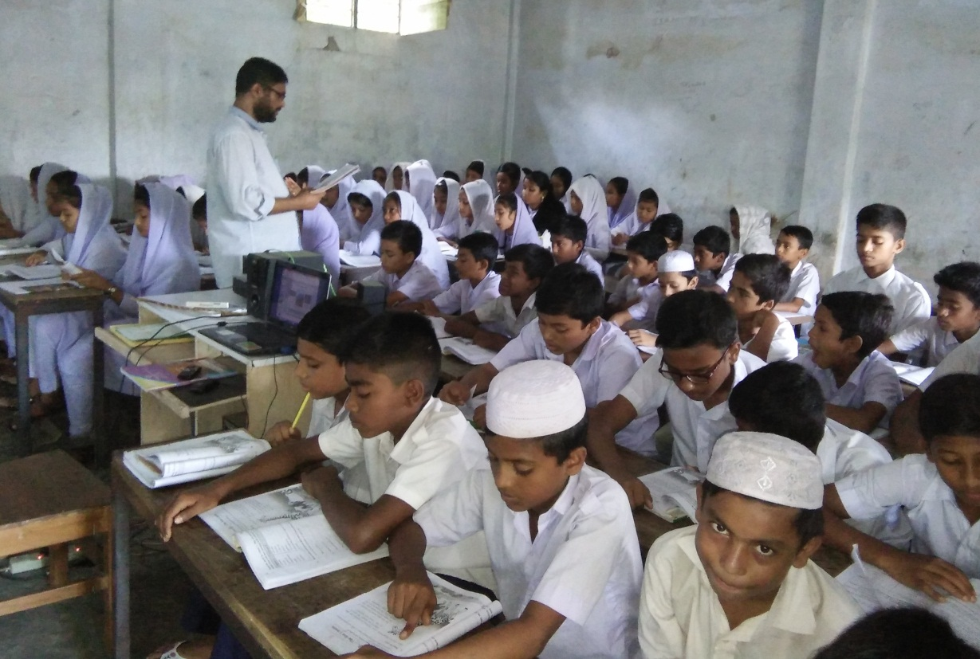
Silent reading
Now go to the next slide and fill in the gaps.
Notes:
Teacher will monitor and help the students.

Slide 14
Individual work
Fill in the gaps with the word from the box.
Once the writer and his friend were (a) ---------- the station. They were (b)--------- for the train. His friend © --------- was going to Dhaka and he came to see him (d)--------. He found the station very (e) ------- . There was a long line of people at the (f) -------- . A woman in the line (g) -------- her child tightly. The writer also saw a group of (h) ------ people was talking and taking tea. There was a (i) ------- of old people trying to find a resting place. Another passenger a young (j) ------- was sitting on her luggage and reading a magazine.
Lady
held
waiting
room
crowded
long
young
at
Sajjad
couple
Ticket counter
off
Notes:
At first students will try to fill in the gaps individually. then teacher compare with their answers.

Slide 15
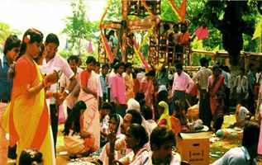
Pair Works
Suppose you went to the place of below.
Describe what you saw, what was happening and what you did there. within five sentences about it.
A Village Fair

Slide 16
Home works.
Visit your local railway station and write down ten sentences on it.

Slide 17
THANK YOU
SEE YOU AGAIN NEXT CLASS

