Slide 1
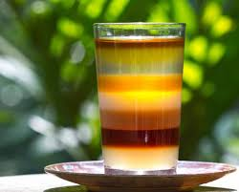
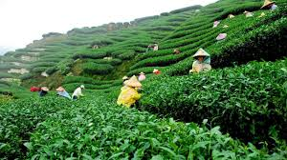
Welcome

Slide 2
Teacher
Name :Siddiqur Rahman
Assistant teacher
66 no Alhaj Ali Akbor mal Govt Primary school.
Damudya,Shariatpur

Slide 3
Learning out comes
By the end of the lesions
Students will able to:
1.3.1:recognize which word in a sentence are stressed.
4.2.1:understand and enjoy simple stories.
1.1.1:say words phrases, with proper sounds and stress.

Slide 4
Introduction of the lesson.
Class: five
Sub:english
Lesson:26 Page:91
Unit :

Slide 5
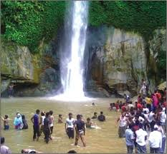
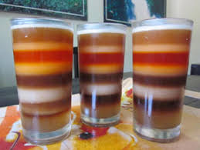
Let’s see some picture
What do you see in the picture?

Slide 6
Our todays
Lesson is
it was a great day

Slide 7
Word meaning
Camporee=
Travel=
Weather=
Prepare=
Visit=
a camporee is a gathering of cubs
Vsit ,
climate
ready ,
look after

Slide 8
Teacher loud reading

Slide 9
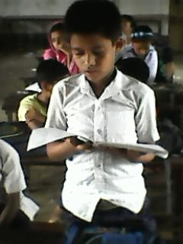
Student’s loud reading

Slide 10
Students Silent Reading

Slide 11
Pair work
What’s the cub campore?

Slide 12
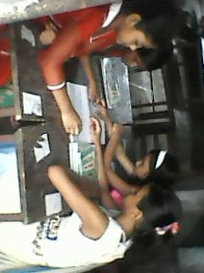
Group work
Group -1
How was the nest day?
Group -2
What’s the cub camporee?

Slide 13
Whole Class Work
1) How was the next day ?
Amazing b)interesting c)Horrible
d) important.
2) How does the garden look?
a) yellow b) red c) green d) white.
3) What is scout ?
a) A social organization b) A govt. organization c) A non-govt organization
4)How did The programme end with ?
a) sing b) dance c) play d) bonfire and scout oath.
5) Where is the Lauachara forest ?
a) In Dhaka b) In Narsingdi c) In Hatia d) In Srimangal.

Slide 14
Evaluation
1) Why was the next day interesting?
2) What is the Nilkontho Tea Cabin ?
3) What is the passage about ?
4) How does the tea garden look ?
5) What was the next day ?

Slide 15
Home work
Write a small paragraph about Your experience of a great day.

Slide 16
Thanks to all

