Slide 1
Good morning

Slide 2
Mental Preparation

Slide 3
What is your name?
What class do you read in?
What is your father’s name?
What is he? What is your mother’s name?
What is she?
Ackowledge

Slide 4
Class : Five
Subject : English
Unit : 3
Lesson : 1-2

Slide 5
Students will be able to :
Listening:
3.2.1 understand questions about family and friends about students.
3.4.1 understand statements made by teacher and students.
Speaking:
1.1.1 say words, phrases and sentences with proper sounds and stress.
1.1.2 say sentences with proper intonation.
Reading:
1.5.1 read words, phrases and sentences in the text with proper pronunciation, stress and intonation .
1.7.1 read paragraphs ,letters and other texts.

Slide 6
Look at the following picture and discuss with your partner what you can see.

Slide 7
Today we are going to read –
Saikat’s family.

Slide 8
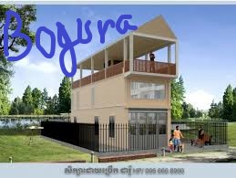
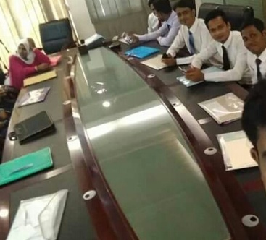
New words- Flat,Banker,Music,Sewing,Order, Neighbours
Flat---a building
Banker---he who works in a bank
Music------song

Slide 9
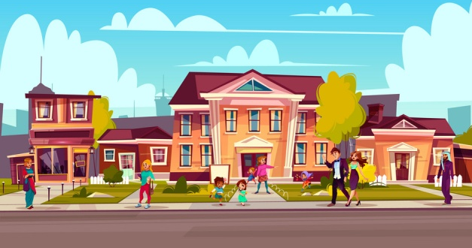
Sewing----making dress
Order-----agree to buy
Neighbours----a person who lives near

Slide 10
Open your book at page 10
Find out the new words

Slide 11
Listen to me carefully and read after me
Saikat Islam lives his parents in a flat in Bogura.
Saikat

Slide 12
His father Mr. Rashidul Islam is a banker . But in his free time Mr. Islam writes stories and listens to music.
Rashidul Islam
Saikat’s mother is Mrs. Monwara Islam . She is a housewife . In her free time she enjoys sewing . She makes dresses . She often gets orders from her friends and neighbours .
Monwara Islam

Slide 13
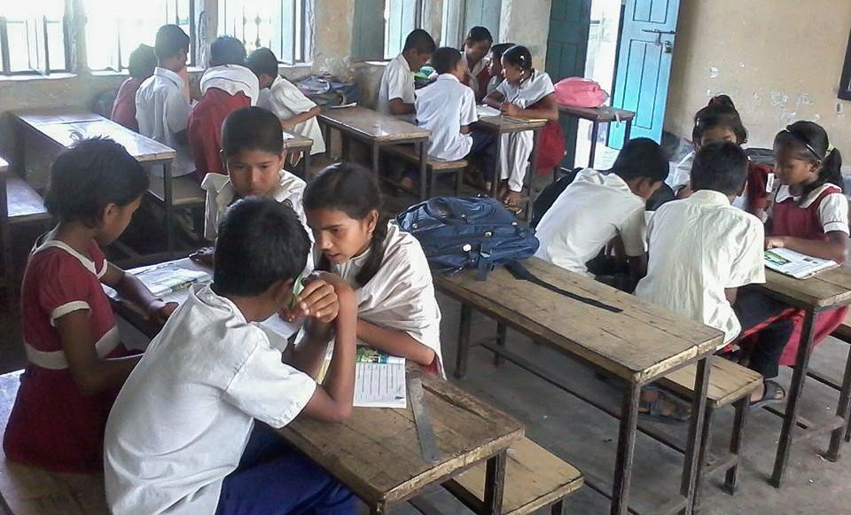
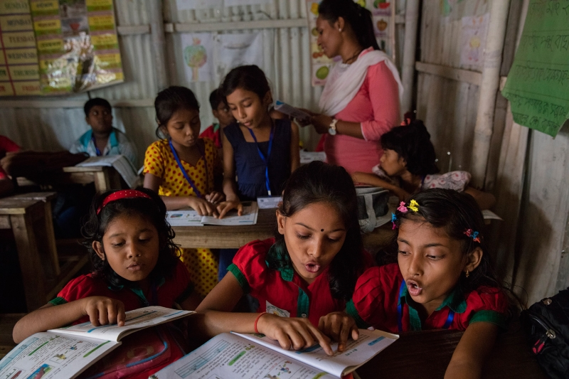
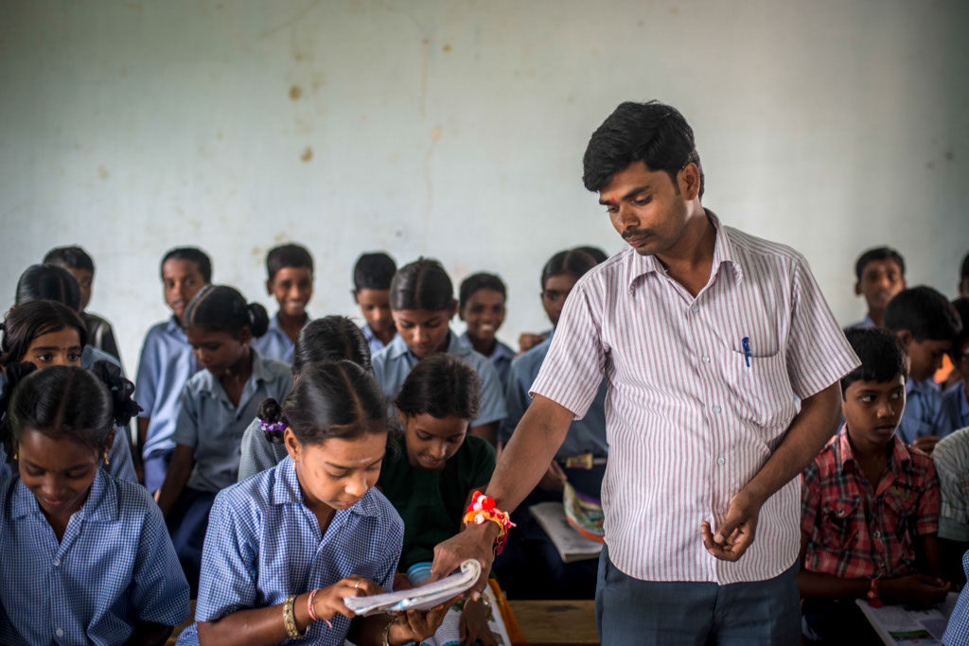
Group Reading
Pair Reading
Indivitual Reading

Slide 14
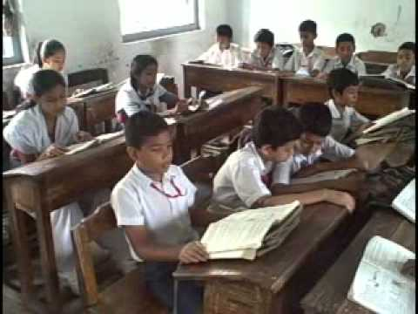
Read the text silently

Slide 15
Match column A with column B in group
column A | column B
Parents | 1.Tale
Story | 2.Leisure
3. Housewife | 3.Father and mother
Free time | 4.Garments
5. Dress | 5.Home maker
column A | column B
Parents | 1.Father and mother
Story | 2.Tale
3. Housewife | 3.Home maker
Free time | 4.Leisure
5. Dress | 5.Garments

Slide 16
Write the following questions in pair .
1.What is Saikat’s father’s name?
2.What is Saikat’s mother’s name?
3.What do his parents do in their free time?
1.Saikat’s father’s name is Mr.Rashidul Islam.
2. Saikat’s mother’s name is Mrs.Monwara Begum.
3.Saikat’s father writes stories and listens to music and her mother enjoys sewing in free time.

Slide 17
Write individually a paragraph on Saikat family in 5 sentence.

