Slide 1
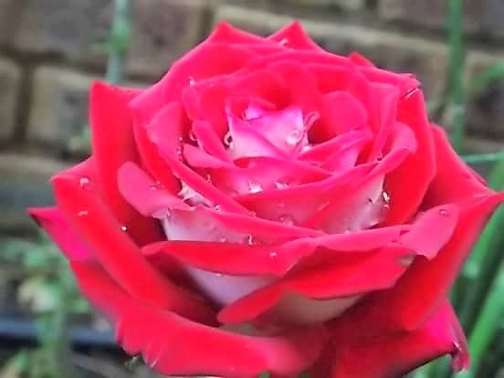
. Welcome to my class

Slide 2
Presented by
Md. Azharul Islam Khan.
Assistant teacher.
Dhala Govt. Primary School.
Tarail , Kishoreganj .

Slide 3
Let’s watch a video.

Slide 4
What can you see in the video?
Some people are eating food.

Slide 5
1.Tell the name of some vegetable items.

Slide 6
Carrot , Papaya , Lettuce

Slide 7
2.Which foods come under grains?

Slide 8
Rice, Ruti , Bread

Slide 9
3. Tell the name of some fruits.

Slide 10
Orange, Mango, Jack fruit,

Slide 11
Today’s lesson
Class- 5, Sub : English. Lesson: 4-5
Lesson part :What food---our health.
Time:35 minutes.

Slide 12
Learning outcomes: Students will be able to
Listening
1.3.1 Recognize which words in a sentence are stressed.
1.4.2Recognize & use intonation patterns for greeting & statements.
3.3.1 understand questions about objects around them.
3.4.1 understand statements made by the teacher & students.
Speaking
1.1.1 say words ,phrases & sentences with proper sounds &stress.
1.1.2 say sentences with proper intonation.
Reading
1.5.1 read words ,phrases & sentences in the text with proper pronunciation ,stress & intonation.
1.7.1 read paragraphs, dialogues stories ,letter s & other texts.
5.1.1read silently with understanding paragraph.
7.1.1 recognize punctuation marks & read accordingly .e.g. full stops ,comma ,questions mark ,quotation marks & exclamation mark.

Slide 13
Now look at the picture.

Slide 14
What can you see in the picture?
The food pyramid.

Slide 15
Tell me your favourite food.
What are the healthy food?

Slide 16
Now look at the cycle.
Healthy food.
Milk
Meat
Fruits
Fish

Slide 17
New words
Vitamins-Certain kinds of elements contained in particular foodstuffs & essential to health.
Energy-Capacity for activity.
Sugar-A kinds of grainy made from sugarcane.
Protein-A substance thought to be the essential component of all organic bodies.
Eyes-The organs to see with.
Bones-The hard part of a human or other living being.

Slide 18
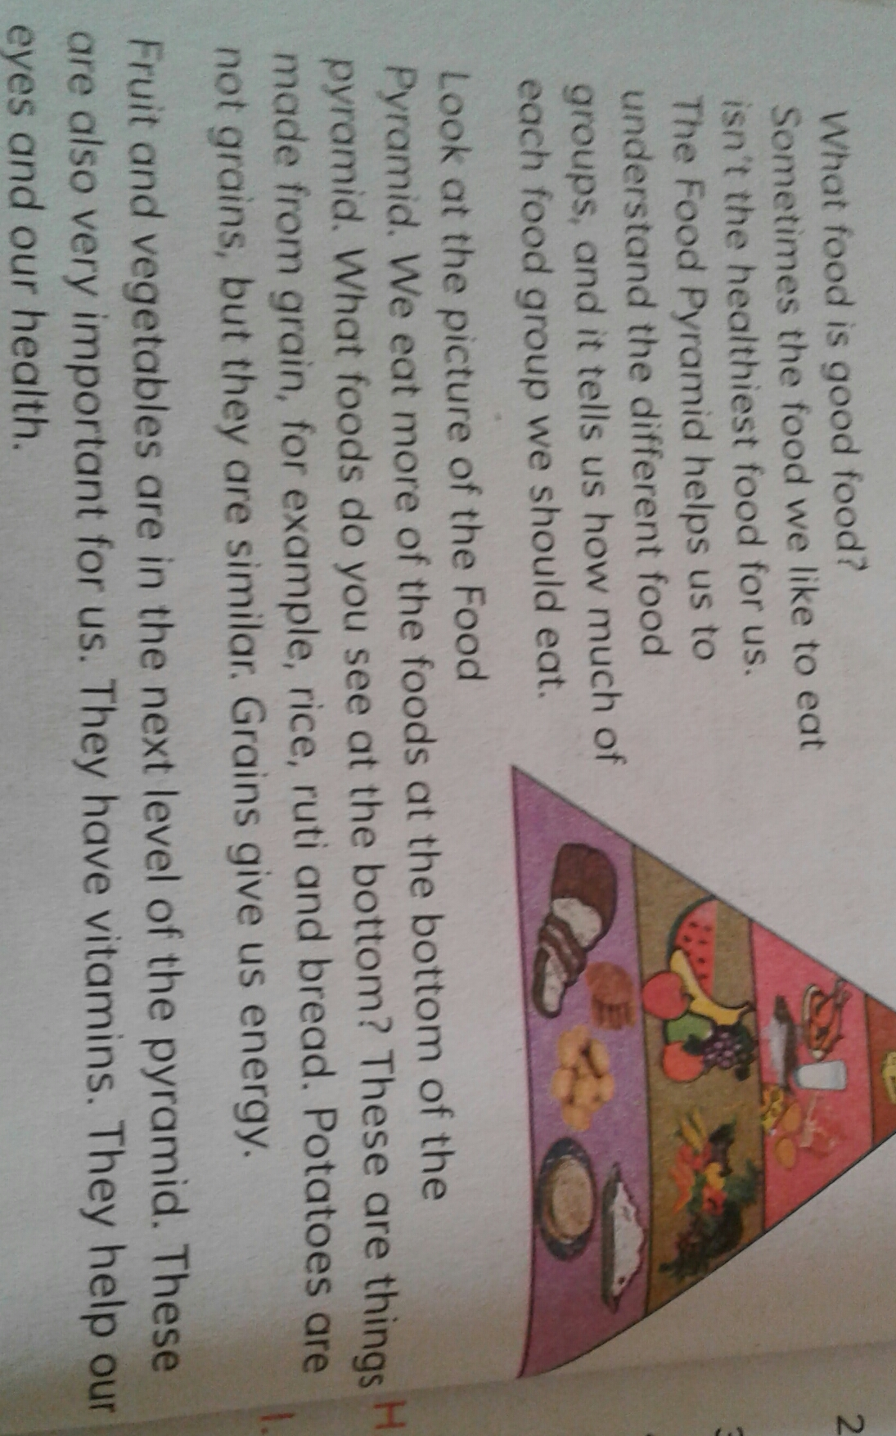
Now open at page24 & read after me

Slide 19
Group reading
Vegetables group
Grains group

Slide 20
Pair reading Read the text with your pair.

Slide 21
Silent reading Now read the text silently.

Slide 22
Evaluation:Q/A(Oral)
1.What does the food pyramid help us to understand?

Slide 23
Probable answer
It helps us to understand how much of each food group we should eat.

Slide 24
2.What foods are made from grains?

Slide 25
Probable answer
Rice,Ruti ,Bread

Slide 26
3.Why are fruits & vegetables important?

Slide 27
Probable answer
They have vitamins . They help our eyes & our teeth.

Slide 28
Bye, see you next class.

