Slide 1
WELCOME

Slide 2
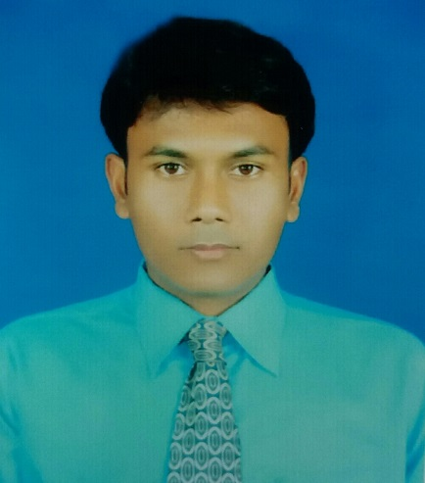
IDENTITY
NARAYAN BISWAS
ASSISTANT TEACHER
FOLTITA SSK SECONDARY SCHOOL
FAKIRHAT,BAGERHAT
Lesson
ENGLISH FOR TODAY
CLASS : SIX
UNIT ---- LESSON – 16

Slide 3
Look at the picture, talk with your partner, who are they and what are they doing?
They are retired women and gossiping among themselves.

Slide 4
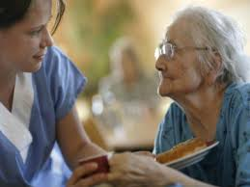
LESSON DECLARATION
An old people’s home

Slide 5
Learning outcomes
After completing this lesson, students will be able to
read and understand texts
infer meaning from context
ask and answer questions
write answers to questions.

Slide 6
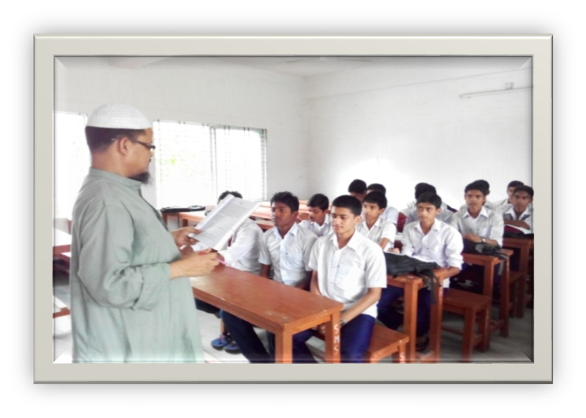
Individual work
Close your book and lesson to me carefully. Now write the following sentences (if they are true or false. If false, then give the right answers).
1. Suriya Begum spends most her time taking care of her family.
2. She wants to set up a school for adults who cannot read or write.
3. There is already an old people’s home in the town.
4. Mariam enjoys spending time with her aunt.
5. The old people Mariam visits do not like children’s presence.

Slide 7
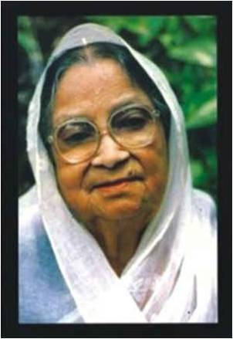
Widow
Key word
Suraiya Begum is a widow.
Meaning
(Click here)
A woman whose husband has died and doesn`t married again.

Slide 8
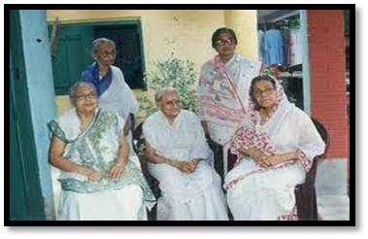
Colleagues
Key word
Meaning
(Click here)
Coworkers

Slide 9
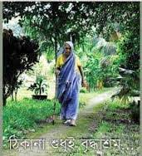
Alone
Key word
Try to say the word meaning and make sentence.
The widow walking alone by the country side.
Meaning
(Click here)
Isolated / Lonely

Slide 10
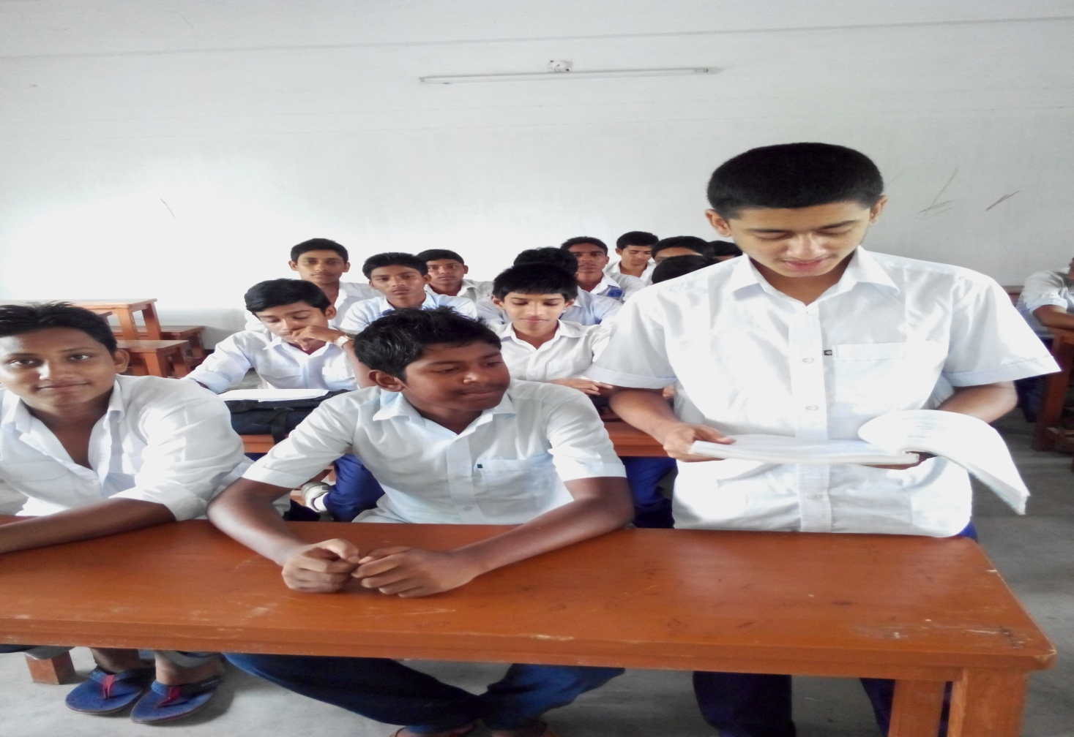
Loud reading

Slide 11
Pair works
Try to match the words on the left with the words on the right that have similar meanings.
Now go to section –A1 and try to do so.

Slide 12
Group/Pair works
Go to section B and read the following letter then answer the following questions.
Who is the writer of this letter?
Who is she writing to? What is the relationship between the two?
Does the writer have any particular reason for writing this letter?

Slide 13
HOME WORK
Think and write about a good work that you can do for someone around you.

Slide 14
Acknowledgement
We would like to express our cordial gratitude to the Ministry of Education, Directorate of Secondary & Higher Education, NCTB, a2i
and
the panel of honorable editors ( Md. Jahangir Hasan, Associate Professor (English) TTC, Rangpur, Ranjit Poddar, Associate Professor (English) TTC, Dhaka, and Urmila Ahmed, Associate Professor (English) TTC, Dhaka, to enrich the contents.

Slide 15
THE END

