Slide 1
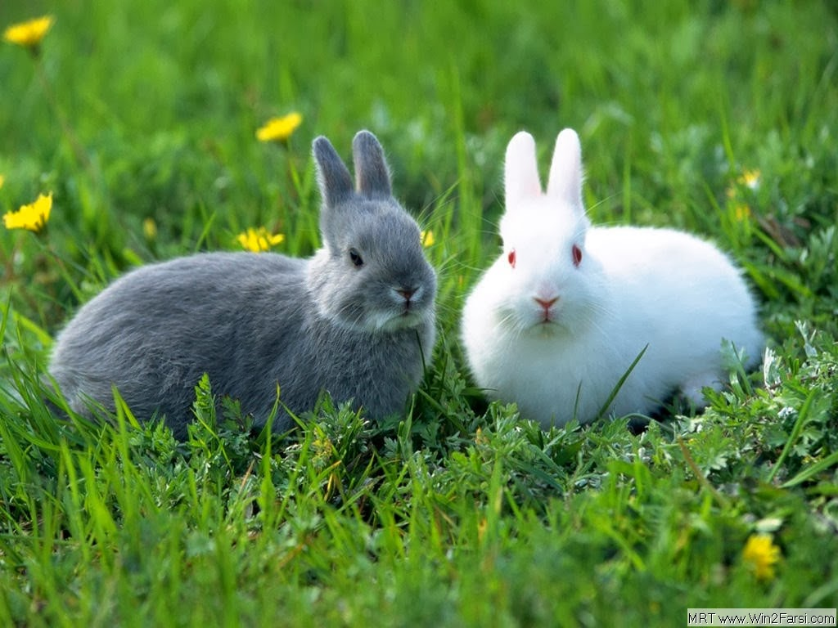
Welcome to my English class

Slide 2
Good morning,my dear students
How are you?
.

Slide 3
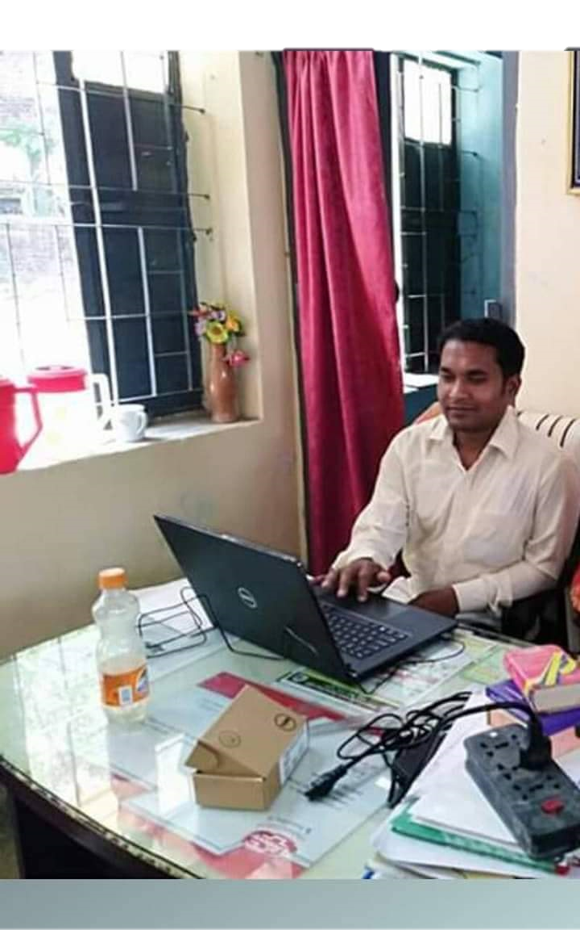
Teacher’s Identity
Raton Akka
Assistant teacher
Mithapur GPS
Badalgachhi,Naogaon.
01750-220 834
E-mail: ratonakka.s2@gmail.com

Slide 4
Lesson’s Information
Class : Five
Subject : English
Time : 1 hour
Unit : 25
Lessons : 2-3
Page : 99

Slide 5
Learning Outcomes
Listening :
1.3.1 recognize which words in a sentences are stressed.
3.4.1 understand statements made by the teacher and students.
4.2.1 understand and enjoy simple stories.
Speaking :
1.1.1 say words and phrases and sentences with proper sounds and stress.
1.1.2 say sentences with proper intonation.
Reading :
1.5.1 read words,phrases and sentences in the text with proper pronunciation,stress and intonation.
1.7.1 read paragraphs,dialogues stories,letters and others text.
7.1.1 recognize punctuation marks and accordingly.

Slide 6
Lets we watch the video

Slide 7
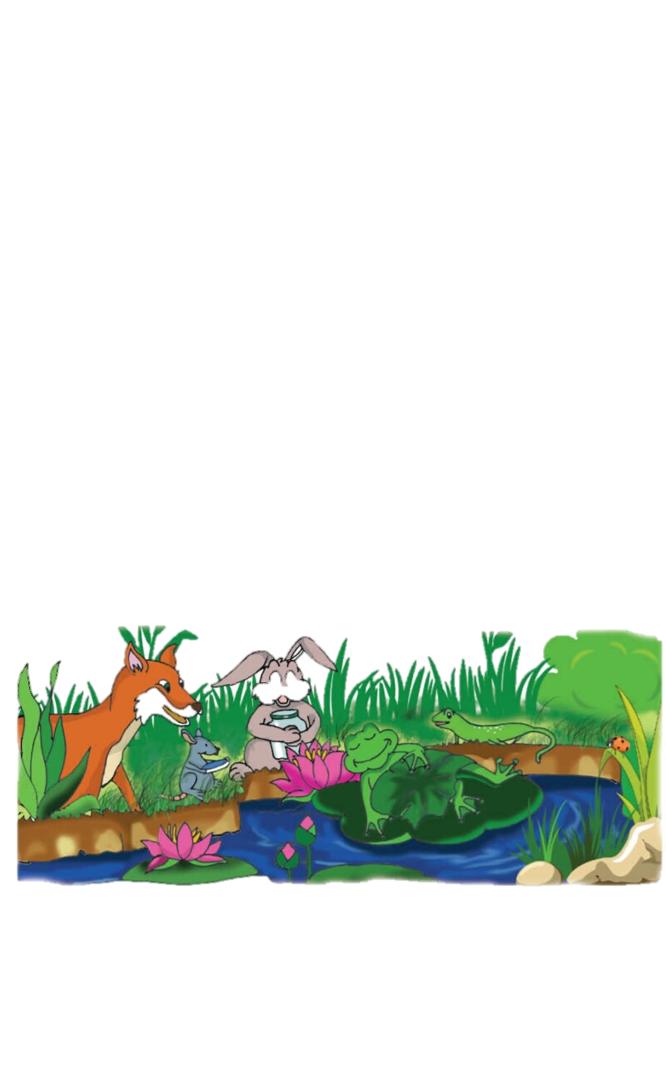
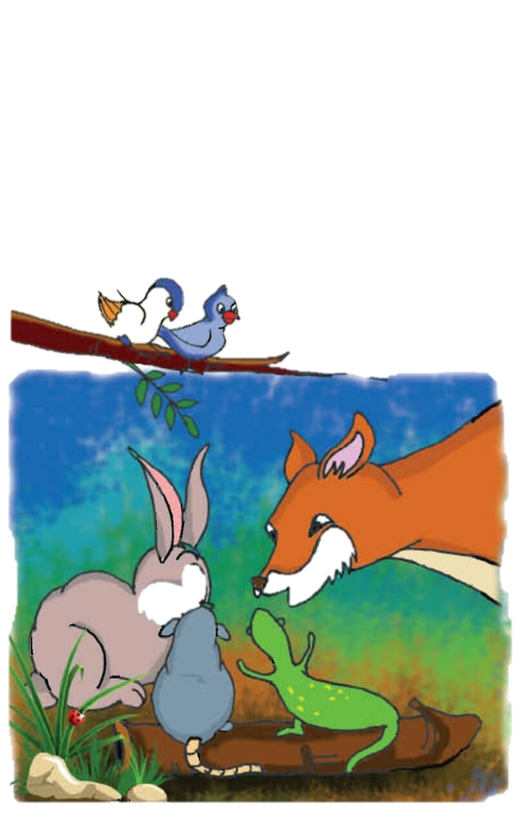
Look at the picture
Who are there in the picture?
What are they doing?
What can you see in the picture ?

Slide 8
Today’s Lesson
Why does the frog croak ?

Slide 9
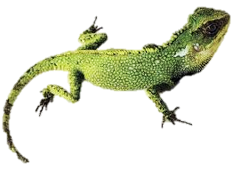
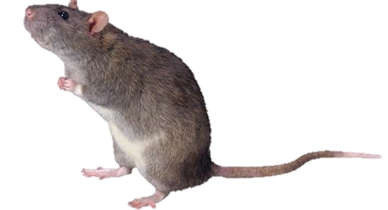
New words
Rabit
Lizard
Rat

Slide 10
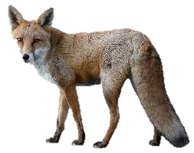
New words
Fox
agree
share

Slide 11
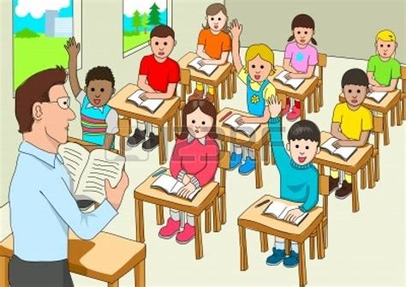
The students will read with teacher

Slide 12
Individuals reading

Slide 13
Group work
Do you think this is a true story? Why, or why not?

Slide 14
Evalution
Which animals were talking in the morning ?
What are the names of the rabit and lizard ?
What was Moxie talking about ?

Slide 15
Homework
You will write your favourite story

Slide 16
See you again.

