Slide 1
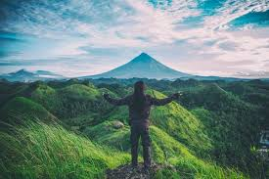

Slide 2
WELCOME TO ALL

Slide 3
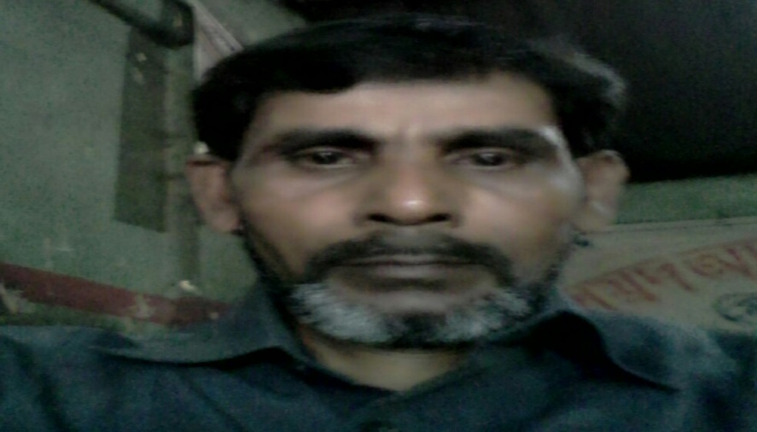
MD ABUL KASHEM
ASSISTANT TEACHER
LAKESHOR DAKHIL MADRASA
CHATAK SUNAMGONJ
MOBILE 01786498922

Slide 4
LESSON INTRODUCE
MY HOME DISTRICT
LESSON-ONE-TWO
UNIT-TEN
CLASS-FIVE
TIME-50 MINUTE
DATE-02/12/2019
MOBILE-01786498922

Slide 5
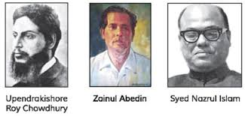
LET US SEE THE PICTURES

Slide 6
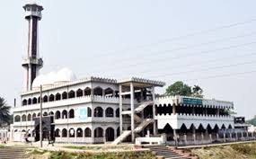
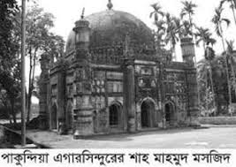
SEE ANOTHER PICTURES

Slide 7
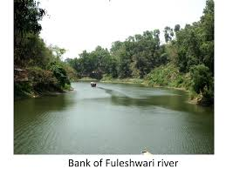
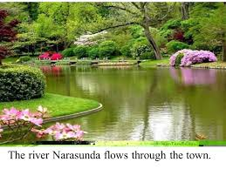
LOOK AT THE PICTURE AND SAY .
WHAT DID YOU SEE IN THE PICTURE ?

Slide 8
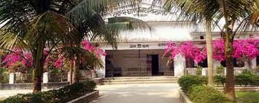
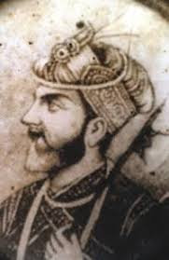
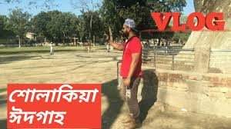
WHAT DID YOU SEE IN THE PICTURE ?

Slide 9
LEARNING OUTCOME
TO DESCRIBE ABOUT KISHOREGONJ TOWN.
TO EXPLAIN ABOUT SOLAKIA EID GROUND.
TO DESCRIBE ABOUT ISAH KHAN AT JANGAL BARI.
TO DESCRIBE ABOUT THE TEMPLE OF CHANDRABATI.

Slide 10
READ LOUDLY
My home district is kishoregonj .it is about 145 kilometres from Dhaka.It is a district headquarters.The name kishoregonj comes from the name of an old landlord known as Brojakishore Pramanik.

Slide 11
WORD MEANING
District –জেলা
Town-শহর
Largest-সবচেয়ে বড়
Mosque –মসজিদ
Visit-বেড়ানো/দেখা
Landlord-জমিদার
Writer-লেখক
Literature-সাহিত্য
Acting-অস্থায়ী

Slide 12
CORRECT PRONOUNCIATION
MUNICIPALITIES,KISHOREGONJ,NARASUNDA,EGAROSHINDHUR,ISAH KHAN,JANGAL BARI,FULESHWARI RIVER,CHANDRABATI,ZAINUL ABEDIN

Slide 13
PAIR WORK
1.What’s the name of Mamun’s home district ?
2.How far is it from Dhaka ?
3.What is the name of the river in the town ?
4.What are two things you can see in the town ?
5.Who are two famous people from this town ?

Slide 14
EVALUATION
1.What are the interesting places in your town ?
2.Who are some famous people from your home district ?
3.What do you like about your home district .

Slide 15
HOME WORK
Write a short composition about your home district.

Slide 16
THANK TO ALL

