Slide 2
Presented by
Shahrina Bin Sweety
Assistant Teacher
Chormonai Madrasa Govt. Primary School
Barishal Sadar
Barishal.

Slide 3
Lesson Identity
Class : Five
Subject : English
Unit : 2 - See you !
Lesson : 1-2
Page : 6

Slide 4
Learning outcomes:
Students will be able to-

Slide 5
Dear students, let’s watch a video.

Slide 6
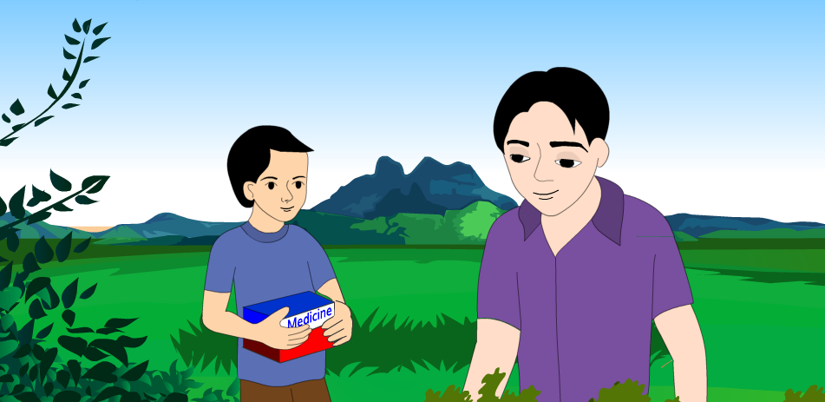
Look at the picture
Who are they?
They are Andy and Tamal.
What do you see in the picture?
How do they know?
They met at a bookshop.
Two men are speaking.

Slide 7
Our today’s lesson is
See you !

Slide 8
Dear students, open your English book at page no. 6.
Point your finger at the first line and listen the audio.

Slide 9
Great
Right now
Book fair
New Words
Later
Medicine
Grandmother
In an hour

Slide 10
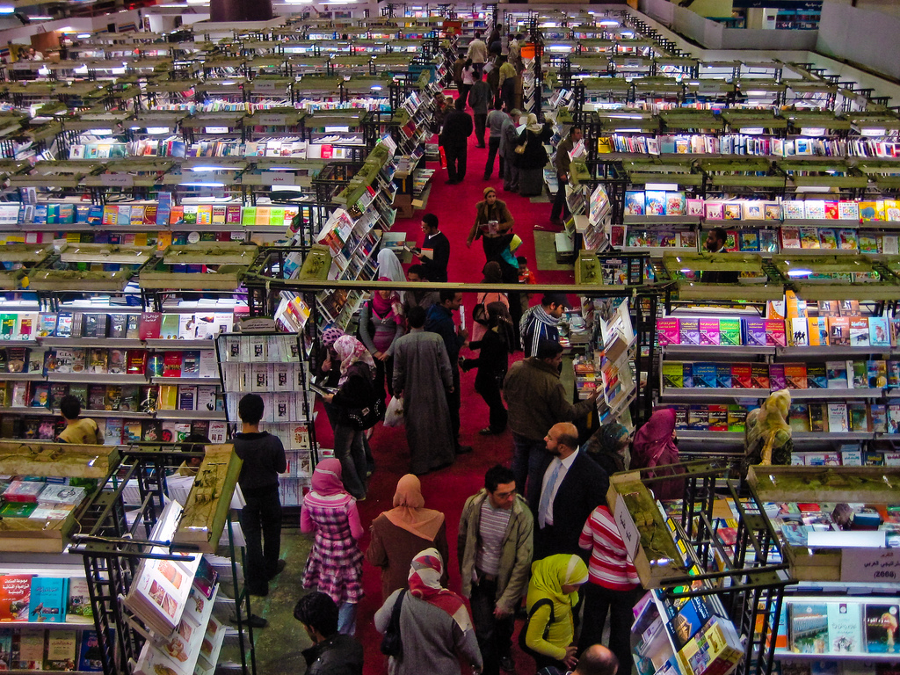
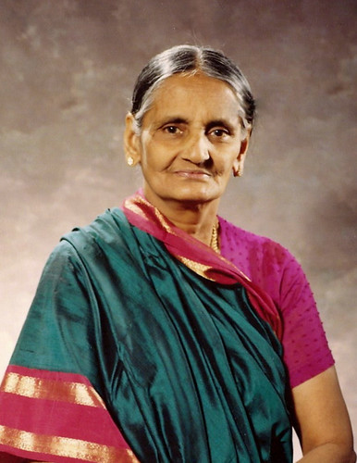
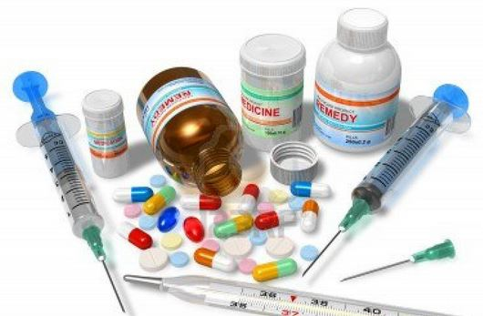
Book fair
Grandmother
Medicine

Slide 11
Pair Work
Every bench make a pair and practise the dialogue in pair.

Slide 12
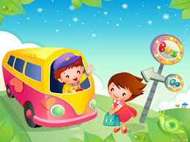
Look at the picture, please.
When we take leave someone then say these sentences.
The boy is going by bus.
May be, bye or see you.
Thank you. Now tell me what is the boy saying?
Yes, you are right.
What is the boy doing?

Slide 13
Group Work
Ask and answer the questions.
Where is Andy going?
Where is Tamal going?
When can Tamal meet Andy?
How does Andy say goodbye to Tamal?

Slide 14
Evaluation
Rearrange the words.
1. going/I’m/book/the/fair/to.
2. can/meet/an/in/hour/I/you.
3. come/would/like/you/to?
4. call/Andy/me/please/.
5. with/come/me.

Slide 15
Home Work
Write a dialogue between you and your friend about a Book fair

Slide 16
THANK YOU.

