Slide 1
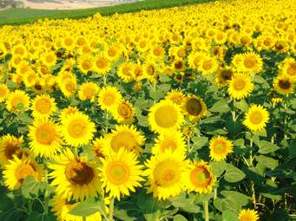
WELCOME

Slide 2
Presented by-
Md.Ali Hossain Pathan
Assistant Teacher
Chowra Nayabari Gps.
Kaligonj, Gazipur.

Slide 3
Lesson Identity
Class:two
Subject: English
Unit:One
Lesson:4-5(A)

Slide 4
Learning outcomes
At the end of the lesson students will be able to----
Listening
1.1.1 become familiar with English sounds listening to common English words.
Speaking
1.1.1 repeat after the teacher simple words and phrases with proper sounds and stress .
1.1.2 say simple words and phrases with proper sounds and stress.
Reading
1.2.1 recognize and read the alphabet both small and capital(non-cursive).
1.3.1 recognize and read the names of objects having the same initial and final sounds.

Slide 5
Let’s see the video.
https://www.youtube.com/watch?v=wDeZMAcuVyk
Link
Alphabet song.

Slide 6
Today’s lesson
Alphabet
Aa---Ee

Slide 7
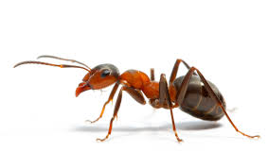
What is this?
What is this?
Ant
Bat

Slide 8
What is this?
What is this?
Cup
Doll

Slide 9
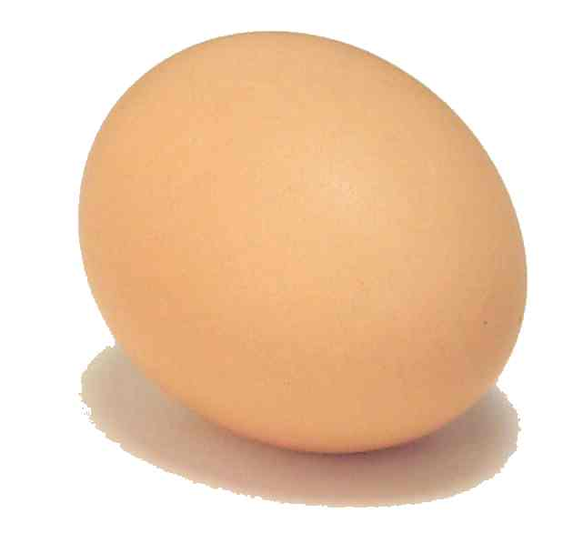
What is this?
Egg

Slide 10
My dear student’s. Open your English book at page 2 and look activity A.

Slide 11
Loud reading by the teacher.
A ant | B bat
C cup | D doll
E egg

Slide 12
Look at the picture’s and fill in the gaps.
IW
cup
ant
doll
bat
egg

Slide 13
WCW
What can you see ?
ant
What is the letter’s name?
Aa
a
What is the letter’s sound?

Slide 14
WCW
What can you see ?
bat
What is the letter’s name?
b
Bb
What is the letter’s sound?

Slide 15
WCW
What can you see ?
cup
What is the letter’s name?
c
Cc
What is the letter’s sound?

Slide 16
Match the words with the letter
PW
Aa
egg
Bb
doll
ant
Cc
bat
Dd
Ee
cup

Slide 17
Evaluation
What is this ?
ant
What is this ?
cup
What is this ?
doll

Slide 18
Evaluation.
Fill in the blanks.
Aa
---
Bb
---
Cc
---
Dd
---
Ee

Slide 19
Thank You

