Slide 1
Welcome

Slide 2
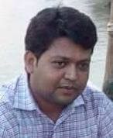
Identity
Md. Hossain Akanda
Assistant Teacher
Jobaida High School
Class : Seven
Subject : English 2nd Paper
Title :Parts of Speech

Slide 3
Learning Outcome
By the end of the lesson ss will be able to
Speak about Parts of Speech
Differentiate different types of Parts of Speech
Give examples

Slide 4
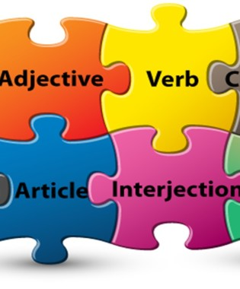
Look at the Screen

Slide 5
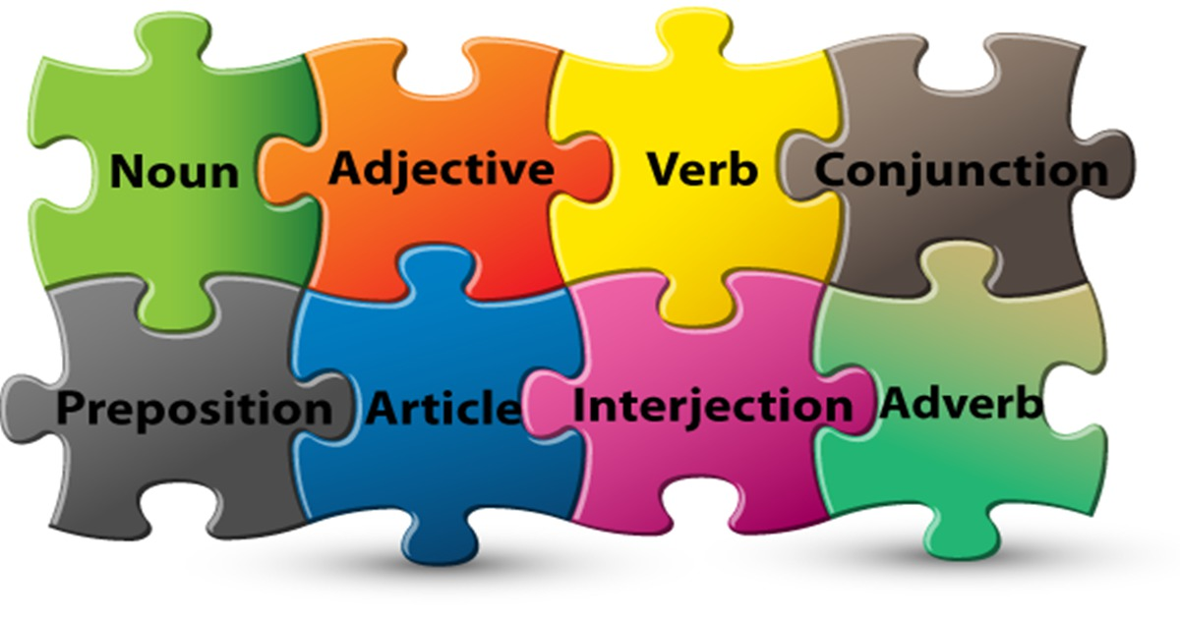

Slide 6
Today’s Topic

Slide 7
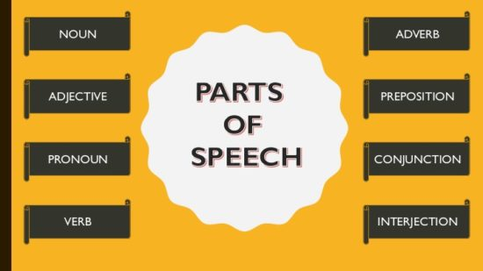

Slide 8
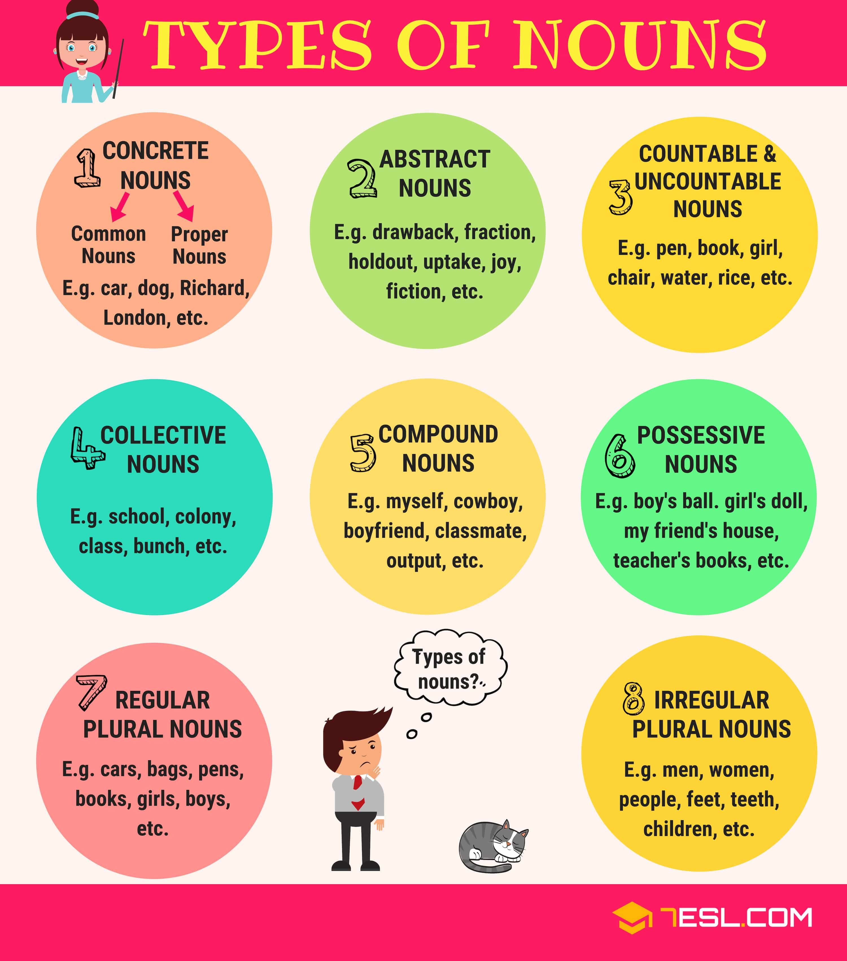

Slide 11
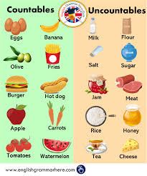

Slide 19
Thanks

