Slide 1
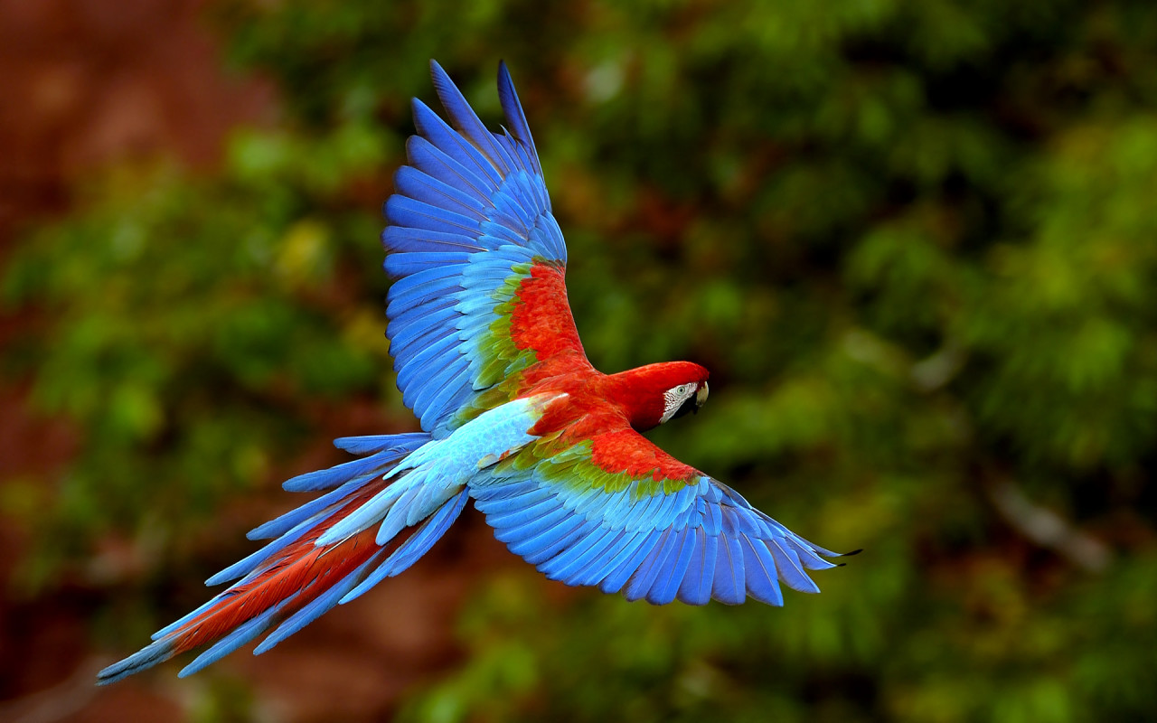
Welcome

Slide 2
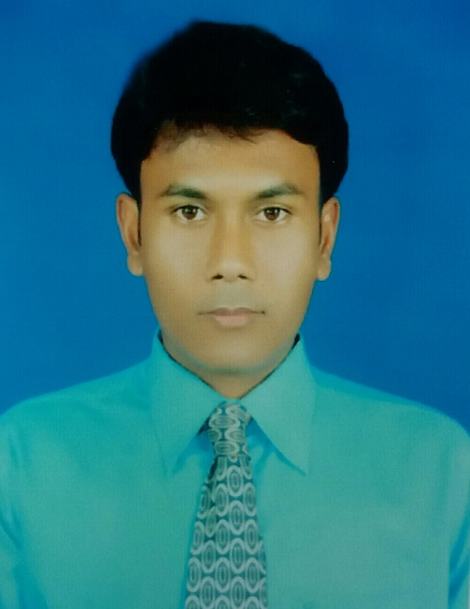
INTRODUCTION
SUBJECT: English 1st Paper
CLASS: Six
Period: One
Prepared by
NARAYAN BISWAS
Assistant Teacher
Foltita SSK Secondary School
Fakirhat,Bagerhat.

Slide 3
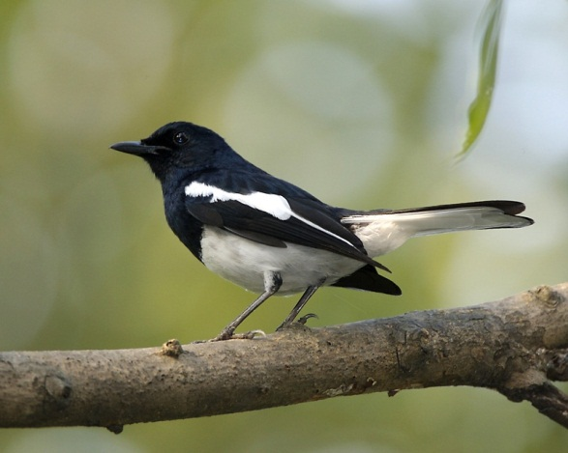
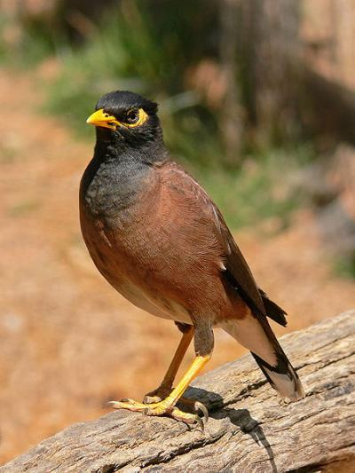
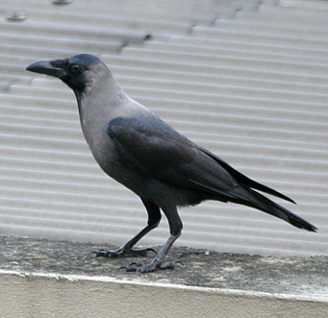
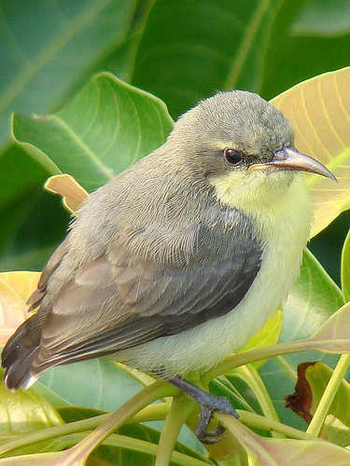
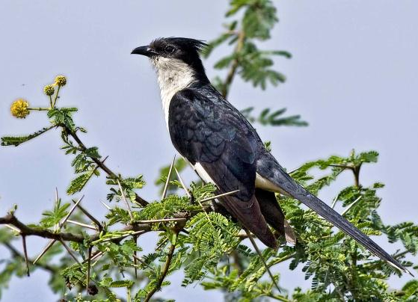
Can you tell the names of the following birds?
Magpie Robin
Shalikh/Myna
crow
Tuntuni/Tailorbird
Cuckoo (Kokil)

Slide 4
Today our topic is
Birds of Bangladesh
Lesson- 12
Page- 37

Slide 5
OBJECTIVES OF THE LESSON
By the end of the lesson the students will be able to
Talk about the video and pictures. (Speaking skill)
Read and understand text. (Reading skill)
Write answers to questions. (Reading skill)
Write a short paragraph. (Writing skill)
Tell the meaning of some key words from the inference. Vocabulary(Plentiful, Fauna, Sprightly, Pleasant)

Slide 6
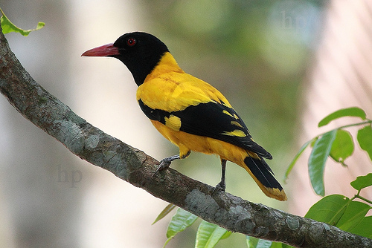
Can you tell the name of this bird?
Blackheaded Oriole
(Benebau)

Slide 7
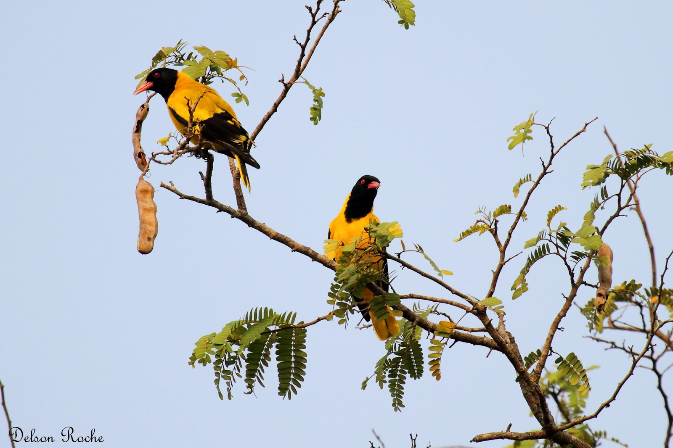
Describe the picture

Slide 8
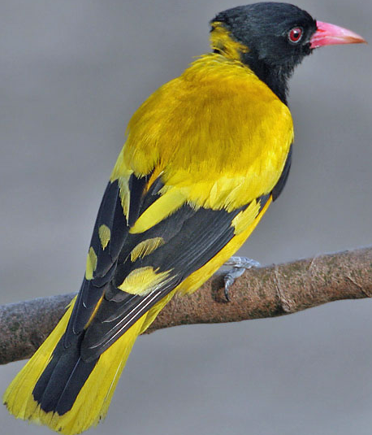
What is the coloure of its beak?
What is the colour of its body?
Red
yellow
What is the colour of its throat, tail and some part of its wings?
Can you guess what is the length of this bird?
Black
25 cm

Slide 9
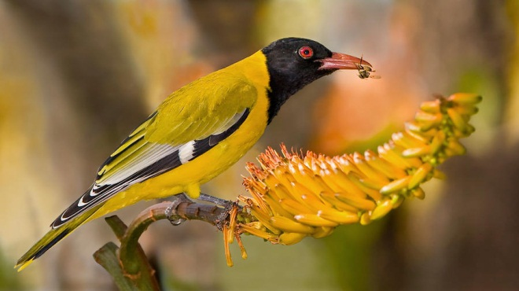
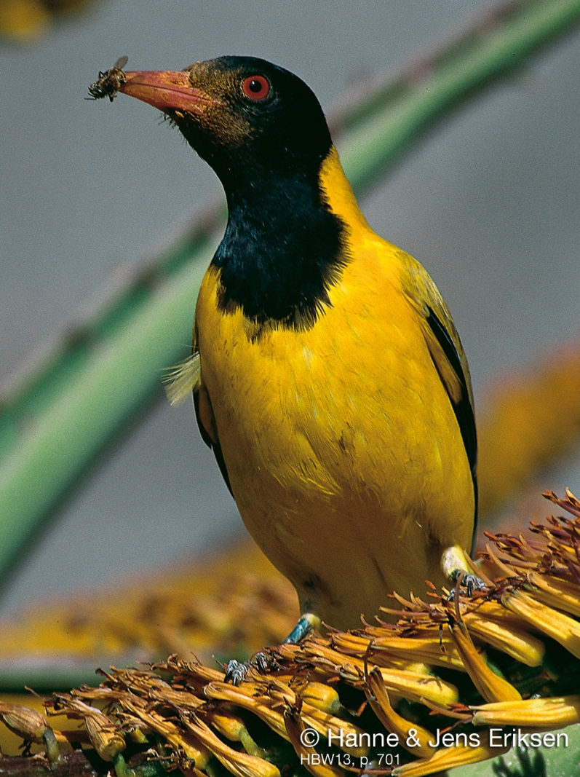
Guess what does this bird eat?
All kinds of insects and worms

Slide 10
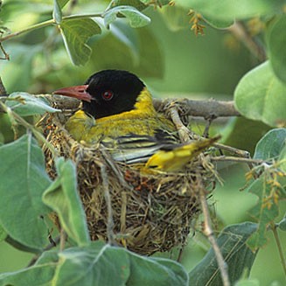
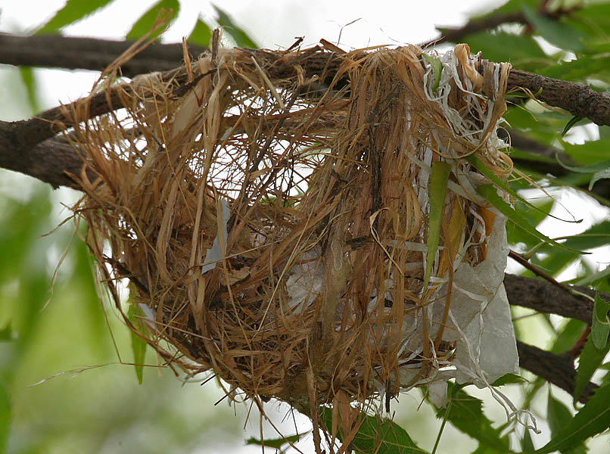
Can you guess by which the nest is made of ?
Dry grass and barks of trees.

Slide 11
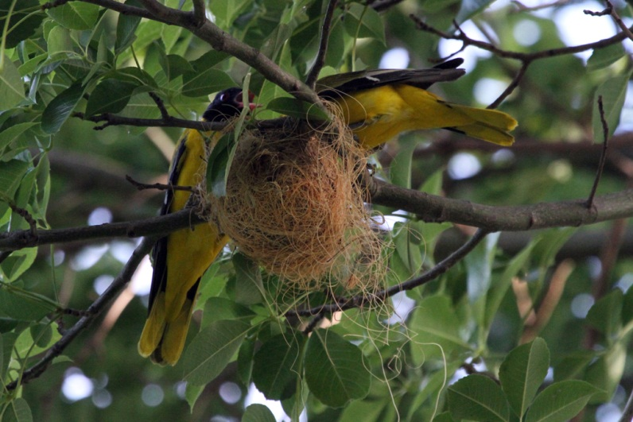
Both the male and female birds build their nest.

Slide 12
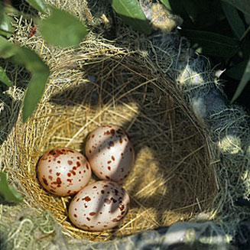
The black headed Oriole lays two or three eggs at a time.

Slide 13
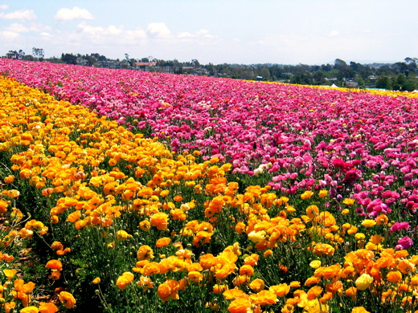
Word meaning
plentiful
(Adjective)
Here we can see a plentiful flowers.

Slide 14
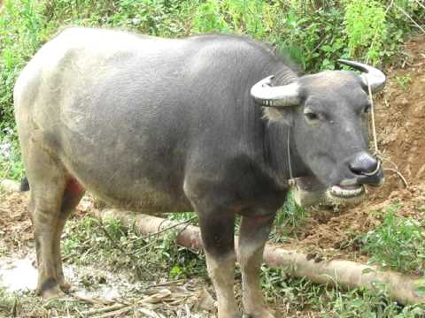
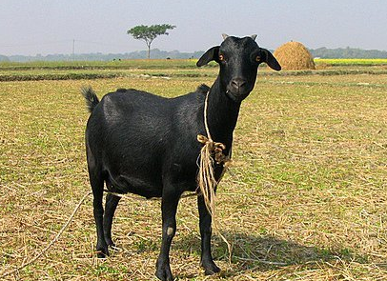
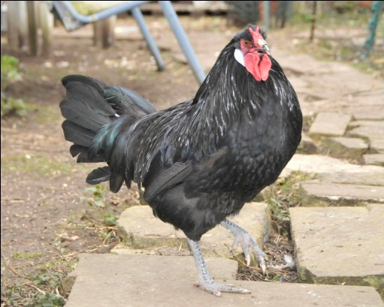
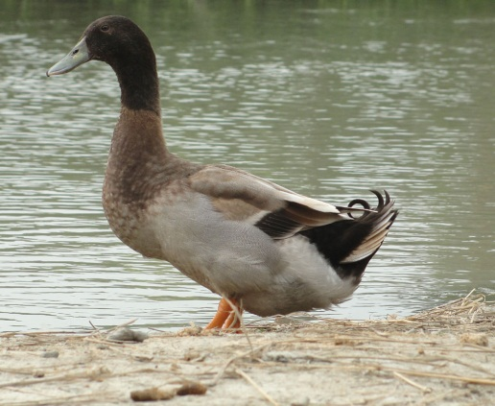
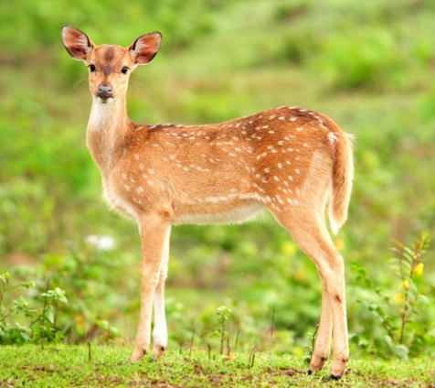
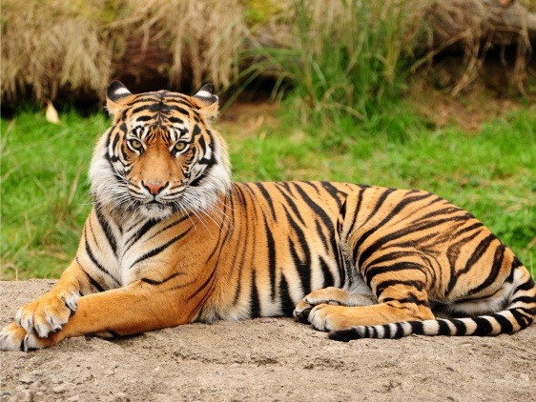
Funa (Noun)
These animals are the fauna of Bangladesh.
The animals of a particular region.

Slide 15
Read the passage about ‘Benebau’ from the text book and write the answer of the following questions.
1. What are we proud of?
Ans: We are proud of our soil, forest, fruits and birds.
2. In which countries is Blackheaded Oriole seen?
Ans: It is seen in Bangladesh, India, Srilanka, Mayanmar and some countries .
3. How is its call?
Ans: Its call is sweet and pleasant.

Slide 16
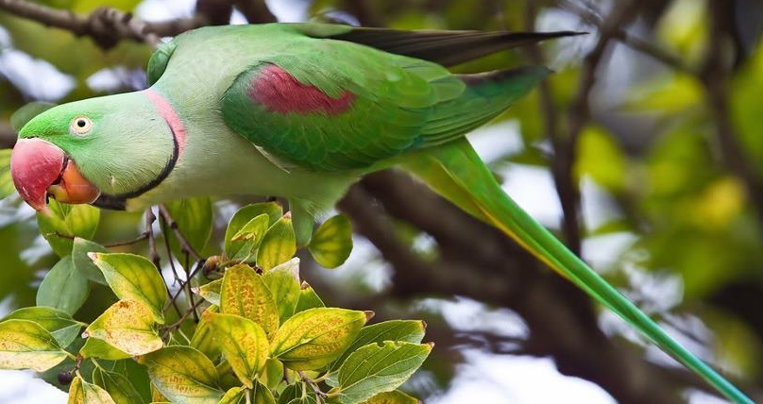
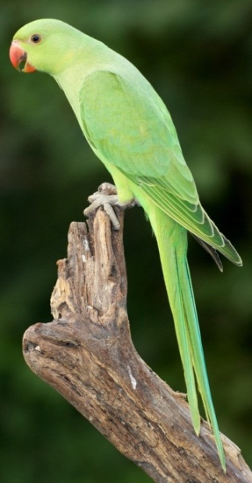
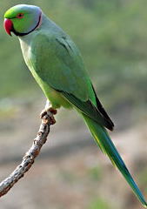
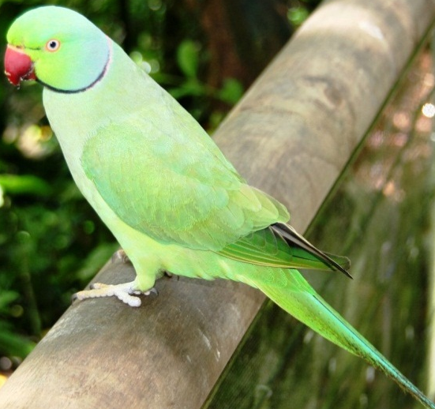
Can you tell the name of the bird?

Slide 17
Acknowledgement
MoE, DSHE, NCTB & A2I respective of officials
And the editors panel: Ranjit Poddar, Associate Professor (English) TTC, Dhaka, Md. Jahangir Hasan (English), Assistant Professor TTC, Rangpur and Urmila Khaled Assistant Professor (English) TTC, Dhaka.
Their direction, valuable suggestions and intensive supervision have enriched the model contents.

Slide 18
Thank you all

