Slide 1
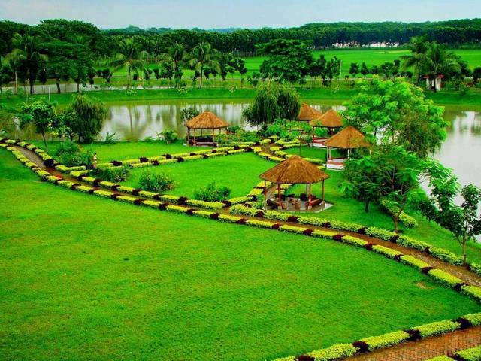
Welcome

Slide 2
INTRODUCTION
শ্যামল কুমার মহাজন
সহকারী শিক্ষক
KUTI ATAL BEHARI HIGH SCHOOL
CLASS: SIX
SUBJECT: ENGLISH SECOND PAPER
UNIT: ONE
LESSON: THIRTEEN
TOPIC: PRESENT CONTINUOS TENSE

Slide 3
What is the boy doing?
The boy is running.
What is the bird doing?
The bird is flying.

Slide 4
What are the giraffes doing?
The giraffes are dancing.

Slide 5
Today’s Topic
Present Continuous Tense
The present continuous tense is used for something happening now. The action is not finished.

Slide 6
LEARNING OUTCOMES OF THE LESSON
By the end of the lesson the students will be able to
give questions’ answer using present continuous tense.
identify present continuous tense.
make sentences with present continuous tense .

Slide 7
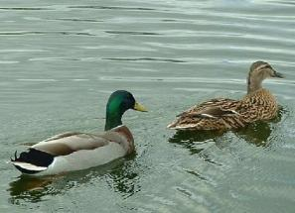
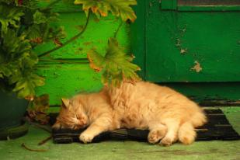
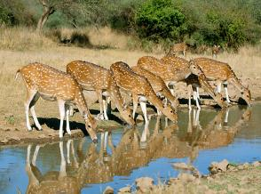
What are two ducks doing in the water?
Two ducks are swimming in the water.
What is the cat doing?
The cat is sleeping .
What are deer doing?
Deer are drinking water.

Slide 8
Structure Of present Continuous Tense
Affirm-ative | Subject | am/is/are | verb | ing | Others
I am doing my homework.
Negati-ve | Subject | am not/is not/are not | verb | ing | others
I am not doing my homework.
Interro-gative | Am/Is/Are | Subject | verb | ing | Others + ?
Am I doing my homework?

Slide 9
Where are these used?
am
I
is
He, She, 3rd person singular number, It, That
We, You, They, 3rd person plural number
are

Slide 10
Answer
A police is driving a car.
A police is not driving a car.
Is a police driving a car?
A man is digging soil.
A man is not digging soil.
Is a man digging soil?
The chickens are eating.
The chickens are not eating.
Are the chickens eating?

Slide 11
Homework
At your home look around and write what the people are doing. Write 10 sentences with present continuous tense.

Slide 12
THANK YOU ALL

