Slide 1
WELCOME

Slide 2
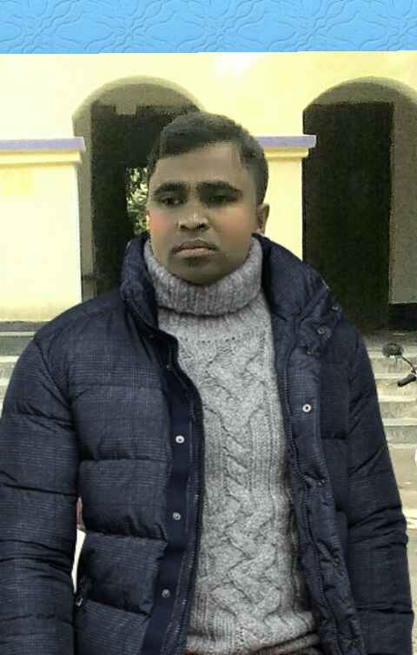
Identity
A.Sukur Ali Khan
Assistant Teacher(English)
Naldha High School.
Fakirhat.Bagerhat.
Mobile-01922360720
Subject – English 1stPaper Class- iX
Date-19 /12/2019

Slide 3
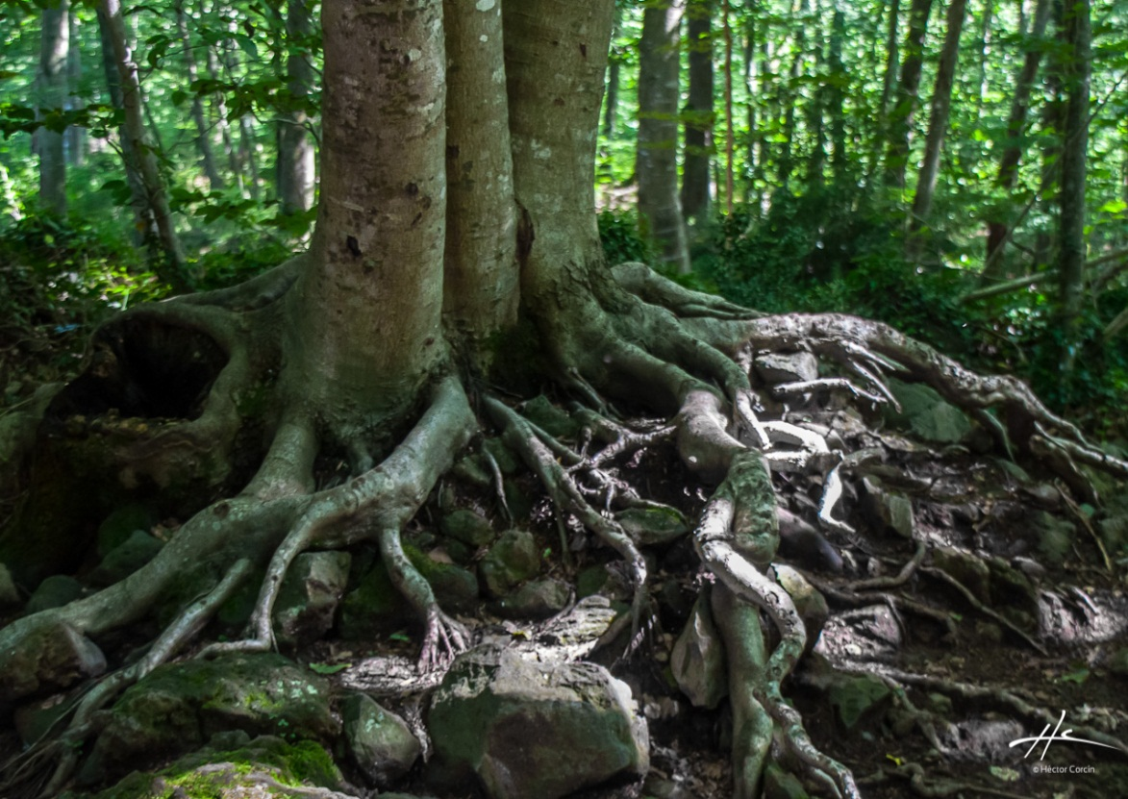
Look at the above pictures and answer the questions-
What do the pictures indicate?
2. What is the most important part of a tree?

Slide 4
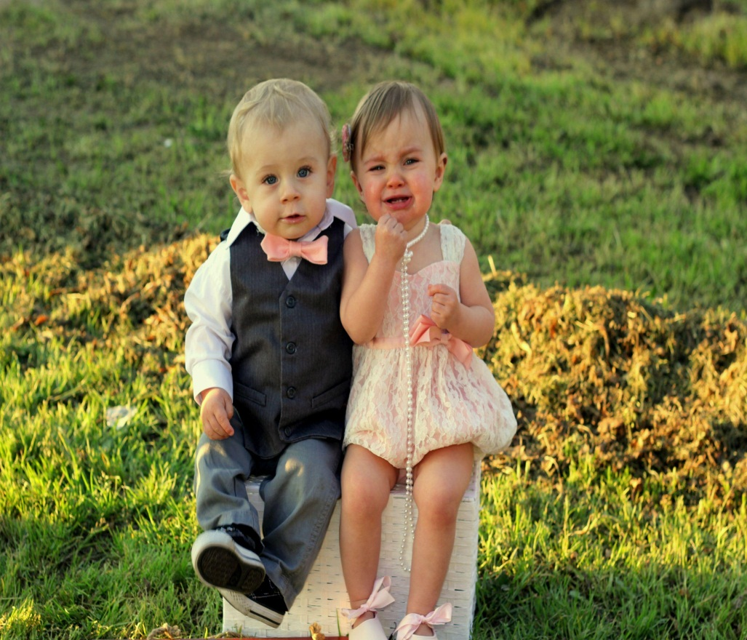
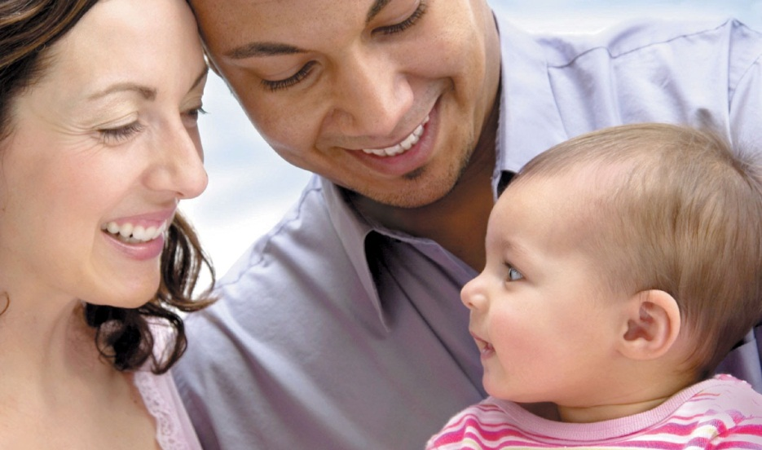
1. Do the babies have roots?
2. Who or what are their roots?

Slide 5
Our today’s lesson is-
My Roots
Unit-12 , Lesson-1

Slide 6
Learning Outcome
After this lesson the students will be able to--
1. learn some new words and use them
2.think about the condition of our vehicles
3. make questions using W/H words
4. Write answers of simple questions
5. Present own ideas, give and ask for information .

Slide 7
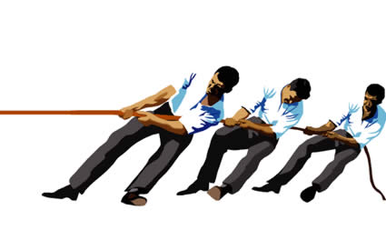
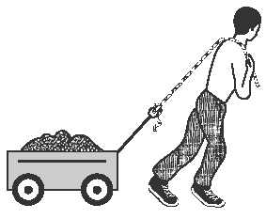
New words
They are pulling
Pull
He is pulling
Pull - to apply force, to draw.

Slide 8
Identity-
Identity- selfhood , a name , an individual .

Slide 9
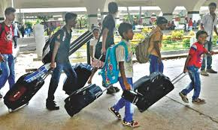
Vacation:
Leave from respective institution

Slide 10
Context-
Context-- the text , the surroundings and environment

Slide 11
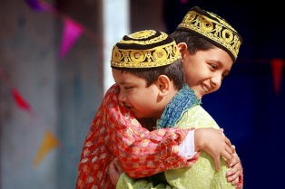
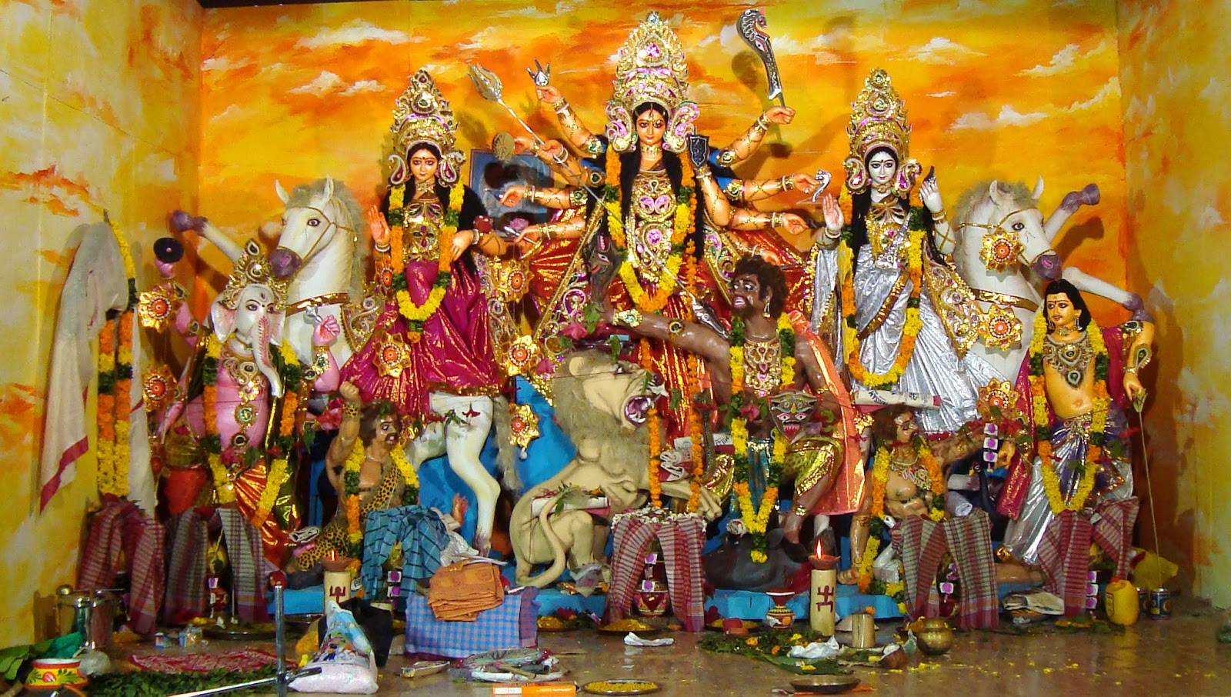
Reading

Slide 12
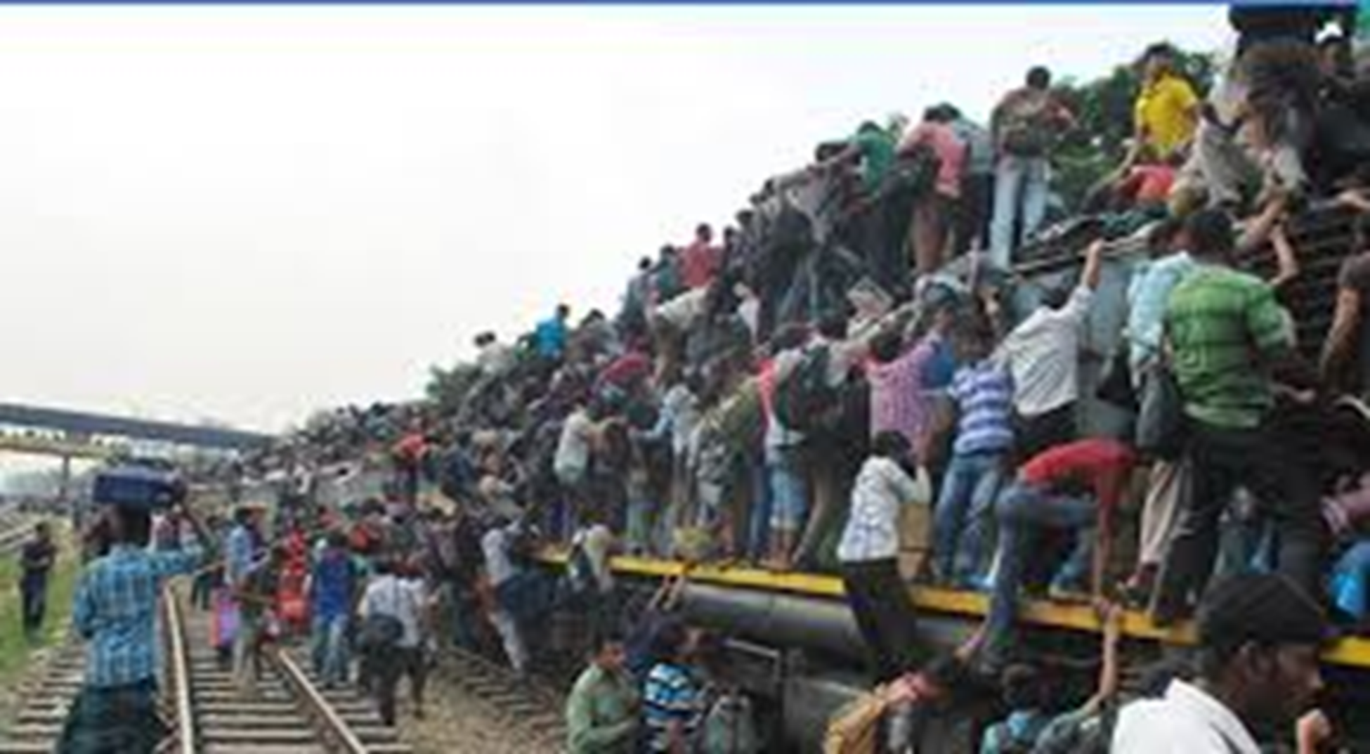
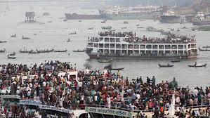

Slide 13
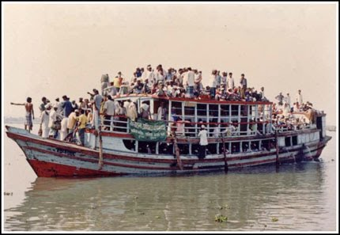
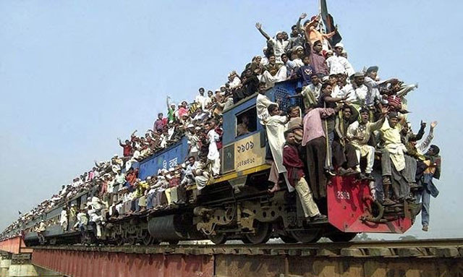
People are returning home because of the pull of the root.

Slide 14
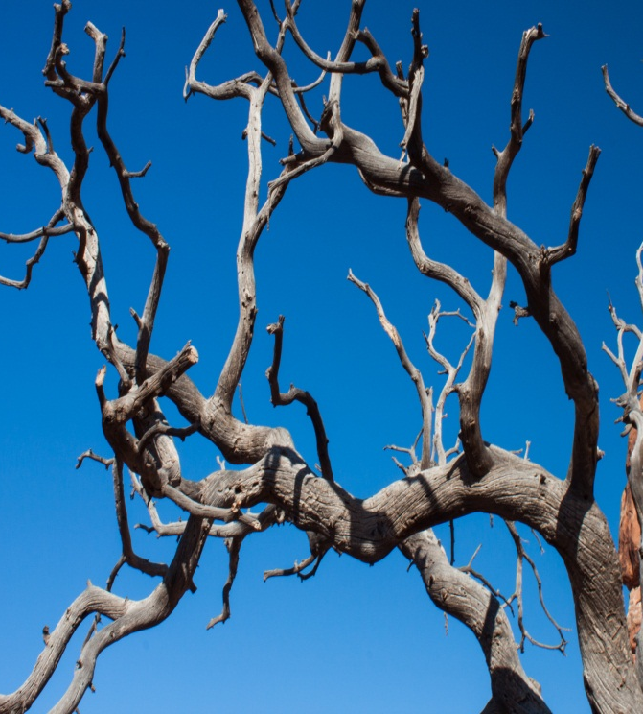
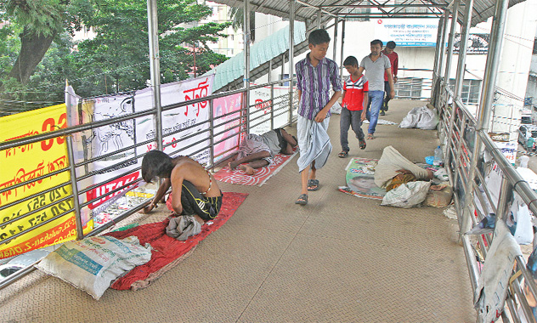
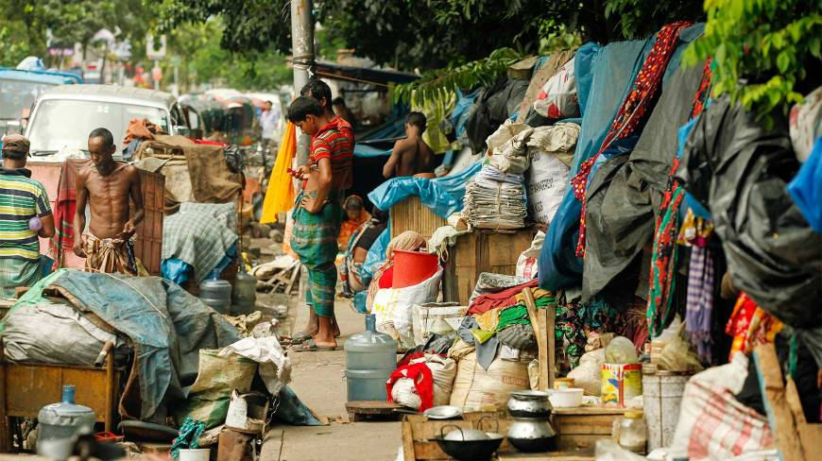
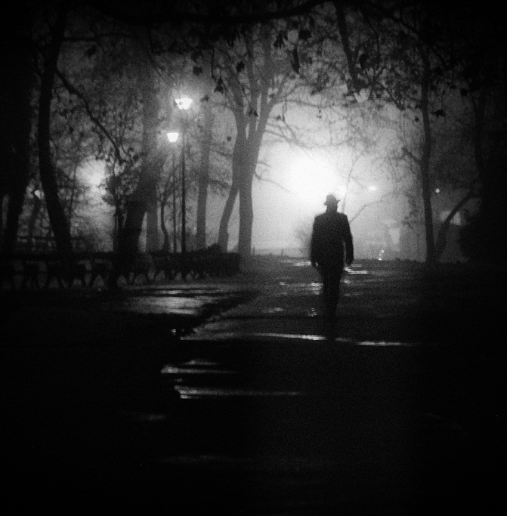
Rootless tree
Rootless person
Rootless person
RRootless people

Slide 15
Read the text in the speech bubbles. Make questions for them and then compare in pairs.
EieEid means
Happiness.
Eid is the main religious festival of the Muslims in Bangladesh.
In that sense our families, land of birth relatives, our culture, traditions or surroundings are our roots.
I1.t It’s our root that develops our identity making us what we are.

Slide 16
Fill in the grid with appropriate information from the text .
That makes our roots. | The problems of a rootless person.
1. ……………………………………. | 1. ……………………………………………
2. ……………………………………. | 2. ……………………………………………
3. …………………………………….. | 3. ……………………………………………
4. ……………………………………. | 4. ……………………………………………
5. ………………………………….... | 5. ……………………………………………

Slide 17
That makes our roots | The problems of a rootless person
…………………………………… | 1. ……………………………………
………………………………… | 2. ……………………………….....
…………………………………… | 3. ……………………………………
……………………………………. | 4. …………………………………...
……………………………………. | 5. …………………………………….
That makes our roots | The problems of a rootless person
Family, in- laws, friends, neighbours, birth land and growing land. | No identity, devoid of values, devoid of humanity, devoid of social responsibilities, feeling of emptiness.

Slide 18
Pair work . Talk about these questions.
Do you have any root other than the place where you are living now? If yes, where is it and who are there? If not, why not?
How do you label your best?
My roots belong to----
an extreme rural village a village
a semi-urban area a small town
a city
3. Do you feel any attraction or pull of your roots?
How do you nourish your roots?
What, according to you, are the reasons why people become rootless?
A city

Slide 19
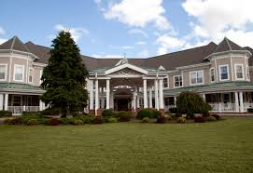
Home Work : Writing Test.
Make a survey and present in a graph or chart the types of roots your neighbours have.

Slide 20
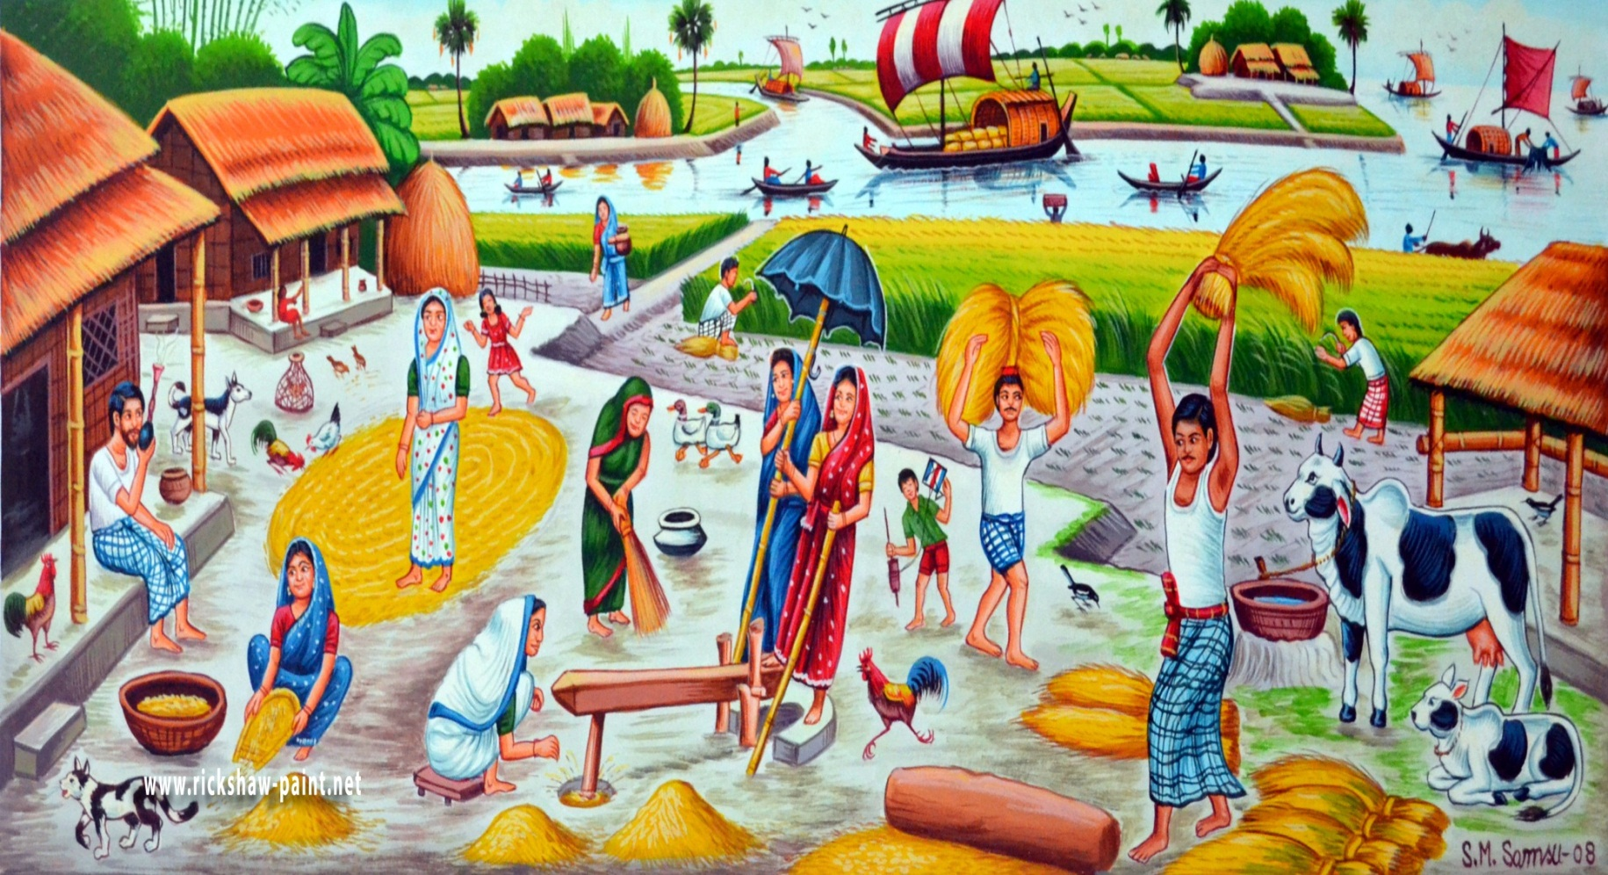
Thank you

