Slide 1


Slide 2


Slide 3


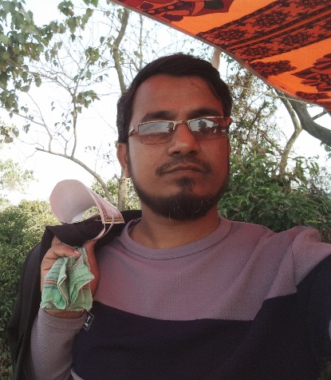

INTRODUCTION
Teacher
Lesson
Abdul Latif
Lecturer in English
Alauddin Siddique College
Kalihati , Tangail
Unit: One
Lesson:01

Slide 4

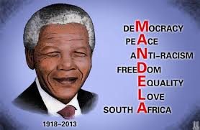
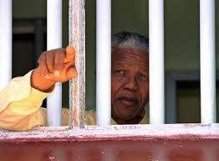
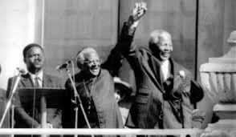
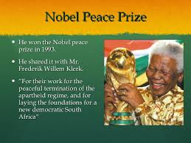
Let’s seee some pictures

Slide 5

Nelson Mandela, from Apartheid Fighter to President

Slide 6



Learning Outcomes
Students will be able-
to talk about Nelson Mandela.
to talk about race discrimination.
to understand the meaning of some words.

Slide 7

Reading the text
JOHANNESBURG (Reuters)-Nelson Mandela guided South Africa from the shackles of apartheid to a multi-racial democracy, as an icon of peace and reconciliation who came to embody the struggle for justice around the world.
Imprisoned for nearly three decades for his fight against white minority rule, Mandela never lost his resolve to fight for his people’s emancipation. He was determined to bring down apartheid while avoiding a civil war. His prestige and charisma helped him win the support of the world.

Slide 8
“I hate race discrimination most intensely and in all its manifestations. I have fought it all during my life; I will fight it now, and will do so until the end of my days,” Mandela said in his acceptance speech on becoming South Africa’s first black president in 1994, …
“The time for the healing of the wounds has come. The moment to bridge the chasms that divide us has come.”
“We have, at last, achieved our political emancipation.”

Slide 9

Let’s watch a video clip

Slide 10
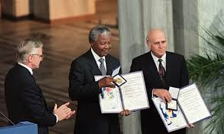
In 1993, Mandela was awarded the Nobel Peace Prize, an honor he shared with F.W. de Klerk, the white African leader who had freed him from prison three years earlier and negotiated the end of apartheid.
Mandela went on to play a prominent role on the world stage as an advocate of human dignity in the face of challenges ranging from political repression to AIDS.

Slide 11
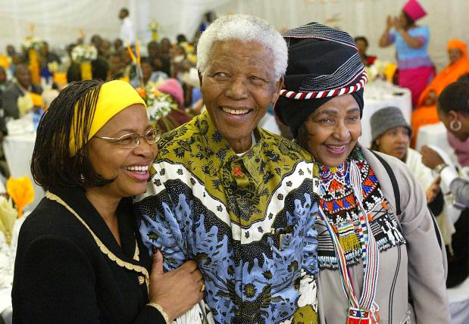
He formally left public life in June 2004 before his 86th birthday, telling his adoring countrymen: “Don't call me. I’ll call you.” But he remained one of the world’s most revered public figures, combining celebrity sparkle with an unwavering message of freedom, respect and human rights.
“He is at the epicenter of our time, ours in South Africa, and yours, wherever you are,” Nadine Gordimer, the South African writer and Nobel Laureate for Literature, once
remarked.

Slide 12
Charged with capital offences in the 1963 Rivonia Trial, his statement from the dock was his political testimony. “During my lifetime I have dedicated myself to this struggle of the African people. I have fought against white domination, and I have fought against black domination.
I have cherished the ideal of a democratic and free society in which all persons live together in harmony and with equal opportunities,” he told the court.
“It is an ideal I hope to live for and to achieve. But if needs be, it is an ideal for which I am prepared to die.”

Slide 13
Work in Group.
Make a list of some famous people that you have heard about and write about their contribution in their fields.

Slide 14
A few words to learn
Word | Meaning
Adore | To love and respect one deeply.
Chasm | Steep- sided rift.
Domination | Having a lot of influence over sb or sth.
Clan | A group of people descended from a common ancestor.
Emancipation | Setting free from legal, social or political restrictions.
Lauded | Praised highly
Epicenter | Central point of sth.
Mythic | Very famous like somebody in myth.
Spur | Anything that motivates or inspires

Slide 15



HOME WORK
Write a paragraph on “ Race Discrimination”

Slide 16


