Slide 1
Good morning to all in my class.

Slide 2
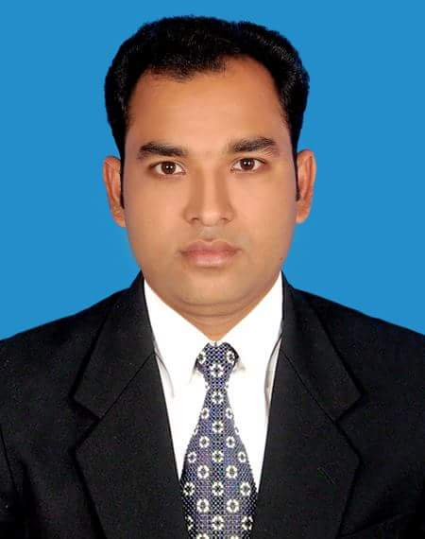
Teacher’s introducing.
Md. Mashum Mia
Assistant Teacher
Paltakanda Srijani Govt. Pri: School
Bhairab, Kishoreganj

Slide 3
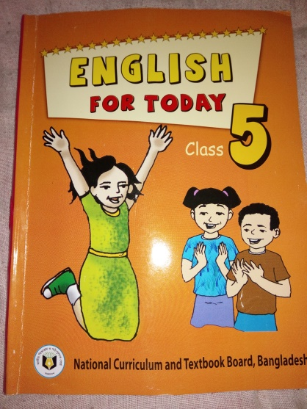
Lesson introduction
Class– Five
Subject- English
Unit– 6
Lesson: 1 (Eat healthy)

Slide 4
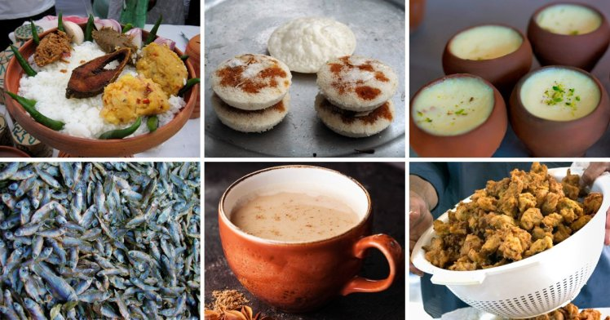
Dear students ,what are looking in the pictures?
What we shall do if we are hungry.
These are various food
If we are hungry, we shall eat food.

Slide 5
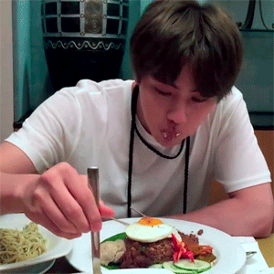
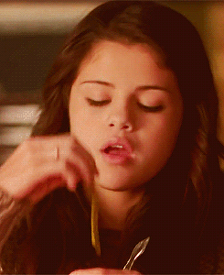
Today’s lesson is “ Eat healthy”.

Slide 6
Learning outcomes—
after the lesson students will be able to
Listening:
3.3.1: understand questions about objects around them.
3.4.1: understand statements made by the teacher and students.
Speaking:
1.1.1: say words, phrase and sentences with proper sounds and stress.
6.2.1: talk about people, objects, events etc.
Reading:
1.5.1: Read words ,phrase and sentences in the text with proper
pronunciation stress and intonation.

Slide 7
Dear students, what do you usually have for breakfast?
We usually have ruti or bread, vegetables , rice,
cake, buiscute etc for breakfast .
Dear students, what do you usually have for lunch?
We usually have vegetables , rice, fish, meat, fruits
lentils etc for lunch .
Dear students, what do you usually have for dinner?
We usually have rice, fish, vgetables, beans ,fruits
lentils etc for dinner .

Slide 8
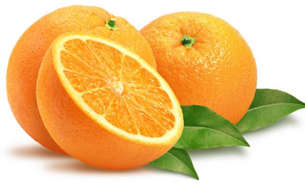
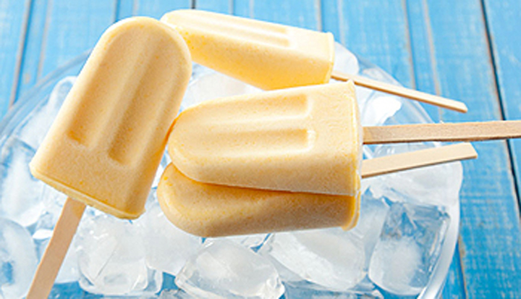
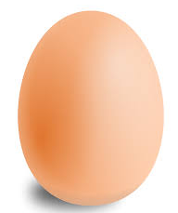
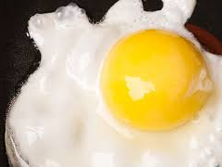
Dear students, look at the pictures and think about these.
Dear students, can you say what are these?
These are some foods.
oranges
ice-cream
egg

Slide 9
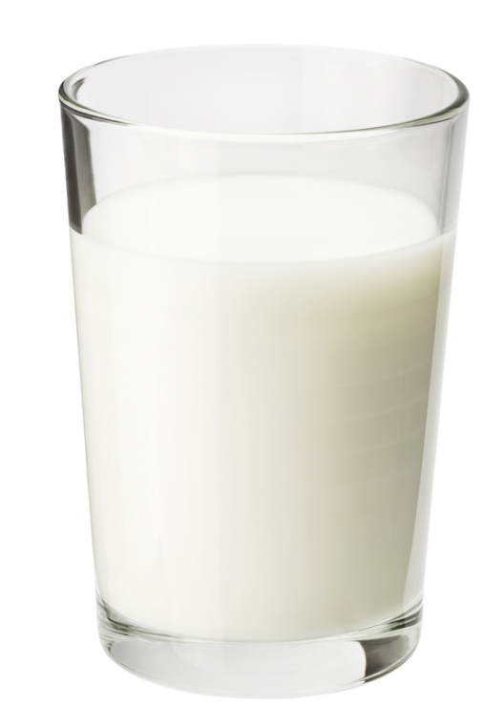
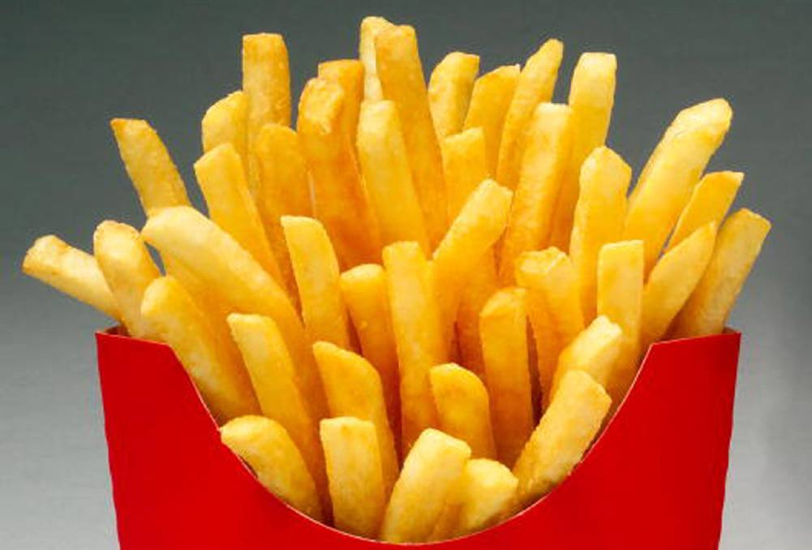
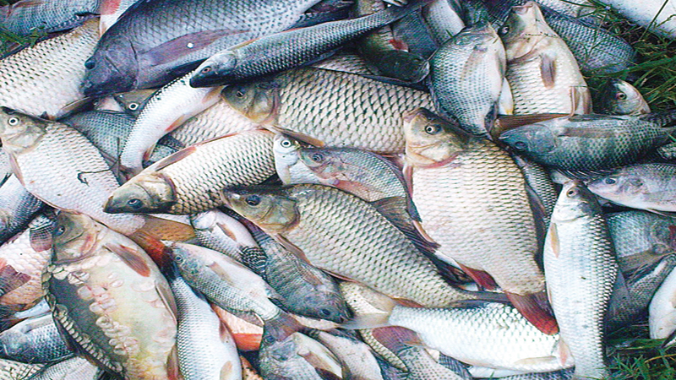
Dear students, look at the pictures and think about these.
Dear students, can you say what are these?
These are one kinds of foods.
milk
friese
fish

Slide 10
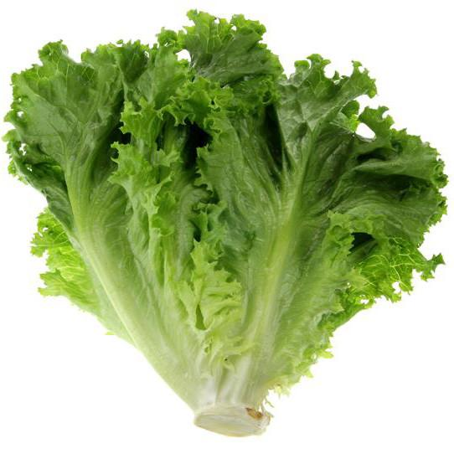
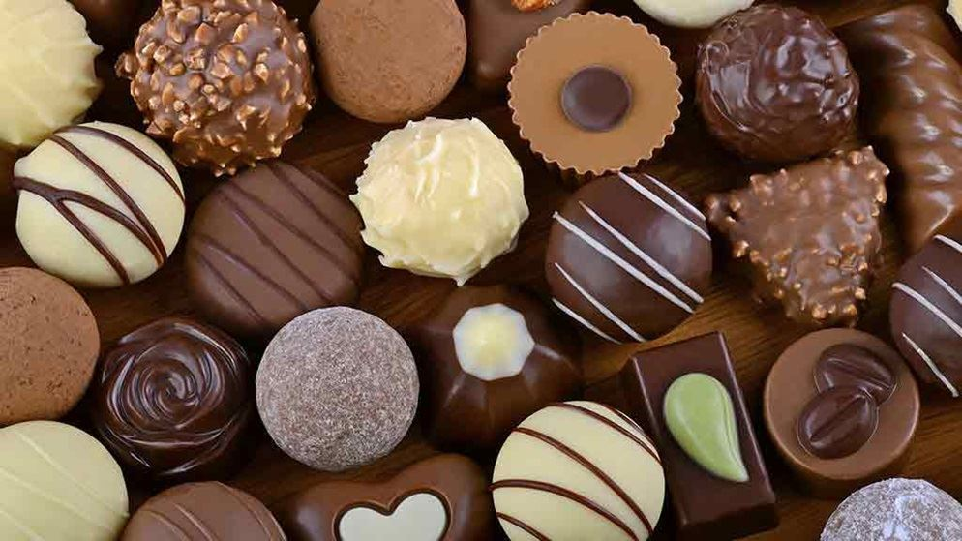
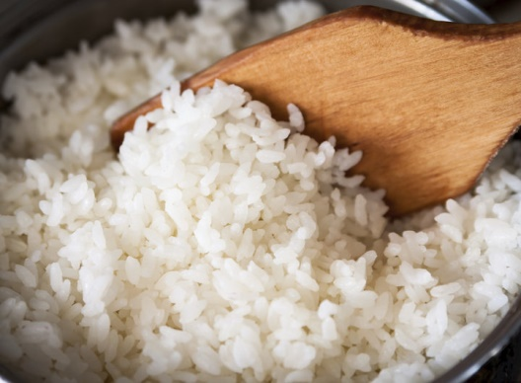
Dear students, look at the pictures and think about these.
Dear students, can you say what are these?
These are some foods.
lettuce
chocolate
rice

Slide 11
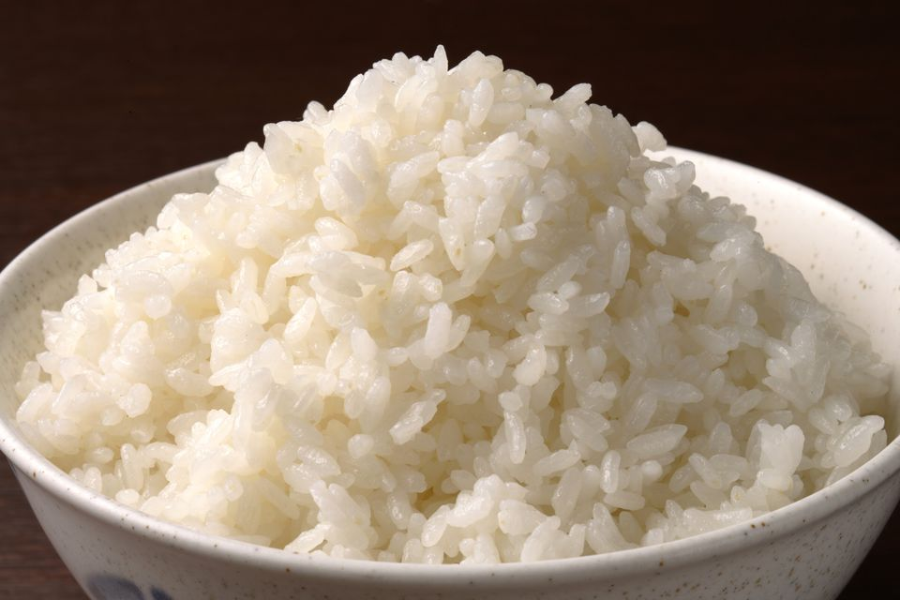
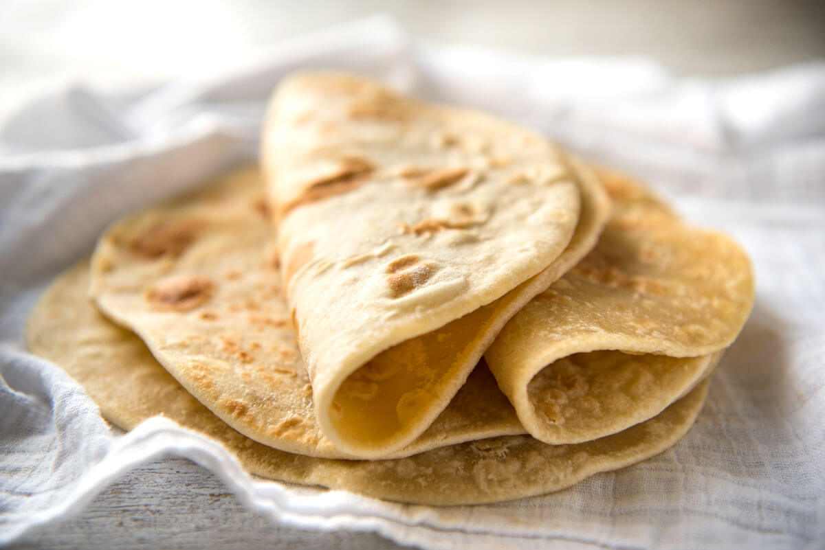
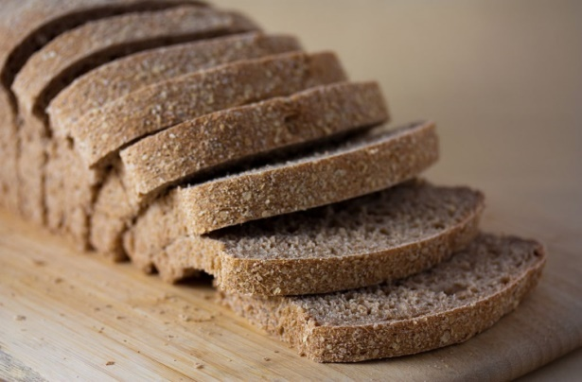
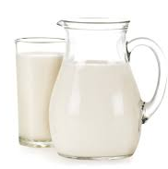
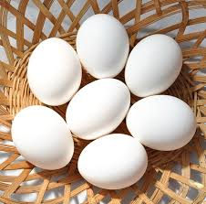
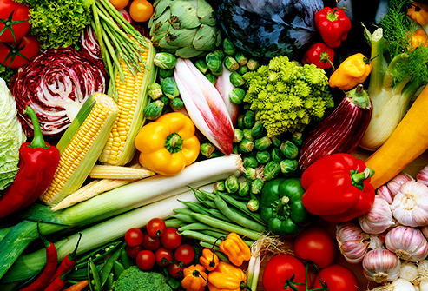
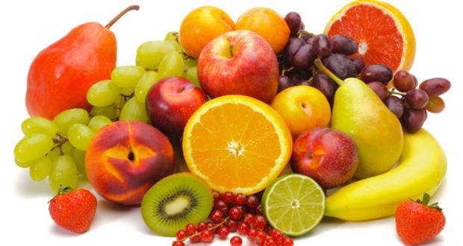
Dear students, what kind food do you eat usually ?
We eat rice, fish , ruti , bread, cake, frise, egg,
Fruits, vegetables , milk usually
rice
fish
ruti
cake
milk
egg
vegetables
fruits

Slide 12
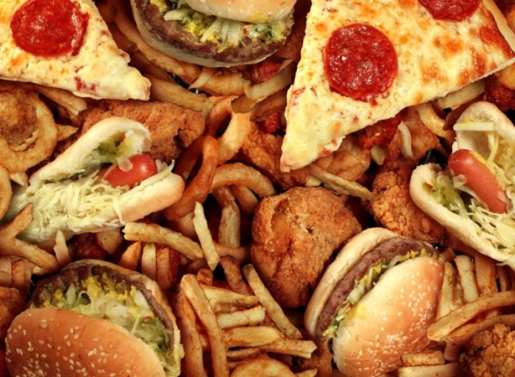
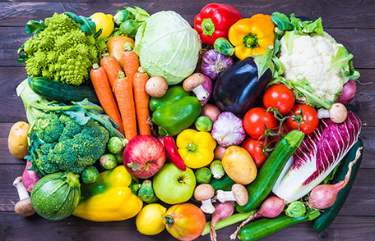
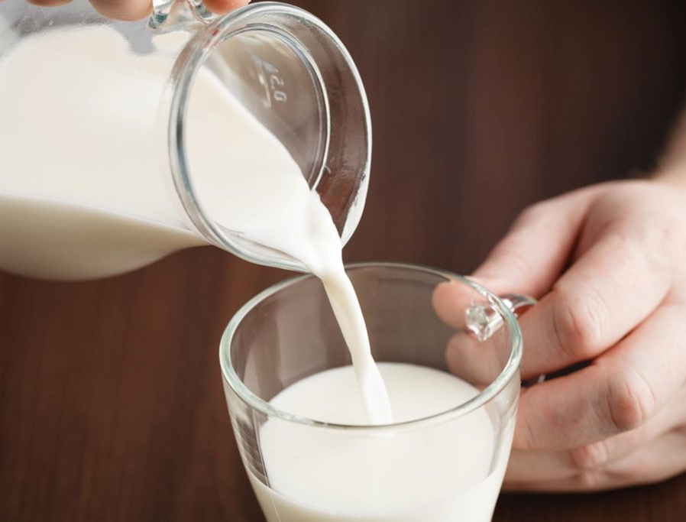
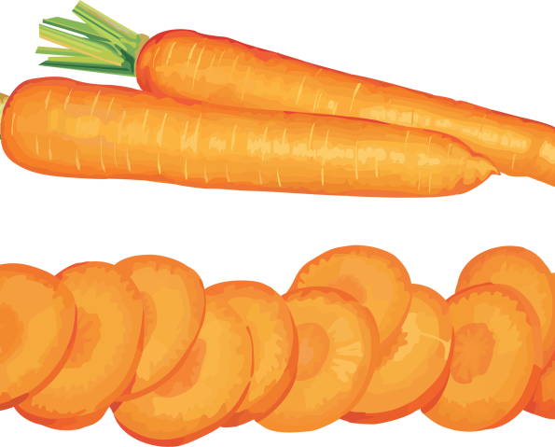
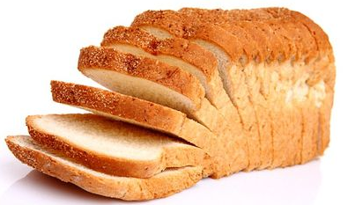
Dear students, what are you looking in the pictures?
These pictures are various kinds of food.
friese
ruti
vegetables
milk
carrot
fruits
rice
cake

Slide 13
My students, let’s play a word game with different letters.
Dear students, make some words with the following letters.
p
papaya
f
fish
c
carrot
r
rice
c
cake
m
milk
f
fruits
l
lettuce
e
egg
v
vegetables

Slide 14
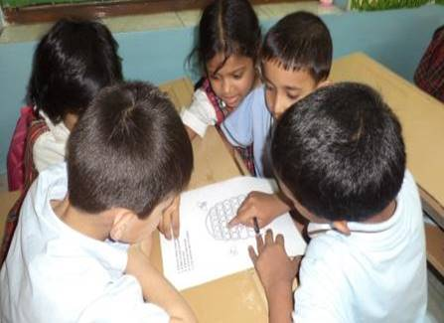
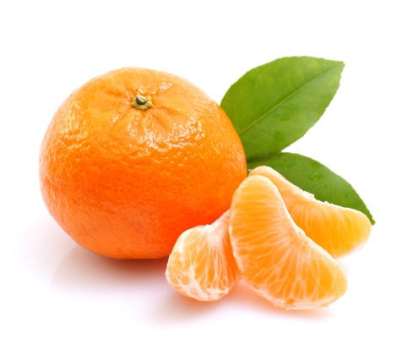
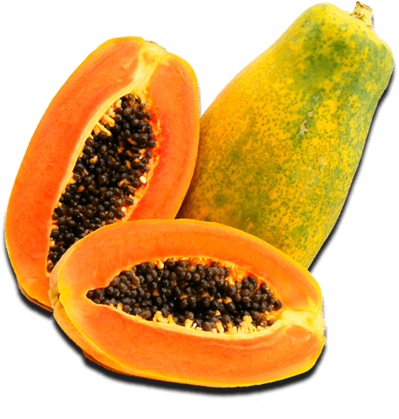
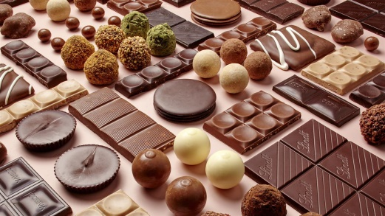
Dear students, say the following
foods name in groups.
orange
fish
vegetables
chocolate
papaya
milk

Slide 15
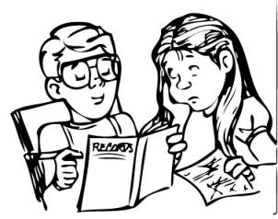
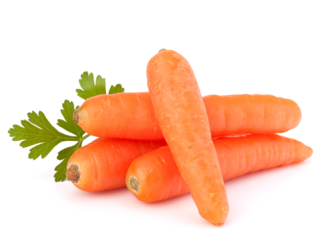
Dear students, say the following
foods name in groups.
chocolate
papaya
orange
carrot

Slide 16
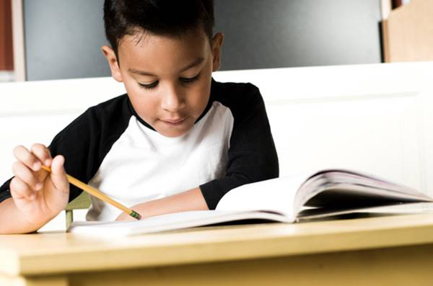
Dear students, say the following
foods name indivisually.
ruti
milk
egg
fish

Slide 17
Dear students , let’s read and say some food’s name.
lettuce
chocolate
friese
bread
rice
fish
ruti
cake
milk
egg
vegetables
fruits

Slide 18
Dear students , open your book page at 22 and
see the food’s name which we eat usually.

Slide 19
Evaluation :
Dear students , say and write the following
food’s name in your khatas.
lettuce
fish
chocolate
ruti
rice
carrot
vegetables
fruits
egg
milk

Slide 20
Home task
My dear students ,you will read and write
the food’s name at your house.

Slide 21
Thanks a lot for your activeness.

