Slide 2
Identity
Nurul Aziz
Assistant Teacher (English)
Krishnakumari City Corporation Girls’ High School,
Nandankanan,Chittagong
E-mail : naziz13.na@gmail.com
Mobile : 01843773924
English Grammar
And Composition
Time : 45 Minutes
Date : 20.09.2019

Slide 3
Let’s watch a short dialogue.

Slide 4
Are they talking about any present event?
No, it was a Past event.
Our today’s lesson is Right form of verbs (Past Tense)

Slide 5
After the end of the lesson students will be able to
Use the correct form of verbs in relation with time and subject.
Apply past tense and non-finite verbs.
Explain rules of subject-verb agreement,
Speak with grammatical accuracy
Learning outcomes

Slide 6
Past Tense at a glance
Past Simple (Sub+ past form verb +object)
Example : I wrote a letter.
Past Continuous (Sub+ was/were+ (verb +ing ) +object)
Example : I was writing a letter.
Past Perfect (Sub+ had+ Past Participle of verb +object)
Example : I had written a letter.
Past Perfect Continuous (Sub+ had been + (verb+ing) +object)
Example : I had been writing a letter.

Slide 7
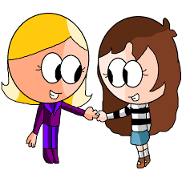
Past Simple
We use the past simple tense to talk about:
something that happened
once in the past:
I last met my friend in 1983.
something that happened
several times in the past:
When I was a boy, I walked a mile to school every day.

Slide 8
something that was true
for some time in the past:
She played a lot of tennis when she was younger.
We use did in past simple questions:
Did she play tennis when she was younger?

Slide 9
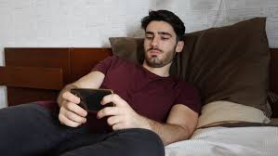
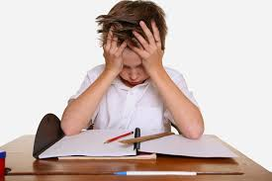
Negatives with the past simple:
Karim didn't go to office yesterday.
He didn’t understand the lesson properly.

Slide 10
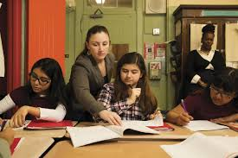
Past Continuous
We use the past continuous to talk about the past for something which happened before and after another action:
The children were doing their homework
when I got home.
for something that happened before
and after a specific time:
It was eight o'clock. I was writing a letter.

Slide 11
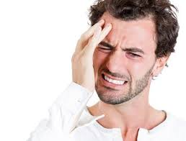
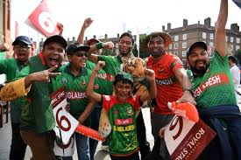
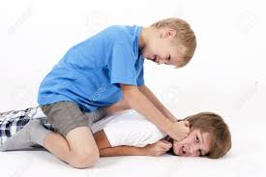
to show that something continued for some time:
My head was aching.
Everyone was shouting.
for something that happened again and again:
They were always quarrelling.

Slide 12
Pair work
Use the right form of the following verbs.
Answers
a) He not (go) to school yesterday.
He did not go to school yesterday.
b) One of the boys (be) absent.
One of the boys was absent.
c) What you (eat) it last night?
What did you eat last night?
d) I (study) for two hours before I went to sleep.
I had studied for two hours before I went to sleep.
e) He (play) every afternoon .
He would play every afternoon.

Slide 13
with verbs which show change or growth:
The children were growing up quickly.
We do not normally use the past continuous with stative verbs. We use the past simple instead:
When I got home, I really needed (NOT was needing) a shower.

Slide 14
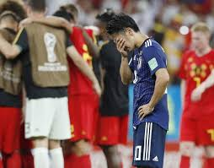
Past Perfect
Past Perfect Tense : To show that an action happened before something else in the past:
How to form? subject + had + past participle = past perfect tense.
For example ,
They lost the game because they had not practiced enough.

Slide 15
To show that an action happened
before a specific time in the past:
She had established her company before 2008.
She had fallen asleep before eight o'clock.

Slide 16
One day a scholar a) a river with a boat. Suddenly a ghastly wind b) to blow. The scholar c) with fear. The boatman d) him if he e) how to swim. The answer from the scholar f) negative. Then the boatman g) , “Very soon you are going to h) . You i) a lot of knowledge but it j) to use at this moment.”
Group work
Use right form of verbs in the following gaps.
Tremble, say, ask, have, come, cross, drown, begin, know, be
was crossing
began
was trembling
asked
knew
was
said
be drowned
have
will not come

Slide 17
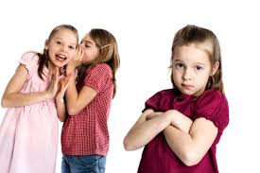
Past Perfect Continuous
They had been talking for
over an hour before Tina arrived.
How long had you been waiting to get on the bus?
We use the past perfect continuous to show that something started in the past and continued up until another time in the past.

Slide 18
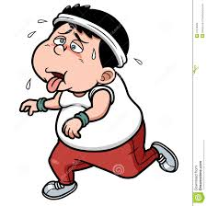
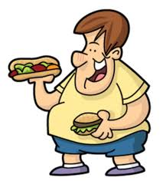
Using the past perfect continuous
before another action in the past
is a good way to show cause and effect.
Examples:
Jason was tired
because he had been jogging.
Sam gained weight
because he had been overeating.

Slide 19
a. It was many years since I (meet) to him.
b. We (start) the meeting after the guest (come).
c. I did not want (leave) the place.
d. You had better (to do) the work.
e. The boy ran away having (take) the first prize.
f. I (go) to market last night.
g. It is high time I (change) my character.
Individual work
Use right form of verbs in the following sentences.
had met
started , had come
to leave
do
taken
went
changed

Slide 20
Evaluation
Match the sentences with the sentences in the right.
I had been studying in the school before we went to Dhaka.
Past Simple
He had done the work before the sunset.
Past Continuous
He used to swim in the river.
Past Perfect Continuous
Who was crying in the room at noon?
Past Perfect

Slide 21
a) I never (see) such a beautiful sunset before I went to the island.
b) He did well in the math test because he (tutor) all week.
c) I did not have any cash because I (lose) my purse.
d) If I (see) him, I would have told him the news.
h) She (live) in California before moving to Texas.
Home Work
Use right form of verbs in the following sentences.
Notes:
Please match the answer in the next slide.

Slide 22
Thank you all.

