Slide 1
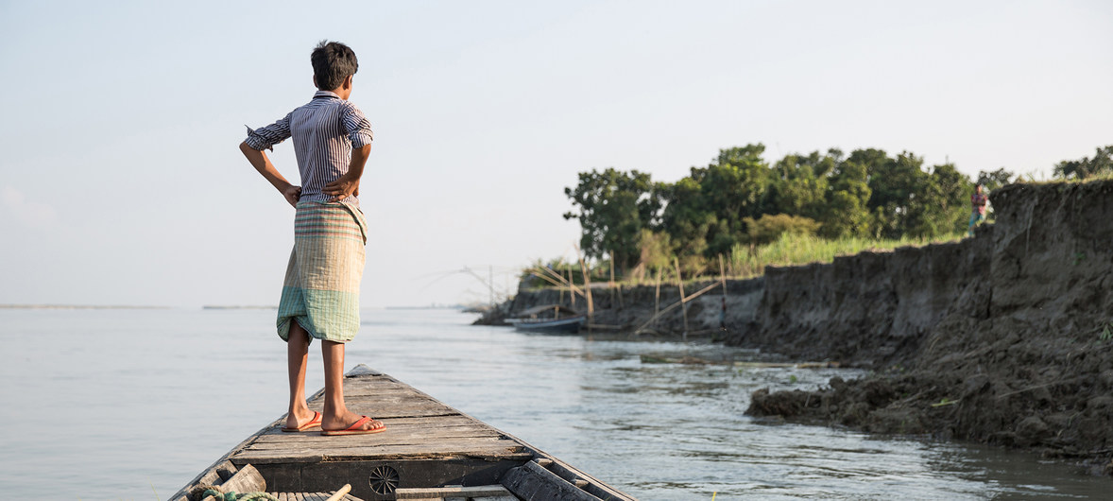
Good Morning

Slide 2
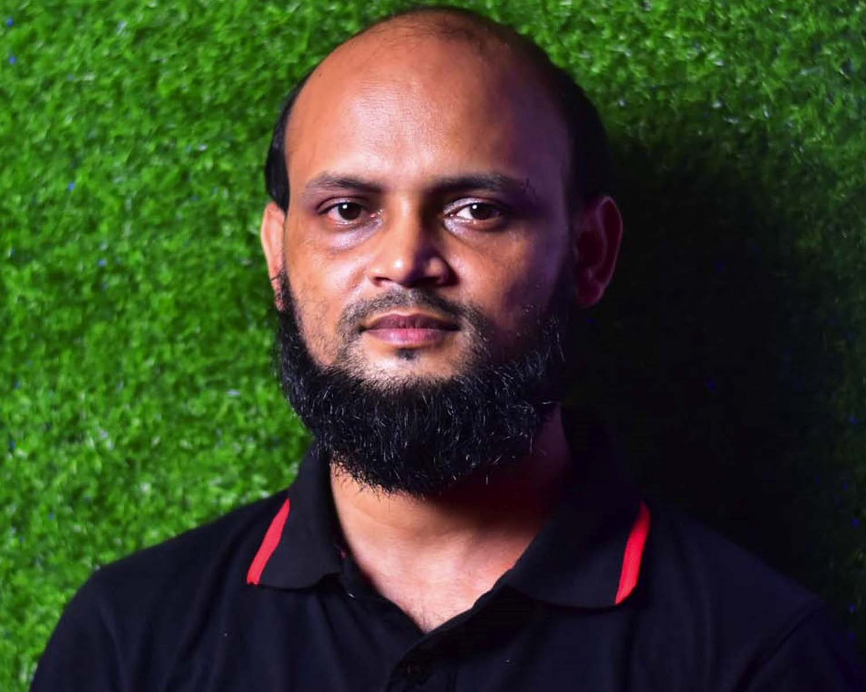
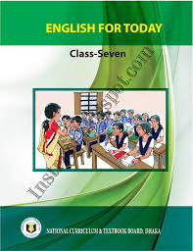
Identity
Nurul Aziz
Assistant Teacher
Krishnakumari City Corporation Girls’ High School,
Nandankanan, Chittagong
E mail : naziz23.na@gmail.com
English For Today
Class VII
Time : 45 Minutes
Date : 18/092019

Slide 3
Let’s watch a video clip

Slide 4
‘What happens next?’
Unit : 9
Lesson : 4
Page : 103
Our today’s lesson is….

Slide 5
Objectives of the lesson
After the end of the lesson students will be able to
i) Make sentences with new words
ii) Ask and answer questions
iii) Tell about the harmful effects of climate change
iv) Write about the disastrous effects of ecological imbalance
v) Play different roles

Slide 6
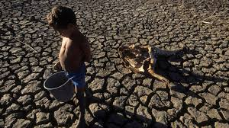
Vocabulary
Syn. Dangerous
Extreme (adj.)
Syn. Risky
Ant. Safe
Extreme heat makes life extreme.

Slide 7
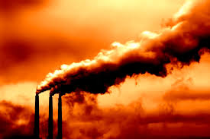
Vocabulary
Syn. Release
Emission (Noun)
Syn. Discharge
Ant. capture
We must control the emission of Green house gases.

Slide 8
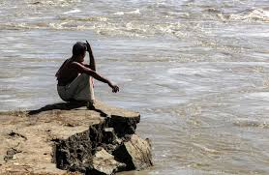
Vocabulary
Syn. Decay
Erosion (Noun)
Syn. Loss of soil
Ant. Accretion
Many people lose their properties due to river erosion.

Slide 9
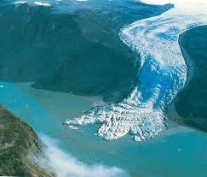
Silent Reading
What happens as a result of global warming? The ice on the Earth’s surface is melting fast due to extreme heat. Oceans and seas are warming too..
Melting of the earth’s surface

Slide 10
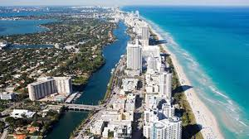
Silent Reading
All the ice that melts will fill up the oceans and seas and they will overflow on land. Thus a huge area of land will go under water.
Overflow of the sea water

Slide 11
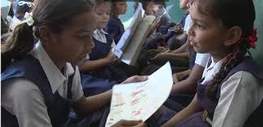
Pair Work
Role play
Partner A plays the role of a person who loves Earth and Partner B plays the role of a car company dealer. First, read the role cards for both A and B. When you are ready, play the roles.

Slide 12
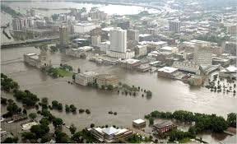
Silent Reading
Even some big cities like London, Kolkata and Bangkok will get flooded. That means thousands of people will lose their houses and land and they will go hungry.
Flood in a city

Slide 13
Group Work
Look at the list of the outcomes (results or effects) of global warming. First rank the outcomes according to their seriousness and tell your partner which of the following may affect your life most.
Polar bears and penguins will disappear.
Winters will be 10 degrees colder.
Africa will become hotter and have more droughts.
Cyclones and hurricanes will become more powerful.
Diseases like skin cancers will increase.
Many countries will have no drinking water.
Countries such as the Maldives, Holland and Bangladesh will disappear under water.
Wars will start between countries fighting over water.
Notes:
Note : The answer of this task will vary according to each students writing and speaking skills.

Slide 14
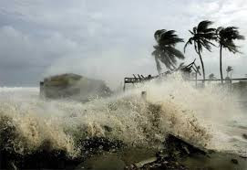
Silent Reading
Moreover, as the earth’s climate warms up, the weather gets more violent. Storms and cyclones will become more powerful. More areas will get drier and turn into deserts. There will be heavier rains too. So there will be more floods and river erosions.
Violent storms

Slide 15
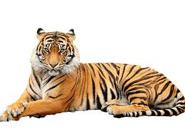
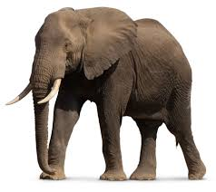
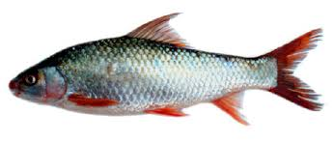
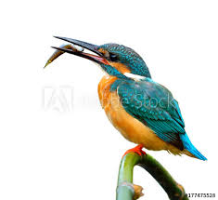
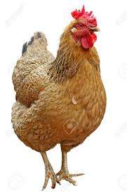
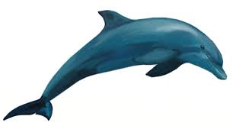
Individual Work
If the world becomes warmer, many species of birds and animals will disappear or become extinct. How would your life change if these creatures disappear? Write five sentences in your own words
Notes:
Note : The answer of this task will vary according to each students writing skill.

Slide 16
Choose the correct answer from the alternatives.
Synonym of ‘extreme’? i) mild (ii) (iii) moderate (iv) great
(b) Storms and cyclones are becoming-----i) weak (ii) fragile (iii) (iv) faint
(c) The ice is melting fast due to (i) (ii) less rainfall (iii) heavy rain (iv) storm and cyclones
(d) More areas will turn into----
wetland (ii) ocean (iii) hill (iv)
Evaluation
excessive
stronger
Extreme heat
desert

Slide 17
Home Work
Write a paragraph on ‘Greenhouse effect’

Slide 18
Thank
You.

