Slide 1
Welcome everybody

Slide 2
Teacher
Class

Slide 3
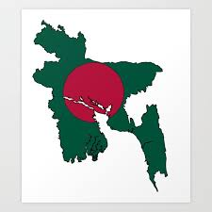
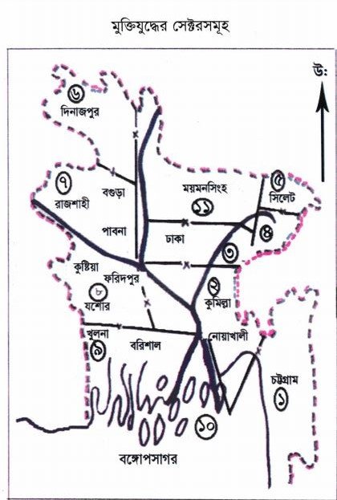
Look at the pictures
Notes:
Md. Eunuse Ali, Assistant Teacher, Charan High School.

Slide 4
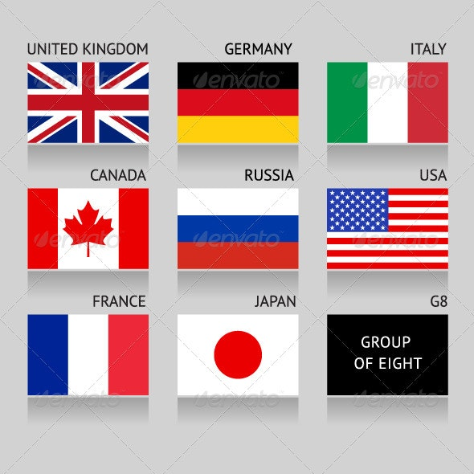
What are these?

Slide 5
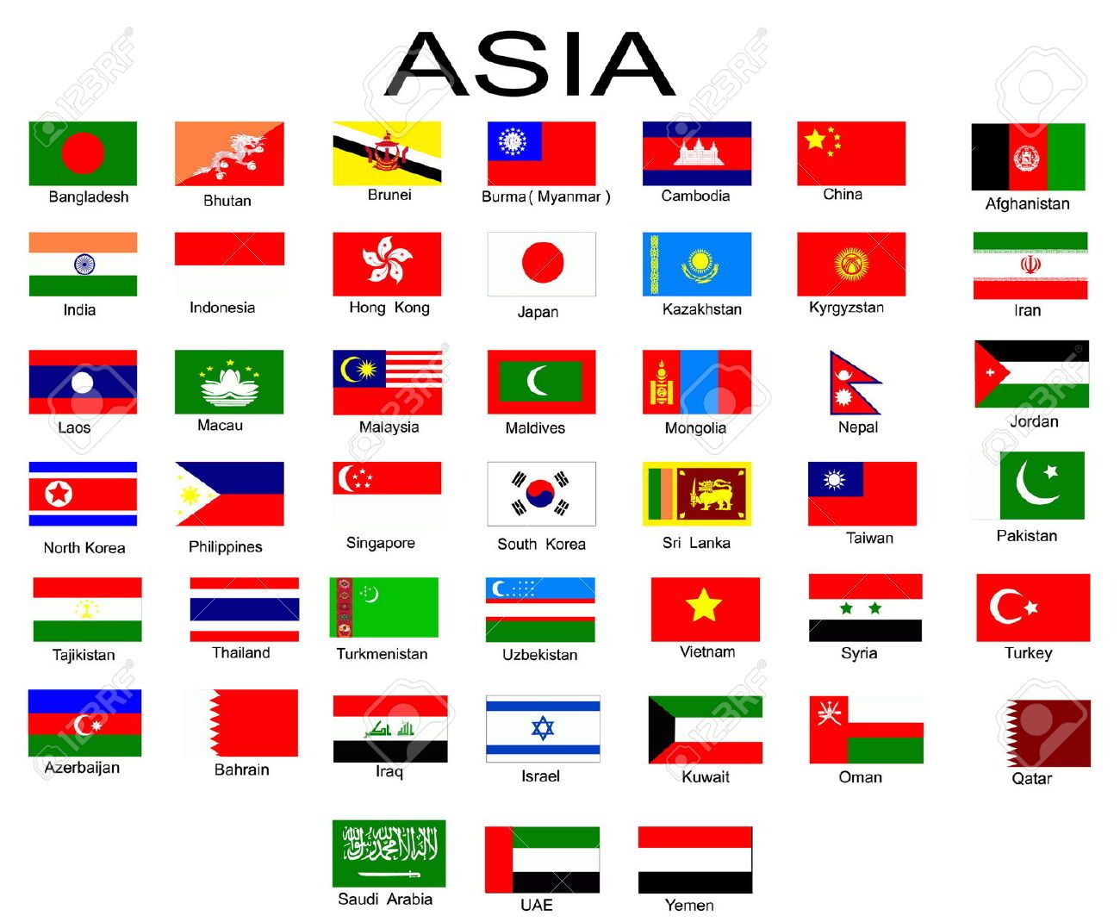
Find out the flag of Bangladesh

Slide 6
Our today’s lesson is a Paragraph about
Our National Flag

Slide 7
Learning Outcomes
After completing the lesson, Students will be able to know--
The measurement of our national flag.
The time to keep the flag half mast.
What the green & red color symbolize.
The significant of our national flag.

Slide 8
National flag is the symbol of independence and sovereignty of a free country.

Slide 9
Every free nation of the world has its own national flag.

Slide 10
As Bangladesh is an independent and sovereign country, she has also a national flag of its own.

Slide 11
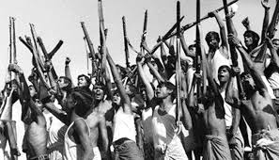
Bangladesh got this national flag on December 16,1971 after a nine-month long valiant struggle of our heroic freedom fighters.

Slide 12
The flag is ------------ in size having a proportion of 10:6. There are --- colors in our national flag. They are --- and ---.
Rectangular

Slide 13
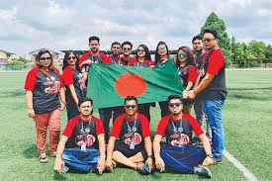
Green color stands for everlasting ----- , freshness and -----. It also symbolizes the green field of Bangladesh.
vigour
Youth

Slide 14
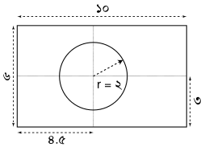
In the middle of the flag, there is a red circle. The radius of the circle is one-fifth of the length.

Slide 15
The deep red color symbolizes the rising sun of independence. It also symbolizes the new hope and aspiration for the nation. It also stands for the bloody struggle of the heroic sons the nation.

Slide 16
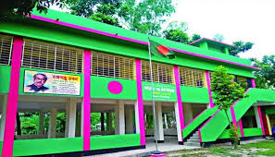
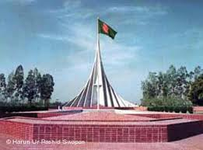
The flag is hoisted everyday on the top of government building, educational institutions and offices.

Slide 17
It is hoisted everywhere on the independent day and the victory day.

Slide 18
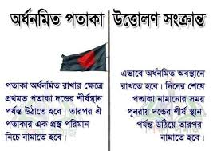
Besides, it is also hoisted half-mast on national and international mourning day.

Slide 19
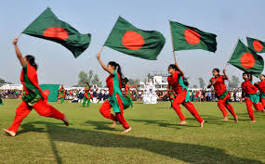
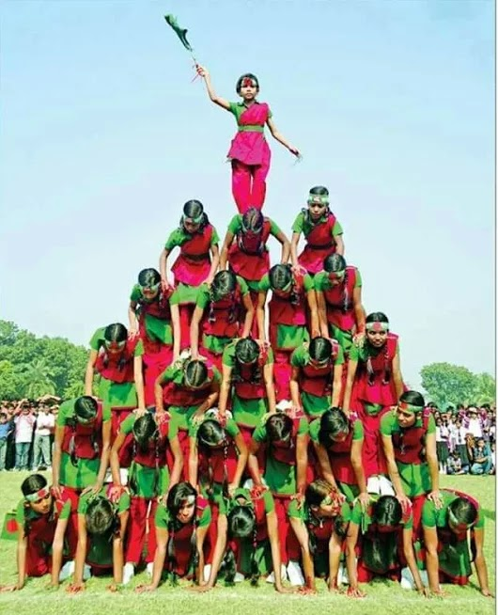
Whenever we see our national flag flying, our mind filled with joy. We feel proud of our national flag. We will try our best to uphold the dignity of our national flag at any cost.

Slide 20
Individual work
What is the measurement of our national flag?
What is the radius of the red circle?
Where is it hoisted?
When is the national flag keep half-mast ?
Md. Eunuse Ali, Assistant Teacher, Charan High School.Kalihati,Tangail.

Slide 21
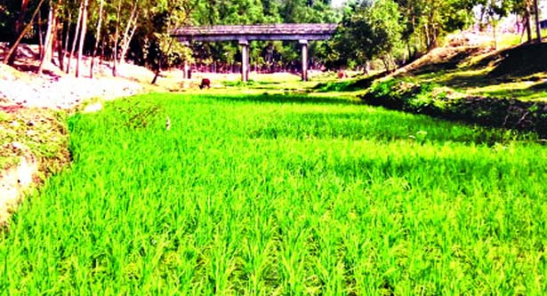
Group work
What does the green color symbolize?
What does the red color symbolize?

Slide 22
Homework
Answering the following questions, write a paragraph about “ Our National Flag.”
What is a national flag?
What does it symbolize?
What do the colors indicate?
Where is it hoisted?
When is the national flag keep half-mast?
How do we feel for our national flag?
How can we uphold its dignity?

Slide 23
