Slide 1
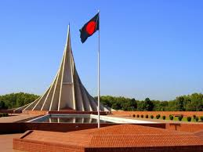
Congratulation to all in my class

Slide 2
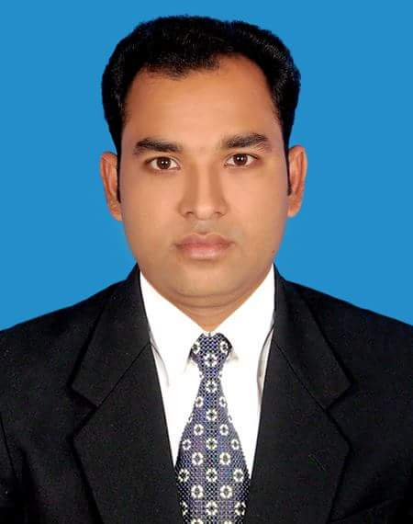
Teacher’s introducing.
Mashum Mia
Assistant Teacher
Paltakanda Srijani Govt. Pri: School
Bhairab, Kishoreganj.

Slide 3
Lesson introduction
Class: Five
Subject: English
Unit: 19
Lesson: 1 (The Liberation War Museum)

Slide 4
Let’s see a video

Slide 5
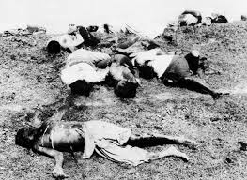
What are about the pictures?
Look at the pictures and think.
The pictures are about our
Liberation War in 1971.

Slide 6
Today’s lesson is -
A visit to the Liberation War
Museum ( On 14 December----
------exhibits of the museum ).

Slide 7
Learning outcomes--
Listening:
3.4.1: understand statements made by
the teacher and students.
4.2.1: understand and enjoy simple stories.
Speaking:
1.1.1: say words ,phrase and sentences
with proper sounds and stress.
6.2.1: talk about people, objects, events etc.
Reading:
1.5.1:Read words ,phrases and sentences in the text with
proper pronunciation stress and intonation.
1.7.1: read paragraphs, dialogues ,stories ,
letters and other texts.

Slide 8
What does Liberation War mean?
Liberation War means struggle
for freedom. Liberation War also
means when we fought for our
freedom in 1971 with west
Pakistan.

Slide 9
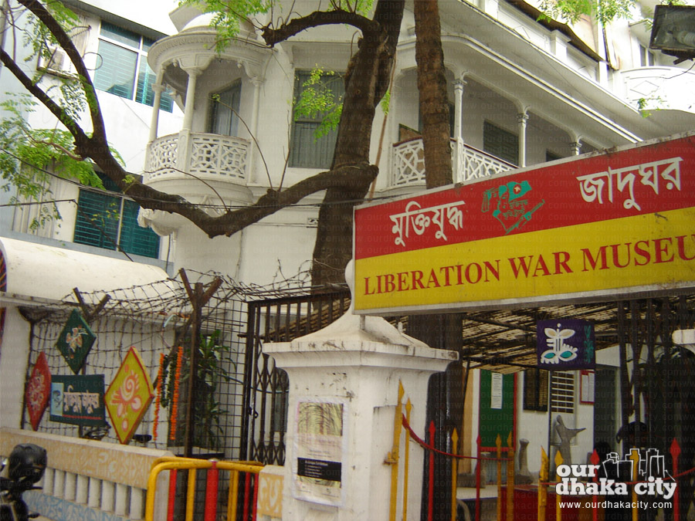
Liberation War Museum is
called in Bangla ‘মুক্তিযুদ্ধ জাদুঘর’.
Can you tell what the Liberation War
Museum is called in Bangla?

Slide 10
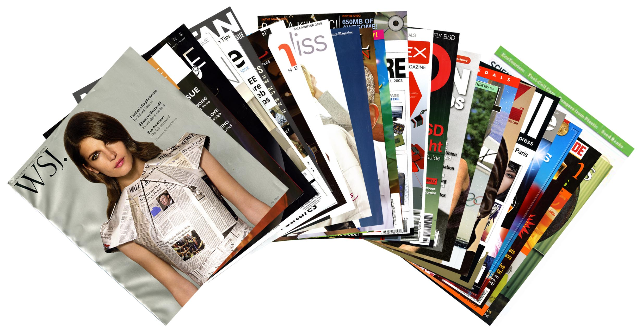
What is Magazine?
Do you know it?
A large thin book with a paper cover
that we can buy every week or month
containing , article, photographs etc
often on a particular topic is called a
‘Magazine’.
These are the Magazines.

Slide 11
Say, what kind of magazine from
todays lesson is taken.
Todays lesson is taken from a
School Magazine which is called
‘Sunshine Magazine’.

Slide 12
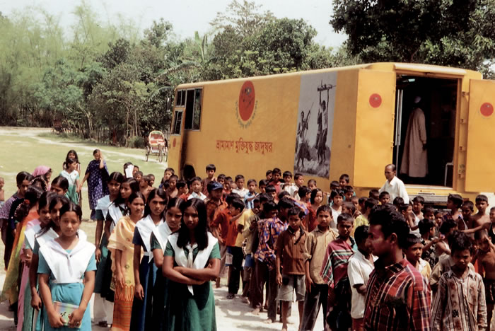
Why are the students waiting in front of the gate?
The students are waiting in front of the
gate for entering into Museum and guide.

Slide 13
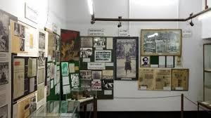
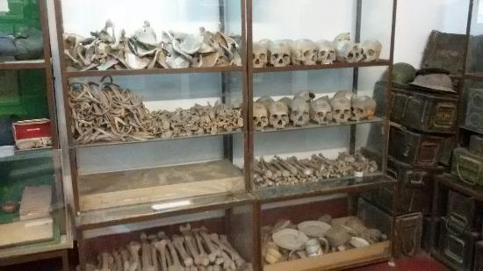
Look at the pictures and think everybody.
What about the pictures are?
The pictures are about Liberation War.

Slide 14
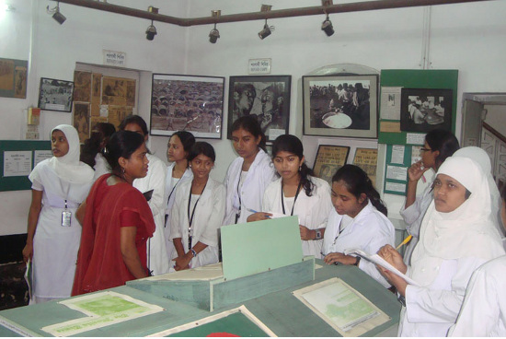
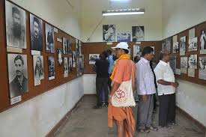
What are the students and people doing ?
The students and people are visiting
the different galleries of ‘Liberation
War Museum.’

Slide 15
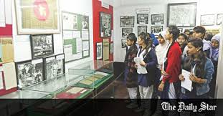
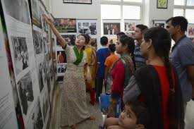
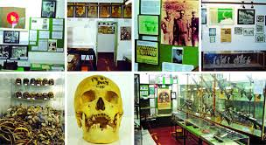
We visit Liberation War Museum to know
about ‘Liberation War’s’ history.
Look at the pictures and say ,
why do we visit Liberation War Museum?

Slide 16
Dear students see some new words
and write these on your khata .
Magazine
Museum
Liberation
Trip
Global
Different
Gallery
Exhibit
সাময়িকী
জাদুঘর
মুক্তি
ভ্রমণ
বিশ্ব
বিভিন্ন
গ্যালারি
প্রদর্শন করা

Slide 17
Let’s play a bingo game.
Museum
Different
Magazine
Exhibit
Gallery
Global
Trip
Liberation

Slide 18
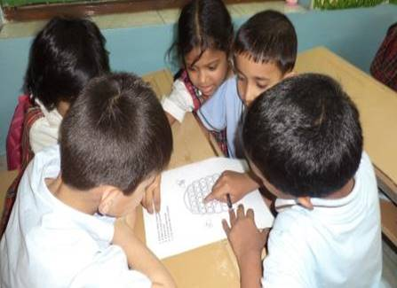
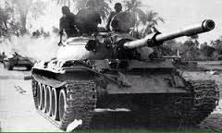
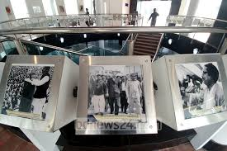
What are you looking at the pictures?
Discuss about these in groups.
The pictures about Liberation War.

Slide 19
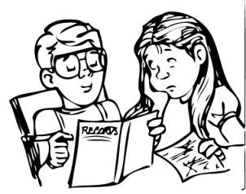
What can you see at the pictures?
Discuss about these in pairs.
There are some photographs of Liberation
War which are exhibited in different galleries.

Slide 20
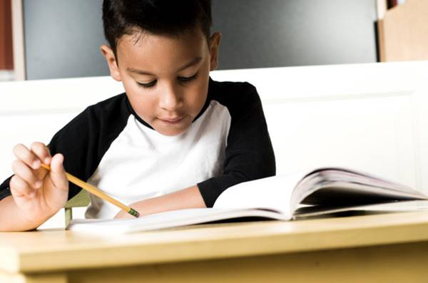
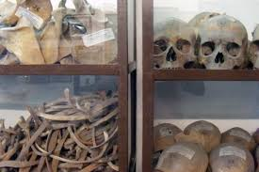
Think about the picture individually.
These are the pictures of human body’s bones

Slide 21
Evalution
Every students come in front of
the class by turns and read the text.What do you understand about Liberation War Museum.

Slide 22
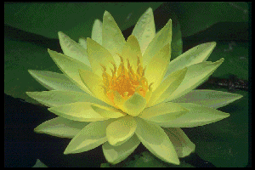
THANKS TO ALL MY STUDENTS.

