Slide 1
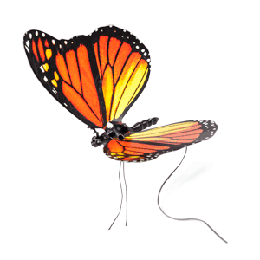
Welcome

Slide 2

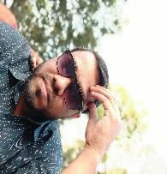
Presenting for you
Lesson Contacts:
Class: Two
Subject: English For Today
Unit: 17
Colours
Lesson: 1-3
Page: 34
Md Emran Hossen
Assistant Teacher
Kattali Nurul Haque Chowdhury Government Primary School
Pahartali, Chattogram.
01819-893135
emran81hossen@gmail.com

Slide 3
Learning Outcomes:
Students will be able to……
Listening:
3.1.2 Understand simple questions and statements about familiar objects.
4.1.1 Enjoy the rhythm and music of simple rhythm.
Speaking:
1.1.2 Say simple words and phrases with proper sound and stress.
4.1. Repeat rhymes after the teacher.
4.1.2 Recite rhymes independently.
Reading:
1.4.1 Reads words and phrases with the help of visual clues and simple sentences.

Slide 4

How are you students? How is your health?
OK. Now enjoy a video..

Slide 5
What will we read today?
Can you tell me?
Rainbow, rainbow,
I see you!
Red
and
orange
Yellow,
green
and
Blue,
Indigo
and
violet
too!

Slide 6
Our today’s lesson is Colours..
Red
orange
Yellow
green
What colour is this?
What colour is this?
What colour is this?
What colour is this?
Blue
Indigo
violet
What colour is this?
What colour is this?
What colour is this?

Slide 7


Look at the picture.
How many colours are there in a rainbow?

Slide 8
How many colours are there in a rainbow?

Slide 9
There are 7 colours in a rainbow.
Red
orange
Yellow
green
Blue
Indigo
violet

Slide 10
Every 7 students make a group.
Group work
Anyone say red. Next student say orange. Say the other colours like that in chain.

Slide 11
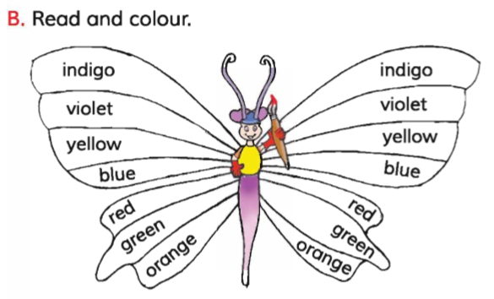
Open your textbook page at 34 and see the activity B.
Pair work
Say the colours name each other.

Slide 12
Evaluates
Colour the wings according to colours name.

Slide 13






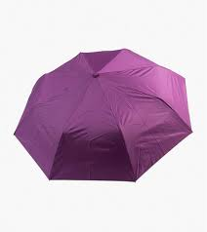
Match the name with there colours.
Evaluates
Yellow
Indigo
4.
1.
green
violet
5.
orange
2.
Blue
6.
Red
3.
7.

Slide 14
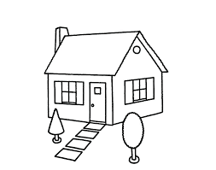
Home work
Draw and colour a rainbow at home.

Slide 15


