Slide 1
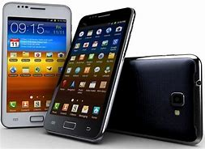

Slide 2
Presented by
NAME:SHAMSUDDIN
TEACHER OF ENGLISH
VEDURIA SERAJIA FAZIL MADRASAH.
LALMOMOHAN,BHOLA.

Slide 3
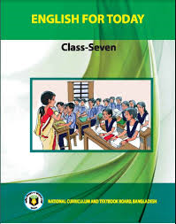
FOR WHOM
CLASS:SEVEN
SUBJECT:ENGLISH
TIME:45 MINUTES

Slide 4
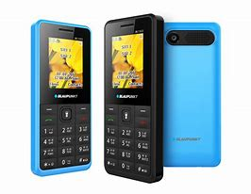

Slide 5
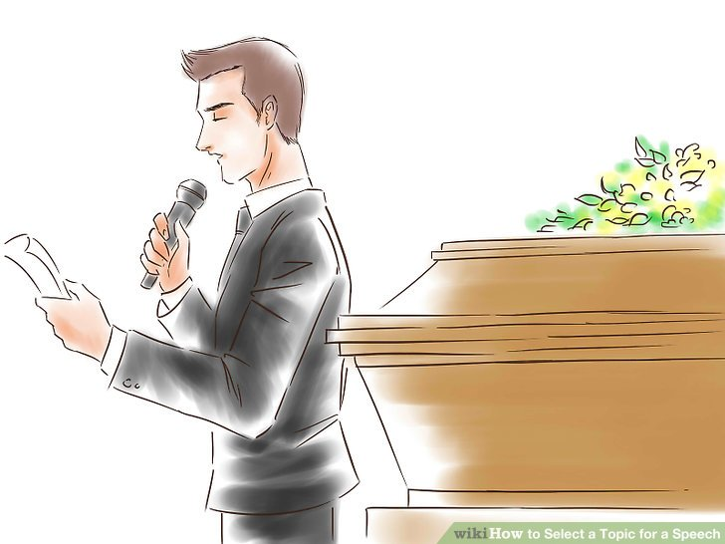
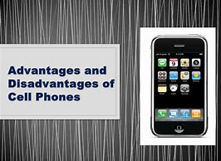
Our Today’s lesson
A paragraph on
‘Adventages and disadventages of mobile phone’

Slide 6
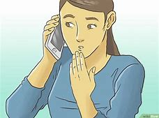
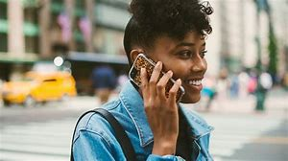
Mobile phone is one of the wonderful inventions of modern science and technology.Mobile phone is a phone by which we can communicate with others. Without any wire.It is an important medium of communication .The use of mobile phone is easier than land phone.

Slide 7
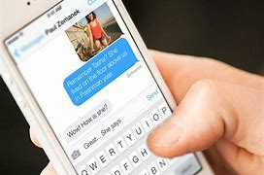
People can send messages and pictures through it.

Slide 8
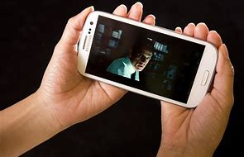
One can see other person while talking over mobile phone

Slide 9
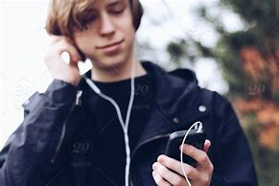
It is also source of entertainment . We can listen music and enjoy movies with the help of mobile phone.

Slide 10
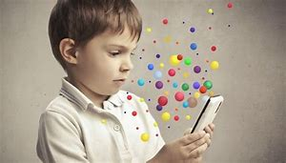
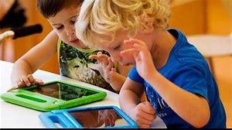
Children like playing games over mobile phone very much.

Slide 11
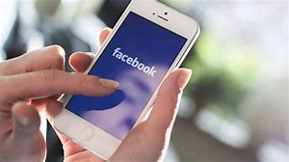
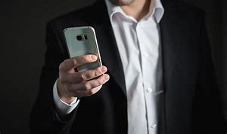
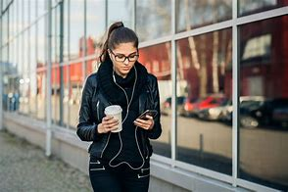
It is useful to all classes of people .we can not think even a day without mobile phone.

Slide 13
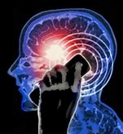
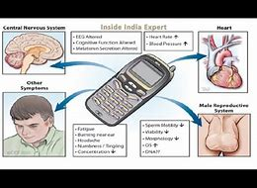
Mobile phone causes irreparable damage to the human body.using mobile phone is also harmful to the pregnant women.

Slide 14
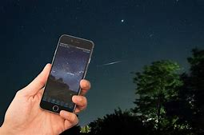
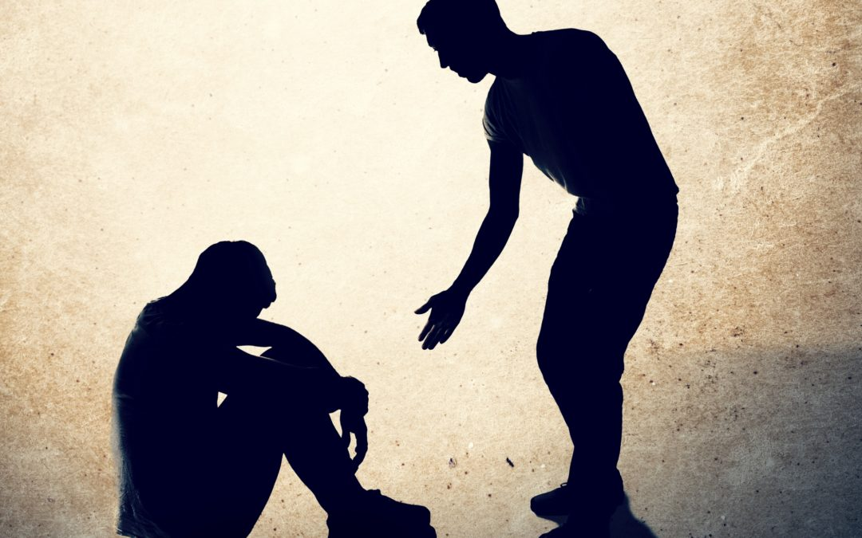
By using the mobile phone,the terrorists and criminals carry out their evil desires and commit crimes without difficulty.

Slide 15
In spite of some such drawbacks,there is no better altrnative to mobile phone in communicating with people at home and abroad.

Slide 16
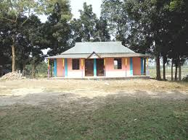
Write the above sentences carefully and read through after going home.

