Slide 1
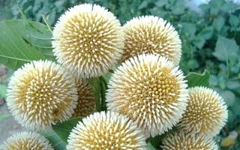
wellcome

Slide 2
TEACHERS INTRODUCTION
NAJMA AKTER
ASSESTENT TEACHER
NEYAMOTPUR GOVT PRIMARY SCHOOL
SADAR ,SUNAMGONJ.

Slide 3
Intriduction of the lesson
Class: Five
Unit: 5
Lesson: 4-5
Lesson title:Eat healthy
Total time:45 minute

Slide 5
Students will be able to-
Listening
1.3.1 recognize which words in a sentence are tressed.
3.4.1 understand statements made by the teacher and students.
Speaking
1.1.2 Say sentence with proper intonation.
Reading
1.7.1 read paragraphs, dialogues stories,letters abd other texts

Slide 6
Find out the story of the picture
কমলালেবু
আইসক্রিম
ডিম
চিপস
দুধ
পেঁপে
মাছ
ভাত

Slide 7

Read the lesson of your text

Slide 8
GROUP WORK
A
D
DAIRY FOOD
B
C

Slide 9
Now answer the question
Ans.Papaya,beans,spinach etc.
Tell the name of some vegetable item?
2.How many types of food are there in the food pyramid?
Ans. Four
Ans.Grain ,fruit, meat,vegetables etc.
3.Which food helps to make us strong?

Slide 10
nn
LET US A BINGO GAME
Lentil,Bottom,Level,Food

Slide 11
HOME WORK
WORD MEANING:
PROTIEN,GRAINS,DAIRY,
PYRAMID.

Slide 12


