Slide 1

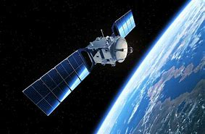

WELCOME

Slide 2


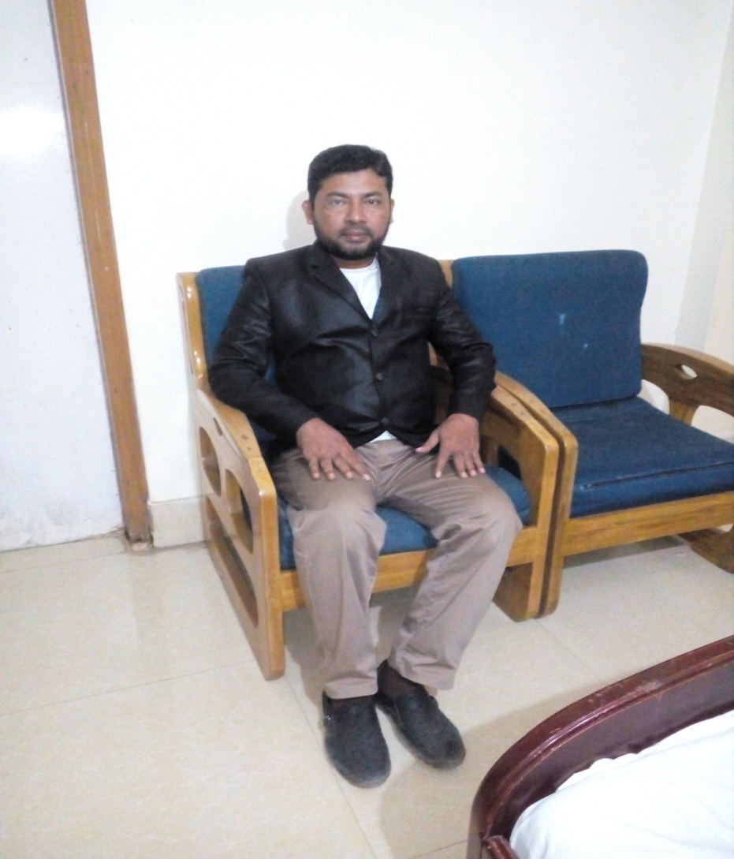
TEACHER’S IDENTITY
NAME:SHAMSUDDIN
ASST. TEACHER.
VEDURIA SERAJIA FAZIL MADRASAH.
LALMOHAN,BHOLA.

Slide 3

Let’s enjoy the video

Slide 4
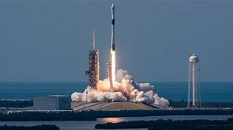

Slide 5

LESSON DECLARATION
Today we will learn about
‘BANGABANDHU SATELLITE’

Slide 6

At the end of the lesson students will be able to:
.Describe the pictures.
.Narrate the satellite.

Slide 7

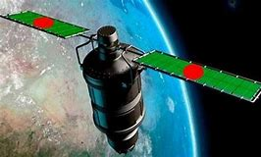

Slide 8
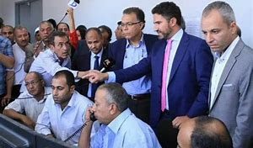

Slide 9
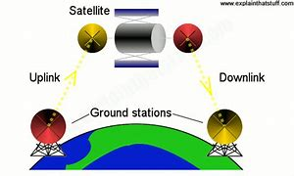
How does it operate?

Slide 10

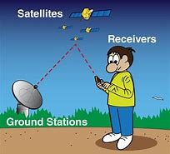

Slide 11
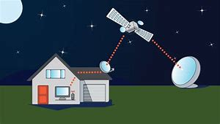

Slide 12

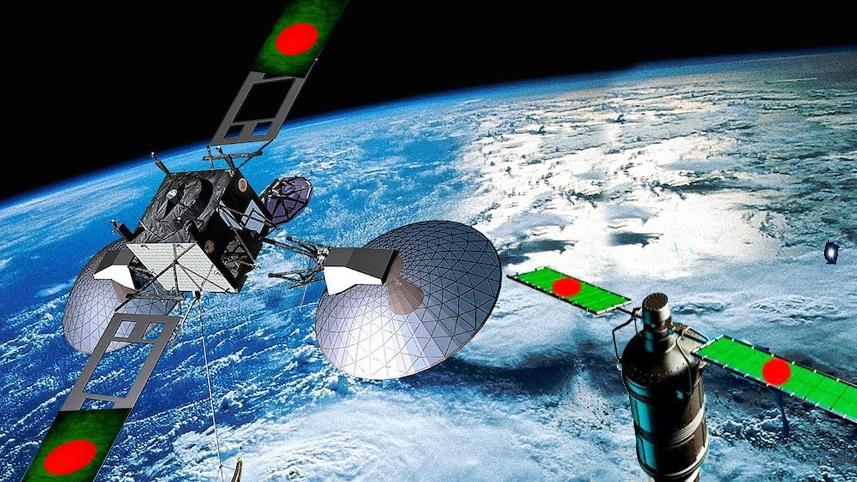

Slide 13
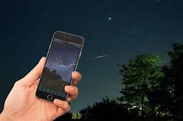

Slide 14
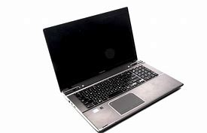

Slide 15
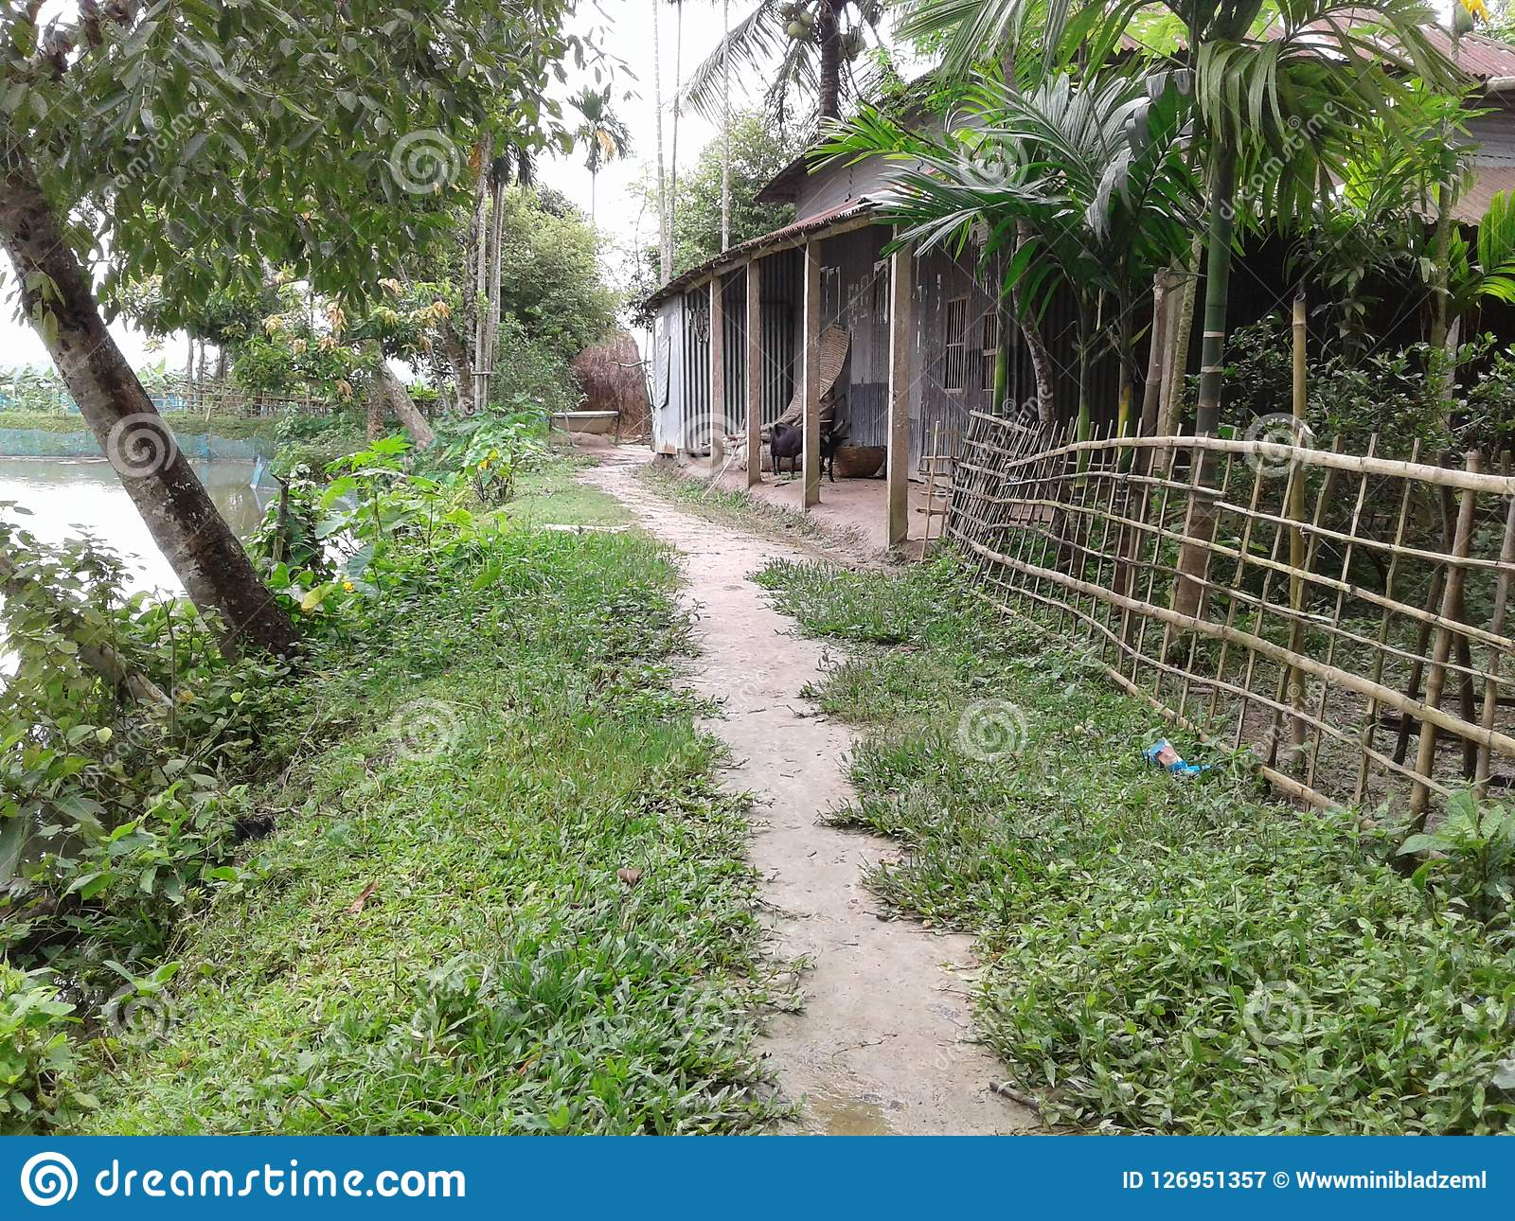
Homework
Wrirte a composition on “Bangabandhu Satellite”

Slide 16


