Slide 1
WELCOME TO
MULTIMEDIA CLASS

Slide 2
TEACHER INTRODUCTION
Kusum Ara Begum
Lecturer: Political Science
Tamirul Millat Mohila Kamil Madrasah .Demra,Dhaka .
Cell:o1878589825

Slide 3
LESSON INTRODUCTION
English For Today
Class :-SIX
Lesson :-13
Time:40 minutes
Date:30/12/ 2019

Slide 4
Do you know about this picture?

Slide 5
An unseen beauty
of Bangladesh

Slide 6
Learning outcomes By the end of the lesson ss will be able to…
ask and answer questions
talk about birishiri
listen for specific information
narrate something

Slide 8
Shusong Durgapur has an amazing landscape.

Slide 9
s
It is located on the bank of the crystal clear Someshwari river .

Slide 10
It is close to the Garo hills.

Slide 11
Here you can see the ceramic mountain leaning against the sky, the blue water of the pictorial mountain-valley.

Slide 12
The modest movement of the river Someshwari, and the abandoned coal.

Slide 13
Birishiri
Dhaka
Shusong Durgapur is located under Netrokona district about 170km north from Dhaka.

Slide 14
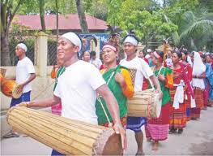
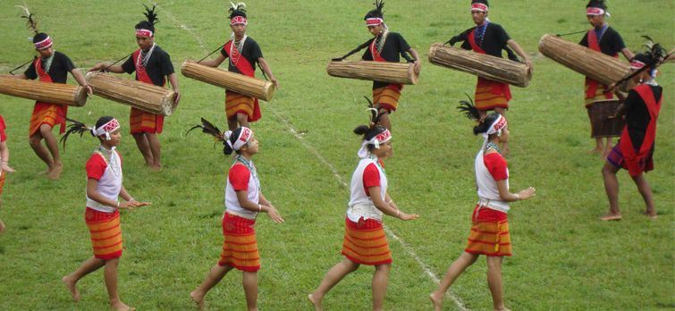
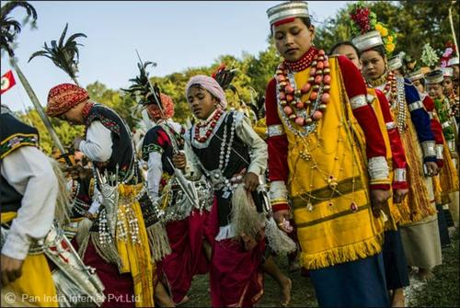
It’s not only blessed with alluring natural beauty, but also rich in vibrant ethnic culture.

Slide 15
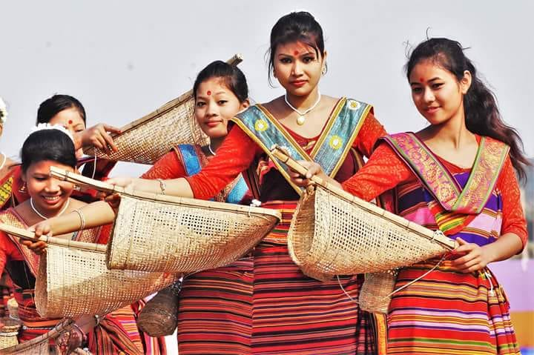
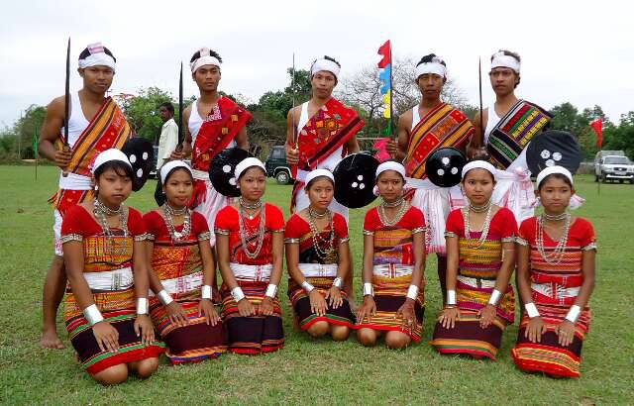
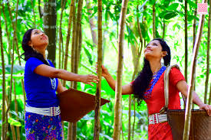
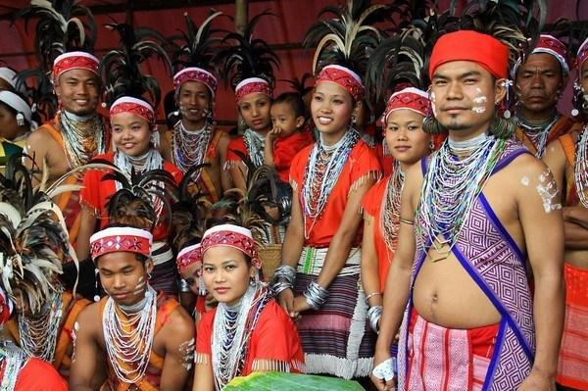
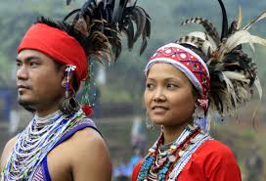
There are many ethnic groups like Hajong, Garo, Achik and Mandi living there.

Slide 16
The main attraction of Birishiri is the ceramic hill of Durgapur and the charming landscape along the Someshwari River.

Slide 17
The best way to get to Birishiri is by road from Dhaka.

Slide 18
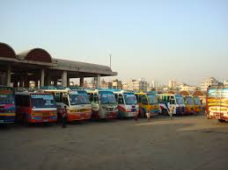
You can find direct bus to Birishiri from Mohakhali bus stand, Dhaka.

Slide 19
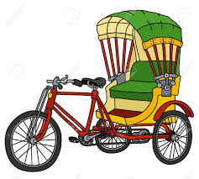
The rickshaw pullers know all the places very well.

Slide 20
Individual work
Match the phrases whit the meaning
Phrases | Meaning
Eye catching destinations Green, remote countryside Crystal clear Pictorial mountain-valley Modest movement Vibrant tribal culture Alluring natural loveliness Modest of transportation | See-through Lively activities of people from certain tribal groups Means of travelling from one place to another Places that draw one’s attentions Gentle flow A rural and distant place full of plants and trees A plain land between two hills that looks like a picture The loveliness of nature that appeals to a viewer

Slide 21
Evaluation
In which district is Shusong Durgapur located ?
How far is Shusong Durgapur from Dhaka?
How can you get to Shusong Durgapur from Dhaka?
Why is Shusong Durgapur called ‘an unseen beauty of bangladesh?

Slide 22
Home Work
Write a passage on
a place of tourist attraction
that you know.

Slide 23
THANK YOU

