Slide 2
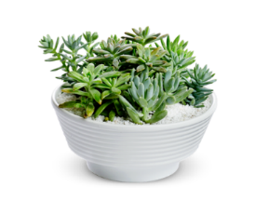
Welcome everybody
How are you?

Slide 3
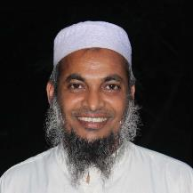
Introduction of the teacher
Dewan Rezaul Hassan
(Assistant Teacher)
Baropakhia Rothindrapara Government Primary School
Delduar, Tangail.
E-mail:drezaulhassan@gmail.com

Slide 4
Introduction of the lesson
Class: Two
Sub: English
Unit: 1
Lesson: 2
Lesson title: Greetings and Introductions

Slide 5
Learning outcomes:
Student will be able to
Listening:
1.1.2 Understand simple words and phrases with proper sounds
and stress
3.1.1 Understand simple Questions and statements about them
3.1.2 Understand simple Questions and statements about familiar
objects
Speaking:
1.1.1 Repeat after the teacher simple words and phrases with
proper sounds and stress
1.1.2 Say simple words and phrases with proper sounds and tress.
2.1.2 Say Good Morning, Hi, Hello

Slide 6
Let’s see some pictures
Notes:
Showing each picture teacher will ask the student- what can you see in the pictures? He will explain each picture.

Slide 7
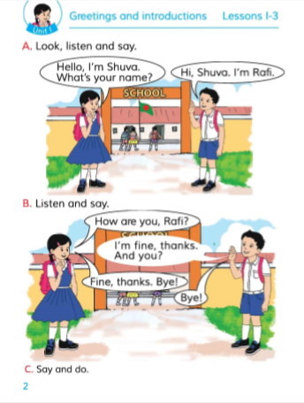
Today’s lesson:
Greetings and Introductions
B: Listen and Say

Slide 8
1. What can you see in the picture?
2. What are they doing?

Slide 9
How are you?
I am fine, Thanks. And You?
Fine, thanks, Bye!
Bye

Slide 10
Teacher practice with students in the classroom.
Teacher ask students
Students reply.

Slide 11
Pair work:
Practice in pair
Notes:
1st student will ask Questions 2nd student will give Answer.
Teacher will observe the class.

Slide 12
Task
What’s your name?
How are you?
Notes:
Teacher will ask somebody about the lesson.

Slide 13
Thanks

Slide 14
See you again.

