Slide 1
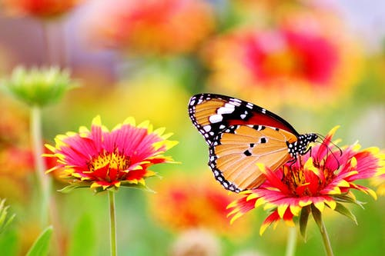
Good Morning

Slide 2
Introducing:
Md. Saiful Islam
Assistant Teacher (English)
Bagbari Chowbaria High School,
Tangail Sadar, Tangail
E-mail: hridoy9555@gmail.com
Class: Eight
Subject: English for today
Unit: 01
Lesson: 02
Time: 50 Minutes
Date: 10-12-2019

Slide 3
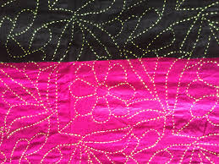
Look at the following pictures

Slide 4
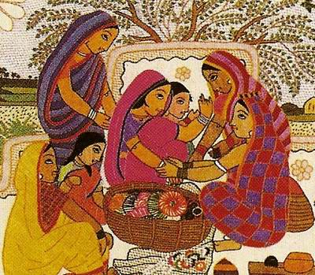

Slide 5
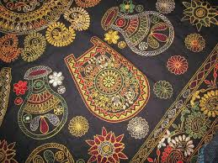

Slide 6
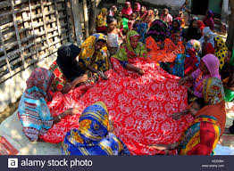

Slide 7
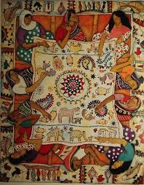

Slide 8
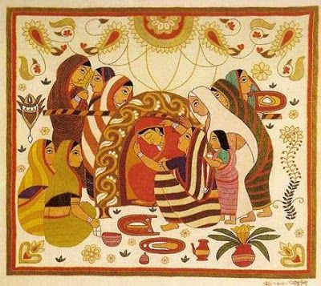
Lesson declaration:
Nakshi Kantha

Slide 9
Learning out comes
After finishing the lesson learners will be able to-
1. Answer the questions.
2. Write a paragraph.
3. Choose the best answer from the alternative
4. say the meaning of the words
5.Make a dialogue.

Slide 10
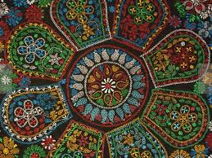
Where do we find ‘ Nakshi Kantha?’
We find them in many expensive handicraft shops

Slide 11
Loud reading or standard reading

Slide 12
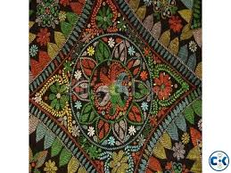
What things are required for making Nakshi Kantha?
Old or new cloth and thread are required for making Nakshi Kantha

Slide 13
Individual work:
What is Nakshi Kantha’?
When did the name ‘Nakshi Kantha’ become popular?
Which districts are most famous for ‘Nakshi Kantha’?
Why are the quilts now in great demand?
Answers:
(1) ‘Nakshi Kantha’ is a kind of embroidered quilt .
(2) The name ‘Nakshi Kantha’ became popular after the poet Jasimuddin’s ‘ Nakshi Kanthar Math’.
(3) Mymensingh, Jamalpur, Rajshahi, Faridpur, Bogra, and Jessore are most famous for ‘ Nakshi Kantha’
(4) The quilts are now in great demand because of the colourful patterns and designs embroidered on them.

Slide 14
Peer work
Make a dialogue between you and your friend about ‘ Nakshi Kantha’.

Slide 15
Group work:
Write the meaning of the following words:
Traditional, Famous, Expensive, Demand, Indigenous
Traditional- ঐতিহ্য বাহী Conventional
Famous- বিখ্যাত Renowned
Expensive- ব্যয়বহুল Costly
Demand- প্রয়োজনীয় Requirement
Indigenous- স্বদেশীয় Instinctive

Slide 16
Evaluation
Choose the best answer from the alternatives:
The word ‘Naksha’ means ---- (i) colourful (ii) design (iii) artistic pattern (iv) none
‘Nakshi Kanther Math’ was written by --- (i) Nazrul Islam (ii) Rabindranath Tagore (iii) Jasim uddin (iv) Sufia Kamal
The art of ‘ Nakshi Kantha’ has been practiced in --- area (i) rural (ii) urban (iii) city (iv) all
‘Nakshi Kantha’ is indigenous to ---- (i) Bangladesh (ii) India (iii) Pakistan (iv) Bangladesh and India
‘ Nakshi Kanthar Math’ was published in (i) 1919 (ii) 1929 (iii) 1819 (iv) 1829

Slide 17
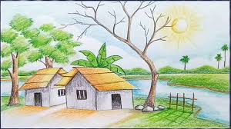
Home work
Write a paragraph about ‘ Nakshi Kantha’

Slide 18
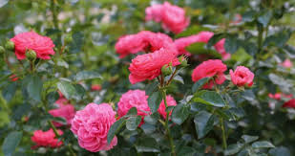
Thank you very much

