Slide 1

Welcome to English class

Slide 2
IDENTITY
Md. Saidul Hoque
Assistant Teacher
Enayetpur Alim Madrash
Senbag, Noakhali.
Contact-01872295453
Email-saidul305844@gmail.com
Dhakhil: Seven
Subject: English 1st paper
Time: 45 minute
Date: 03-12-2019

Slide 3
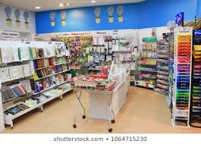
Look at the picture.
Is there any sales man?
What kind of shop is it?
What do you think about the picture?
This is a fixed-price shop.

Slide 4
So dear, Our today’s lesson is-----
Fixed-price shop
Unit-Four
Lesson-4

Slide 5
Learning outcomes
After completing this lesson students will be able to-----
tell about a fixed price shop,
describe the difficulty of bidder shopping,
specify the conveniences of of the store of fixed price.

Slide 6
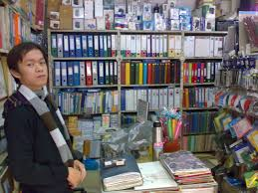
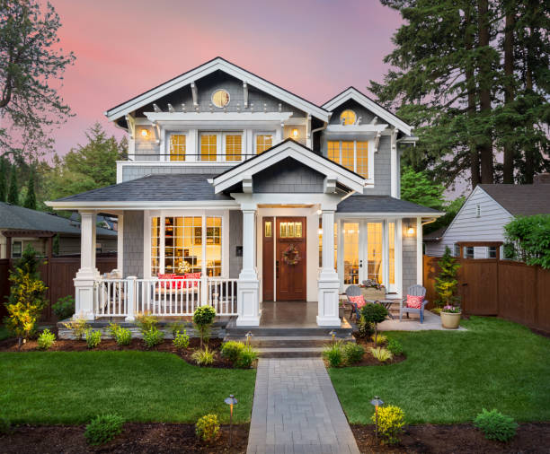
Look at the picture?
Where is the shop?
The shop is near
to house.

Slide 7
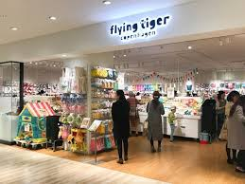
Look at the picture
What are they doing?
They are buying stationary, soap, confectionary, cloths, sweet etc from the shop.

Slide 8
Individual work
Write in your own words about a fixed price shop.

Slide 9
Word meaning and sentence making
Word | Image | Meaning
Stationary
Grocery
Sentence: Students buy necessary things from stationary shop

Slide 10
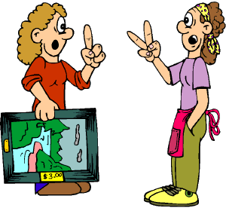
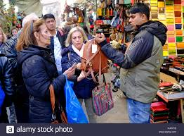
Word | Image | Meaning
Bargain
Settle the price of things
Sentence: Buyers buy things bargaining with sellers
Negotiation
Haggle
Sentence: Buyers usually haggle with sellers while shopping

Slide 11


Word | Image | Meaning
offer
Propose/suggest
Sentence: Sometimes Grameen phone company offers weaver for their customers.
Admit
Agree
Sentence: After bargaining customers agree to buy goods.

Slide 12
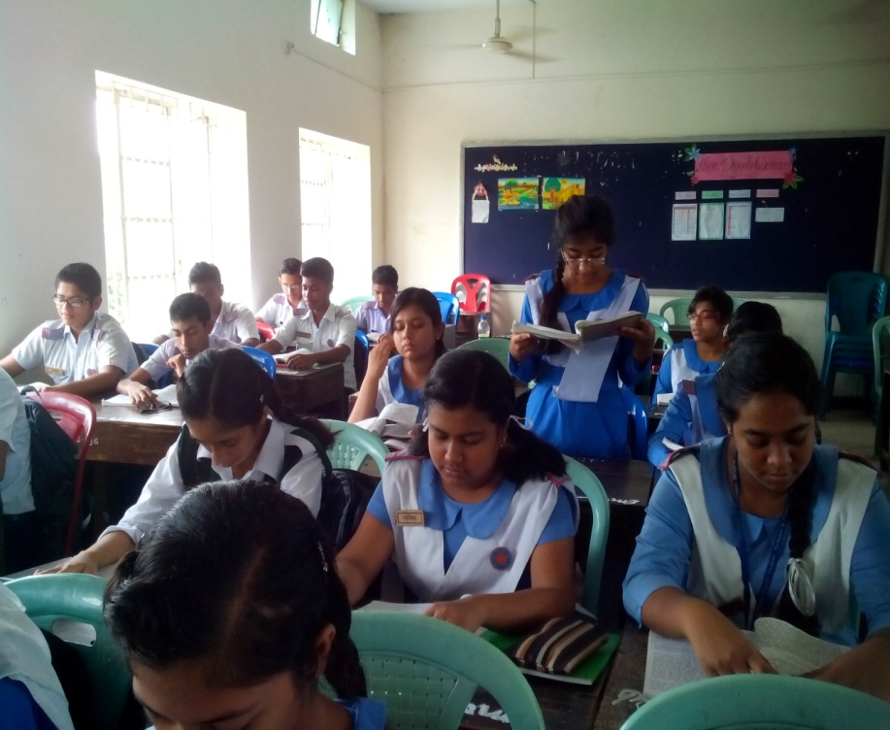
Loud/silent Reading

Slide 13
Pair work-1
Match the words in column A with the words nearest the meaning from column B.
Column A | Column B
Stationary | (i) Customers and shopkeepers agree to deal with each another by setting prices.
(b) Bargain | (ii) With shopkeeper the customer is negotiating the price of goods.
(c) Haggle | (iii) Verity store.
(d) Offer | (iv) Price fluctuates with each other.
(e) Agree on | (v) To offer something to another.

Slide 14
Pair work-2
Ask the following questions to your partner.
Do you know about a Fixed-price shop?
2. Where is it located?
3.What are sold there?

Slide 15
Evaluation
Where is the shop?
What do you do to buy things?
Do you bargain?
Why do you do that?

Slide 16

HOME WORK
What are the advantages of marketing at a fixed price store?

Slide 17

Thanks
See you again

