Slide 1
WELCOME

Slide 2
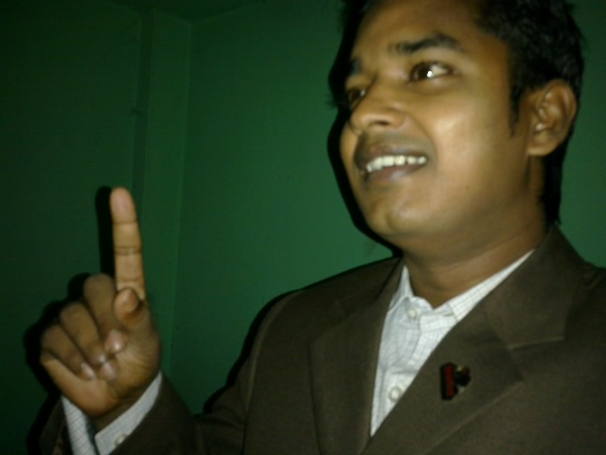
Teacher’s Identity:
Md. Rubel Haque
Assistant Teacher
Nirmoil Darazia Dakhil Madrasha
Mob: 01774795179

Slide 3
English 1st paper
Class: Nine
Unit: Seven
Time: 45 minutes

Slide 4
Learning outcomes:
1. tell something about the life of Mother Teresa.
2. give some example of the kindness of Mother Teresa.

Slide 5
See and talk about the picture in pairs
3 minutes
Notes:
T will ask ss to talk about the picture in pair for two minute.
T will monitor.
T will elicit their ans.

Slide 6
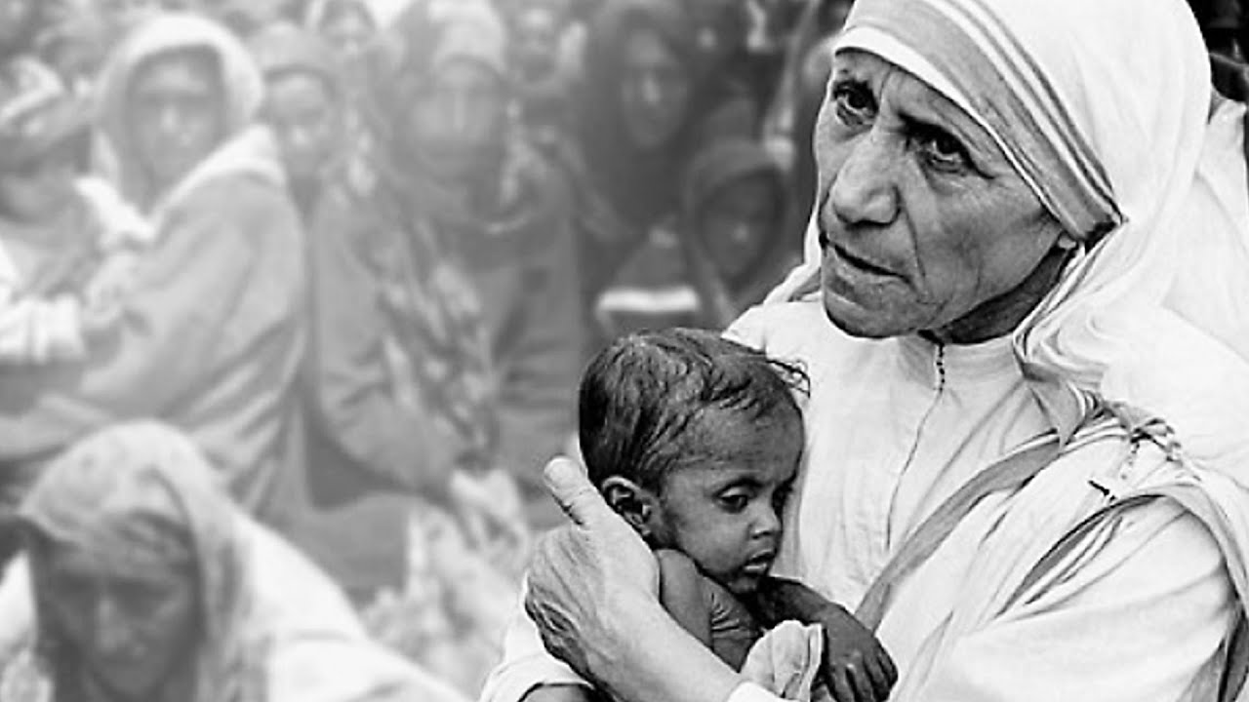

Slide 7
1. What do you see in the picture? 2. Do you know this woman? 3. What do you know about her?

Slide 8
Our Title is “Love for humanity” Lesson:6

Slide 9
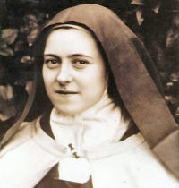
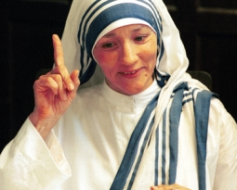
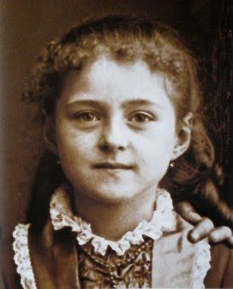
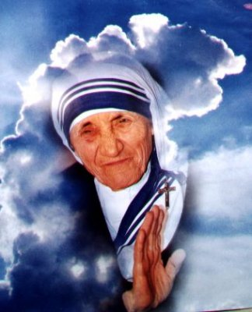
She is Mother Teresa

Slide 10
Vocabulary Chart
5 minutes
Main word | Meaning | example
Dying: | Seriously ill | We should help the dying people.
Divine | spiritual | Kindness is a divine peace.
Missionaries | charitable mission to a foreign country | She went to the missionaries.
Salutes | honour | Everybody salutes the brave.
Notes:
T will present vocabulary following method

Slide 11
Individual work:
8 minutes
Everybody read the passage silently.

Slide 12
Pair work: Identify true and false. If false, give the correct ans.
5 minutes
1. Mother Teresa was moved to see the diseases that spread in the streets of Kolkata.
2. She opened a home for the orphan.
3. She and her group brought the dying people from the streets of Kolkata.
4. ‘Nirmol Hridoy’ was found for the people who are dying.
Notes:
Find out the ans and write down.

Slide 13
Answer the questions:
10 minutes
Why do you think Mother Teresa won so many awards?
What does ‘Nirmol Hrodoy’ stand for?
Who was mostly benefited from here?
What are things that we have learnt from Mother Teresa?
Notes:
Find out the ans and write down in khata.

Slide 14
Home work
Mother Teresa
Born
Early life
Contribution
Award
Write a bibliography on Mother Teresa using this clues.

Slide 15
