Slide 1
Welcome

Slide 2
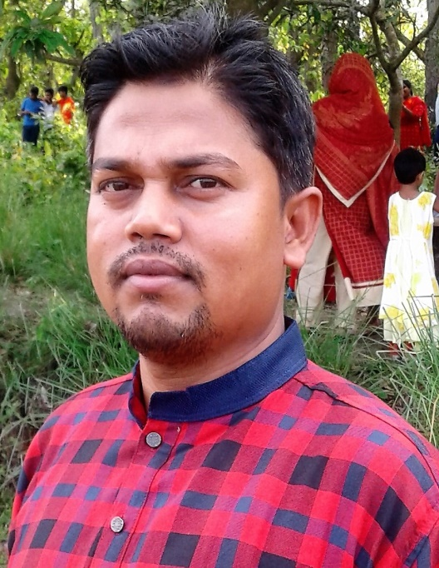
Teacher’s Introduction
Shohag Chowdhury.
Assistant teacher,
Daudpur govt. primary school, Nawabganj, Dinajpur.

Slide 3
Lesson introduction
Class:- One
Unite: 13 ( Rhyme )
Lesson: 1 (A)
Time: 45 minutes

Slide 4
Let’s enjoy a video.

Slide 5
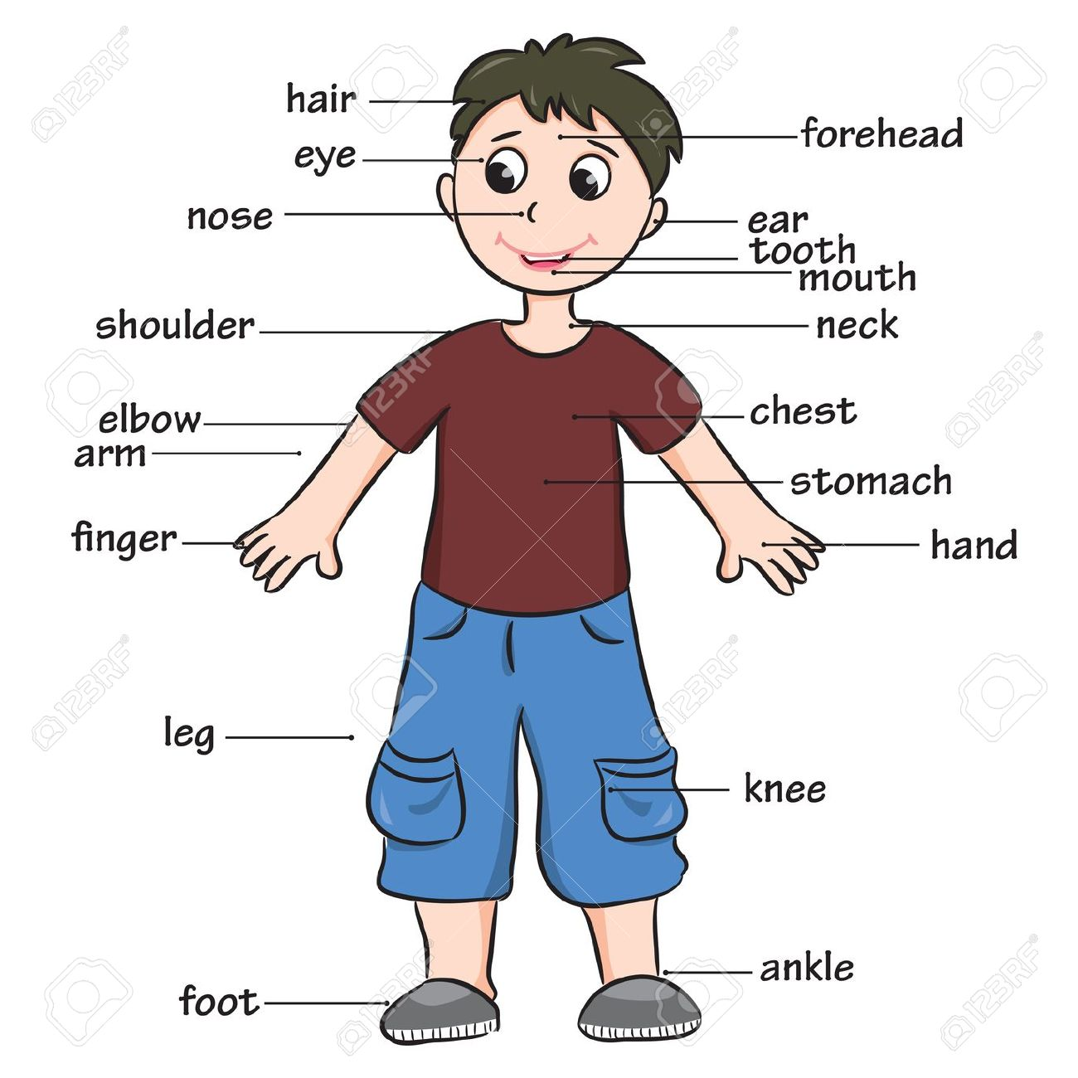
Look at the picture and think about it.
What about is the picture ?
The picture is about a human body.

Slide 6
Today’s lesson is—
Hands , feet , eyes , head .

Slide 7
Learning outcomes:
After the lesson students will be able to
Listening:
1.1.1 : become familiar with English sounds by
listening to common English words.
Speaking:
1.1.1 : Repeat after the teacher simple words and phrases.
1.1.2 : Say simple words and phrases.

Slide 8
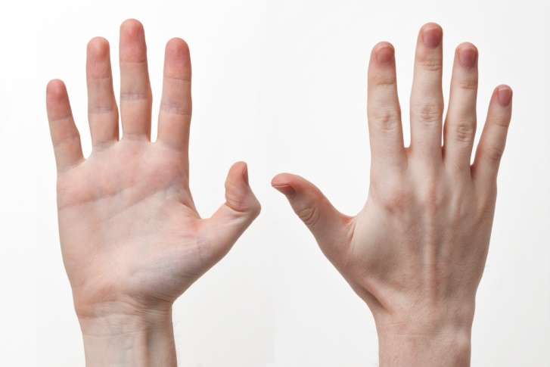
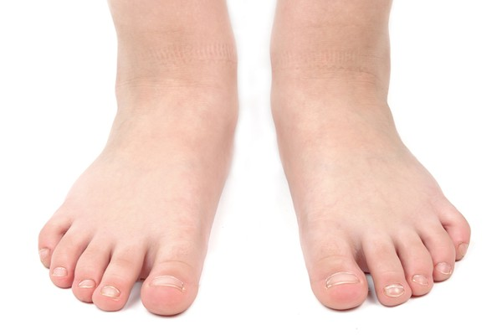
Look , listen and say.
hands
feet
eyes
head

Slide 9
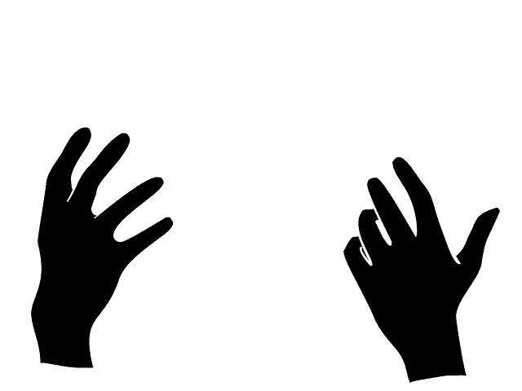
Dear students listen to me attentively.
hands
feet

Slide 10
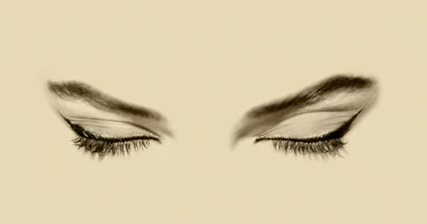
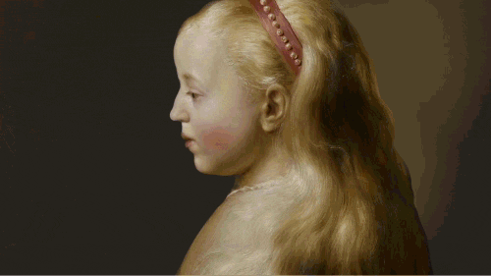
Dear students listen to me attentively.
eyes
head

Slide 11
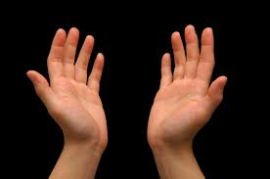
What can you see in the picture ?
These are ‘hands’.

Slide 12
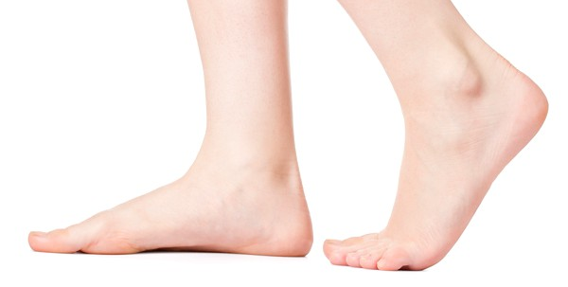
What can you see in the picture ?
These are ‘feet’.

Slide 13
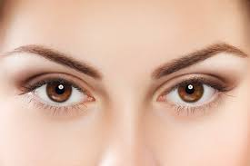
Dear students , What can you see in the picture ?
These are ‘eyes’.

Slide 14
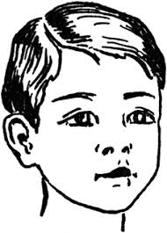
Dear students , What can you see in the picture ?
This is a ‘head’.

Slide 15
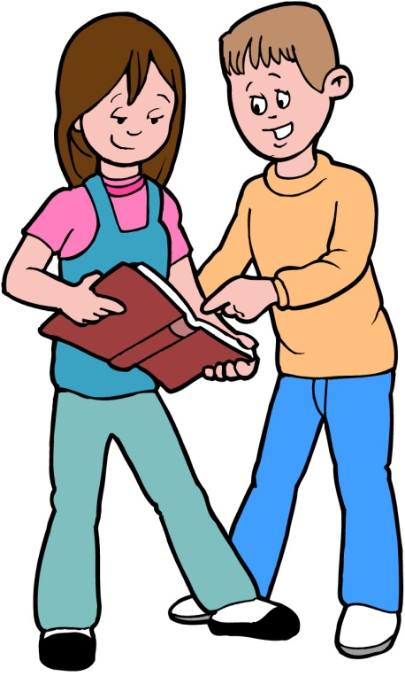
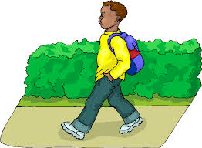
Dear students ,come in front of the class by turns.

Slide 16
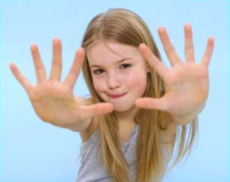
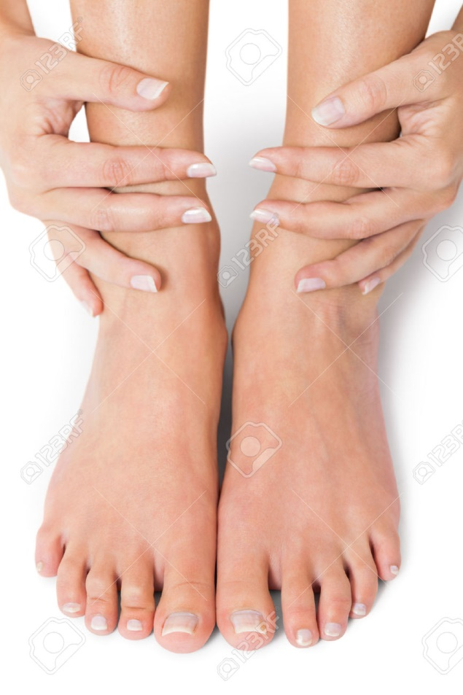
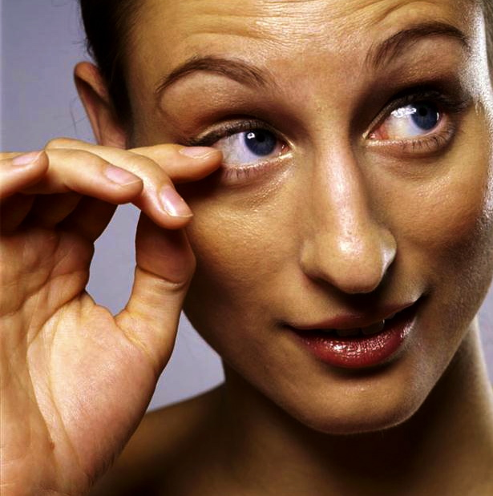
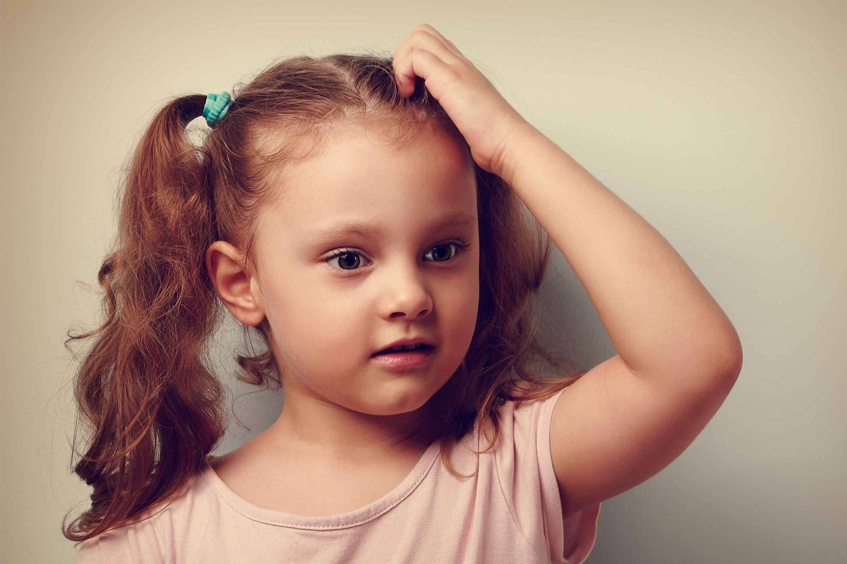
Dear students, show your hands.
Show your feet.
Show your eyes.
Show your head.

Slide 17
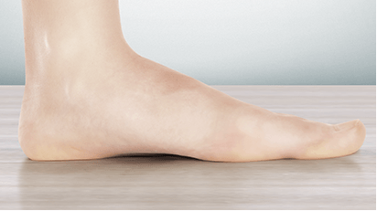
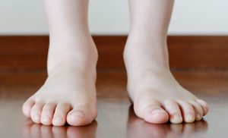
What is this?
What are these?
This is foot.
These are feet.
When we say foot, it means one leg.
When we say feet, it means two legs.

Slide 18
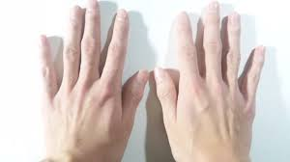
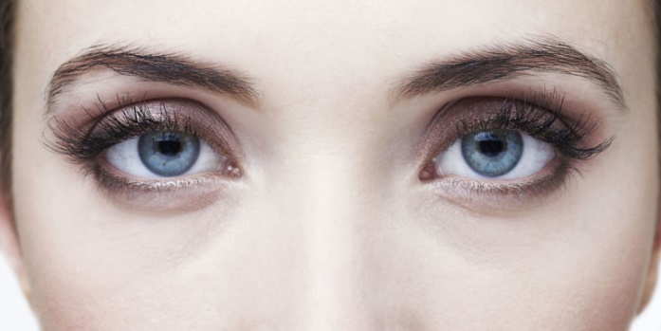
Dear students, listen to me again,
say the words after me.
feet
hands
eyes
head

Slide 19
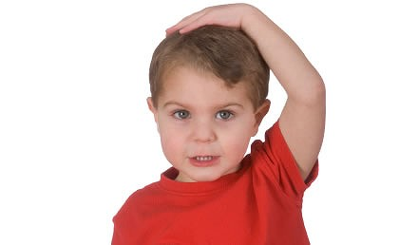
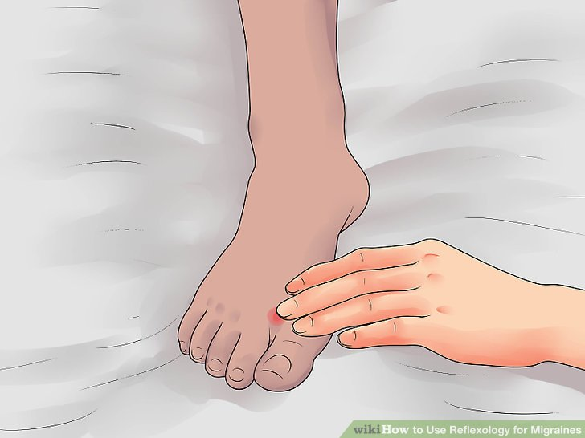
Dear students follow me carefully.
Touch your foot .
Touch your hands.
Touch your eyes .
Touch your head.

Slide 20
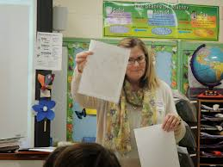
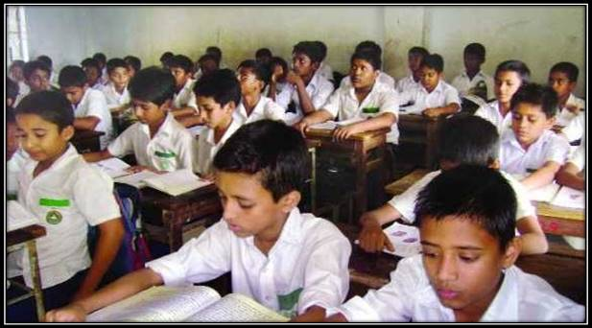
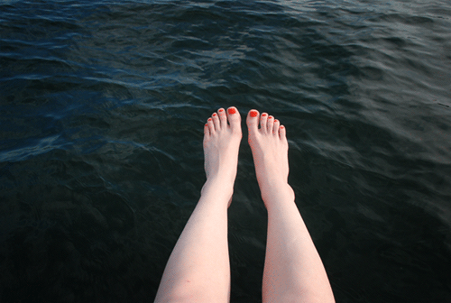
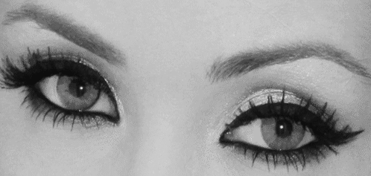
Every body, open your book . Page no 26.
Dear students , again say after me.
hands
feet
eyes
head

Slide 21
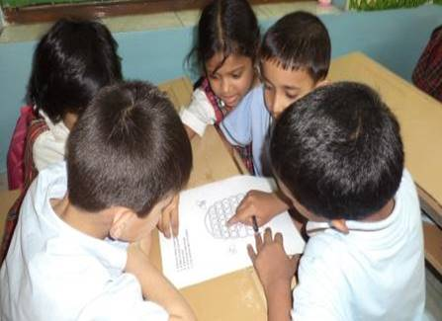
Discuss and say about the pictures in groups.
hands
feet
eyes
head

Slide 22
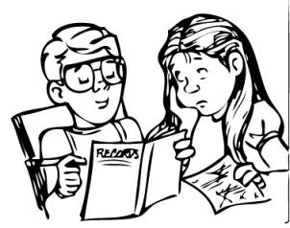
Discuss and say about the pictures in pairs
hands
eyes
head

Slide 23
Discuss about the pictures lonely.
eyes
feet

Slide 24
Evaluation ( oral ).
Everybody say name of the following pictures.
hands
feet
eyes
head

Slide 25
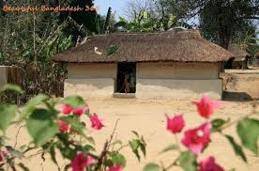
Home task.
Dear students, you will read the
today’s lesson at your home.

Slide 26
THANK YOU ALL. BYE-BYE.

