Slide 1
GOOD MORNING STUDENTS.

Slide 2
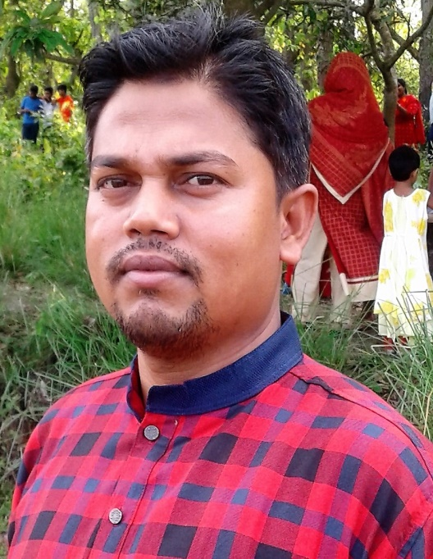
Shohag Chowdhury.
Assistant teacher,
Daudpur govt. primary school., Nawabganj, Dinajpur.

Slide 3
Lesson introduction
Class:- One
Unite: 11 ( Commands)
Lesson: 2 (B)
Time: 45 minutes

Slide 4
Dear students let’s enjoy a video.

Slide 5
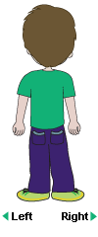
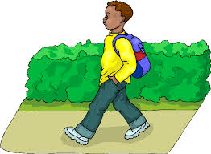
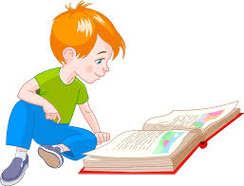
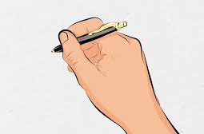
Dear students , look at the pictures and think.
What do the pictures mean?
The pictures are about walking,
reading wring and looking.
The pictures mean some commands.

Slide 6
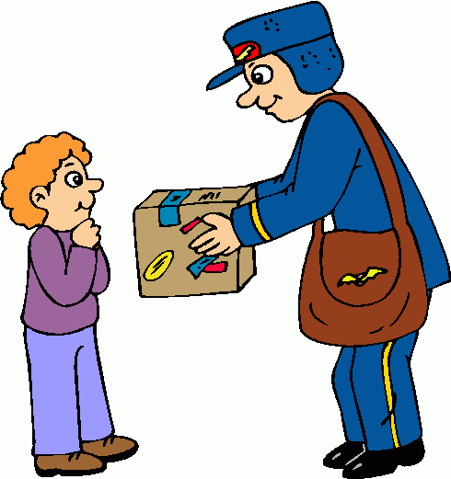
Today’s lesson is commands.

Slide 7
Learning outcomes:
Listening-
1.1.1: become familiar with English sounds by
listening to common English sounds.
2.1.1: follow some commands and instructions.
Speaking-
1.1.1: Repeat after the teacher simple words and phrases.
1.1.2: say simple words and phrases.
7.1.1: give simple commands and instructions.

Slide 8
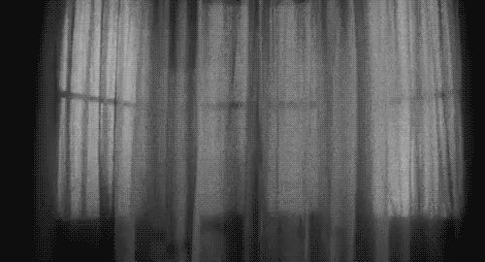
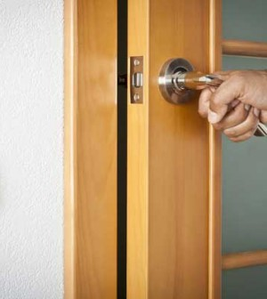
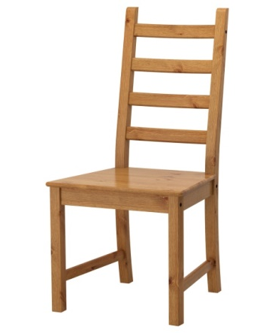
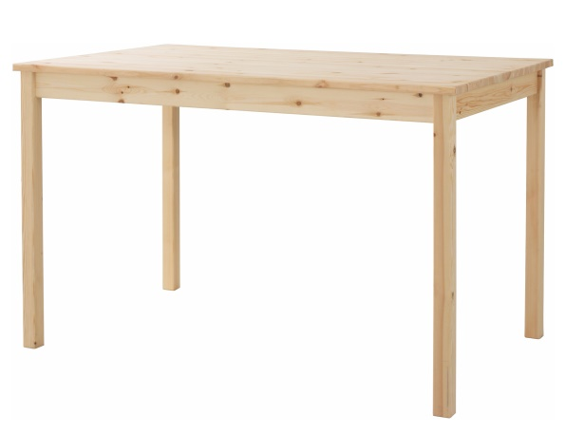
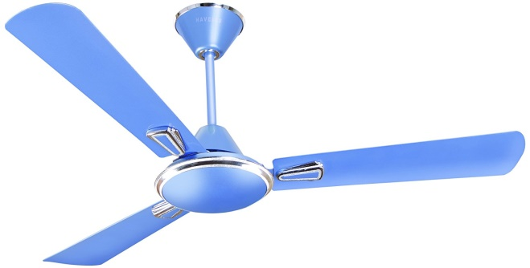
Dear students, try to point some elements of your class.
Window
Door
Chair
Table
Book
Fan

Slide 9
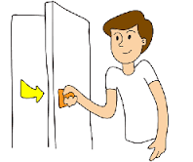
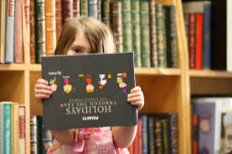
Dear students, what are you looking at the pictures?
We are looking some commands at the pictures.
Open the
window.
Close the
door.
Show me
your bag.

Slide 10
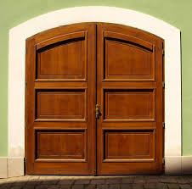
Dear students , listen and say with me.
Open the window.
Close the door.
Show me your bag.

Slide 11
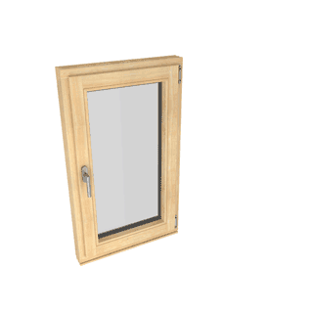
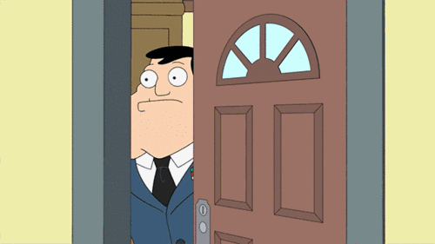
Dear students , again listen and say with me.
Open the window.
Close the door.
Show me your bag.

Slide 12
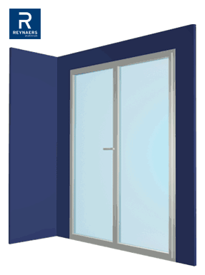
Dear students ,someone come in front of the class.
Read and say the commands .
Close the door.
Open the window.
Show me your bag.

Slide 13
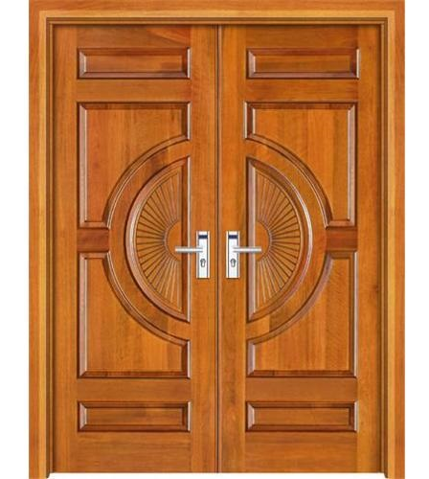
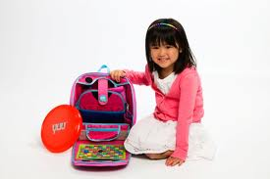
Dear students ,someone come in front of the class
by turns and read the following commands.
Open the window.
Close the door.
Show me your bag.

Slide 14
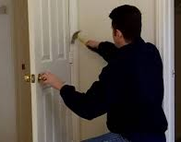
Students ,say the commands about the pictures in pairs.
Open the
window.
Close the
door.
Show me
your bag.

Slide 15
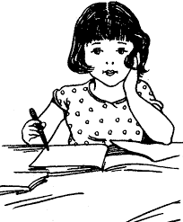
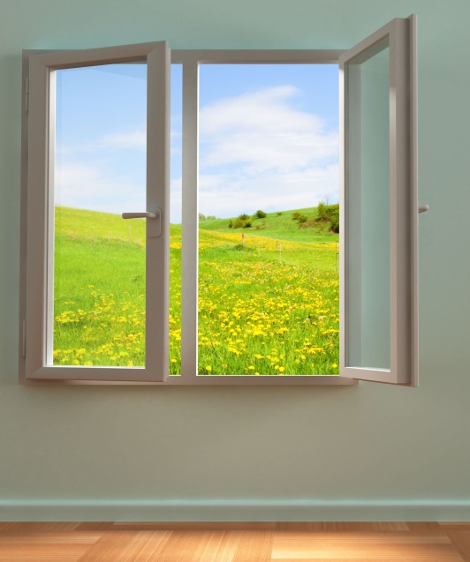
Students ,say the following commands about the pictures indivisually .
Open the window.
Close the door.

Slide 16
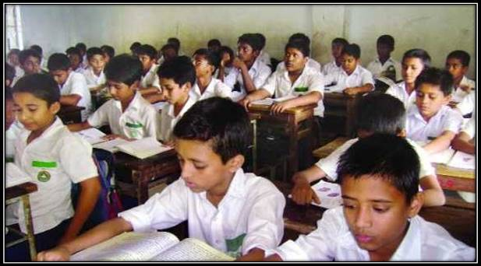
Dear Students , open page at 22 say and follow the commands.
Open the
window.
Close the
door.
Show me
your bag.

Slide 17
Evalution:
*Say the following commands by using the pictures.
Open the
window.
Close the
door.
Show me
your bag.

Slide 18
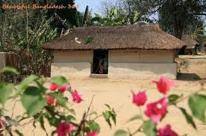
Home task
students ,you will read the today’s
lesson at your own house.

